Slide 1
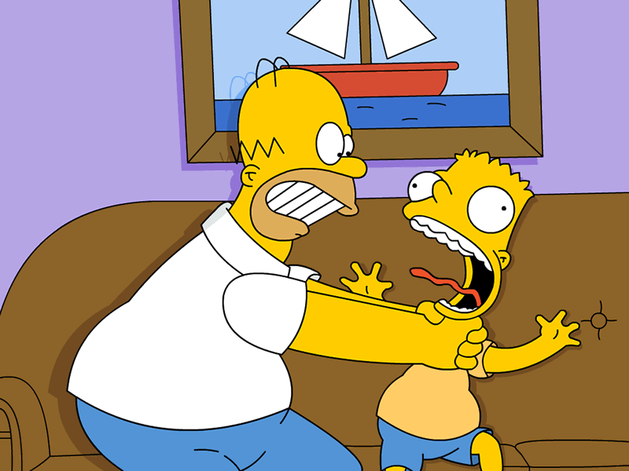
Generation Gaps
Written by pupil Yury Retler
Form 7(11)
Veselynove gymnasia

Slide 2
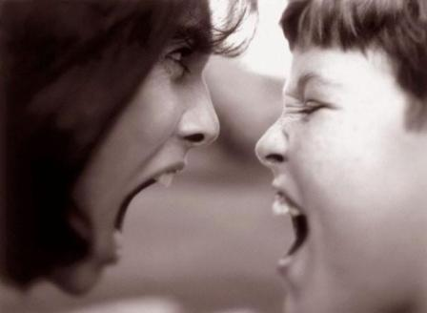
Term
The generational gap is a term popularized in Western countries during the 1960s referring to differences between people of younger generations and their elders, especially between children and their parents. It might be summarized as the differences in language, for the younger generations developed slang languages(informal way of speaking), like pidgins, instead of using the formal language.it might also be the difference in appearance, or even in technology

Slide 3
Generation gap is nothing but certain psychological and emotional gap between parents or elder people and the younger's age . The success of parenting lies in how effectively they avoid the generation gap or ignore the differences with kids.
Generation gap is the result of the fast paced development of the society. In earlier times two or three generations live in the same lifestyle and environments as the development was so slow. But today, nearest past is very much outdated and the world is more advanced each day. Parents do not even know many of the modern technologies and equipments children use.

Slide 4
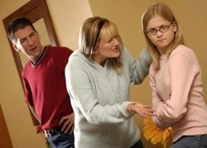
To realize how to deal with it, you should keep in mind that generation gap includes several aspects:
Children demand a great deal of attention, time and patience, so, Due to the fact that he has not got any guidance from his parents he may be involved in some bad companies which commit violence or even crime and become alcohol or drug addicted. When the parents discover that, it's usually too late to change anything.
On the other hand, there is a different situation when the parents treat their children too strict and don't give them any freedom at all. In this case the children may become pariahs among their peers. Constant bans may increase the risk that the child will grow up insolent and defiant. This causes another big problem — lying. The child is forced to lie to the parents because of the fear to be punished.

Slide 5
Parents should become his close friends. First of all they should learn to respect his interests. Try to speak with him as often as possible. It is worth involving the child in discussing some family questions, just to show that he is a full member of the family. Parents should always be honest and sincere with their child; otherwise it would be unfair to require the same from him.

Slide 6
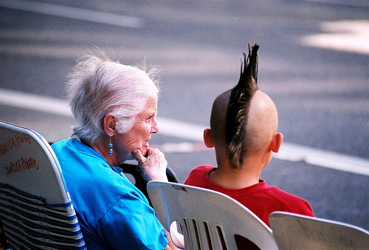
Some children rebel against discipline and family values. They listen to a loud music, wear inappropriate, to their parents' mind, clothes, dye their hair in inconceivable colours, have all their bodies pierced and tattooed trying to show their independence and establish their identity. They want to be treated as adults, but they are not ready to take all the necessary responsibilities. It doesn't mean that your child is bad and he will become a criminal. Of course, not! It only means that your child is in his transitional age and he is in need of your understanding and support.

Slide 7
The generation gap is of course not a given for all families. There are many households where it doesn't occur at all. There are fights and arguments and children defying their parents but these are occasional and minor.

Slide 8
In my opinion this conflict is inevitable. On the one hand, it is natural because life is rapidly changing . Every year something new emerges, from fashion styles to pop-stars and of course young people accept it very quickly. On the other hand, adults do not need to worry about their kids too much. Until the "generation gap” gets too big to handle, there is nothing bad in it.
But both adults and children should remember about general culture. If people are well brought up and educated their culture will help them to prevent the conflicts making teenagers less defiant and adults more lenient.
To sum up, I think that the "generation gap” problem will forever be actual, but if the generations respect each other, it will not be so serious.

