Slide 1
EDUCATION IN GREAT BRITAIN

Slide 2
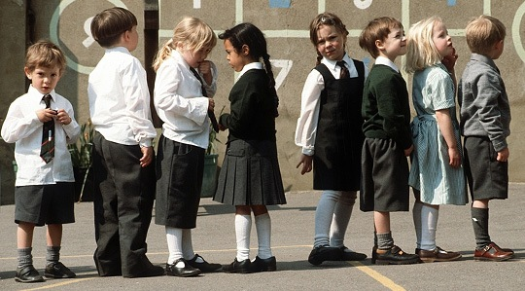
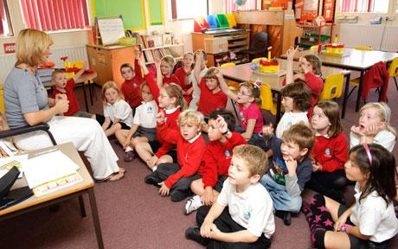
English children must go to school when they are five, first to infant schools where they learn the first steps in reading, writing and using numbers. Young children are divided into two groups according to their mental abilities. The curriculum for “strong” and “weak” groups is different, which is the beginning of future education contrasts.

Slide 3
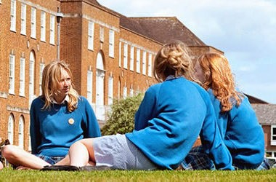
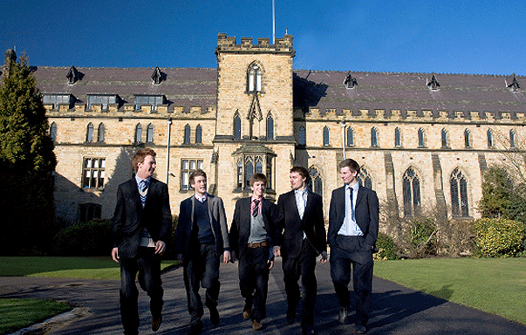
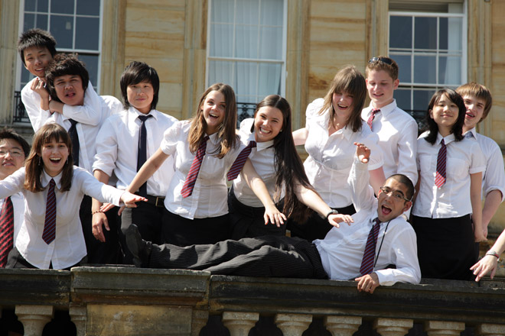
When children leave infant school at the age of seven, they go to junior schools until they are about eleven years of age. Their school subjects include English, arithmetic, history, geography, nature study, swimming, music, art, religious instruction and organized games.
The junior classroom often looks rather like a workshop, especially when the pupils are working in groups making models or doing other practical work.

Slide 4
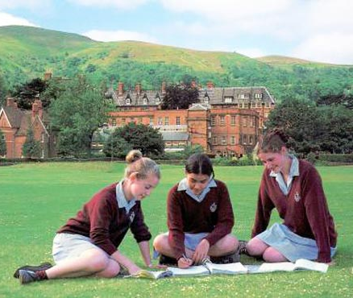
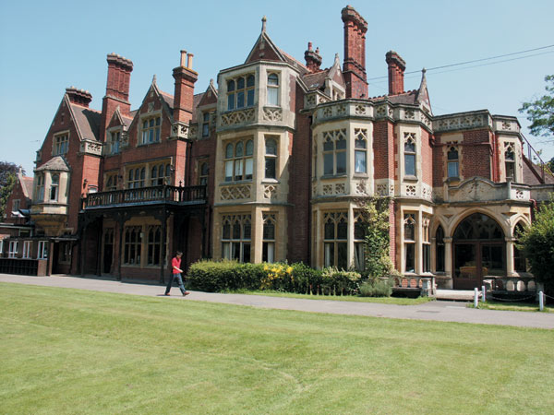
When pupils come to the junior school for the first time, they are still often divided into three “streams” - А, В and С - on the basis of their infant-school marks or sometimes after a special test. The brightest children go to the A-stream and the least gifted to the C-stream.
Towards the end of their fourth year in the junior school, a certain percentage of English schoolchildren still have to write their Eleven Plus Examinations, on the results of which they will go the following September to a secondary school of a certain type. Usually these examinations should reveal not so much what a child has learned at school, but his mental ability.

Slide 5
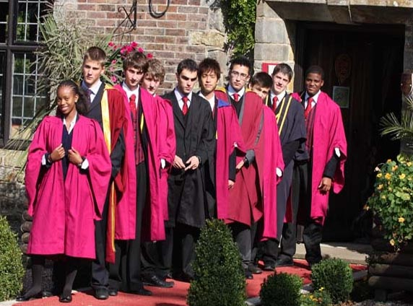
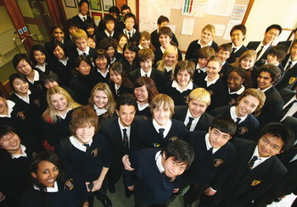
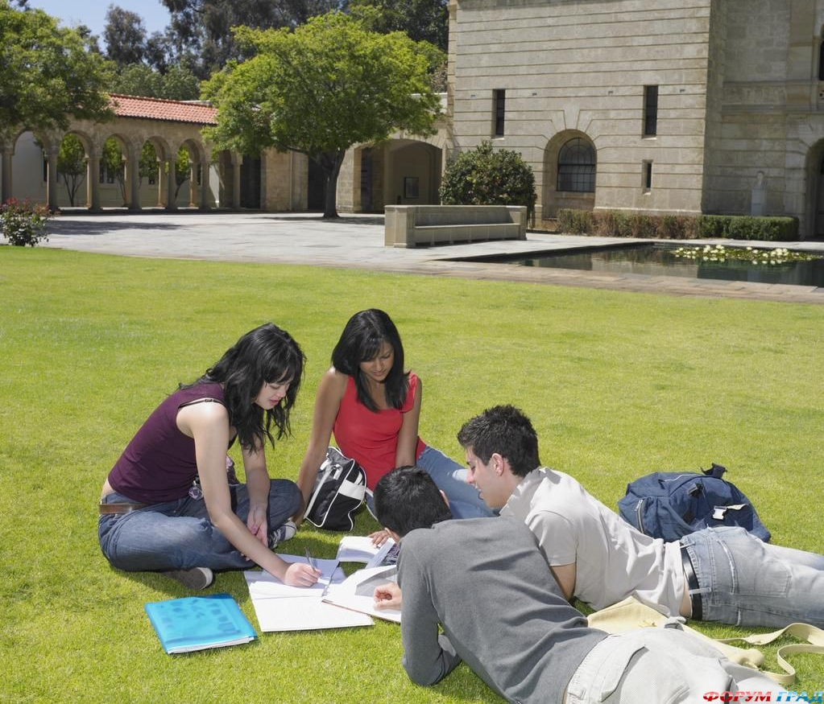
About 5 % of elementary school - leavers in Britain go to secondary modern schools. Modern schools do not provide complete secondary education. As the pupils are considered to be interested in “practical” knowledge only, study programmes are rather limited in comparison with other secondary schools. Some modern schools do not teach foreign languages. In modern schools pupils are also streamed according to their “intelligence”.

Slide 6
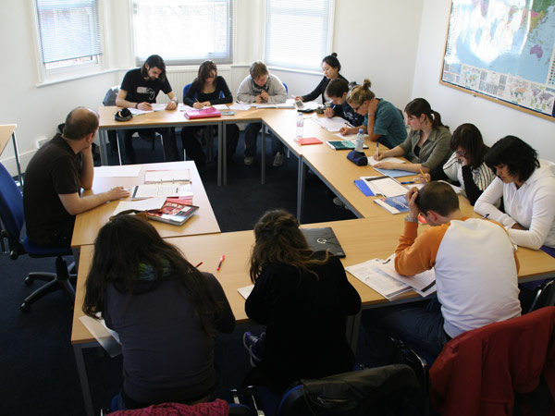
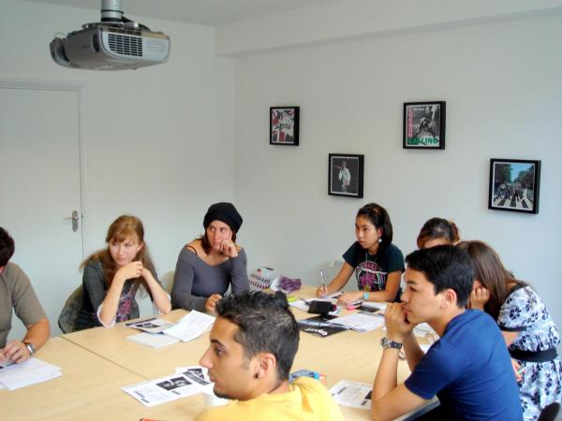
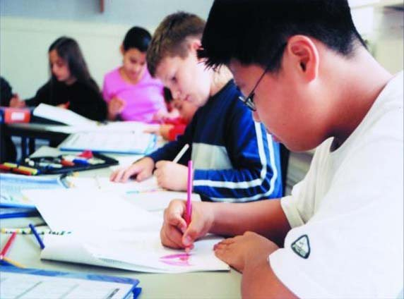
The secondary technical school, in spite of its name, is not a specialized school. It teaches many general subjects. Boys and girls in technical schools study such practical subjects as woodwork, metalwork, needlework, shorthand (stenography) and typing. Not more than two percent of schoolchildren in Britain go to technical schools.

Slide 7
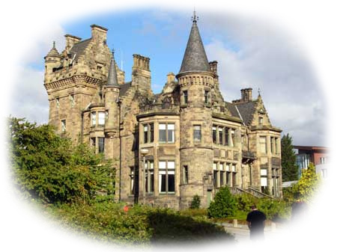
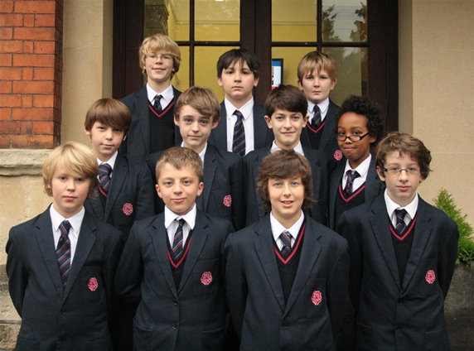
The grammar school is a secondary school taking about 3% of children offering a full theoretical secondary education including foreign languages, and students can choose which subjects and languages they wish to study. In most of them there are food, chemistry and physics laboratories. The majority (80 or 85%) of grammar school students, mainly children of poorer families, leave the school after taking a five-year course. Then they may take the General Certificate of Secondary Education at the ordinary level. The others continue their studies for another two or three years to obtain the General Certificate of Secondary Education at the advanced level, which allows them to enter university.

Slide 8
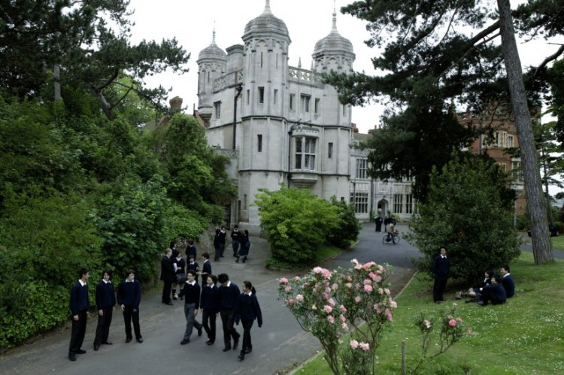
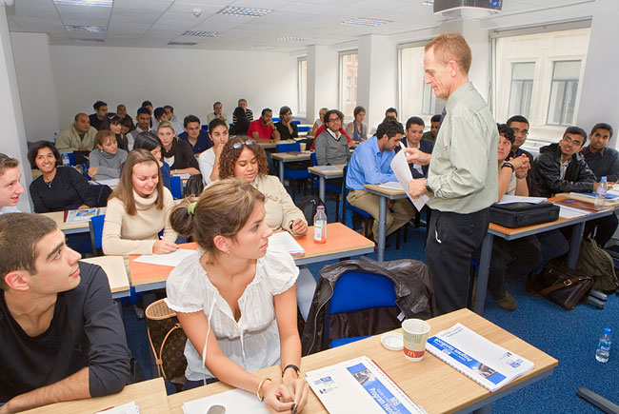
The comprehensive school combines in one school the courses of all three types of secondary schools; so the pupils can study any subject which is taught in these schools. Their number is growing; there are more than two thousand of them now. They are of different types; all of them preserve some form of streaming, but pupils may be moved from one stream to another. Comprehensive schools take over 90 % of schoolchildren in Great Britain.
The comprehensive school is the most popular type of school, for it provides education for children from all strata.

