Slide 1
Natural disasters

Slide 2
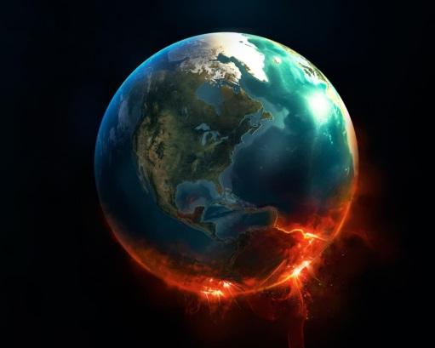
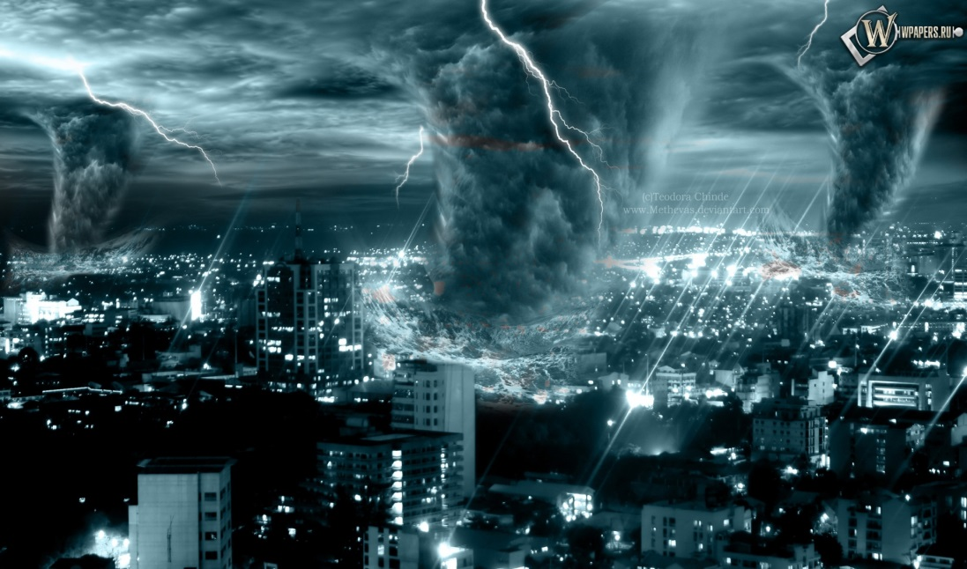
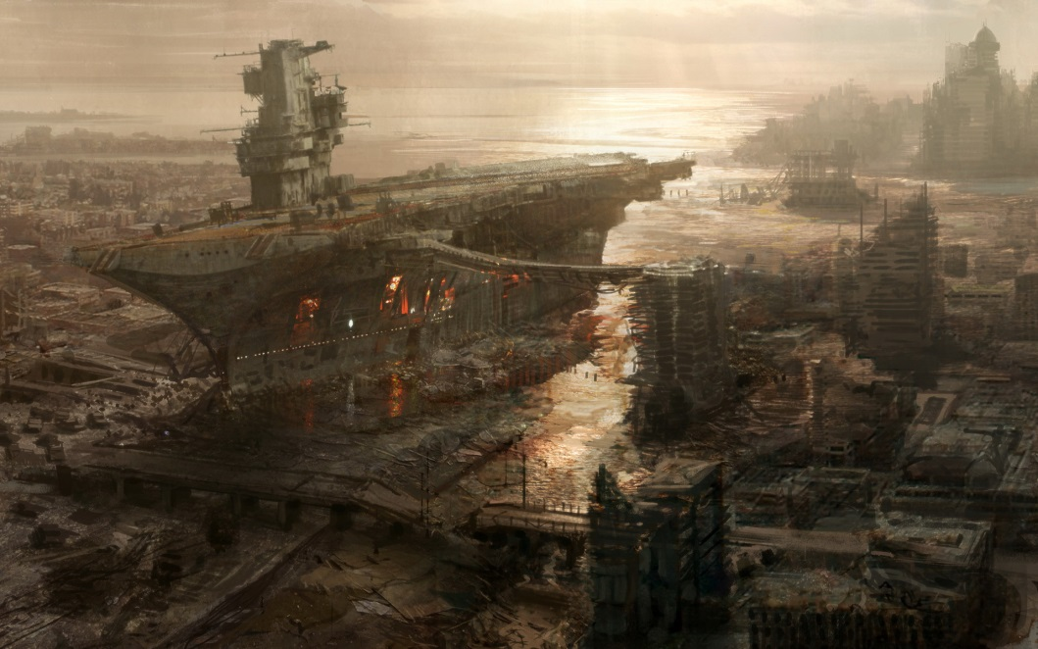
Natural disaster – is the effect of a natural hazard that affects the environment and leads to financial, environmental or human losses.

Slide 3
Types of Natural Hazards
• An avalanche (лавина)
• An earthquake ( землетрус)
• Floods ( повінь)
• A tsunami (цунамі)
• A heat wave (теплова хвиля )
• A tornado (торнадо)
• Hailstorms ( град )
A landslide (зсуви)
• A volcanic eruption(виверження вулкану)
• A hurricane (ураган)
• A wildfire (пожежа)
A blizzard (заметіль)
• A drought (засуха)

Slide 4
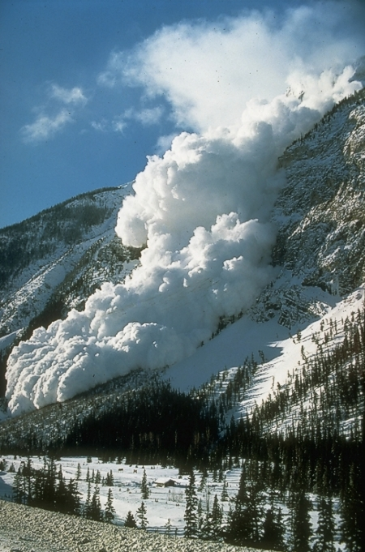
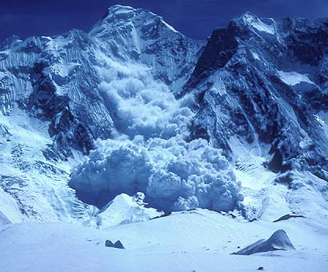
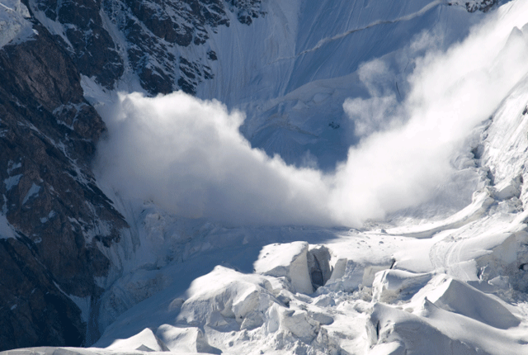
An avalanche – is a slide of a large snow mass down a mountainside. It is one of the major dangers faced in the mountains in winter.

Slide 5
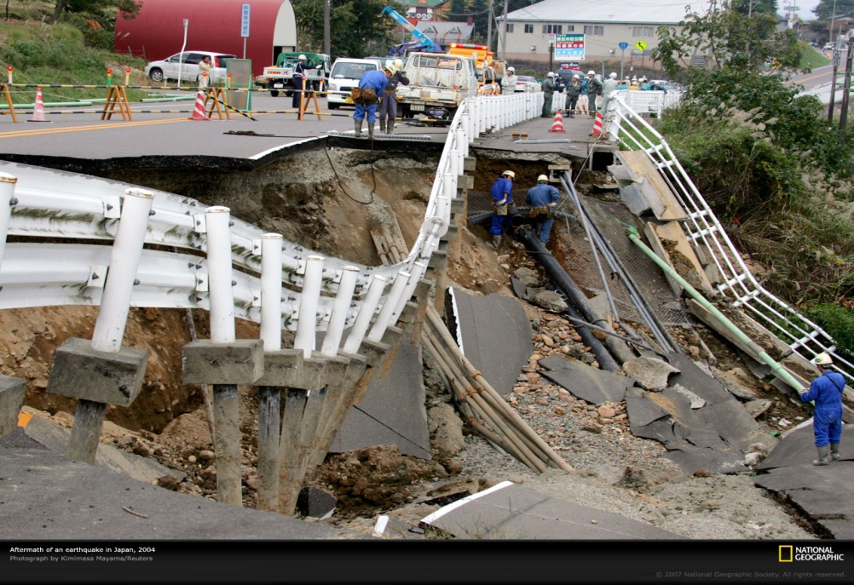
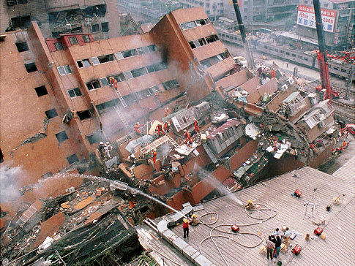
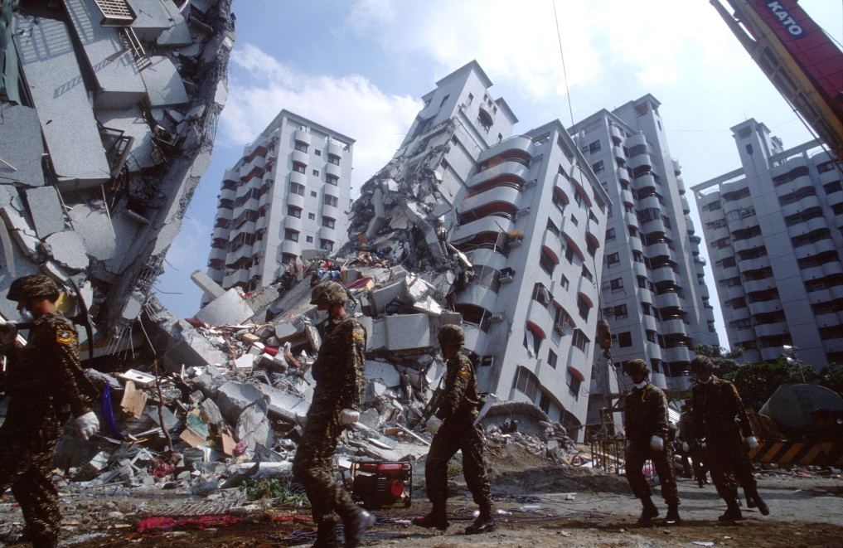
An earthquake - is the phenomenon that results from a sudden release of stored energy that radiates seismic waves. It shows itself by a shaking of the ground.

Slide 6
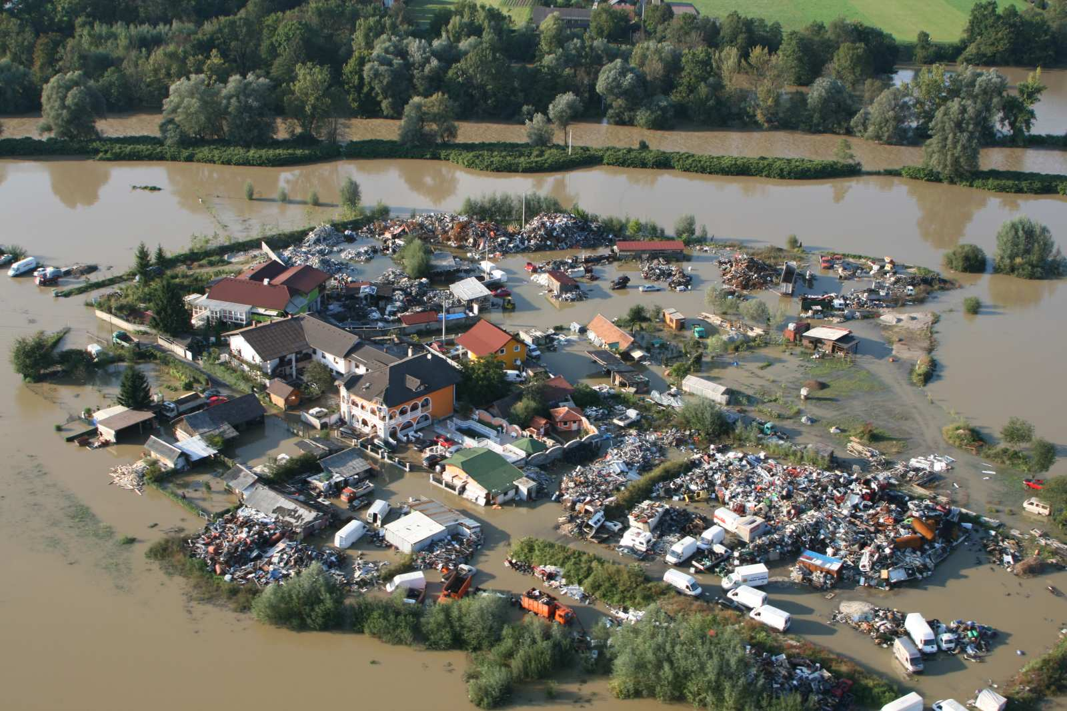
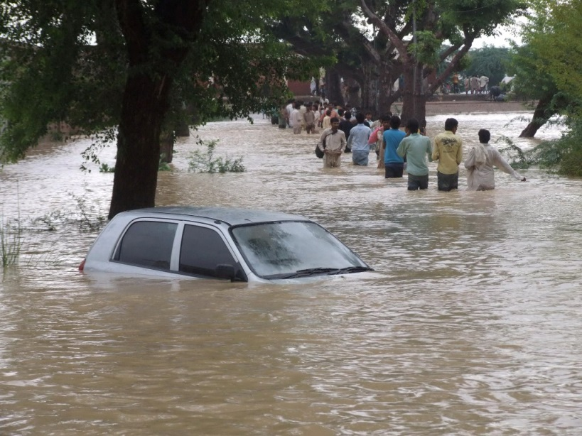
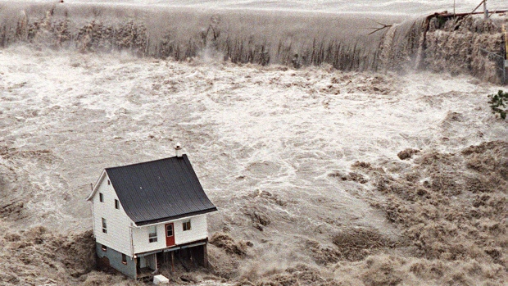
Floods - are the result of prolonged rainfall from a storm, rapid melting of a large amounts of snow, or rives which rise up their levels of water.

Slide 7
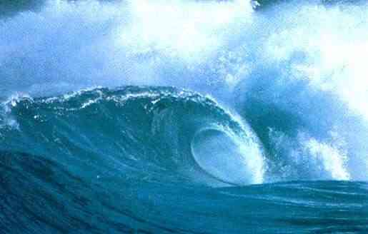
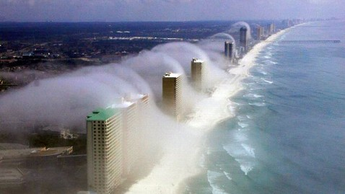
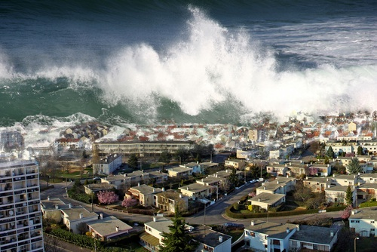
A tsunami - is a wave of water caused by the displacement of a body of water. It can be caused by undersea earthquakes or by meteorological phenomena.

Slide 8
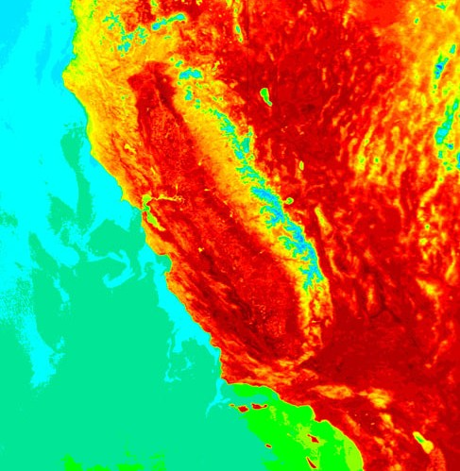
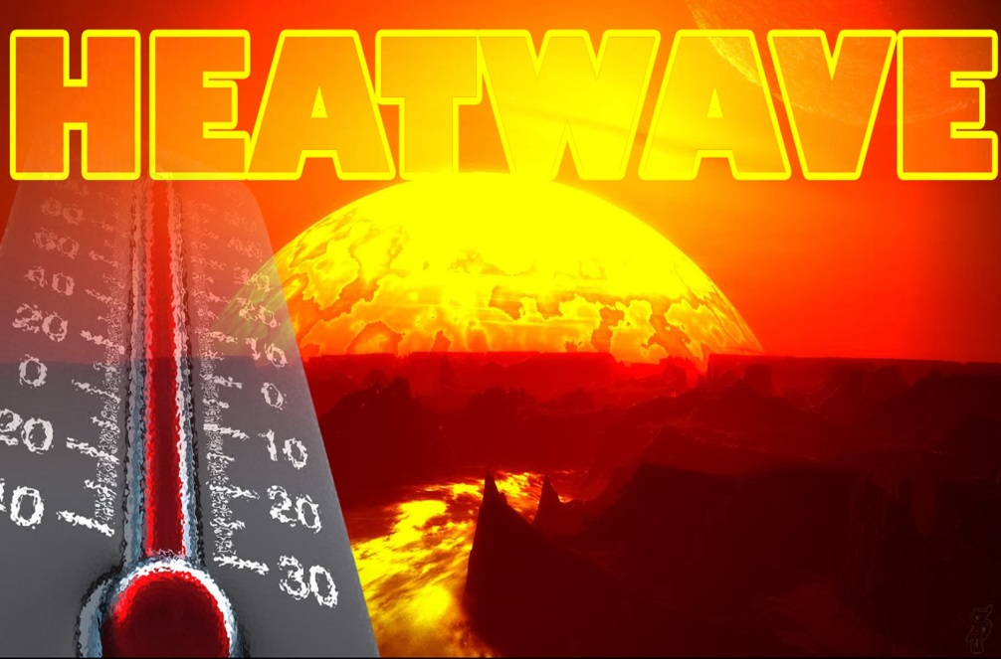
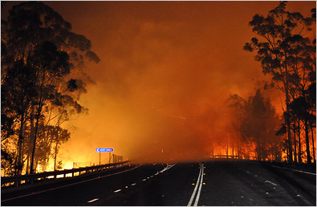
A heat wave - is a hazard characterised by heat which is considered extreme and unusual in the area in which it occurs.

Slide 9
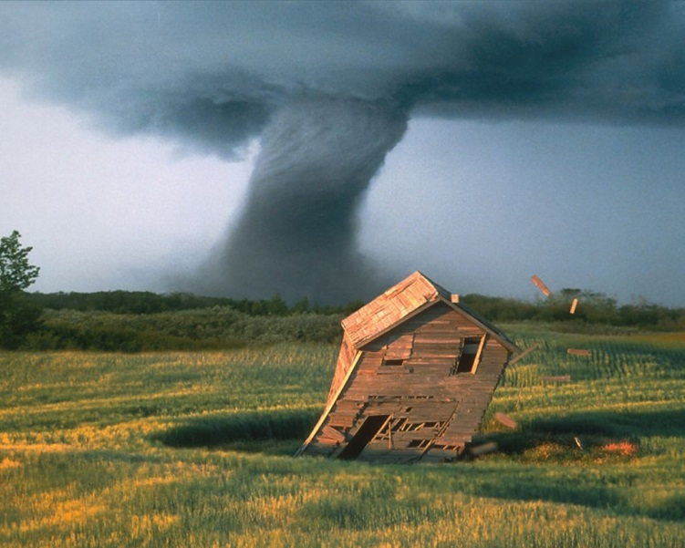
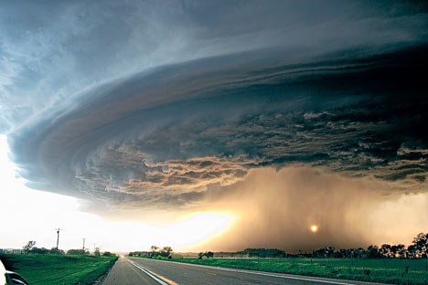
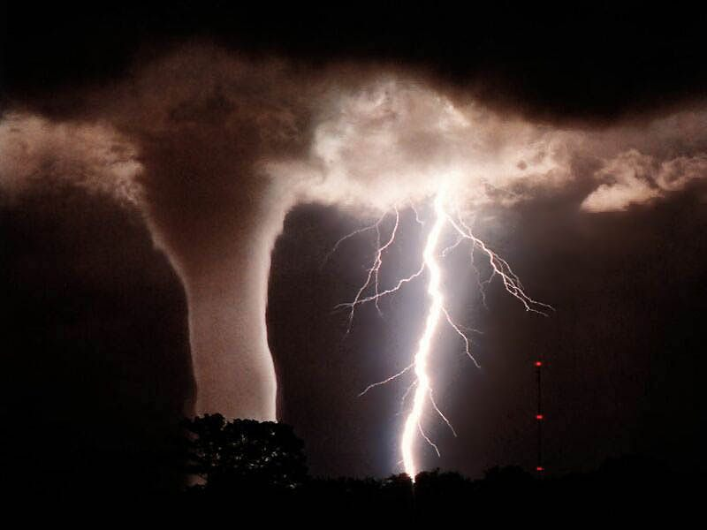
A tornado - is one of the names of cyclonic storm that forms over the oceans. It is caused by evaporated water that comes from the ocean. Typhoon is another name for it.

Slide 10
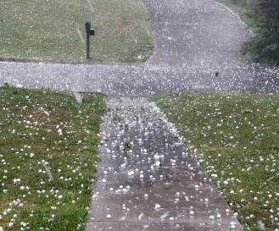
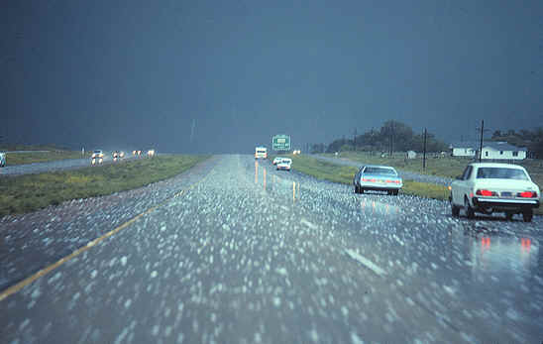
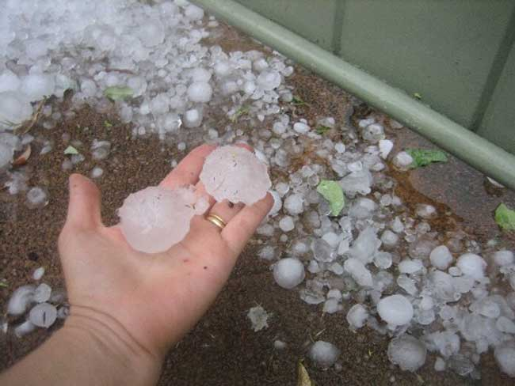
Hailstorms - are rain drops that have formed together into ice.

Slide 11
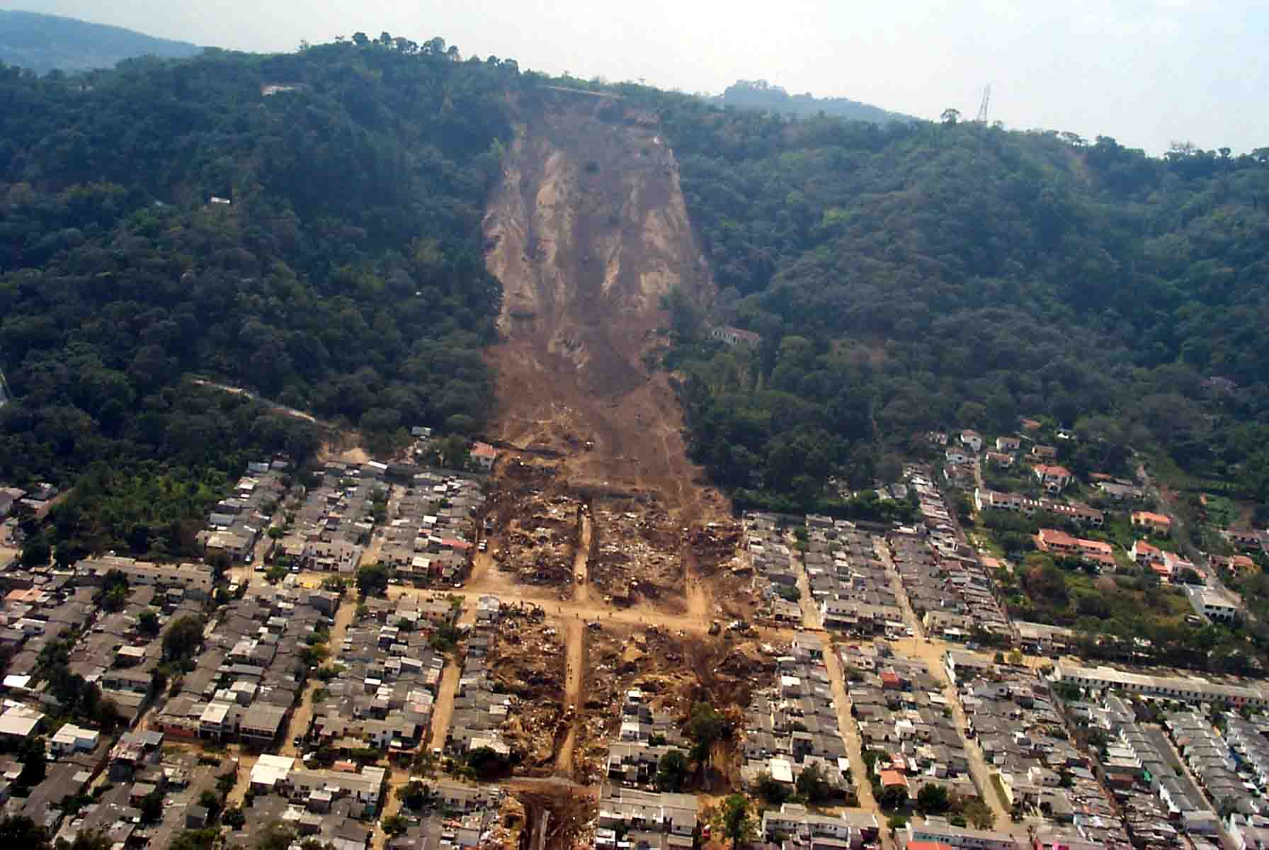
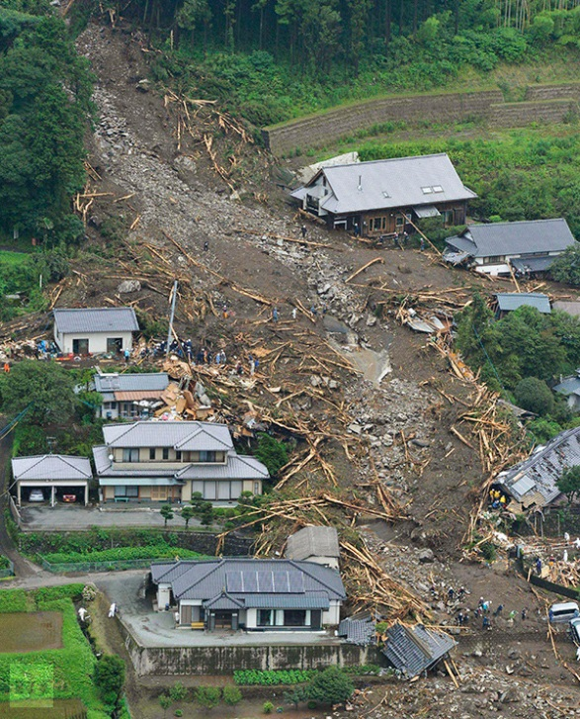
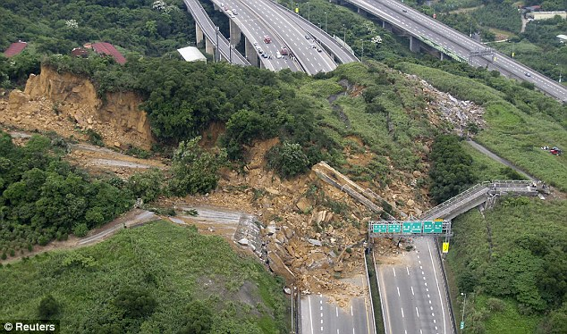
landslide – is a disaster closely related to an avalanche, but instead of occurring with snow, it occurs involving actual elements of the ground, including rocks, trees, parts of houses which may happen to be swept up.

Slide 12
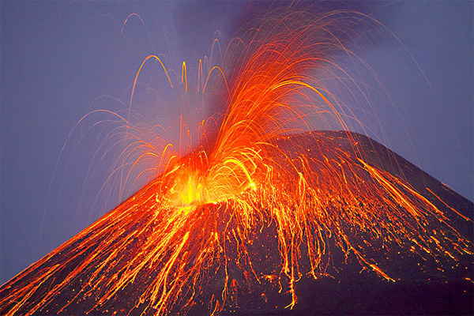
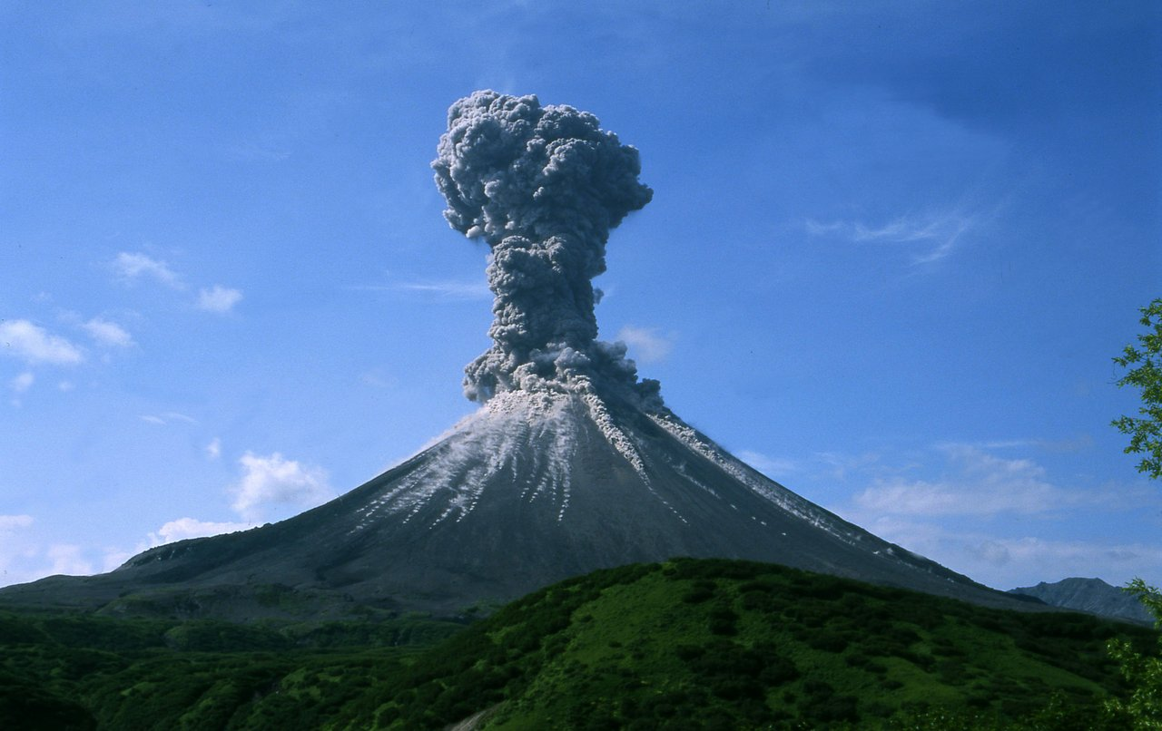
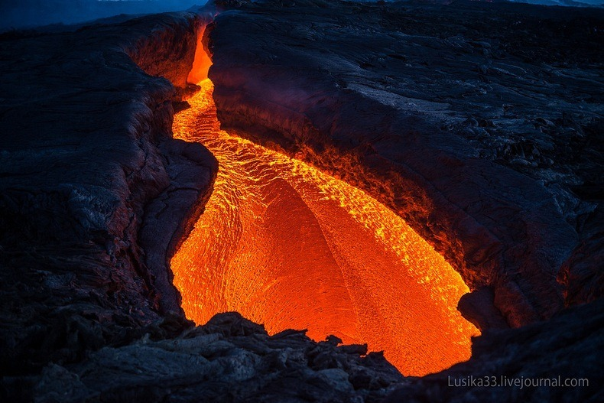
A volcanic eruption - is the point in which a volcano is active and releases its power, and the eruptions come in many forms.

Slide 13
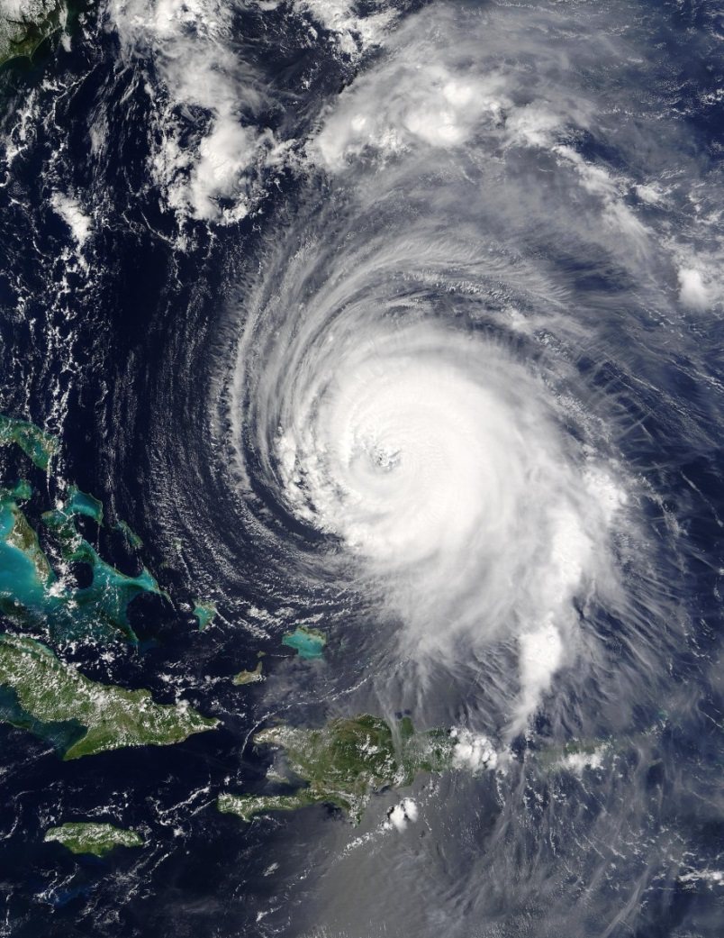
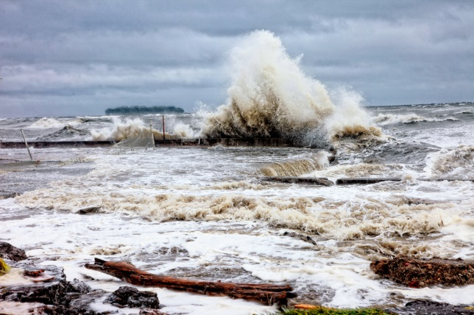
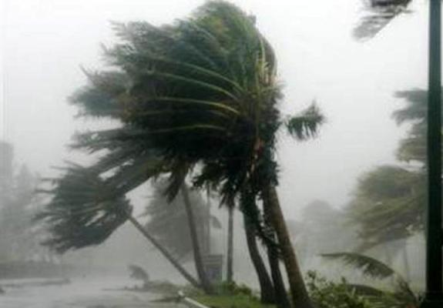
A hurricane - is a natural disaster resulting from a thunderstorm. It can occur one at time or can occur along lines occupying large areas.

Slide 14
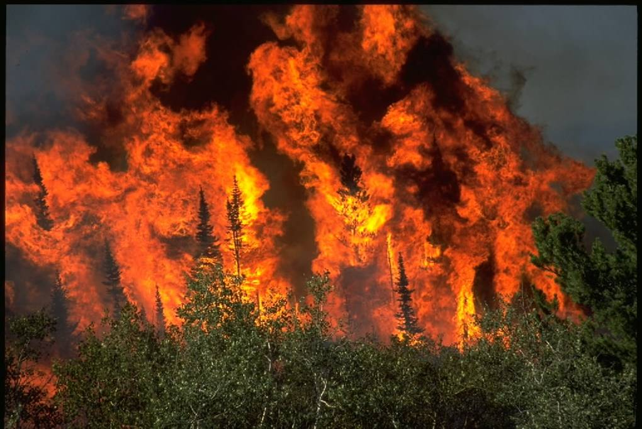
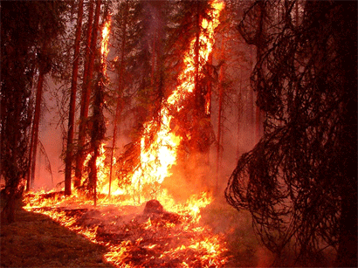
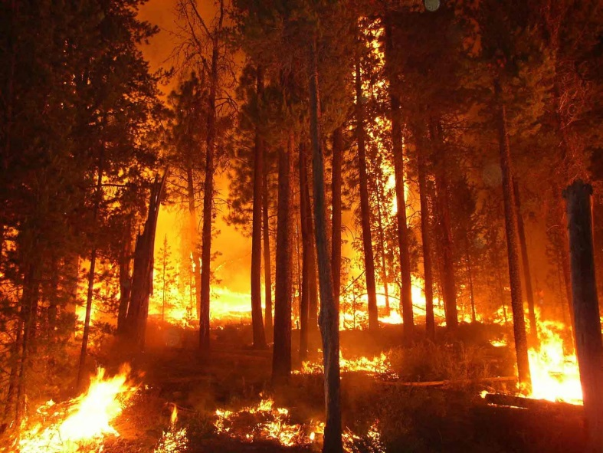
A wildfire - is an uncontrolled fire burning in wildland areas. Common causes include lightning and drought but they may also be started by human carelessness.

Slide 15
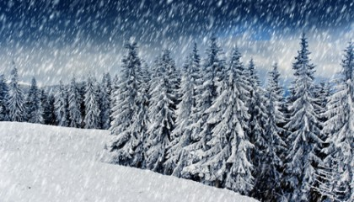
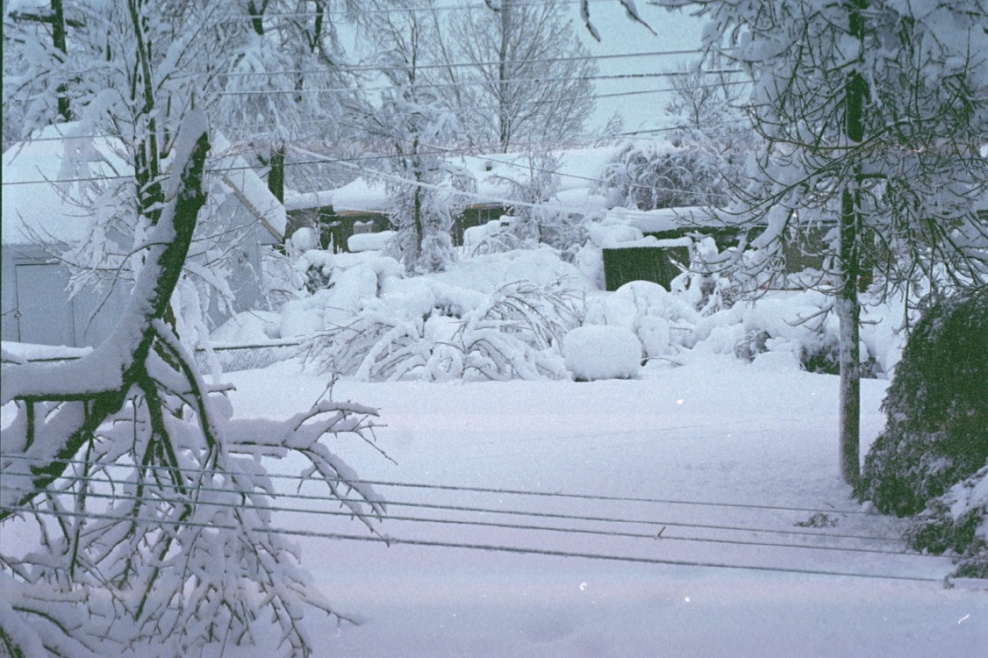
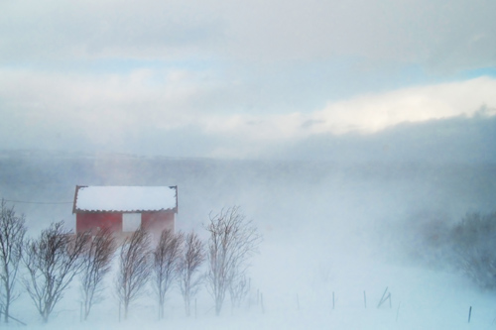
A blizzard - is a severe winter storm condition characterised by low temperatures, strong winds, and heavy blowing snow.

Slide 16
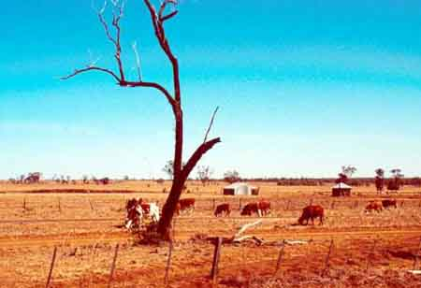
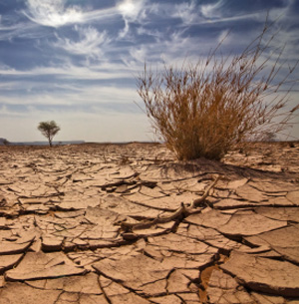
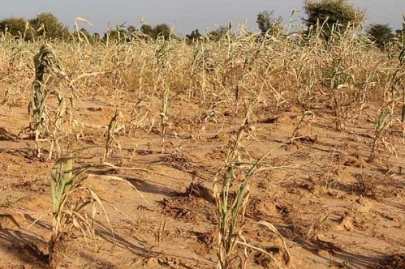
A drought - is defined as an acute shortage of water and crop failure. It is an abnormally dry period when there is not enough water to support water needs.

Slide 17
The century we have started recently gives us a new chance to apply the lessons we have learned about natural hazards. As we look ahead, we must continue to improve both our understanding of how the earth works and our ability to provide timely and effective warning,
so that we can live safely on our planet!

