Slide 1
MARIA CALLAS
Prepared
Victoria Tsybulska
From 7(11)-B

Slide 2
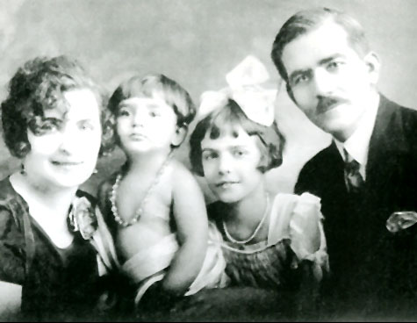
Maria Callas (December 2, 1923 - September 16, 1977) - opera singer (soprano), one of the greatest singers of the twentieth century. Enthusiastic audience during his lifetime was awarded her the title of La Divina.
Maria Callas (real name Maria Anna Sofia Cecilia Kalogeropulu) was born December 2, 1923 in New York, the son of Greek immigrants. Despite the small wealth, his parents decided to give her singing education. Mary extraordinary talent manifested itself at an early age.

Slide 3
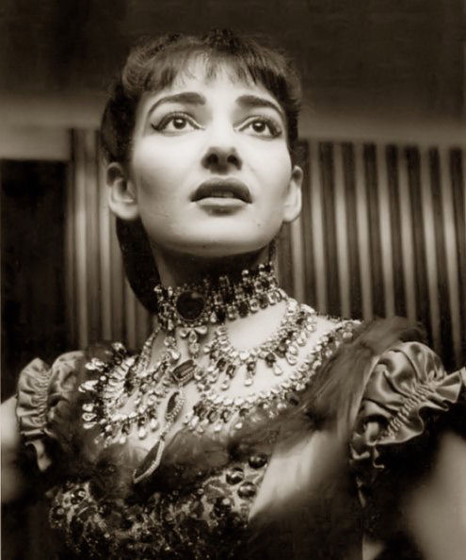
In 1937, together with her mother she comes home and goes to one of the Athens Conservatory , " Etnikon Odeon ", to the famous educator Mary Trivelli . Under her leadership, Callas produced and performed in a student play his first operatic roles - Santuzza role in the opera " Cavalleria Rusticana " Pietro Mascagni . Such a significant event occurred in 1939 , which became a sort of the future life of the singer. She moves to another Athens Conservatory , " Odeon Afyon " in class outstanding coloratura singer Elvira de Hidalgo Spaniard , who completed a grinding voice and helped place as Callas opera singer . In 1941, Callas made ​​her debut at the Athens Opera, performing the role in the opera Tosca by Puccini. Here she works until 1945, gradually starting to develop leading operatic roles. Callas's voice was brilliant "irregularity." In the middle register she heard muffled custom, even as a few muffled voice. Experts considered this lack of vocals, and the audience saw this as a special charm. Not casually talked about the magic of her voice that she captivates the audience with his singing. The singer called his voice "dramatic coloratura."

Slide 4
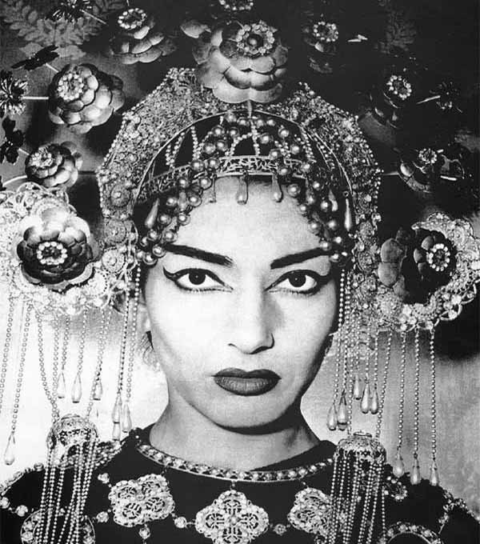
In 1947 she received the first prestigious contract - she had to sing opera Ponchielli " Mona Lisa " at the Arena di Verona, the world's largest opera theater in the open air , where he performed almost all the greatest singers and conductors of the XX century . Tullio Serafin conducted a performance , one of the best conductors of Italian opera . Again, a personal meeting determines the fate of the actress. That recommendation Seraphina Kallas invited to Venice. Here, under his guidance, she takes the title role in the opera "Turandot" and Puccini's "Tristan and Isolde" by Richard Wagner .

Slide 5
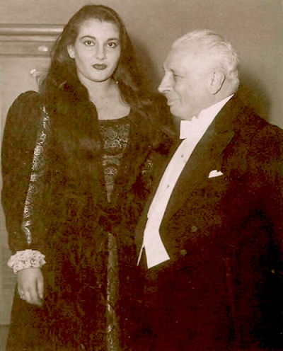
Maria tirelessly to improve not only your voice, but also the shape. Tortured himself severe diet. And achieved the desired result, virtually unchanged beyond recognition. She so record their achievements: "La Gioconda 92 kg 87 kg Aida; Norm 80 kg 78 kg Medea; Lucia 75 kg 65 kg Alceste; Elizabeth 64 kg." So the weight of her heroines melted at height 171 cm

Slide 6
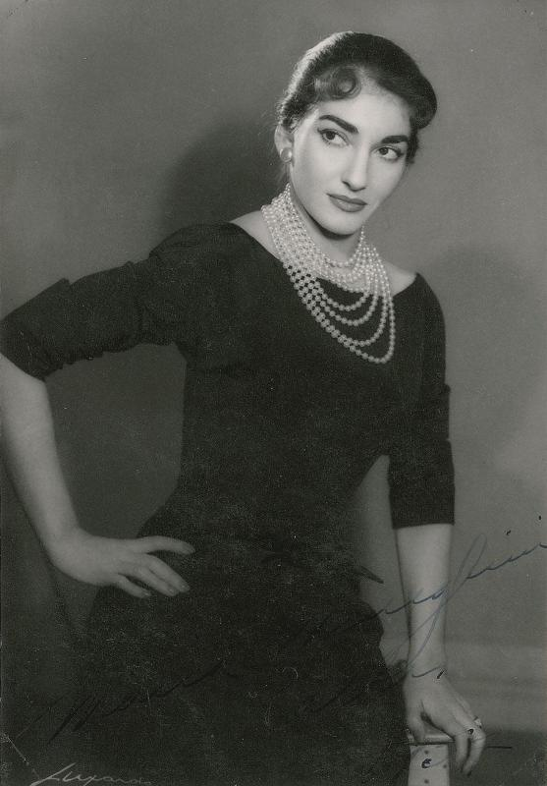
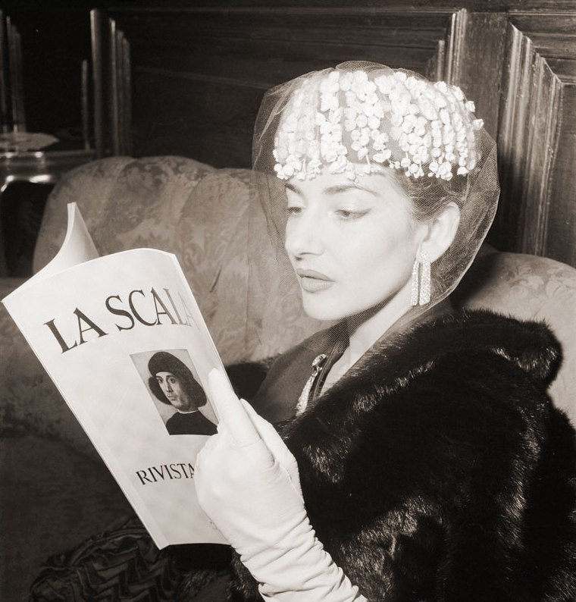
In the most famous theaters in the world - Milan "La Scala" - Callas appeared in 1951, singing the role of Helena in the "Sicilian Vespers" by G. Verdi.

Slide 7
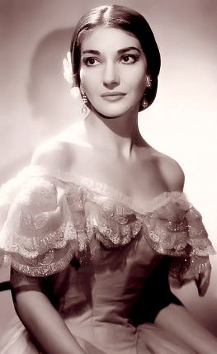
It seemed that in opera parties Callas live pieces of their lives. At the same time it reflects the woman's fate, and in general, love and pain, joy and sorrow. Callas images were always full of tragedy. Her favorite opera was "La Traviata" by Verdi and "Norma" by Bellini, because their heroine sacrifice themselves and love it purify the soul. In 1956, she will triumph in the city where she was born - in the "Metropolitan Opera" specially prepared for the debut of a new production of Callas "Norms" Bellini. This game along with Lucia di Lammermoor by Donizetti in the opera critics of those years ranked among the highest achievements of the actress.

Slide 8
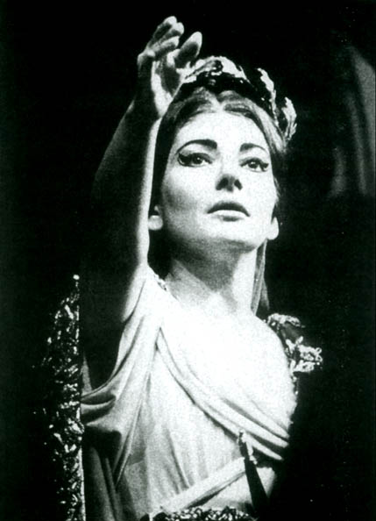
Callas embodied passionate artistry on stage , having incomparable appearance as an actress. It made her world famous performer , gifted by nature. Her volatile personality have earned her an admiring and sometimes puzzled public nicknames Tigress and Cyclone Callas. Callas took a deep psychological significance of Medea as his alter ego, it becomes clear from the following lines , written just before her last performance in 1961 : "I saw Medea as I felt it : hot , outwardly calm, but very strong . Lucky time passed with Jason , she now torn by suffering and rage . " Last years of his life Maria Callas lived in Paris , practically leaving the apartment , where she died in 1977.

Slide 9
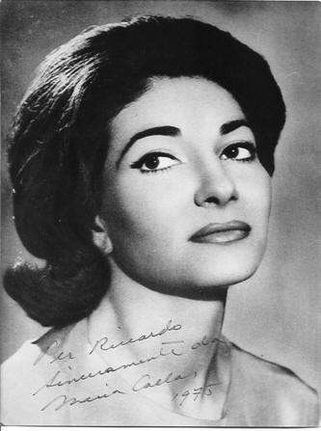
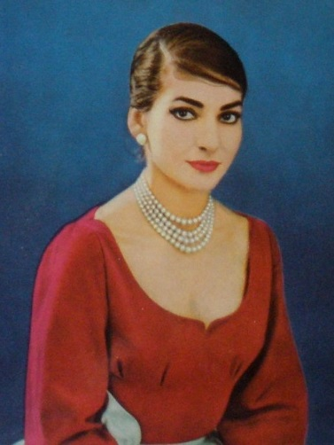

Slide 10
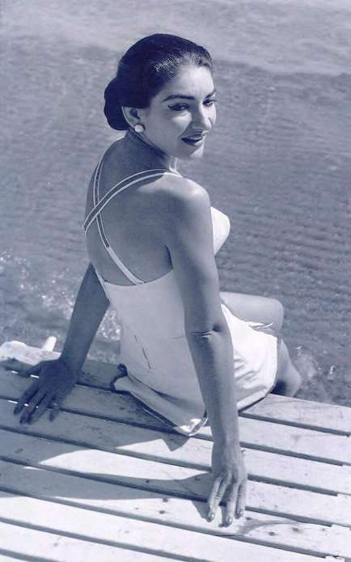
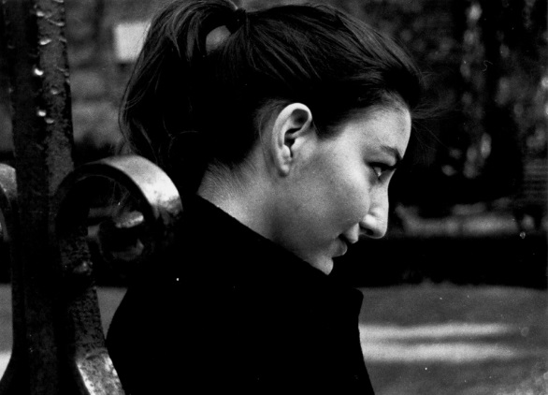

Slide 11
Thank you!

