Slide 1
Benjamin Franklin

Slide 2
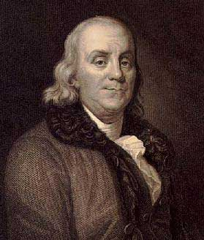

Slide 3
Benjamin Franklin
Born in Boston on January 17, 1706
Father was Josiah Franklin, a soap maker
Mother was Abiah Folger, second wife of Josiah
Benjamin was the tenth son of Josiah, who fathered 17 children in all

Slide 4
The Apprentice
Brother James was a printer
Benjamin helped compose pamphlets and set type
Young Benjamin would go sell them on the streets
He wanted to write for the paper, but James wouldn’t let him
He wrote letters under the fictional name, “Silence Dogood”
After 16 letters, he confessed what he had done to his brother

Slide 5
The Runaway
Benjamin quit his apprenticeship with his brother at age 17 due to harassment and beatings from James and ran away
He eventually ended up in Philadelphia, where he landed work as a printer
He got married in 1730 to Deborah Read

Slide 6
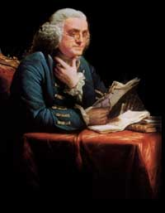

Slide 7
The Educator
In 1749, Franklin wrote Proposals Relating to the Education of Youth in Pennsylvania
This publication led to the establishment of the Academy of Philadelphia in 1751

Slide 8
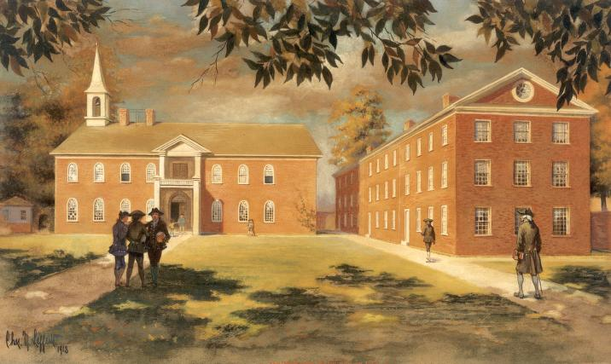
The Academy

Slide 9
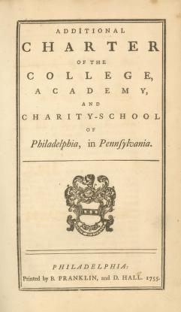
The Academy
Education at the Academy followed three patterns:
  Traditional college preparatory with emphasis on Latin and Greek
  English-Language program for those planning to end their education at the Academy
  The normal course, for prospective common school teachers

Slide 10
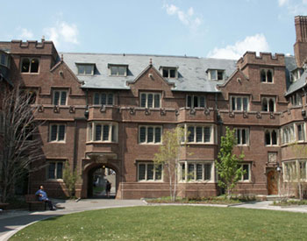
University of Pennsylvania

Slide 11
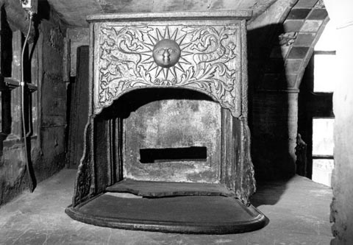

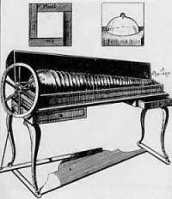
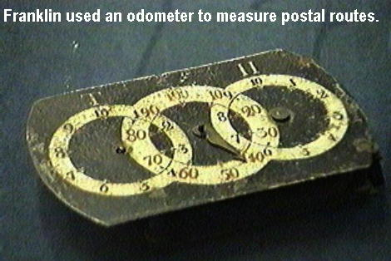
Other Inventions
Bifocals
Franklin Stove
Discovered Electricity
Lightning Rod
Glass Armonica
Odometer
Suggested Daylight Savings Time

Slide 12
The END

