Slide 1
The Politics of Bilingualism in Ukraine
Yuliia Khomych

Slide 2
Playing with ambiguities
People who point to Ukraine as an example of a bilingual country do not always understand — or pretend not to understand — what they are proposing. It turns out that studying Swedish, the second official language of Finland, is not mandatory. In Ukraine, people who do not master Russian, which is not the second official language, cannot receive their secondary education diplomas. We have countless Russian-language publications. We hear Russian on television and radio. What official status does this language require?

Slide 4
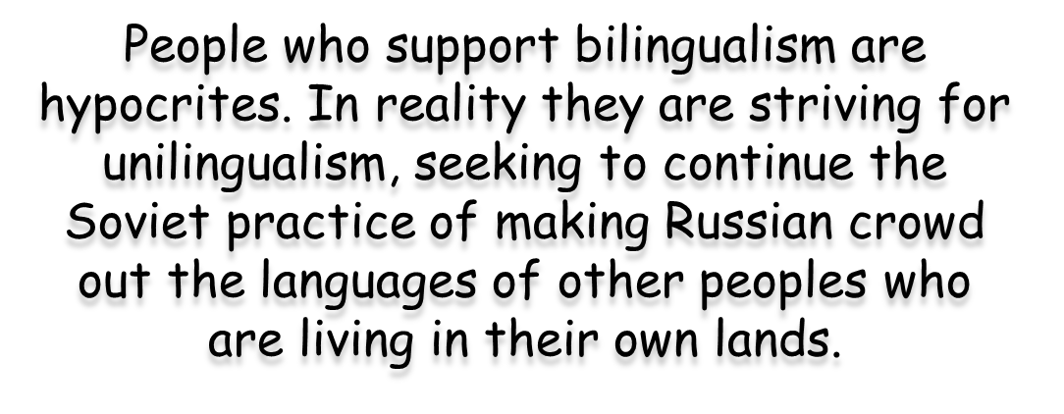

Slide 5
Lytvyn calls official bilingualism idea utopian
KYIV, June 22 /UKRINFORM/. Verkhovna Rada Chairman Volodymyr Lytvyn is convinced that the idea of sealing in the Constitution an official status of Russian as the second national language is utopian.
"I think this is a utopian idea, given the society's moods and the alignment of political forces, as well as projected election returns," he said.
As reported, on June 21, deputy chairman of the Party of Regions' faction in parliament, Vadym Kolesnichenko said that they would seek including in a new Constitution the provision that Ukraine has two official languages - Russian and Ukrainian.

Slide 6
Russification Via Bilingualism
Under the current circumstances in Ukraine, most bilingual people ultimately become Russian-speakers
So-called bilingual Ukrainians constitute quite a large group of the population. Surveys that allow for two native languages, such as the 2007 survey by the Razumkov Centre, show that 21.5% of those polled cannot decide whether Ukrainian or Russian is their native language, this figure is particularly high in the South at 25.5% and East at 32.2%. The number of bilinguals in these regions exceeds that of people who list Ukrainian as their native language.

