Slide 1

Healthy Lifestyle

Slide 2


One of the important tasks of the modern school - to educate physically, mentally, socially and spiritually healthy. For public health Ukraine testifies to the existence of a real threat of extinction of the nation.

Slide 3
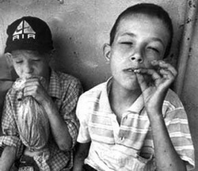
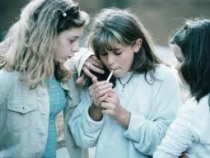
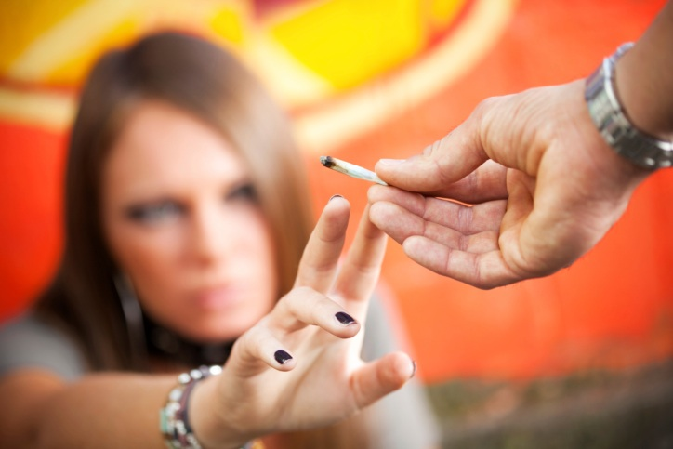
Today, nearly 90% of pre-school children, pupils and students are variations in health. In the last 5 years 41% increase in the number of pupils, referred to as special health care groups. 60% increase in the number of juveniles who use drugs, smoke, drink.

Slide 4



Human Health - an interesting and complex phenomenon. It has always attracted and will attract the attention of not only researchers, but also every person. This concept is old, that in all languages ​​the word "health"

Slide 5
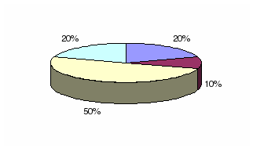
Human health depends on 20% of the inheritance, 10% of the level of development of medicine, 20% of the environment, 50% of life.

Slide 6

Lifestyle - a set of stable forms of human life that define her career. This is - a set of habits.
The basis of a healthy lifestyle is the individual system behavior and habits of each individual, which provides it with the right level of life and healthy longevity. Healthy lifestyle - a practical action to prevent disease, strengthen all systems of the body and improve the overall well-being.
The main thing - to think about the consequences of their actions.

Slide 7

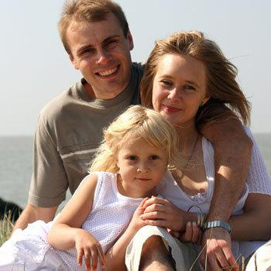

The basis of a healthy lifestyle based on the following principles:

Slide 8
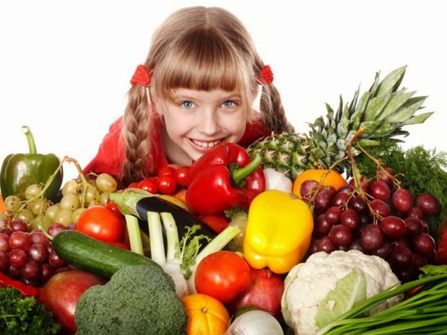
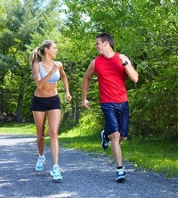
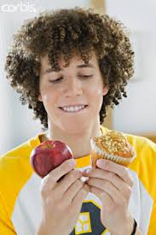

nutrition;
optimum driving mode;

Slide 9
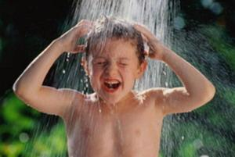

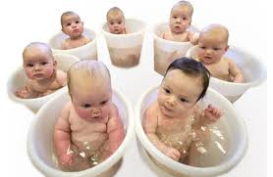
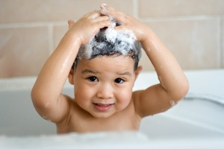
hardening of the body;
personal hygiene;

Slide 10

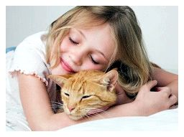
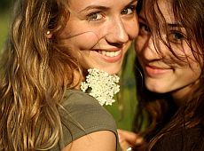

no bad habits;
positive emotions;

Slide 11


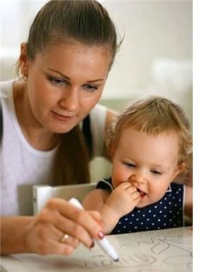

moral and spiritual development;
intellectual development;

Slide 12
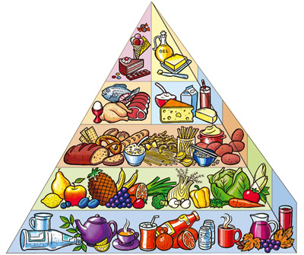
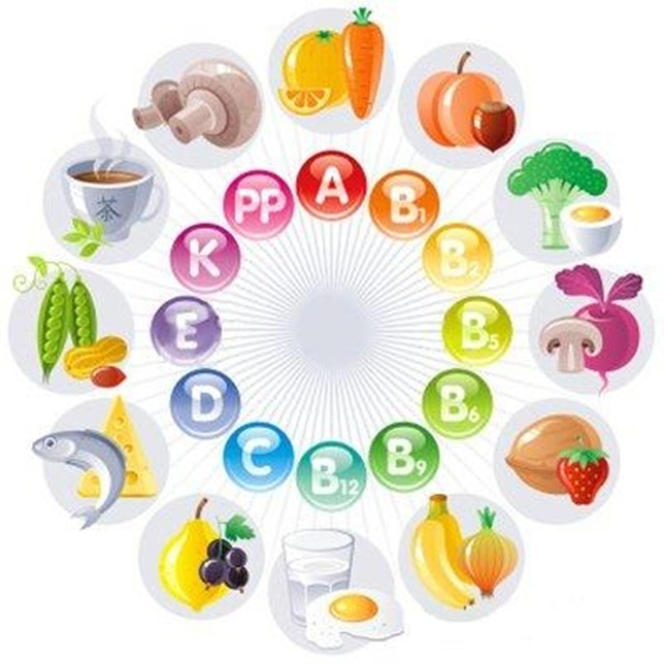
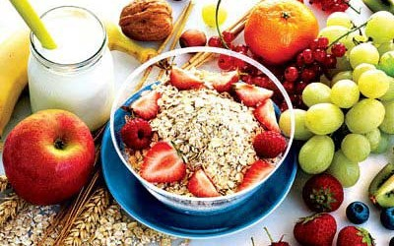
Nutrition has five basic requirements:

Slide 13
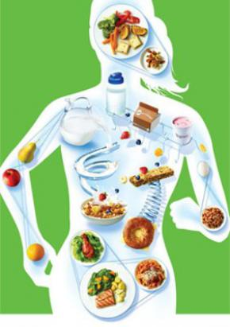
1. The amount of food - it's so much that it provided daily energy consumption of the body;
2. The quality of the food - the right balance of fats, proteins, carbohydrates, vitamins, minerals, water under the age periods of the child;
3.Properly organized mode of eating;
4. Digestion - create a pleasant atmosphere when eating;
5. The food was not harmful.

Slide 14
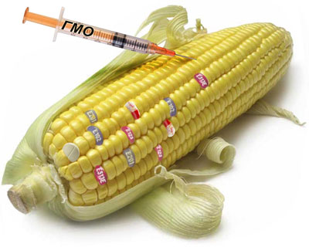
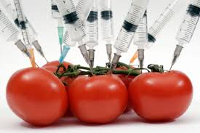
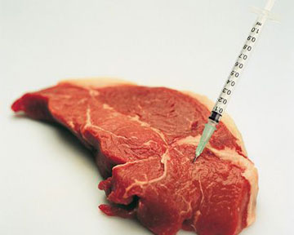
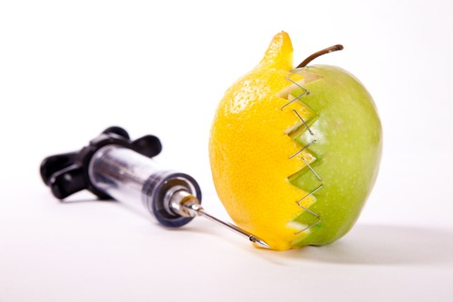
You can not skip a threat to health as genetically modified foods, which increasingly appear on our table. They are called time bomb, the consequences of which no one can perebachyty.

Slide 15
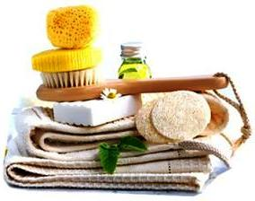


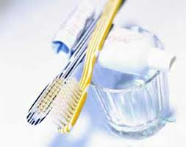
Personal hygiene - is the foundation of a healthy lifestyle, the condition effectively prevent various diseases. This particular body hygiene, teeth and mouth; mental work.

Slide 16
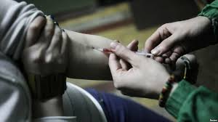
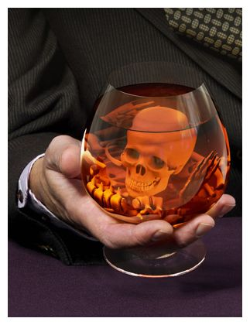
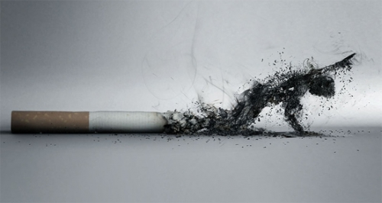
Habits that are detrimental to health, life or do not comply with the cultural norms of the society in which we live - are harmful. Most bad habits that may emerge at school age are smoking and drinking alcohol, drugs.

Slide 17
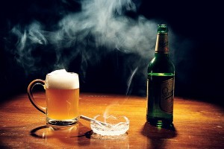

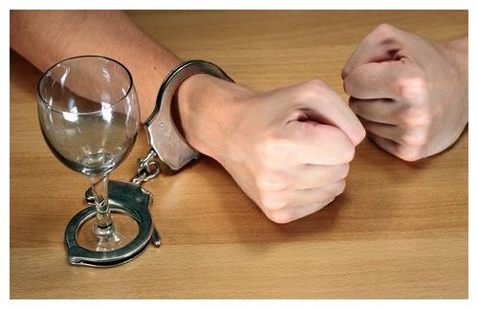
Effects of alcohol are:
-reduction of coordination;
-memory impairment;
-reducing ability to think;
-blurred vision;
-stomach pain, heartburn, vomiting;
-cardiovascular disease;
-disruption of the brain;
-reduction in life expectancy.

Slide 18
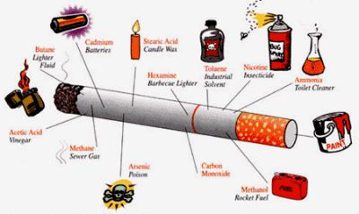
In tobacco leaves contain nicotine, carbohydrates, proteins, essential oils, hydrocyanic acid, ammonia, nitrogen, ethylene, carbon monoxide, carbon dioxide.

Slide 19
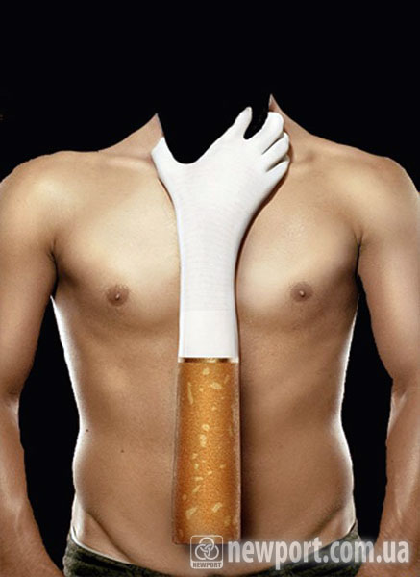
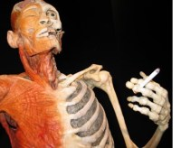
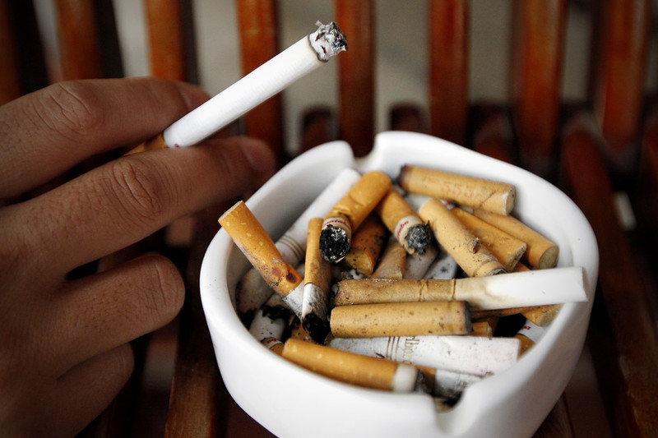
During the combustion of cigarettes to 50% with nicotine smoke into the air and inhaled by nonsmokers, 25% destroyed during the combustion of tobacco, 5% remains in the butt and 20% ingested. In tobacco smoke contains the radioactive substance polonium 210 as tobacco smoke - is radioactive.

Slide 20
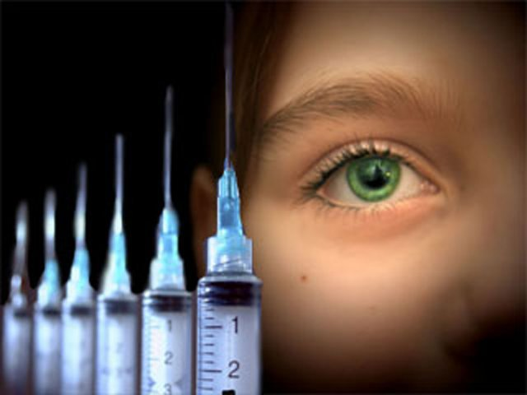
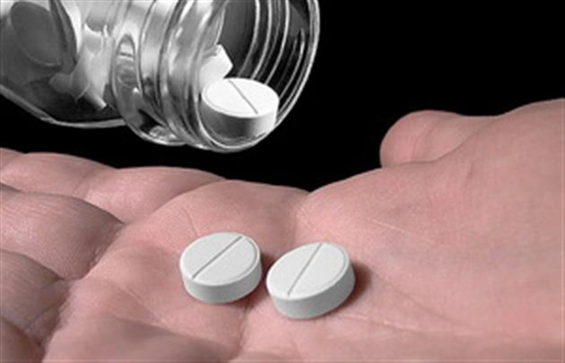
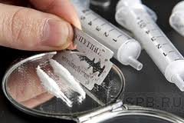
Addiction - the general name of illnesses manifested craving for continuous use in growing quantities of narcotic medicines and drugs as a result of sustained psychological and physical dependence on them with the development of withdrawal symptoms when stopping taking them. Addiction leads to profound adverse changes in personality and other psychological disorders, as well as dysfunction of the internal organs.

Slide 21
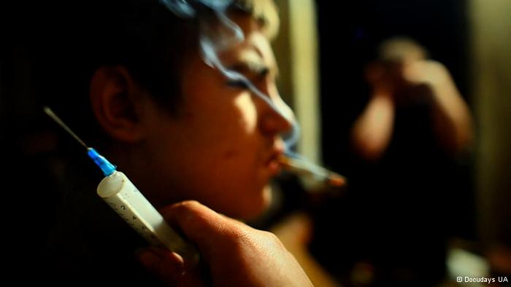
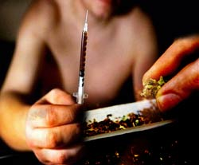
The formation depending affect:
frequency of use and number of drugs;
toxicity and biochemical characteristics of the drug product;
feature of the consumer (the person's age, his weight);
mental state;
nature of the relationship to drugs.

Slide 22



Consequently, drugs, alcohol, nicotine and other drugs harm the body of man. They constitute a public danger and valeological (degradation of the individual, chronic illness, death). Therefore, it is important to put an end to bad habits. It is better to live a healthy lifestyle and do not shorten own life

Slide 23
Thank you for attention!!!

