Slide 1
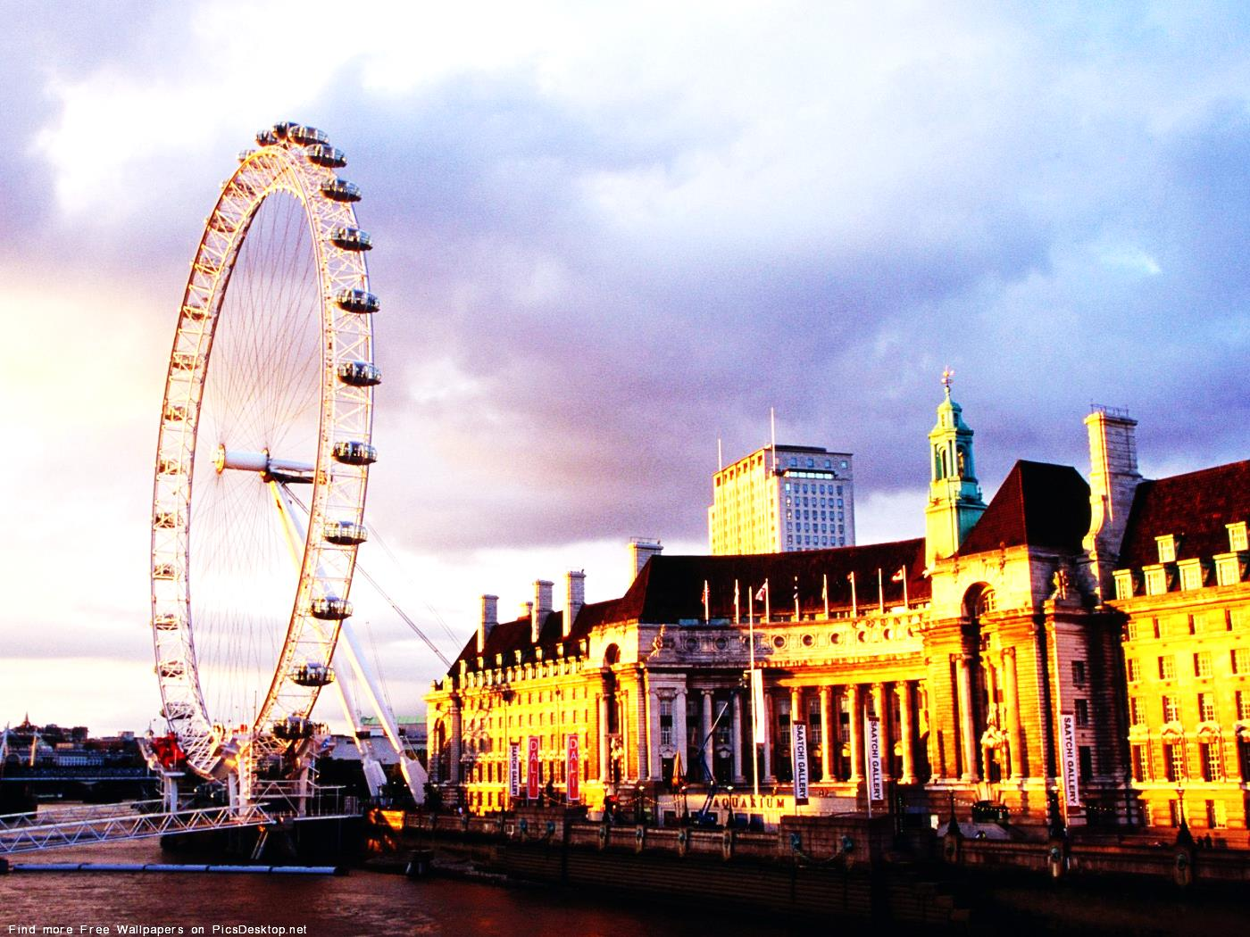
Great Britain

Slide 2
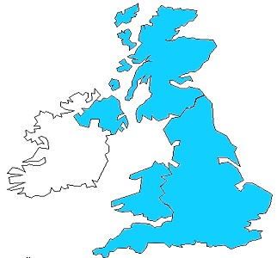
Where is the UK?
The UK is situated on the British Isles, north-west of the European continent between the Atlantic Ocean and the North sea.
Great Britain
Northern Ireland
The official name of
the UK is the "United Kingdom of Great Britain and Northern Ireland".

Slide 3
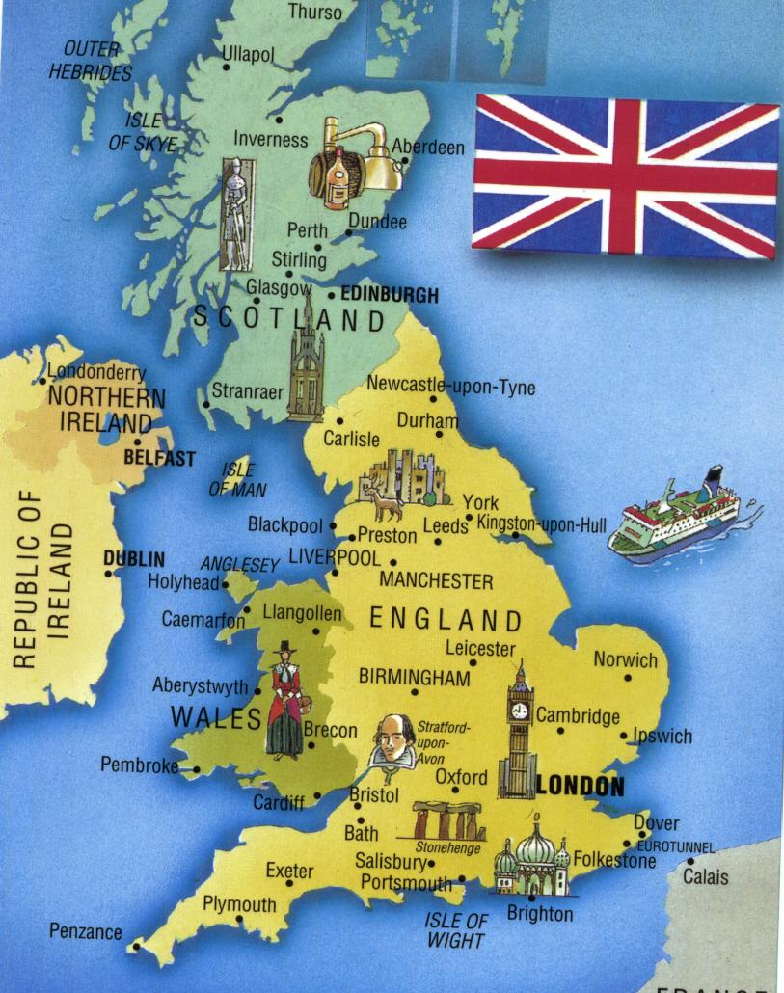
The United Kingdom of Great Britain and Northern Ireland
If you look at the full name of the UK,
you will see that the UK includes Scotland, England, Northern Ireland and Wales
People in the UK are called British although they have different nationalities

Slide 4
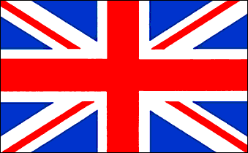
What have I done for you, England, my England? What is there I would not do, England, my own? With your glorious eyes austere, As the Lord were walking near, Whispering terrible things and dear As the Song on your bugles blown, England— Round the world on your bugles blown!

Slide 5
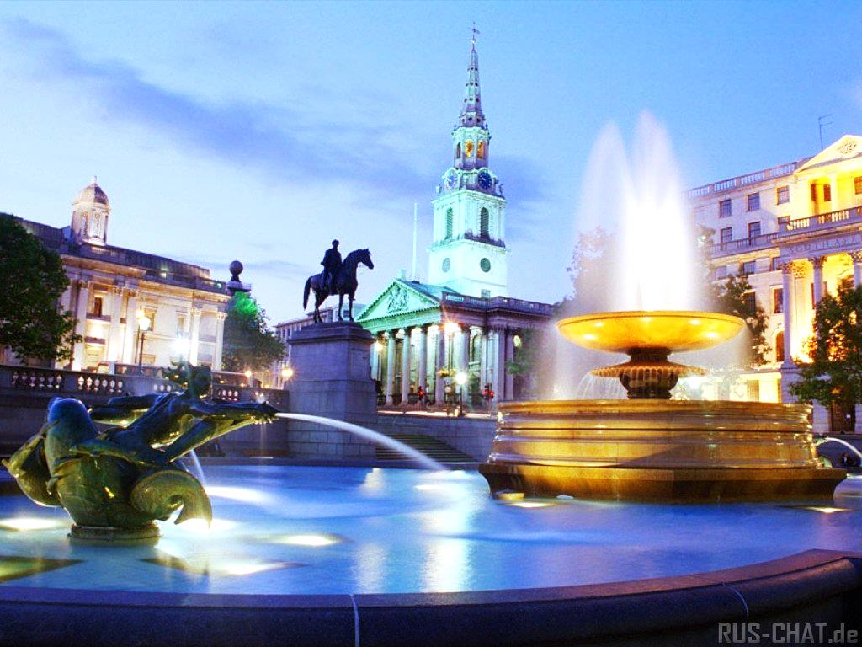
Welcome to London…

Slide 6
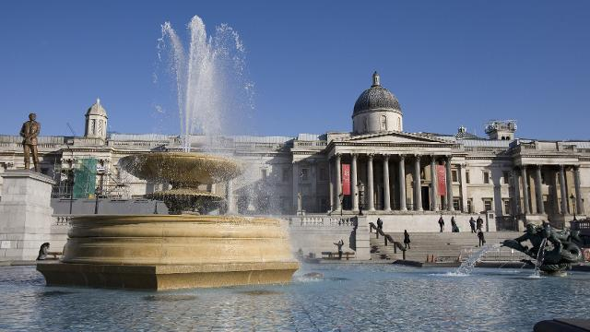
Trafalgar Square

Slide 7
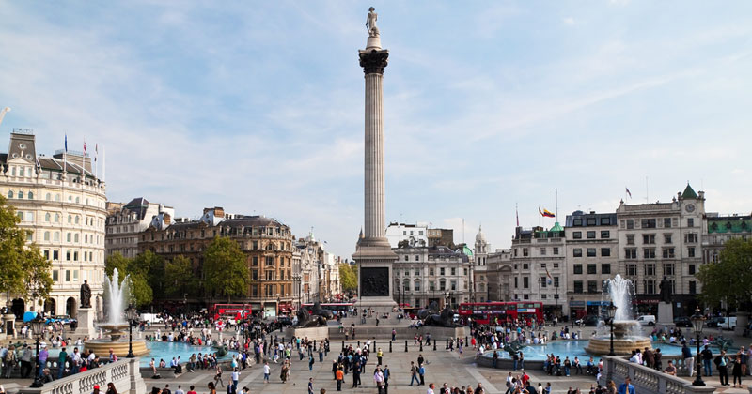
There are always a lot of people and pigeons on the square.
Every winter there is a big Christmas tree which is a gift from Norway in the middle of the square.
On New Year’s Eve people gather around the tree.
In the middle of the square there is Admiral Nelson’s Column.

Slide 8
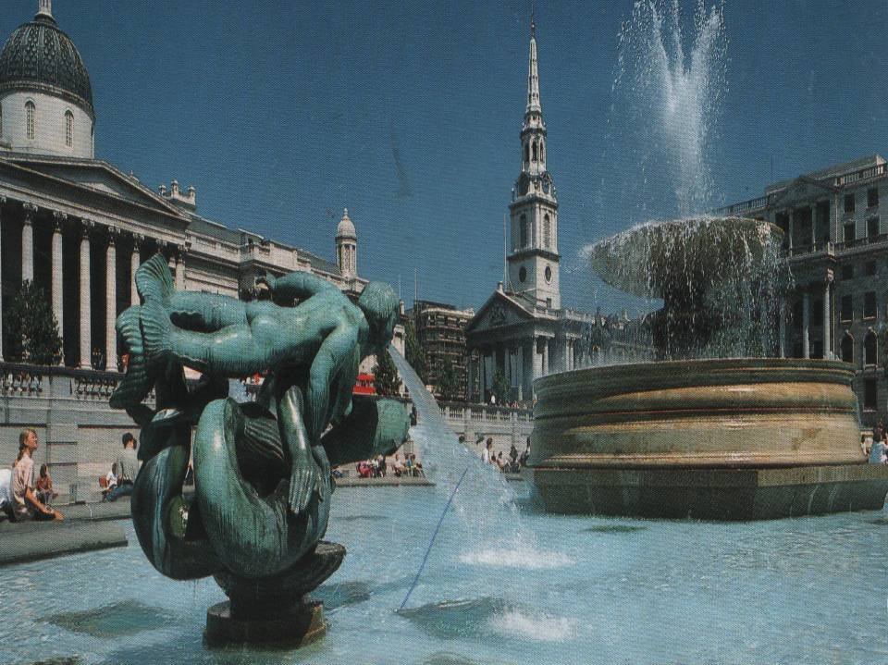
Trafalgar Square is the popular place for political rallies and meetings. The Admiral Lord Nelson’s statue surveys the memorial to his great naval victory in 1805. The Admiral’s statue looks towards the House of Parliament. To the other side of the column are fountains.

Slide 9
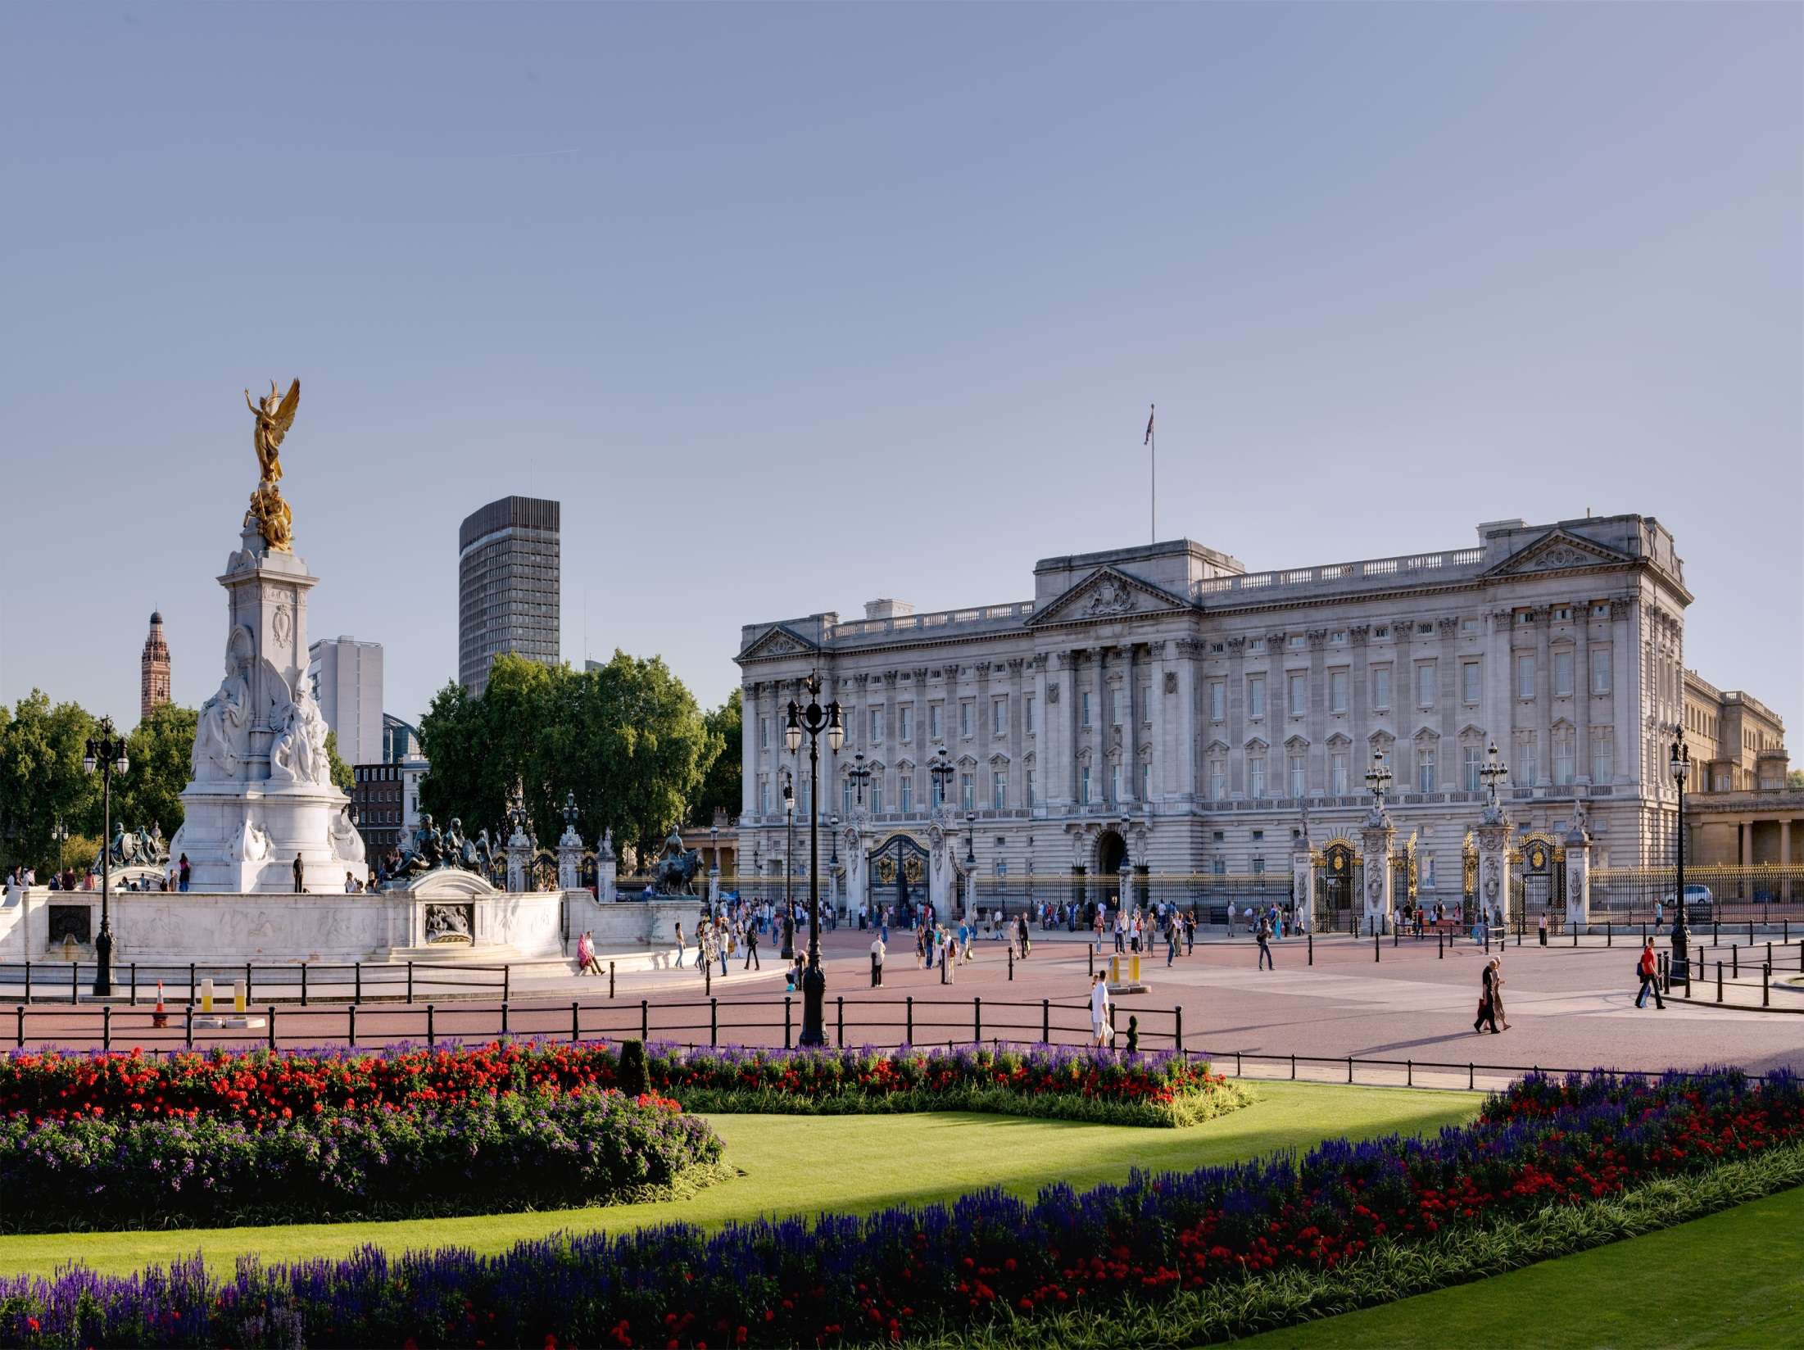
The Buckingham Palace

Slide 10
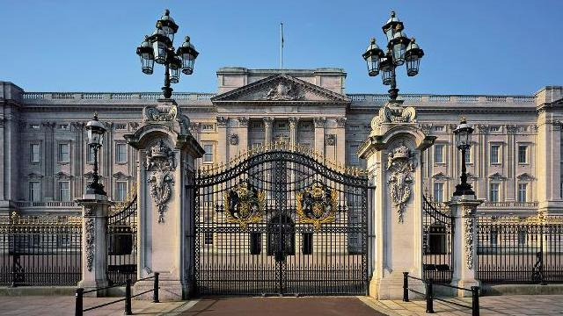
This is the Queen’s home.
It was built in 1703.
There is a great collection of paintings
Buckingham Palace is the best known royal palace in the world. It was build in 1703. When Her Majesty the Queen is in the residence, the Royal Standard flutters over the east front. The palace is open to public in August and September.

Slide 11
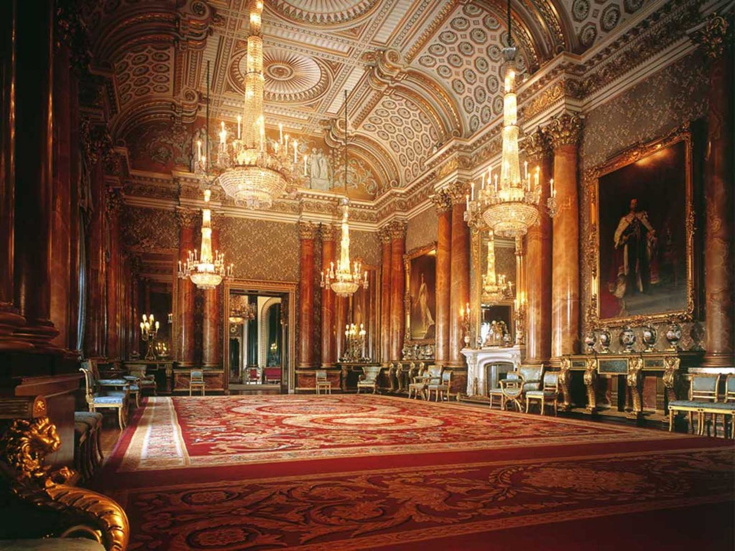

Slide 12
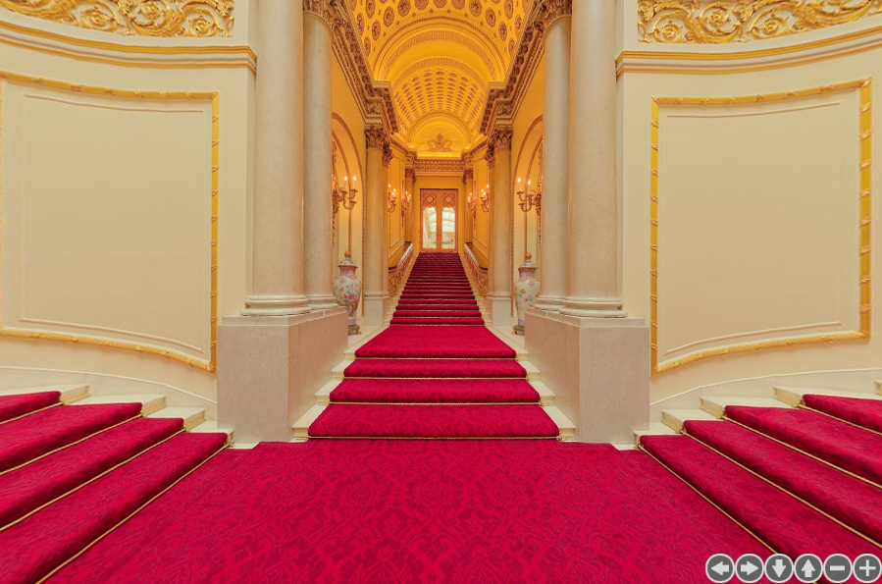

Slide 13
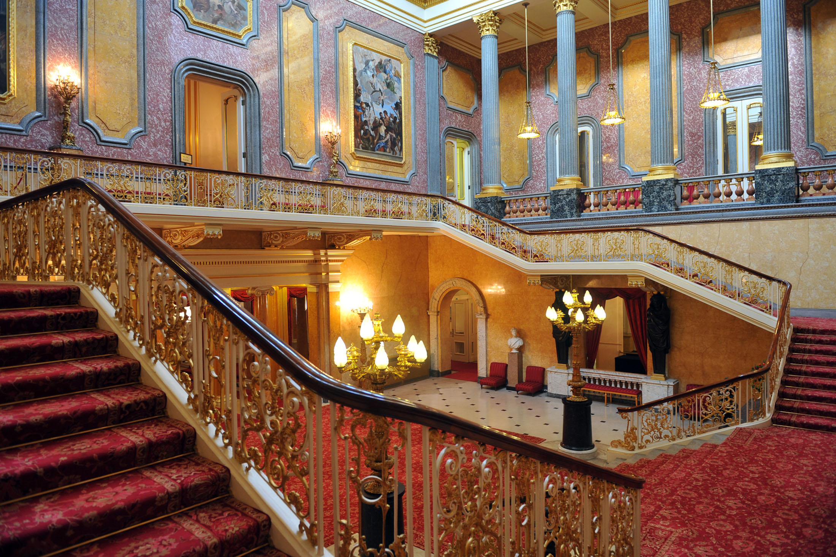

Slide 14
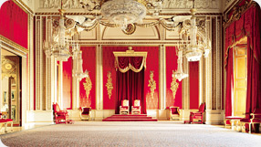
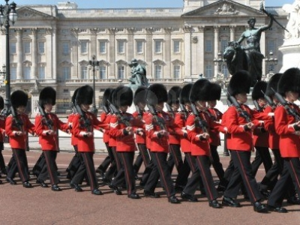
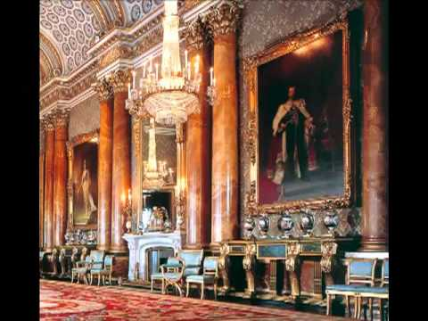
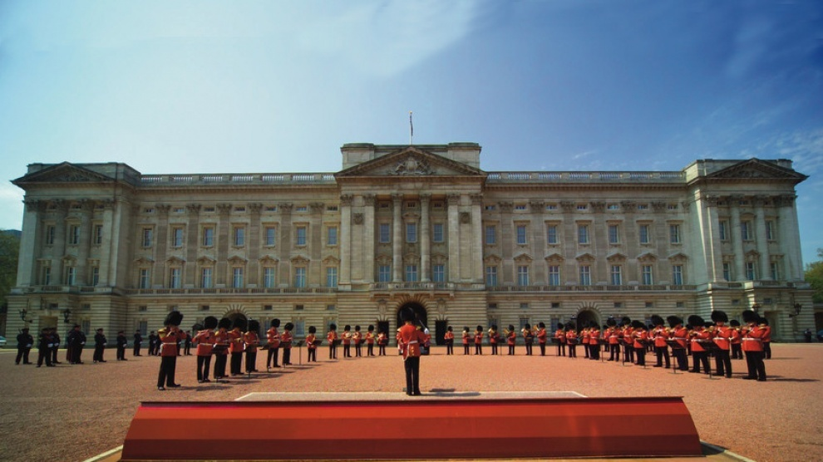

Slide 15
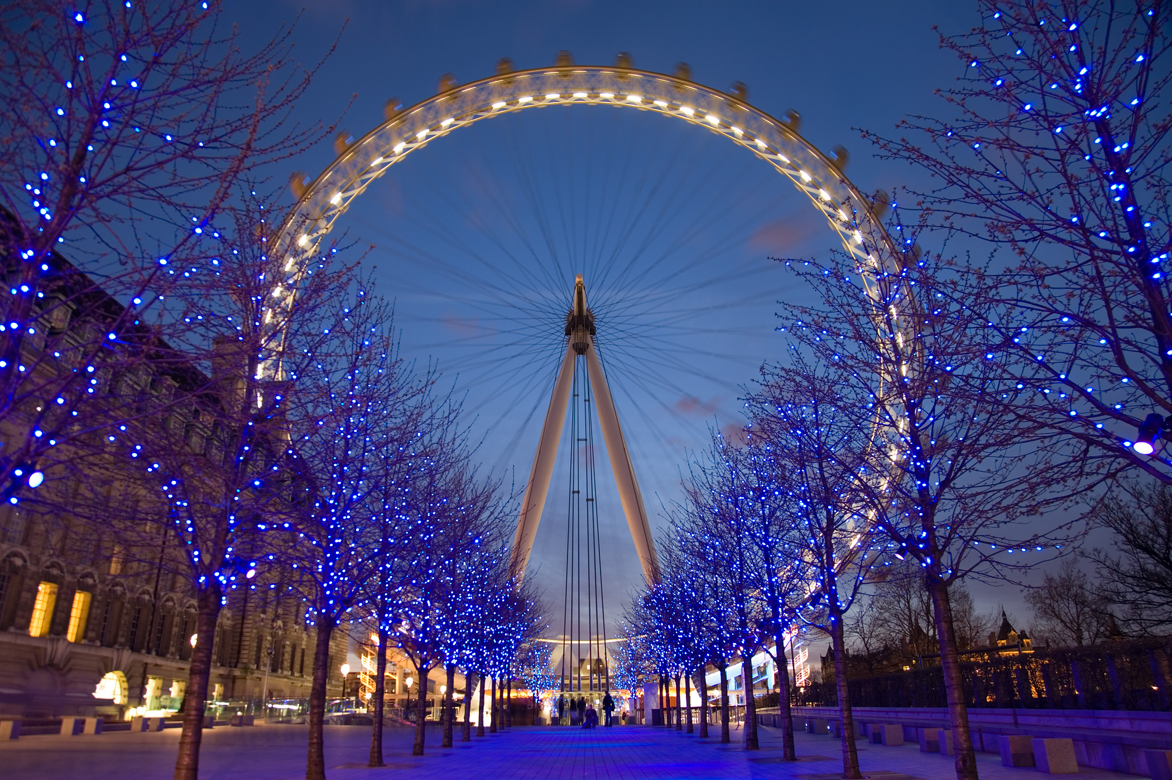
The London Eye

Slide 16
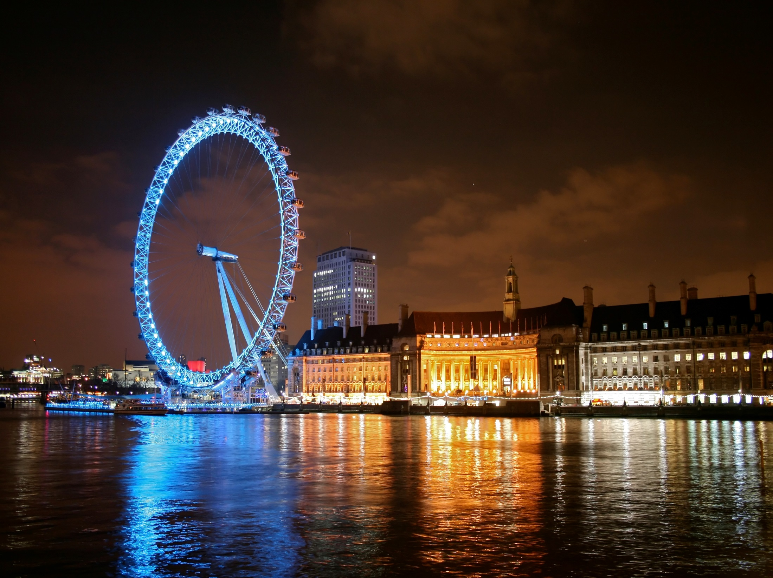

Slide 17
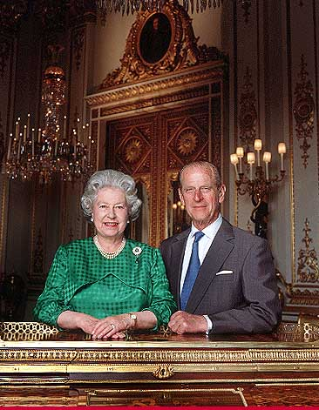
The Queen of Great Britain
The Queen of Great Britain is Elizabeth II. Her husband is Duke of Edinburgh.
They have got 4 grown-up children: Prince Charles, Princess Anne, Prince Andrew and Prince Edward.

Slide 18
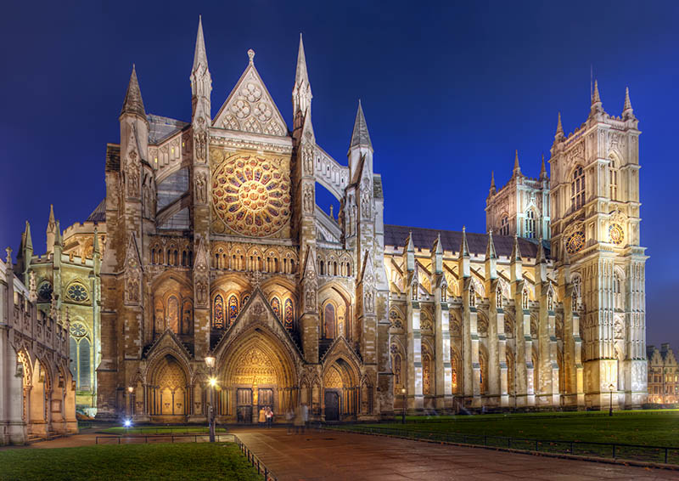
Westminster Abbey

Slide 19
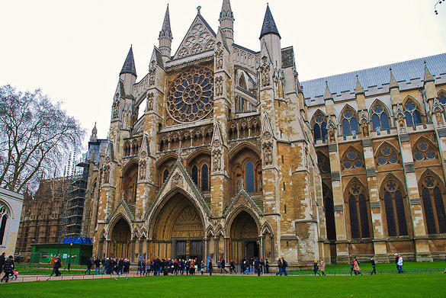
This is a holy place.
All English kings have been crowned and buried in the church since 1308.

Slide 20
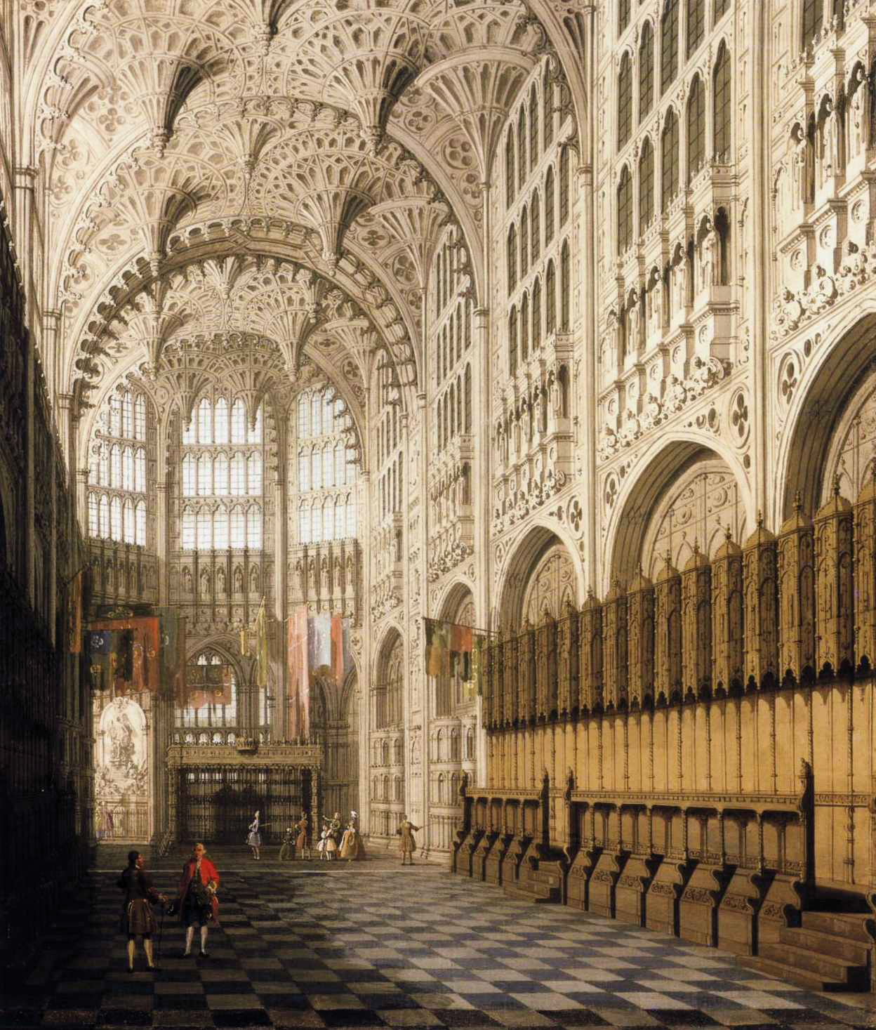

Slide 21
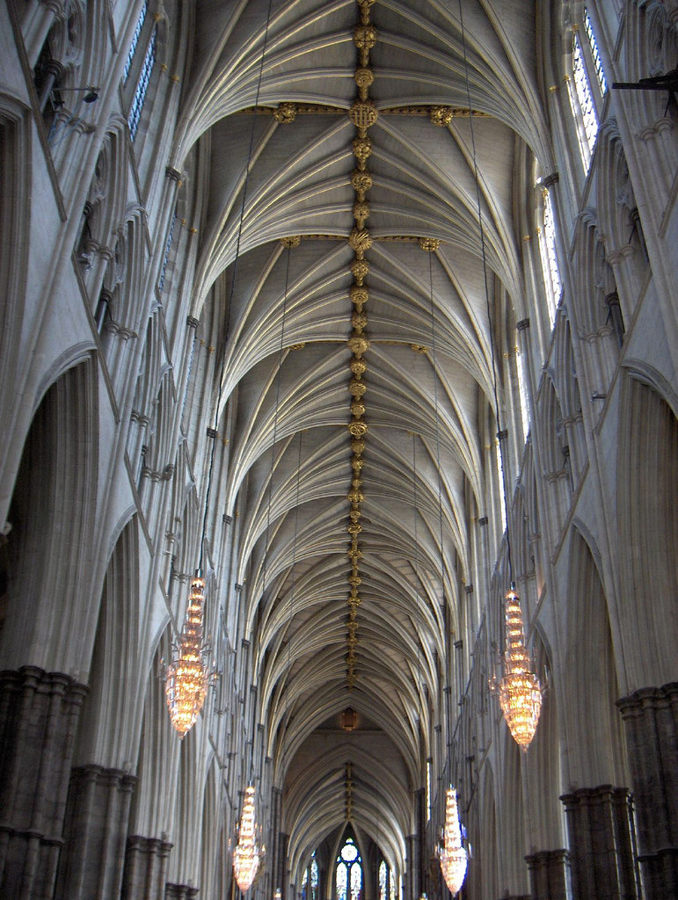

Slide 22
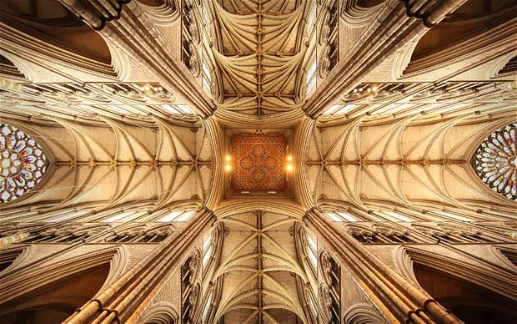

Slide 23
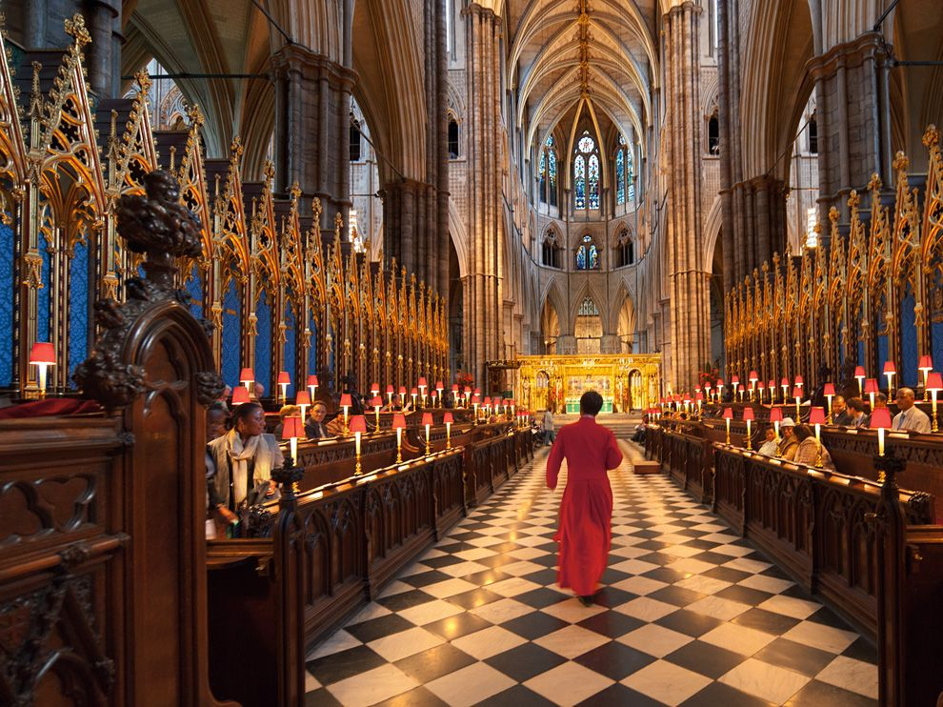

Slide 24
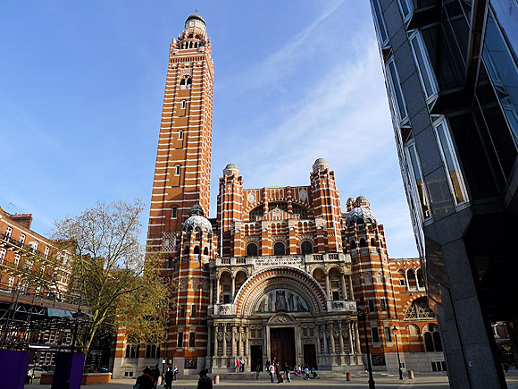
Westminster Cathedral

Slide 25
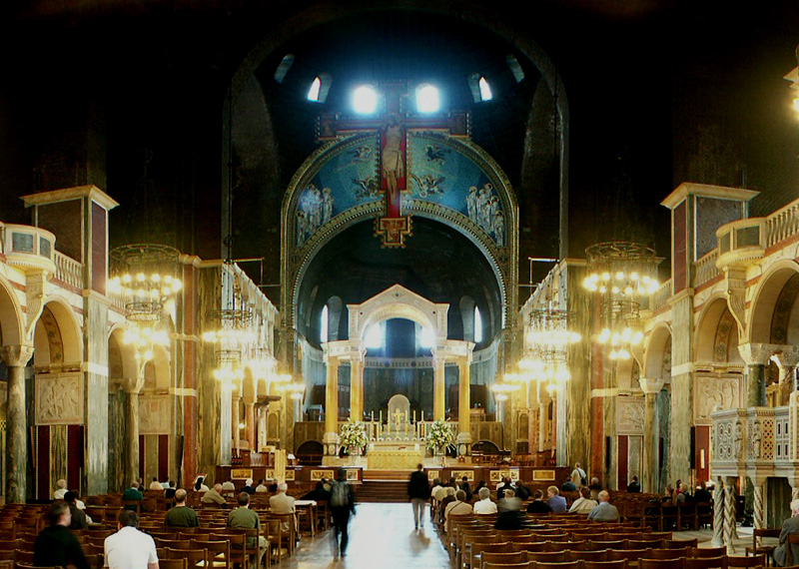
It was built between 1895 and 1903.
This is the seat of the Cardinal Archbishop and the leading Roman Catholic Church in England.
Its bell tower is 84 metres high.

Slide 26
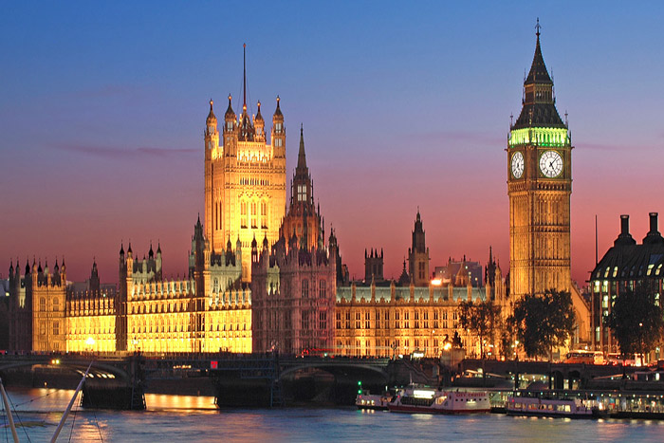
The Houses of Parliament

Slide 27
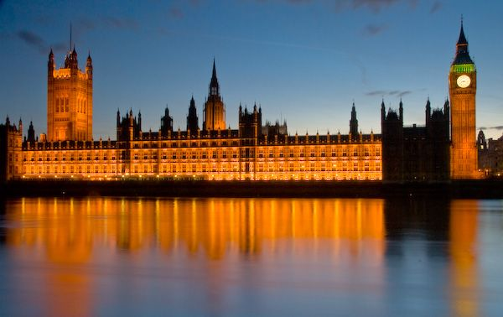
Houses of Parliament stands on the River Thames at Westminster. It begun in 1840 after a Great Fire of London. It is officially known as the Palace of Westminster. The complex includes the House of Commons, the House of Lords, Westminster Hall, and the 320 foot high Clock Tower. It contains the world famous sight Big Ben.

Slide 28
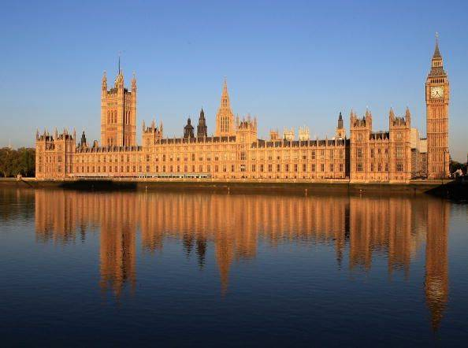
This big palace is the most famous building in the world – the British Parliament.
The building is 280 metres long.
There are more than 1000 rooms.

Slide 29
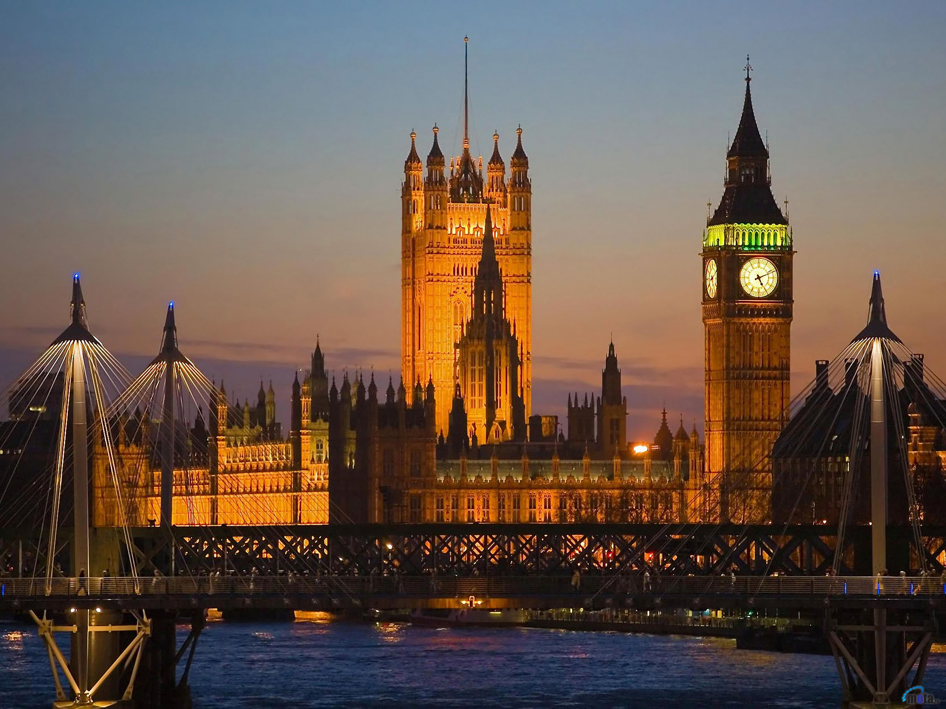
Big Ben

Slide 30
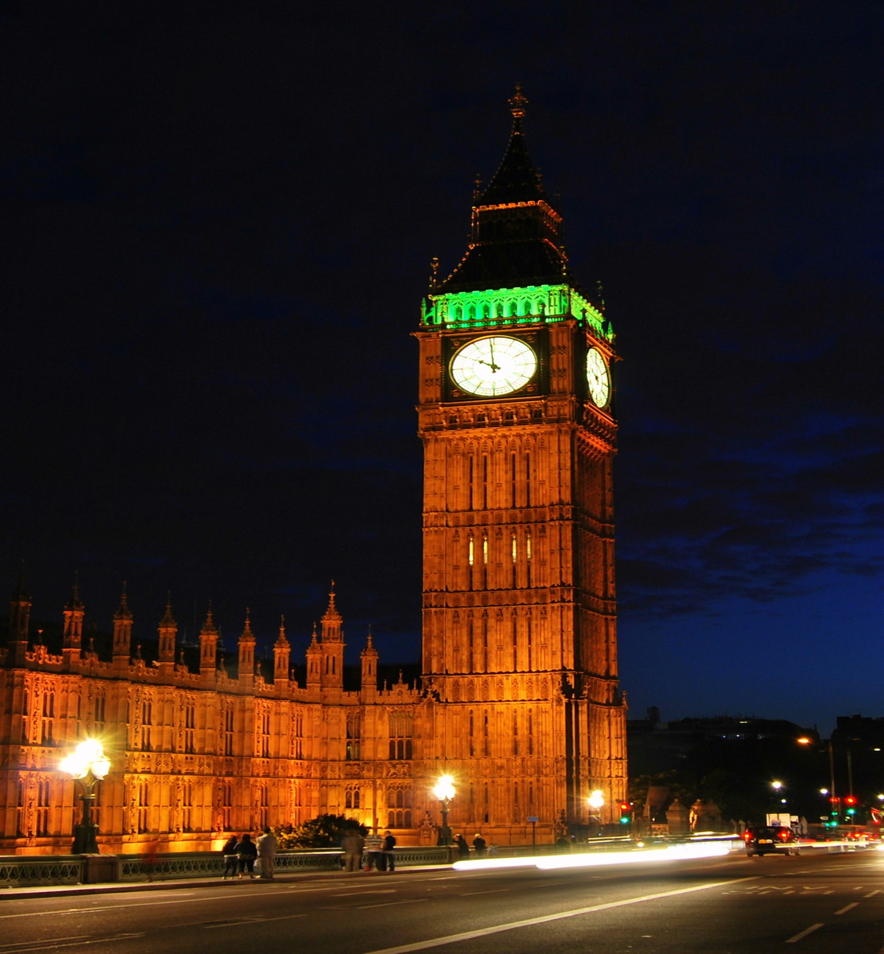

Slide 31
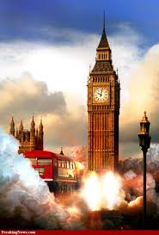
Big Ben, the big clock tower, is the symbol of London. It strikes hours

Slide 32
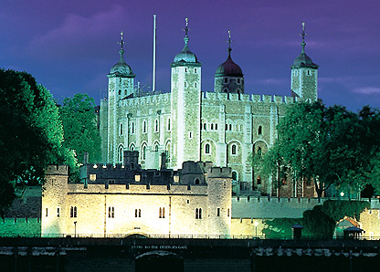
The Tower of London
The Tower has been part of the capital’s history for the past 900 years. The fortress first built by William the Conqueror as a citadel, royal palace, seat of the government. The Tower now protects the Crown Jewels.

Slide 33
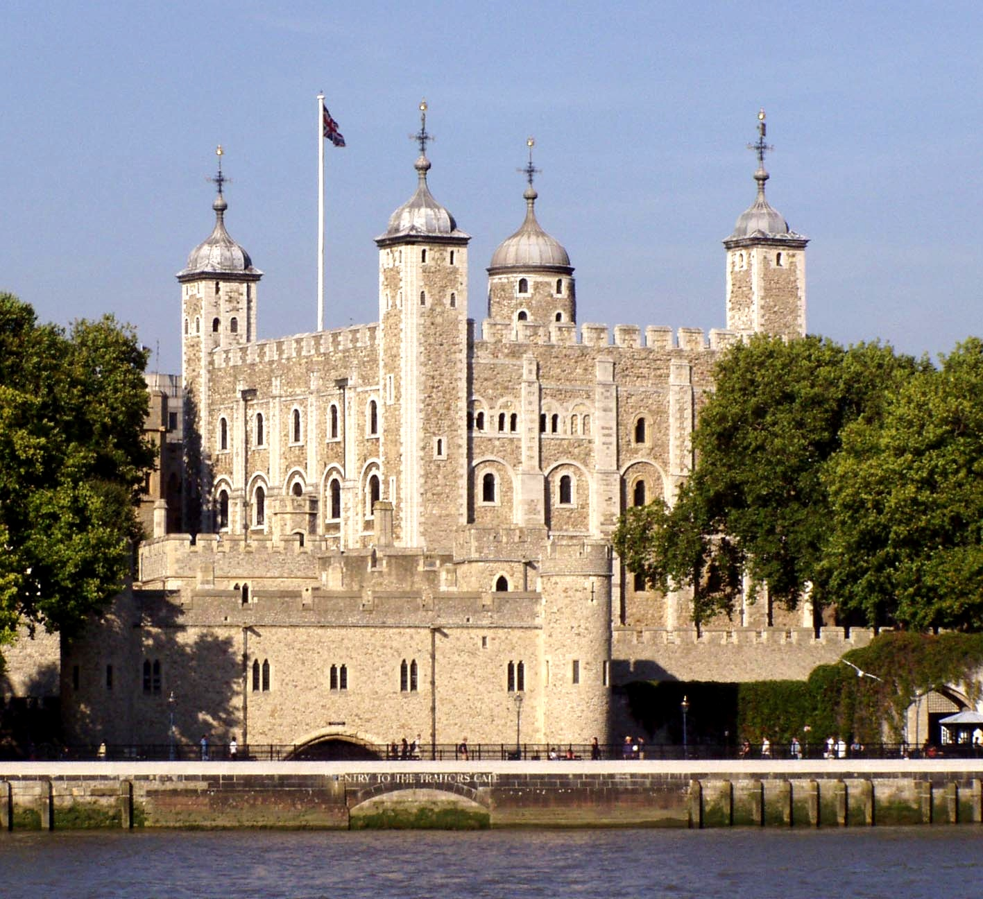
The Tower of London has been a fortress, a palace, an arsenal, a mint, a prison, an observatory, a zoo, the home of the Crown Jewels and a tourist attraction.

Slide 34
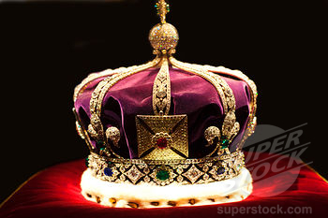
Imperial State Crown

Slide 35
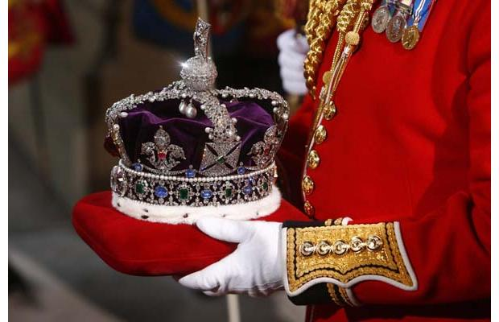
The Tower’s greatest treasure is the Imperial State Crown.
There are 2 800 diamonds on it.

Slide 36
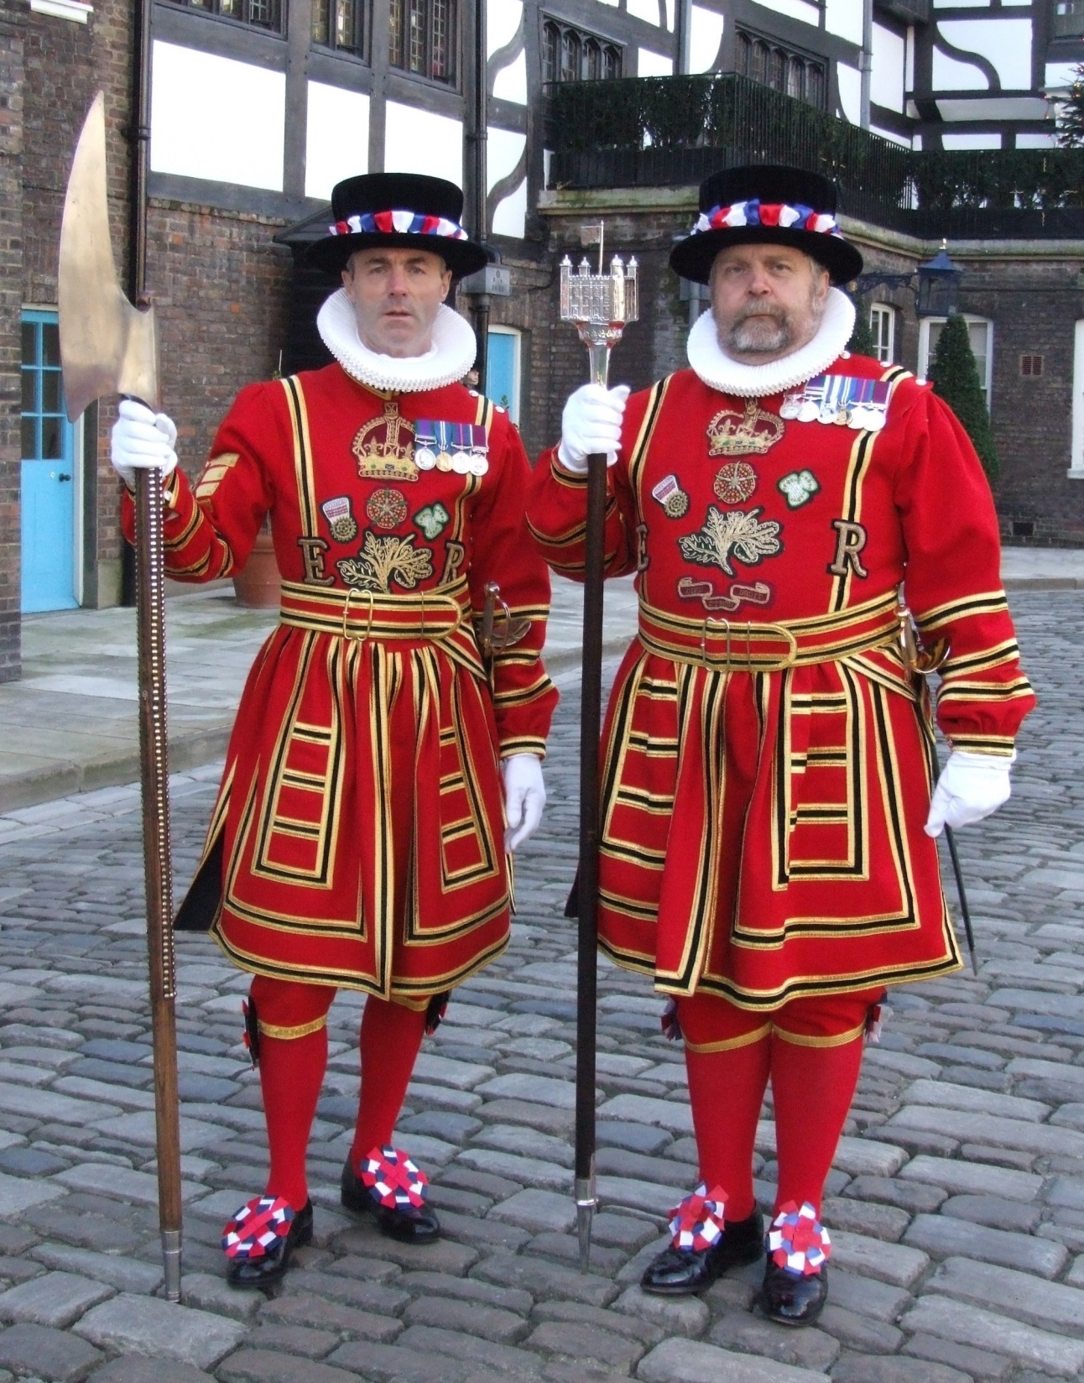
Beefaters

Slide 37
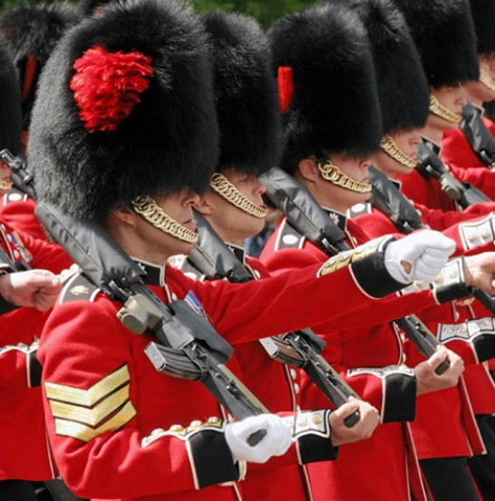
The quards of the Tower are called Beefeaters.
The legend says that if the ravens leave, the Tower and the country will fall.

Slide 38
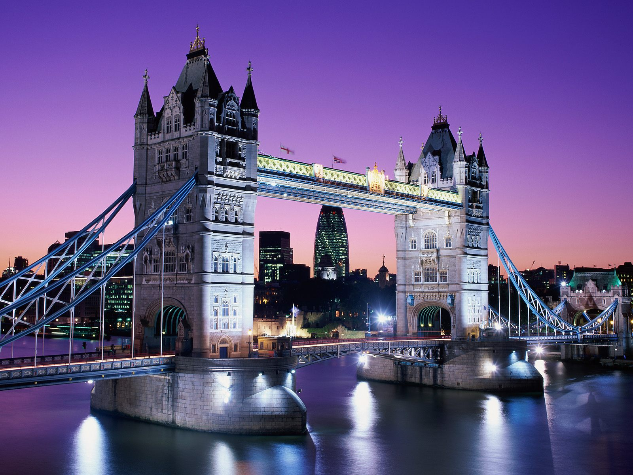
Tower Bridge

Slide 39
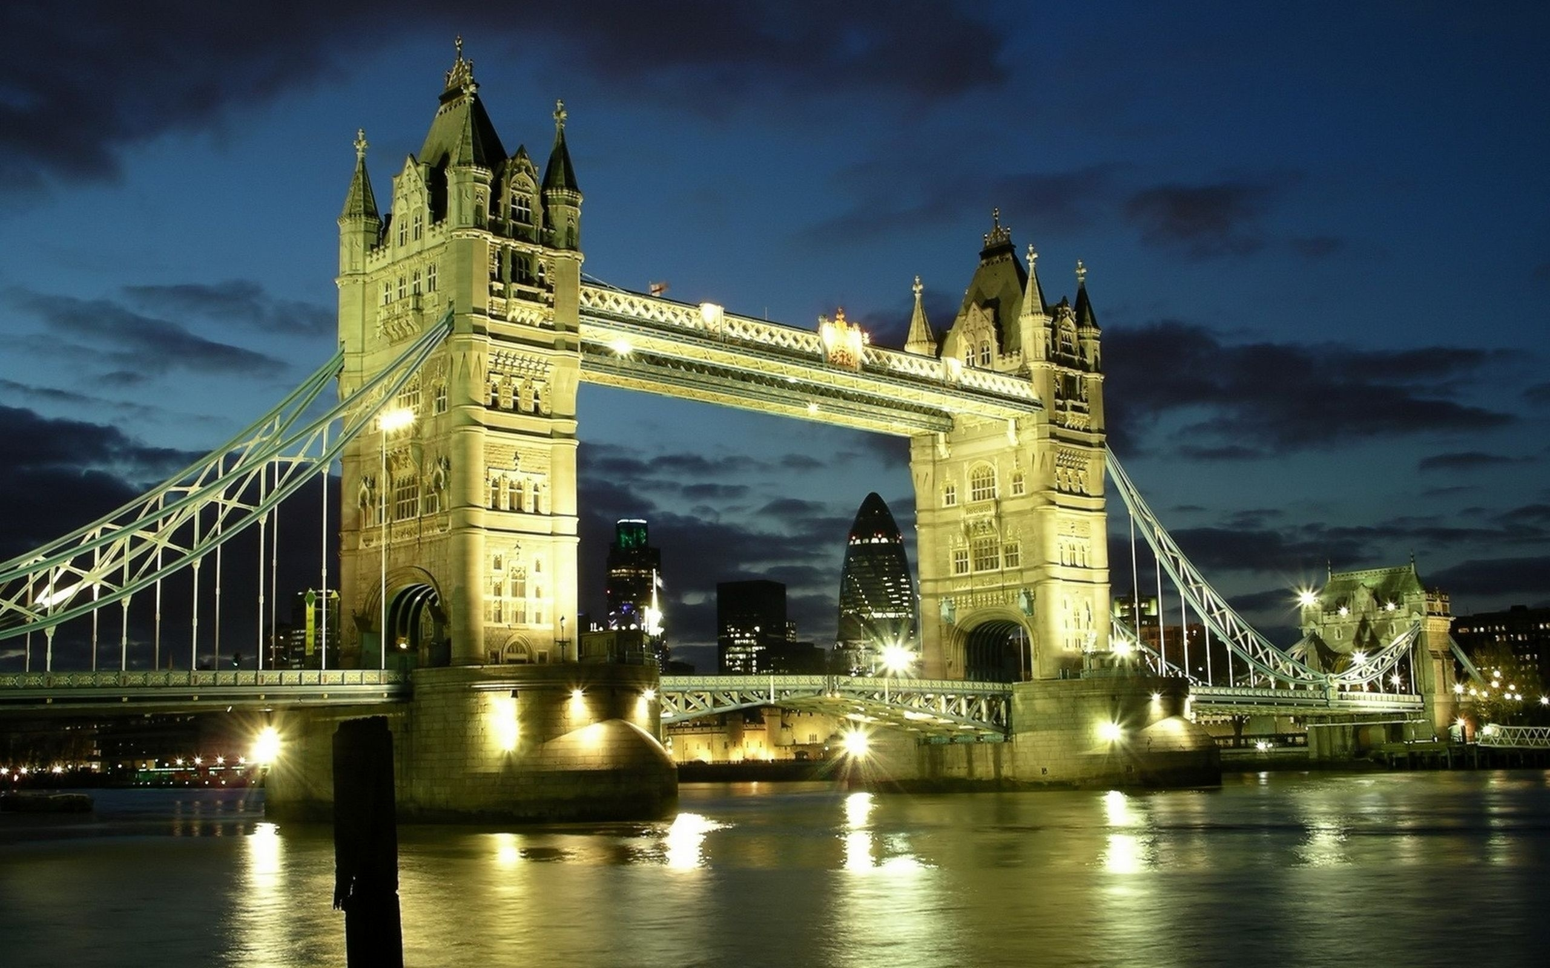
The most famous
bridge in London
is a Tower bridge.

Slide 40
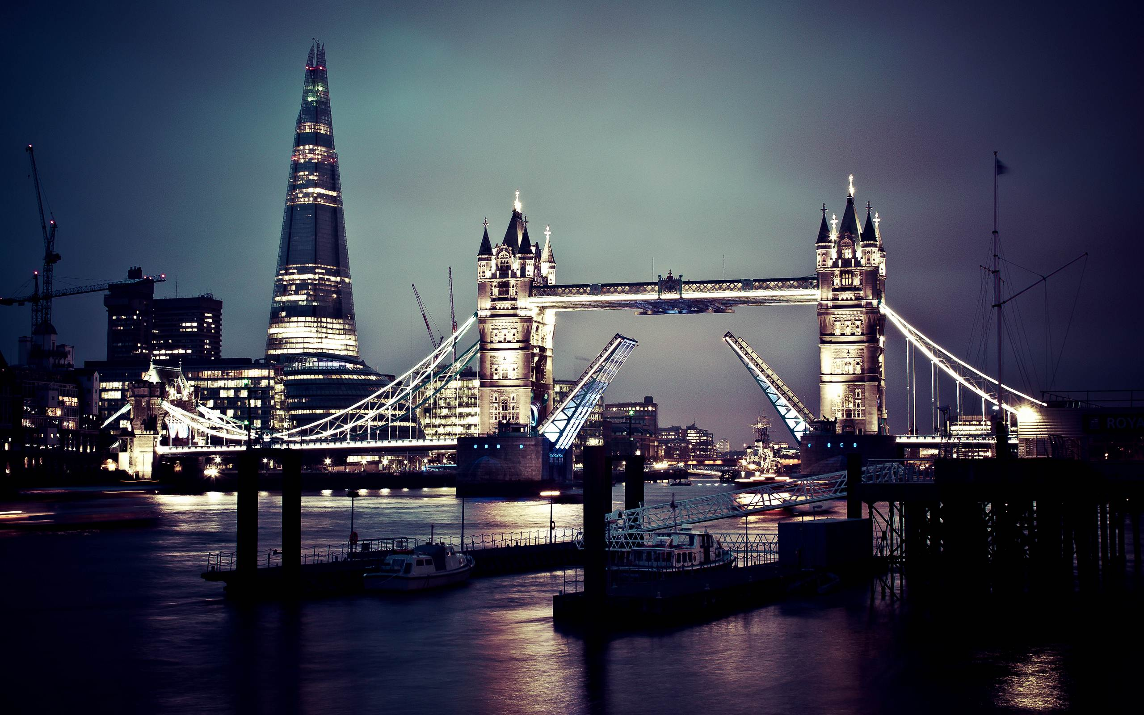
Tower Bridge is a bascule-bridge.
The bascules will open to let ships pass through.

Slide 41
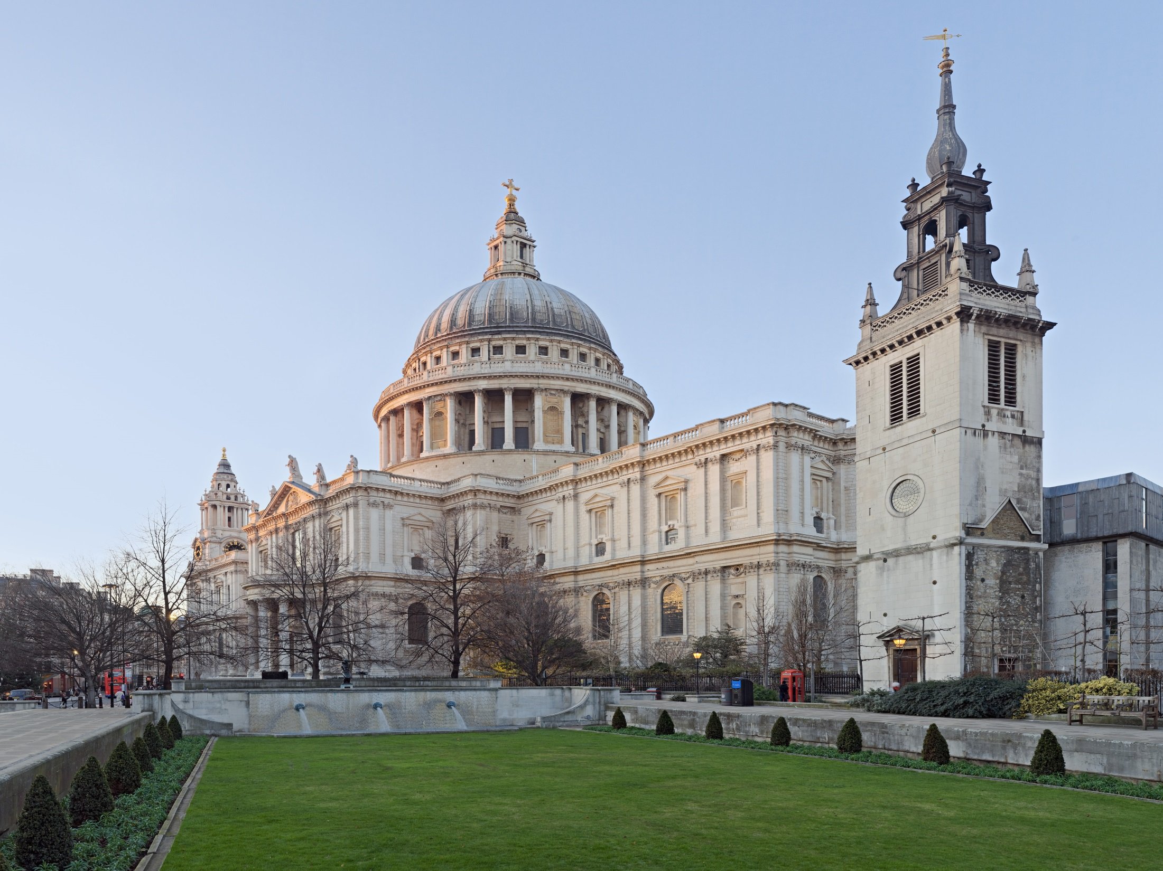
St. Paul’s Cathedral

Slide 42
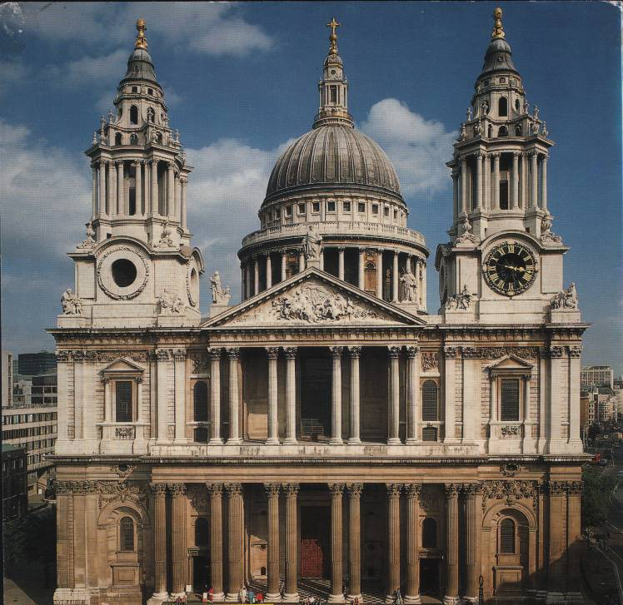
St Paul’s Cathedral is the spiritual centre of the City. It was first built in 1666. The present building is the fifth cathedral to built built on the site. The architect of the baroque-style building was Sir Christopher Wren. St Paul’s Cathedral `is a fitting final place for many of the nation’s heroes.

Slide 43
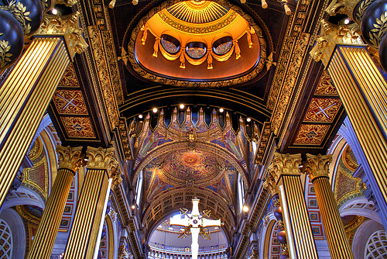
St.Paul’s Cathedral is a famous building too.
Prince Charles and Princess Diana married here in 1981.

Slide 44
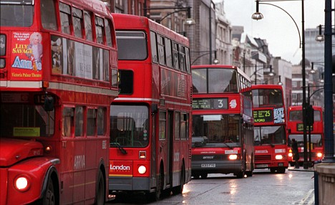
Double-deckers

Slide 45
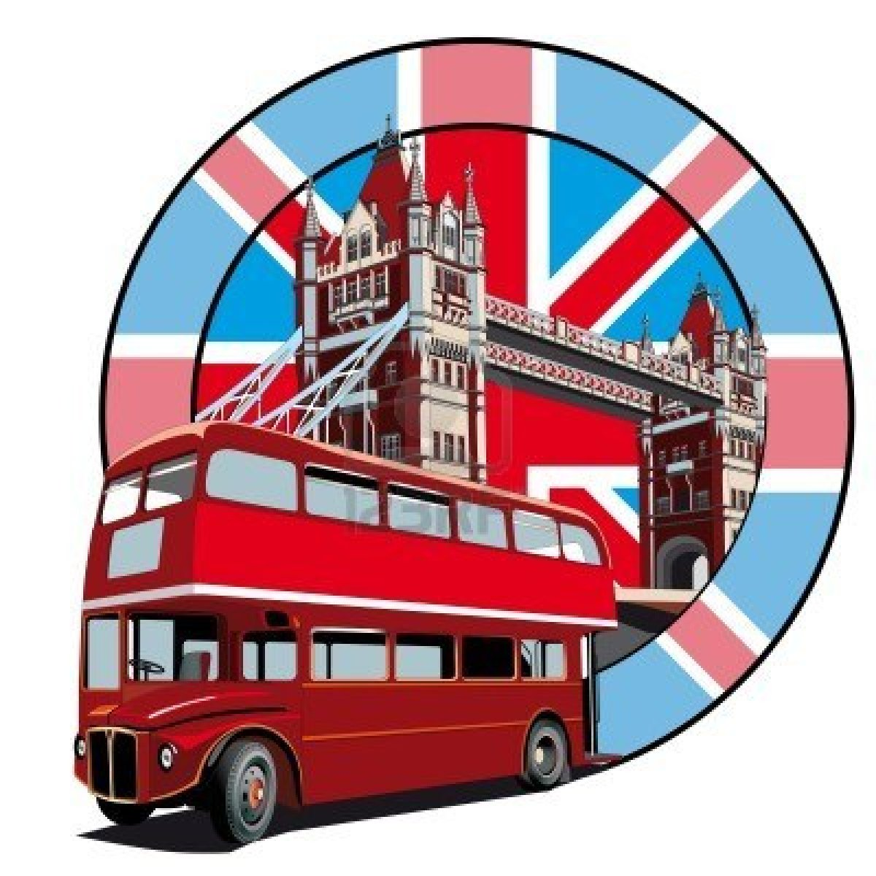
There are big red buses called double-deckers in London.
People sit upstairs and downstairs on these buses.
Tourists like them very much.

Slide 46
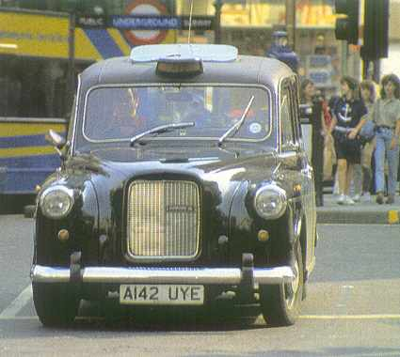
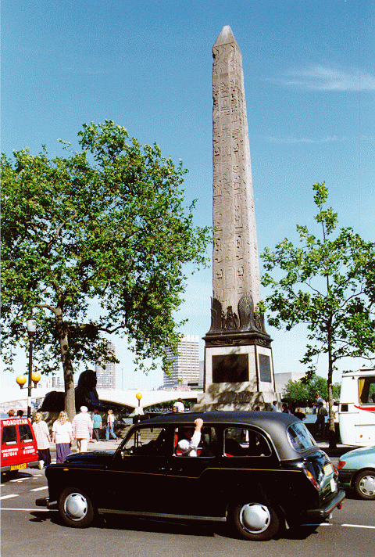
Taxis
Taxis in London are old-fashioned black cars.

Slide 47
Telephone booths

Slide 48
From here you can call your friends.

Slide 49
River Thames

Slide 50
Thames flows through London.
The River Thames is 338 km long.
It is 245 m wide here.
Even big seaships can visit London.

Slide 52
Piccadilly
Piccadilly is the centre of entertainment. It is the meeting point of six streets. Here you can find the most expensive shops, restaurants and entertainment places. This centre was created in 1980s.

Slide 53
Shops and shopping in Britain

Slide 54
Number one leisure activity
The British, in the words of Napoleon, is 'a nation of shopkeepers‘. They are also a country of compulsive shoppers. They love to shop! It is their number one leisure activity and accounts for around 37% of all money spent in England.

Slide 55
Number one leisure activity

Slide 56
The main shopping street in many towns is called the High Street, where you should head for if you want to go shopping.
A few small shops are owned by local people. Most are owned by national 'chains' of stores. This makes many town centres look the same.
Some towns also have street markets where fresh food and cheap goods can be bought
. Away from the town centre, small 'corner' shops provide groceries to local customers.

Slide 57
High Street – the main shopping street in every city and town

Slide 58
Time to go shopping
Peak shopping days are Saturdays and Sundays.
Shops are generally open on Bank Holidays.
Bank Holidays are a great time to shop as there are many sales on especially around Easter and Christmas.

Slide 59
Shopping Hours
In England, most retail shops are generally open 6 or 7 days a week.

Slide 60
Typical opening times are:
Mondays - Saturdays 9 am to 5:30 pm
Some shopping centres stay open until 8 pm or later.
Sunday – 10 am to 4 pm (or 11 am to 5 pm)
Sunday shopping has become popular in recent years and most large shops in towns are open for business. Shops are only allowed to trade for 6 hours on Sundays.
Large supermarkets are open for 24 hours except for Sundays.
Many supermarkets and superstores otherwise open from 8am until 10pm from Mondays to Saturdays and 10 am to 4 pm (or 11 am to 5pm) on Sundays.

Slide 61
Public Holidays / Bank Holidays
On public holidays some shops open and some shops do not. As a general rule banks will be closed, most supermarkets and large stores will be open (although with reduced Sunday opening hours), and in larger towns many shops will open.
Bank Holiday Shop opening times 10am to 4pm (or 11am to 5pm)
Over the Christmas and New Year period, all shops are closed on Christmas Day (December 25) and a some shops are closed on New Year's Day (January 1). However, an increasing number of shops are now opening on Boxing Day (December 26), which is when many start their 'New Year' sales.
It is likely that most shopping centres will be closed on Easter Sunday and there will be reduced shopping hours on Easter Monday (often from either 10 or 11 o'clock in the morning).

Slide 62
In Villages
Some rural shops still follow the tradition of an early closing day (usually Wednesday) when the shops close at 1.00pm.

Slide 63
Banking Hours
The major high street banks in England and Wales are Lloyds, Barclays, Midland and National Westminster (Nat West). In Scotland they are the Bank of Scotland, the Royal Bank of Scotland and the Clydesdale Bank.
Generally Monday-Friday 9:30 am-3:30 pm. Some branches stay open until 5:30 pm, and a few are open Saturday morning.
Most banks will have an ATM (Automated Teller Machine) outside the bank where you can draw out money with a credit or cash card. Many of these are available to use 24 hours a day, but some do still close for a few hours during the night.

Slide 64
The Largest Shopping Centre

Slide 65
Bluewater is the largest out of town shopping development in Europe, located in a disused chalk pit at Dartford in Kent. With more than 300 shops and parking for 13,000 cars, it attracts around 30 million visitors each year.
Open: Monday to Friday: 10am – 9pm
Saturday: 9am – 8pm
Sunday: 11am – 5pm

Slide 66
Types of Shops in England

Slide 67
Shopping in London
London has over 40,000 shops and 26 major street markets to choose from.
Oxford Street (Nearest Tube: Oxford Circus)
Oxford Street, London's busiest shopping street, is in the heart of the city's West End. It is the place for buying souvenirs, clothes, and so on.

Slide 68
When you will be in London, at night you will go in night clubs
Bubble

Slide 69
Baroque
Shadow Lounge

Slide 70
Holidays in Britain

Slide 71
New Year’s Day
the beginning of the new year. People make resolutions.

Slide 72
Saint Valentine’s Day
February 14
Was started in the time of Roman Empire.
Is dedicated to St. Valentine.
People send a card to someone they love, like, fancy or admire.

Slide 73
The Boat Race
In March
A rowing race between the universities of Oxford and Cambridge.
On the river Thames in London (7,2 km).

Slide 74
Pancake Day
In March
The last day before Lent.
Pancake race-running while holding a pancake in a frying pan. Competitors have to throw it in the air and catch it again in the pan.

Slide 75
Good Friday
The Friday before Easter.
The church marks the death of Christ.
British usually eat hot-cross buns, which are marked on top with cross.

Slide 76
Easter
In April.
The celebration of the Resurrection of Christ
Schools are closed for two weeks.
People give each other chocolate eggs that are wrapped in silver paper.

Slide 77
The London Marathon
One of the biggest marathons in the world.
Each year about 30,000 people start the race and about 25,000 finish.
Raise money for charity.

Slide 78
May Day
May 1
A pagan festival to celebrate the end of winter and welcome summer.
Children dance around the maypole and sing songs.

Slide 79
Chelsea Flower Show
In May
Britain’s most important flower and garden show.
Thousands of people come to see the prize flowers and specially built gardens.

Slide 80
Midsummer Day
June 24
Summer solstice.
People stay up until midnight to welcome in midsummer day.
When the fires die down, men run or jump through it to bring good luck.

Slide 81
Trooping The Colour
The second Saturday in June.
Celebrates the Queen’s official birthday.
Lots of marching, military music and the soldiers are dressed in colourful uniforms.

Slide 82
Saint Swithin’s Day
July 15
Saint Swithin was England’s Bishop of Winchester.
40 days of bad weather will follow if it rains on this day.

Slide 83
Wimbledon
The last week of July and the first week of June.
At Wimbledon in South-West London.
One of the four great world tennis championships and the only one which is played on grass.

Slide 84
Notting Hill Carnival
The last weekend in August.
Takes place in Notting Hill.
People dress up in fabulous costumes.
Steel bands play African and Caribbean music.

Slide 85
Harvest Festivals
In September.
A Christian festival.
It was held to say thank you to God for a good harvest.
Churches are decorated with fruit, vegetables and flowers.

Slide 86
Halloween
October 31
A pagan festival celebrates the return of the souls that visit their former houses.
People dress up as witches, ghosts etc.
Houses are decorated with pumpkins.

Slide 87
Guy Fawke’s Night
November 5
He was a terrorist.
The day marks the discovery of a plot to blow up Parliament in 1605.
People make models of him and burn them on big bonfires.

Slide 88
Christmas Day
December 25
Religious ceremony commemorating the birth of Christ.
Children wake up early to find presents in their stockings.
Traditional Christmas tree and dinner.

Slide 89
New Year’s Eve
December 31
Traditionally Scottish celebration.
At midnight everybody joins hands and sings Auld Lang Syne.

Slide 90
So what is so great
about Britain, that
people want to
live here?

Slide 91
Good for Work
low unemployment rate (under 5%)
a typical work week of 35 hours
generous leave, maternity
and paternity benefits
12 public holidays
good salaries
reasonable taxes.

Slide 92
Social and Cultural
it is a multi-cultural society
most people are tolerant
the crime rate is low
lively theatre, music, art
it has beautiful scenery
fascinating historical sites & buildings.

Slide 93
Education
Britain is a world leader in education
world famous universities
education is free

