Slide 1
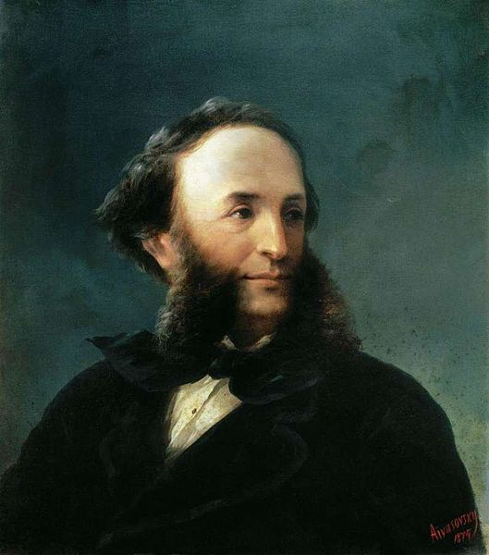
Ivan Aivazovsky

Slide 2
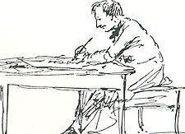
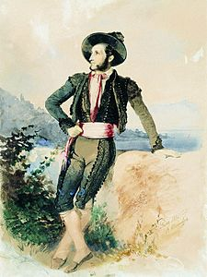
Biography
Born - Hovhannes Aivazian (baptized)
29 July 1817 Feodosia, Taurida, Russian Empire (present-day Crimea, Ukraine)
Died - 2 May 1900 (aged 82) Feodosia, Russian Empire

Slide 3
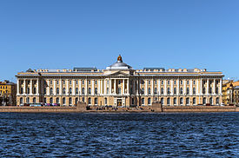
Imperial Academy of Arts

Slide 4
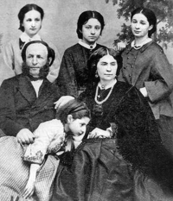
Aivazovsky with his first wife, Julia, and their four daughters

Slide 5
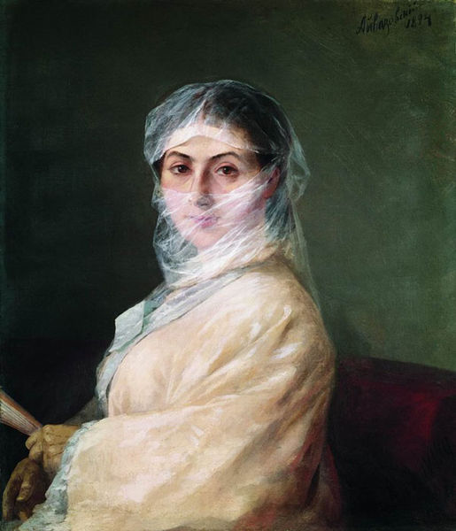
Aivazovsky's painting of his second wife Anna Burnazian (1882)

Slide 6
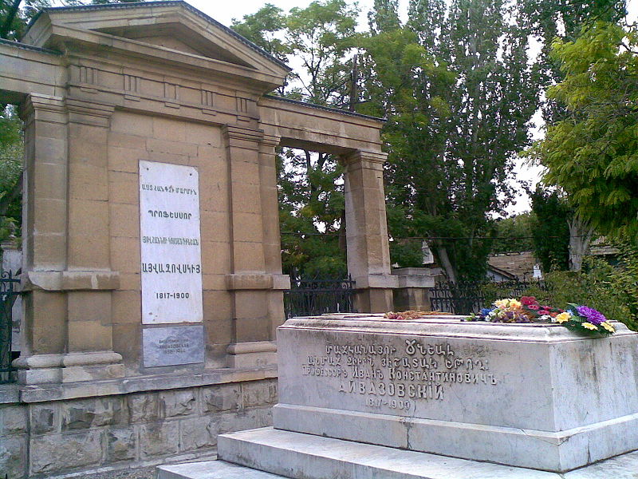
Aivazovsky's gravestone in Feodosia

Slide 7
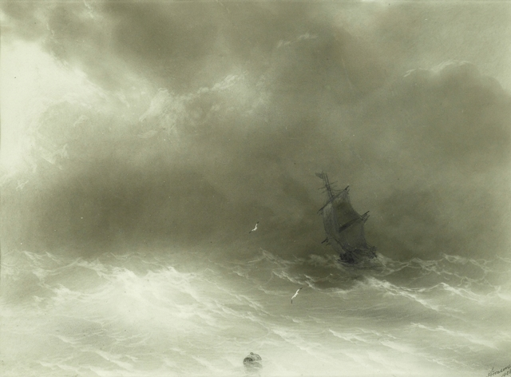
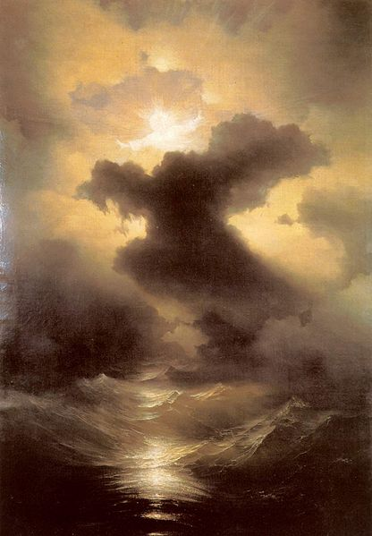
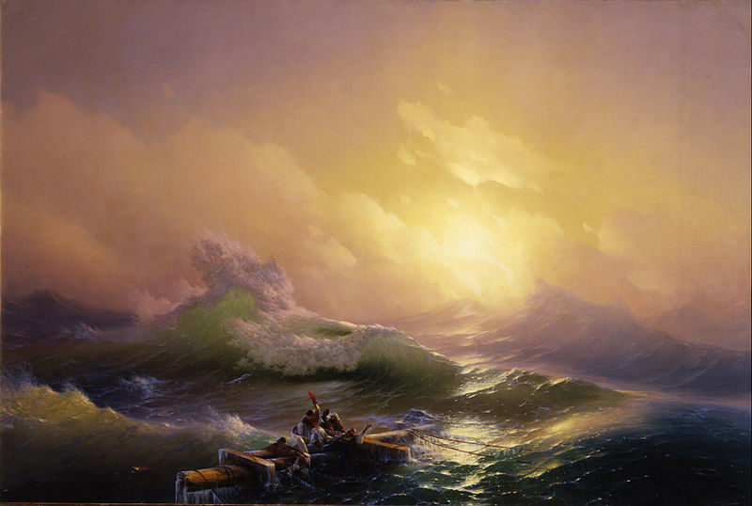
Aivazovsky the artist

Slide 8
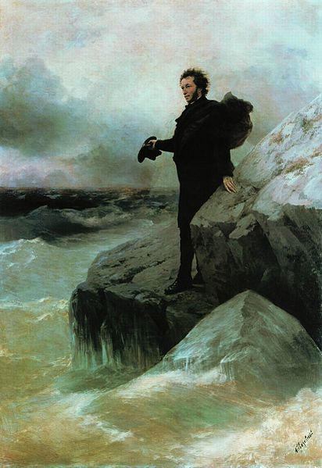
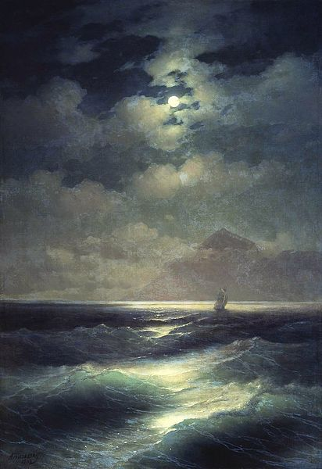
Pushkin farewell to the sea
Sea view by Moonlight

Slide 9
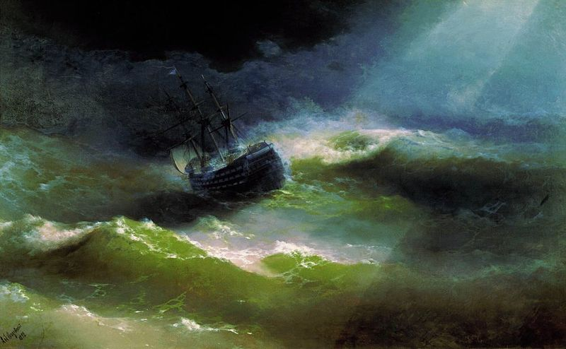
Ship «Empress Maria» in storm

Slide 10
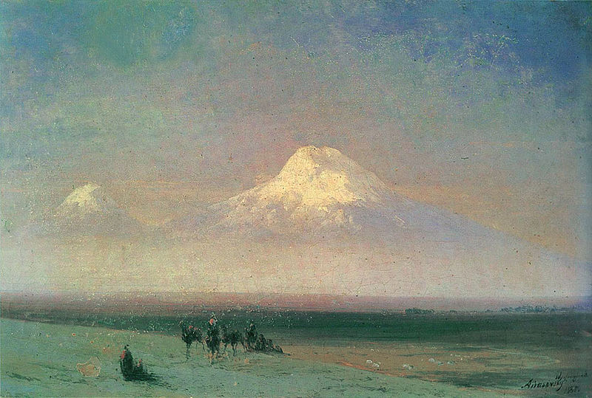
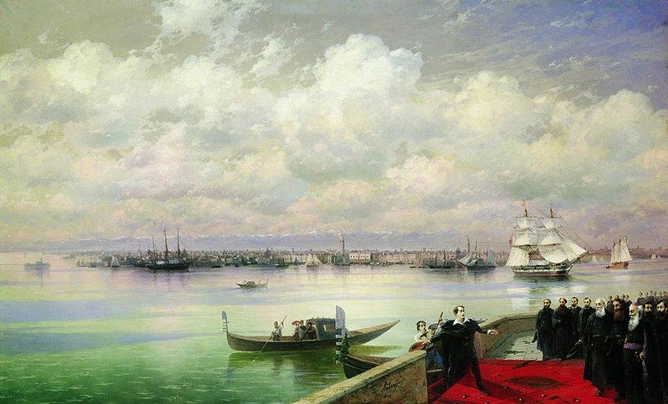
Armenian themes

Slide 11
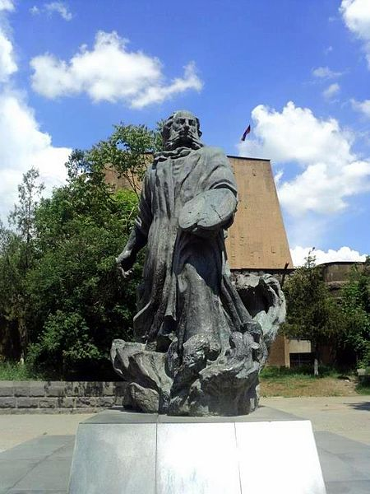
Posthumous honors
Monuments in Ukraine, Armenia and Russia stand in Aivazovsky's memory. A statue of the artist can be found in front of the Feodosia Art Gallery, his former home. A statues of Aivazovsky and his brother Gabriel is located in Simferopol, Crimea's administrative center.

