Slide 1
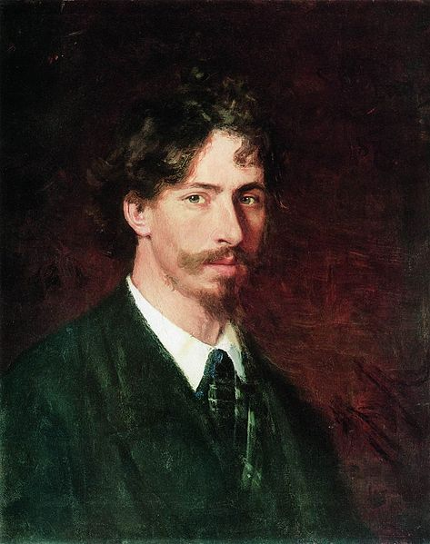
Ilya
E. Repin

Slide 2
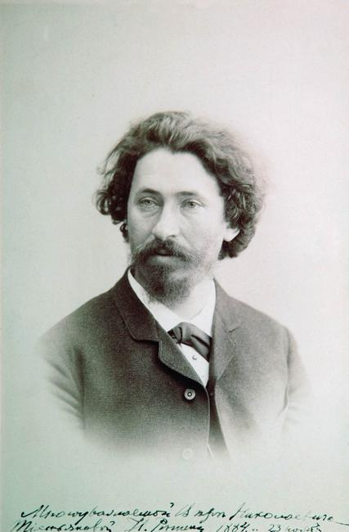
He was born on August,
5th 1844 in Kharkiv gover-
norate. He graduated icon-
painting school. Then he
became a student of I.
Kramskoi. He was awarded
2 gold medals. Repin treve-
lled a lot (Russia, Ukraine,
France, Italy, England etc.),
when he explored people,
their life, traditions. That’s
why I think he painted such
true-to-life pictures.

Slide 3
His works
-Artworks by Genre;
- Artworks by Style;
- Artworks by Technique;

Slide 4
Genre painting

Slide 5
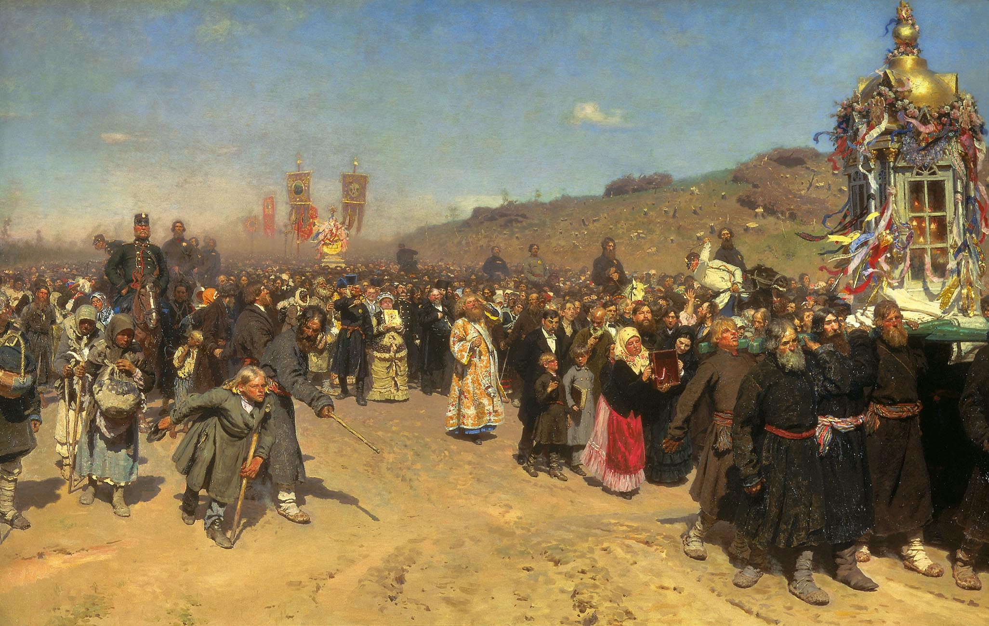
“Religious Procession in Kursk Province” 1880-83. There are a lot of different characteres

Slide 6
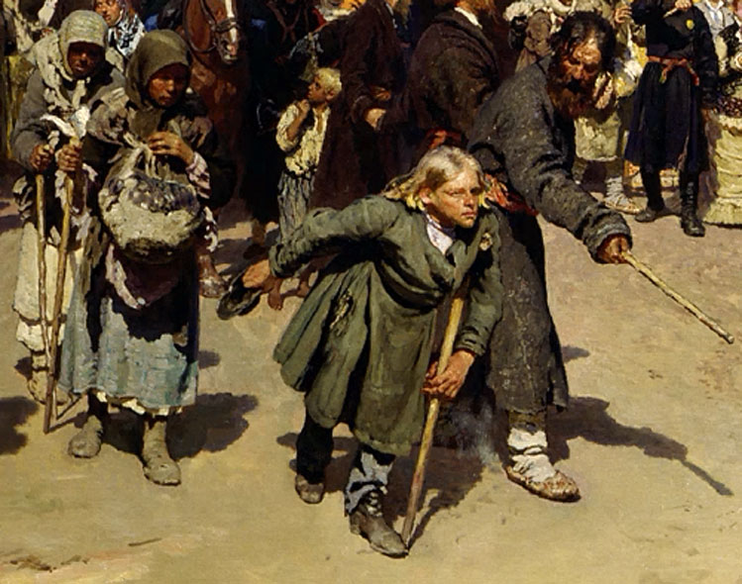
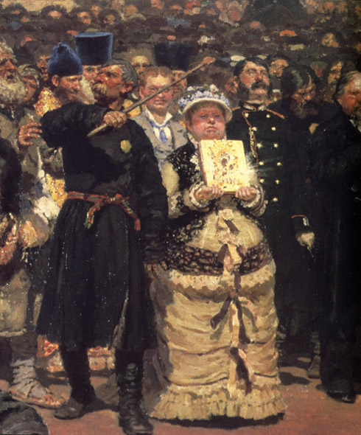
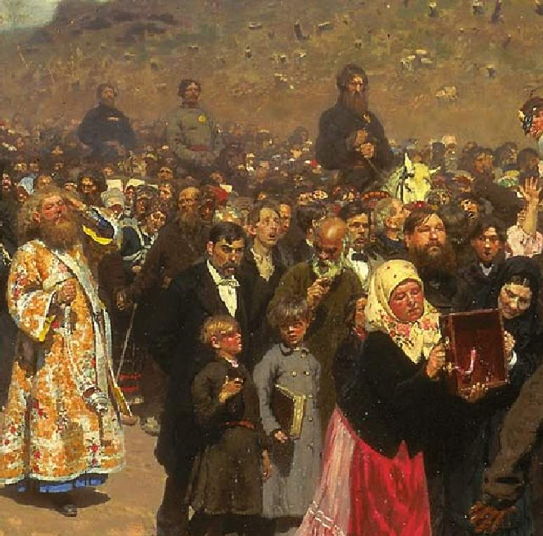

Slide 7
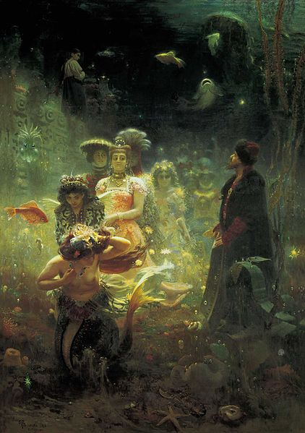
“Sadko” 1876.
Sadko was a
famous folk hero.
There was a popular
folk epic, so he
decided to write
such picture.

Slide 8
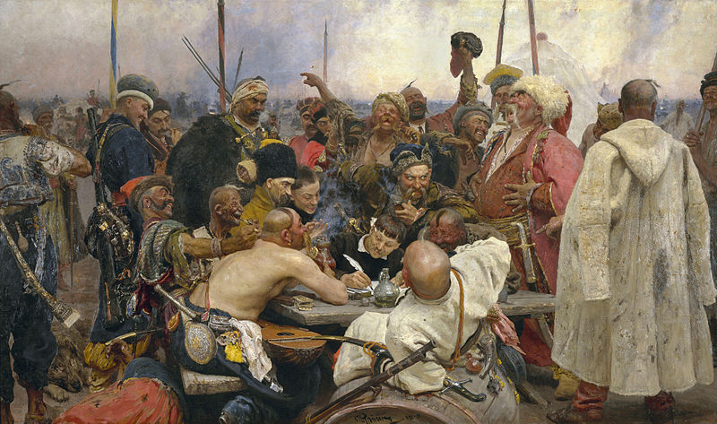
“Reply of the Zaporozhian Cossacks to Sult” 1879-91

Slide 9
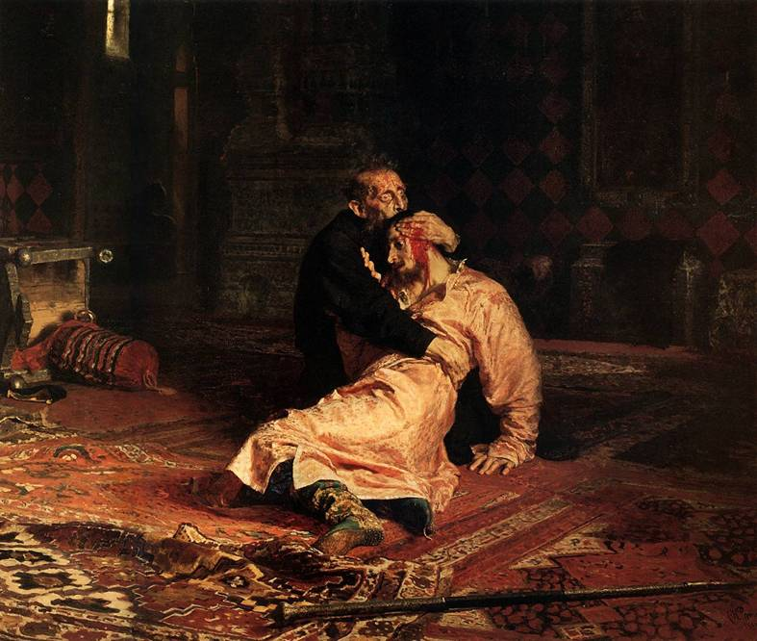
“Ivan the
Terrible
and His
Son Ivan
on
November
16,”
1885

Slide 10
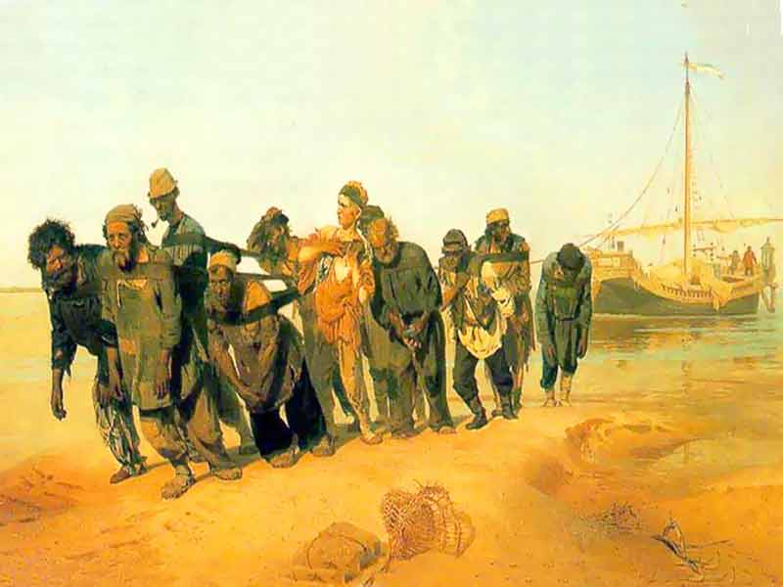
During this time, he worked on the painting Barge Haulers on the Volga
(1873). This picture was well-known even in Russia, in Europe

Slide 11
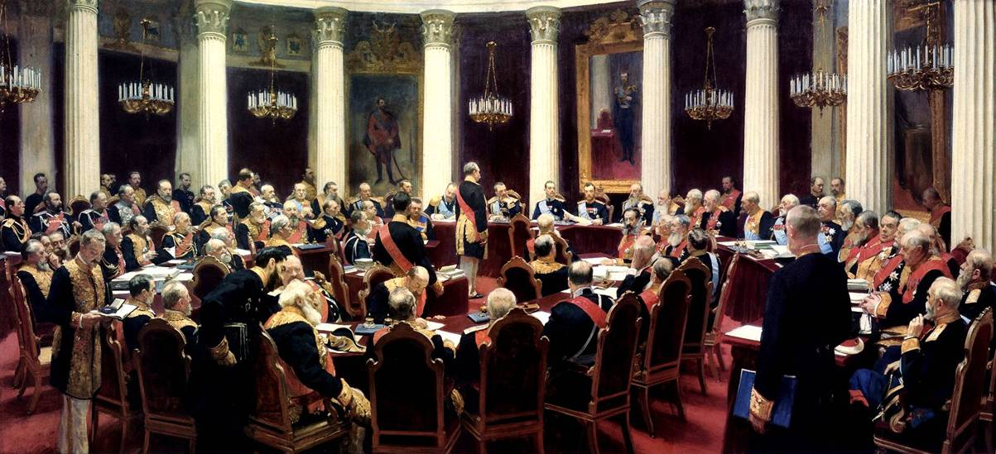
Ceremonial Meeting of the State Council
on May 7, 1901, 1903

Slide 12
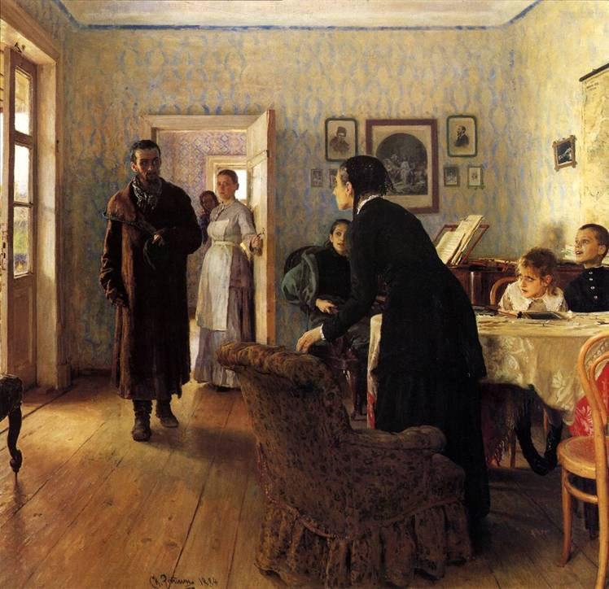
“Unexpected
Visitors”
1884-88

Slide 13
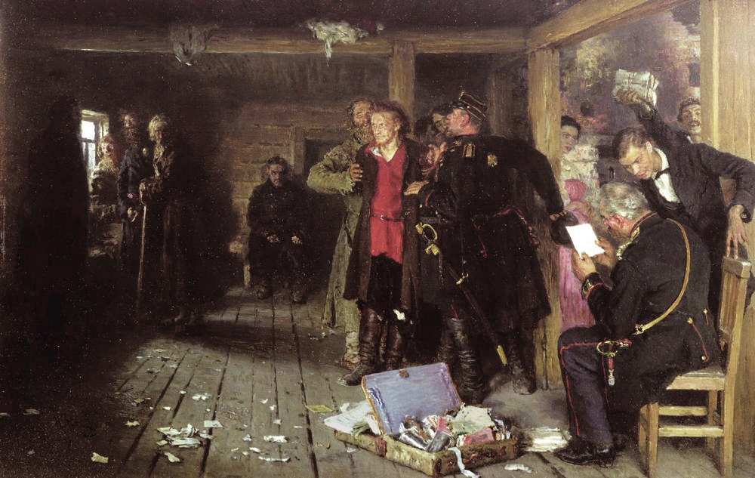
“Putting a Propagandist Under Arrest, 1880-1892”

Slide 14
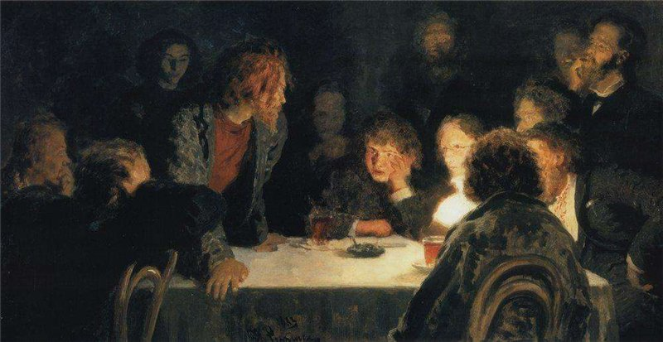
The Revolutionary Meeting, 1883

Slide 15
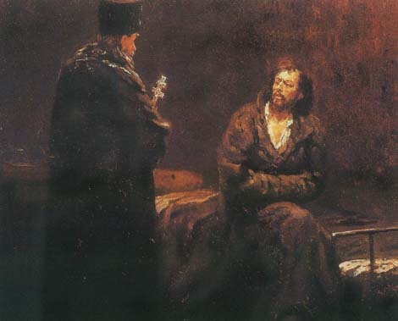
“Refusal of the Confession” 1879-1885

Slide 16
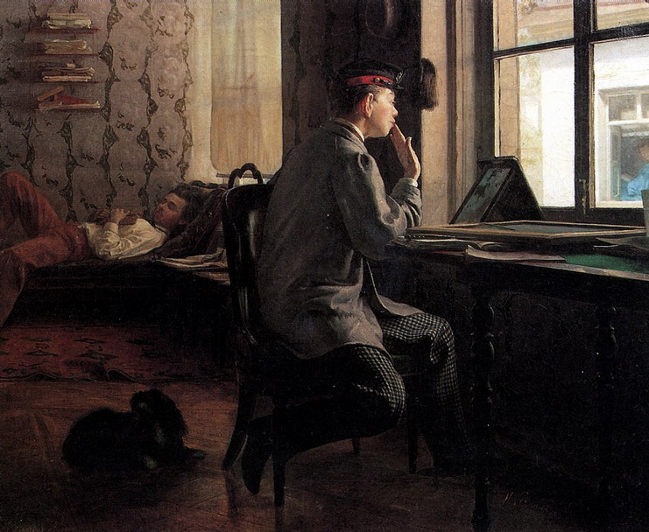
“Prepera-
tion for
examina-
tion”
1864

Slide 17
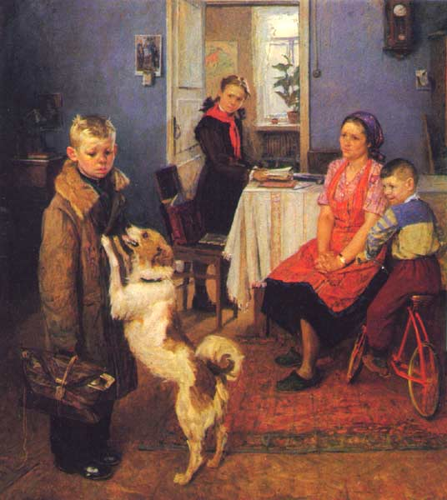
“2 again”

Slide 18
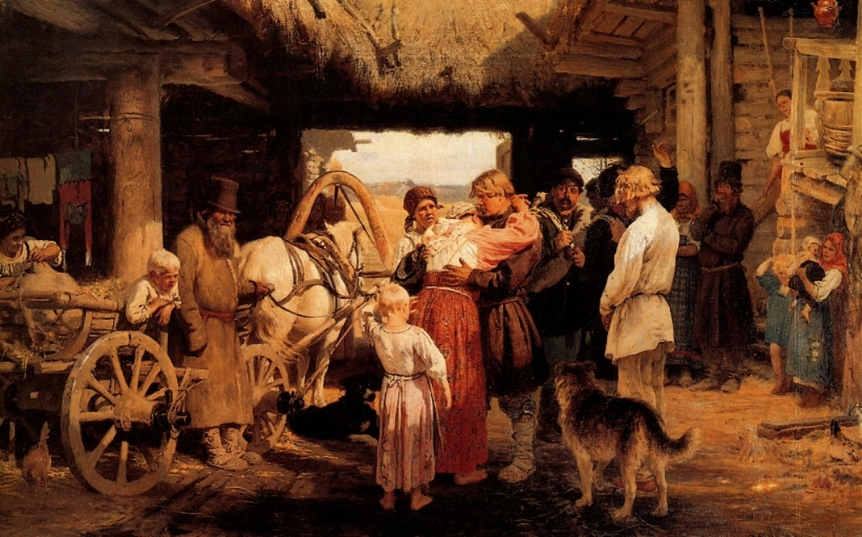
Send off of recruit, 1879

Slide 19
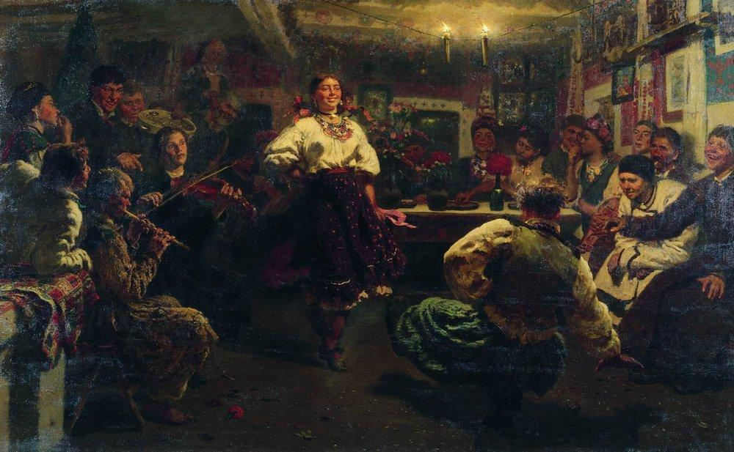
Evening party, 1881

Slide 20
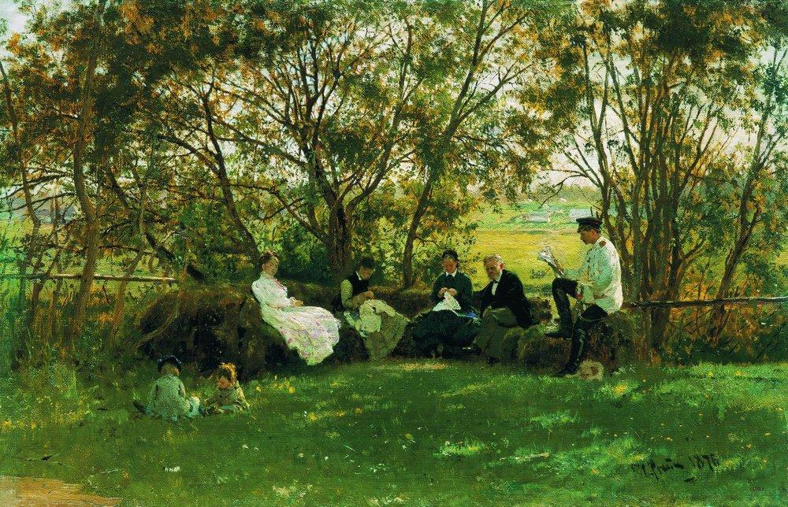
On a Turf Bench, 1876

Slide 21
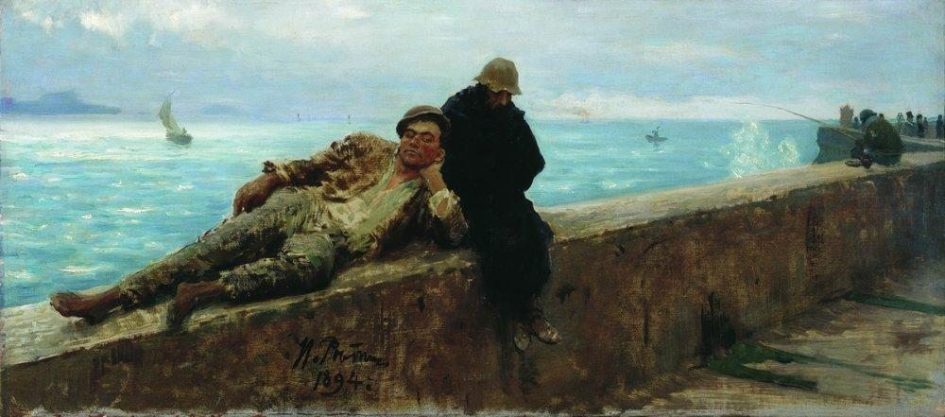
Tramps. Homeless., 1894

Slide 22
Portraits

Slide 23
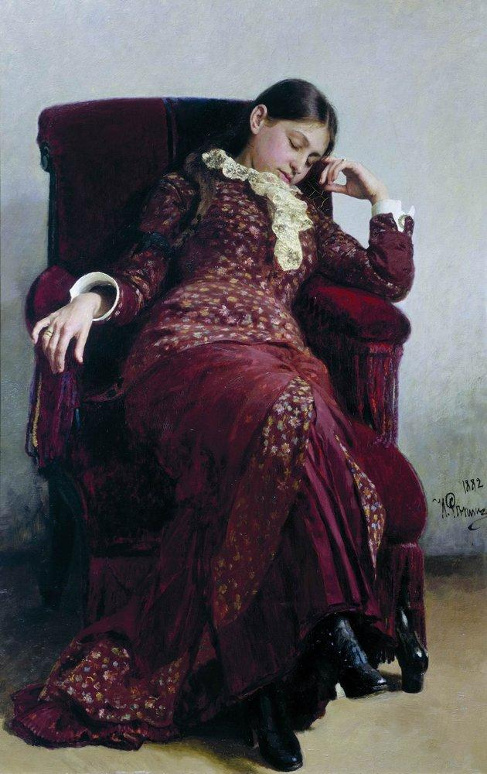
Rest. Portrait of Vera
Repina, the Artist' s
Wife., 1882

Slide 24
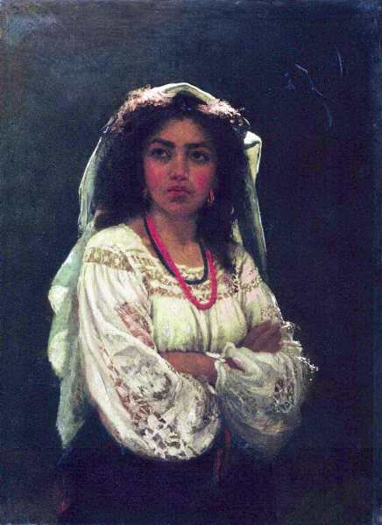
Italian

Slide 25
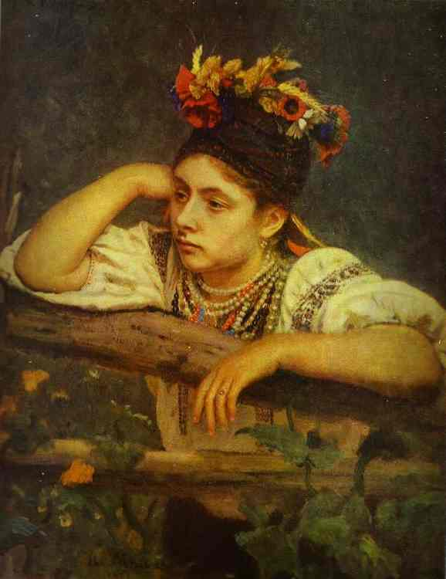
Ukranian Girl,
1875

Slide 26
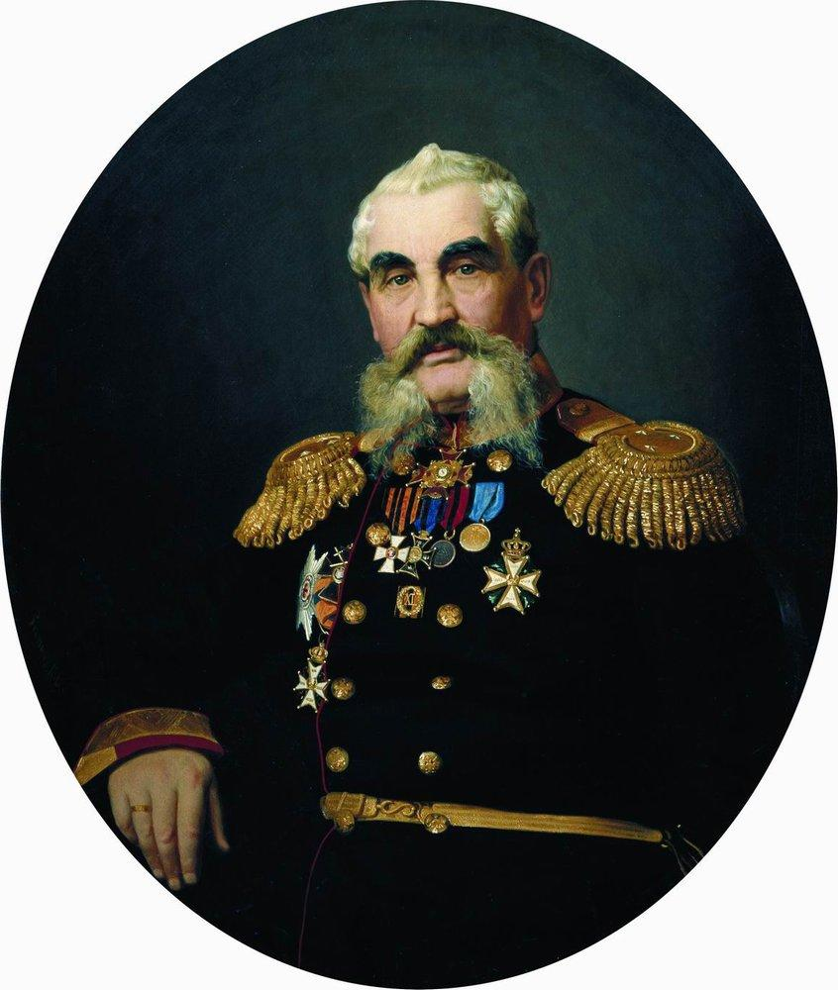
Portrait of the
military, 1866

Slide 27
Portraits of
famous people

Slide 28
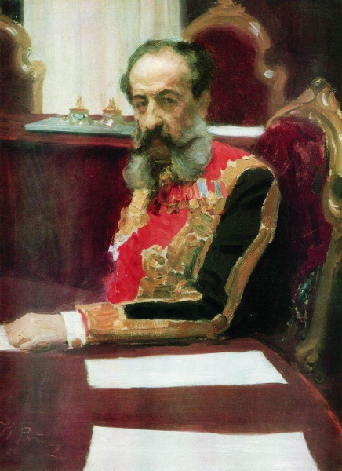
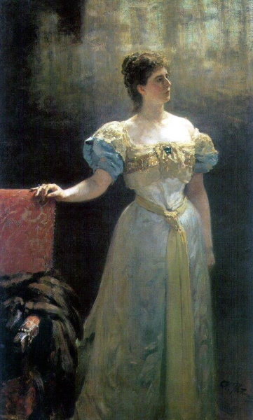

Slide 29
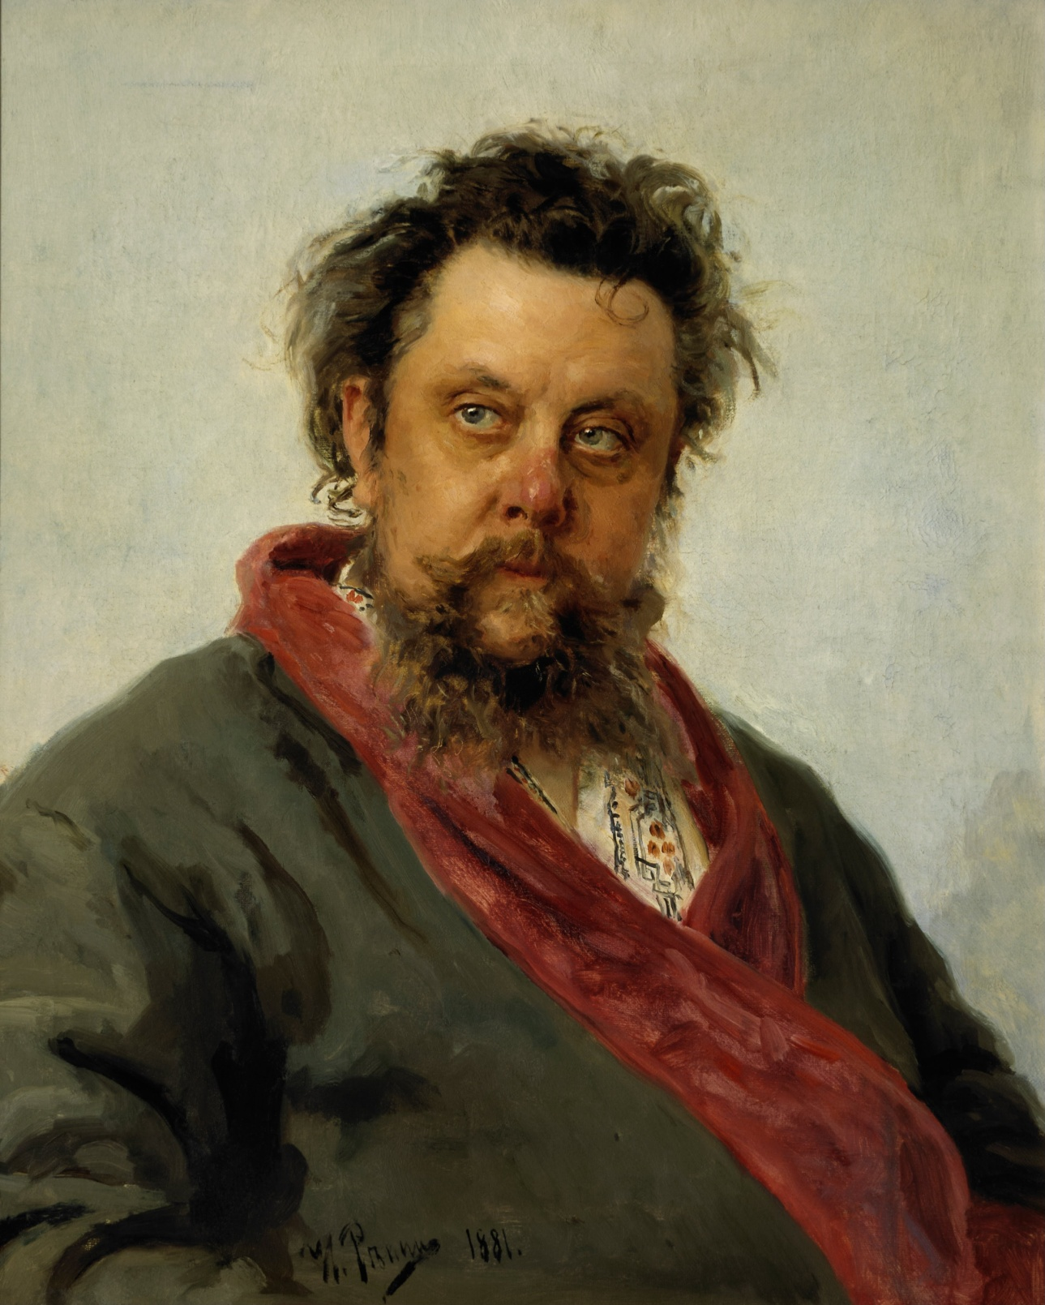
The portrait of M. P.
Musorgskoi 1881.
Musorgskoi was
outstanding Russian
composer. As you can
see Modest was alco-
Holic.He was termi-
nally ill, so Repin
painted a portrait
just for 4 days.

Slide 30
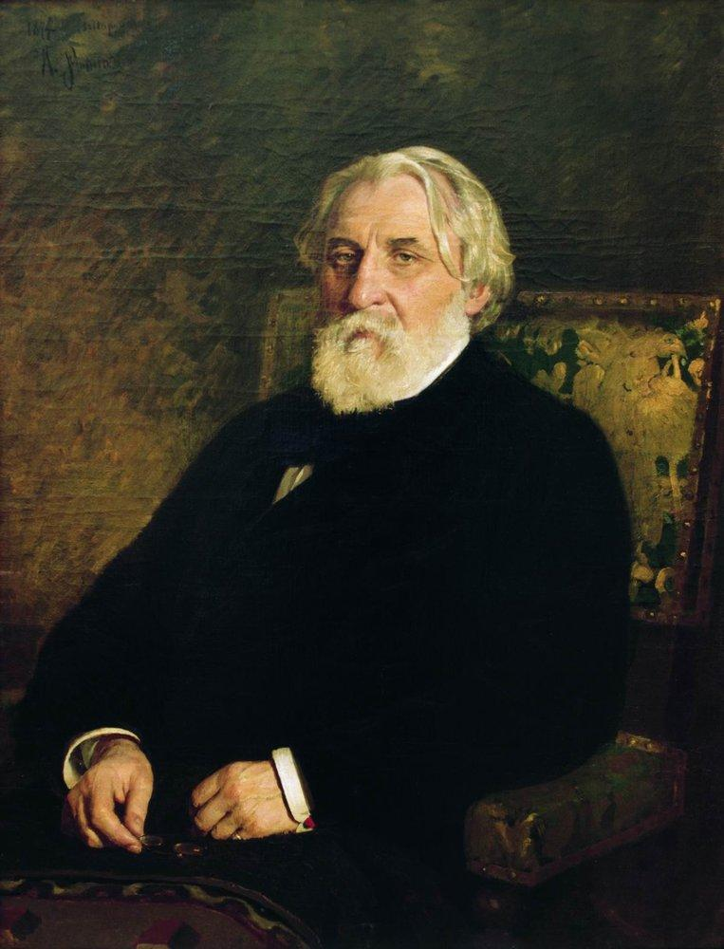
Portrait of writer
Ivan Sergeyevich
Turgenev, 1874

Slide 31
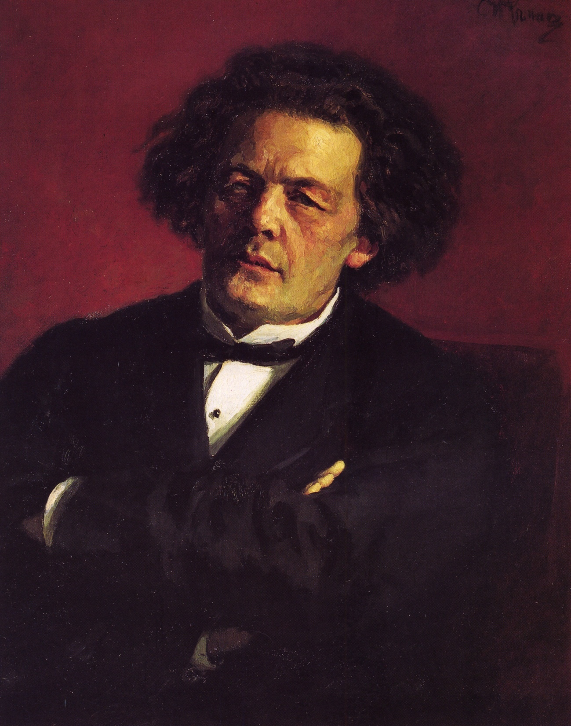
Portrait of the
pianist, conductor
and composer
Anton Grigorievich
Rubinstein, 1881

Slide 32
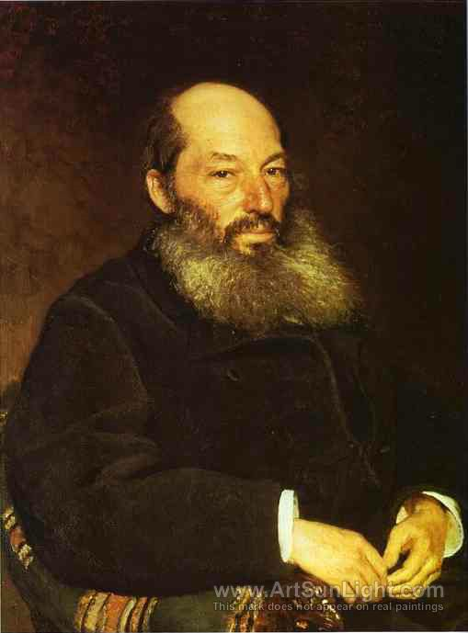
Portrait of the
Poet Afanasy Fet,
1882

Slide 33
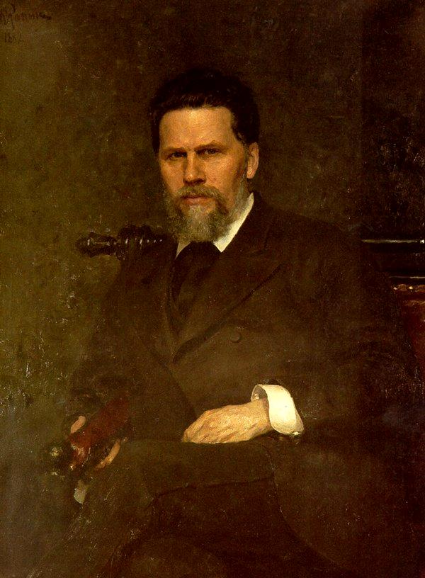
Portrait of the
Artist Ivan
Kramskoy, 1882

Slide 34
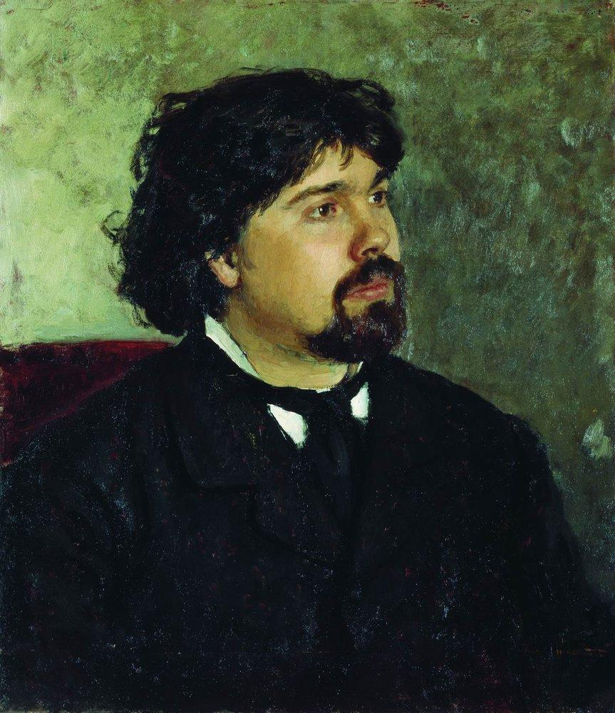
Portrait of the
Artist Vasily
Surikov, 1885

Slide 35
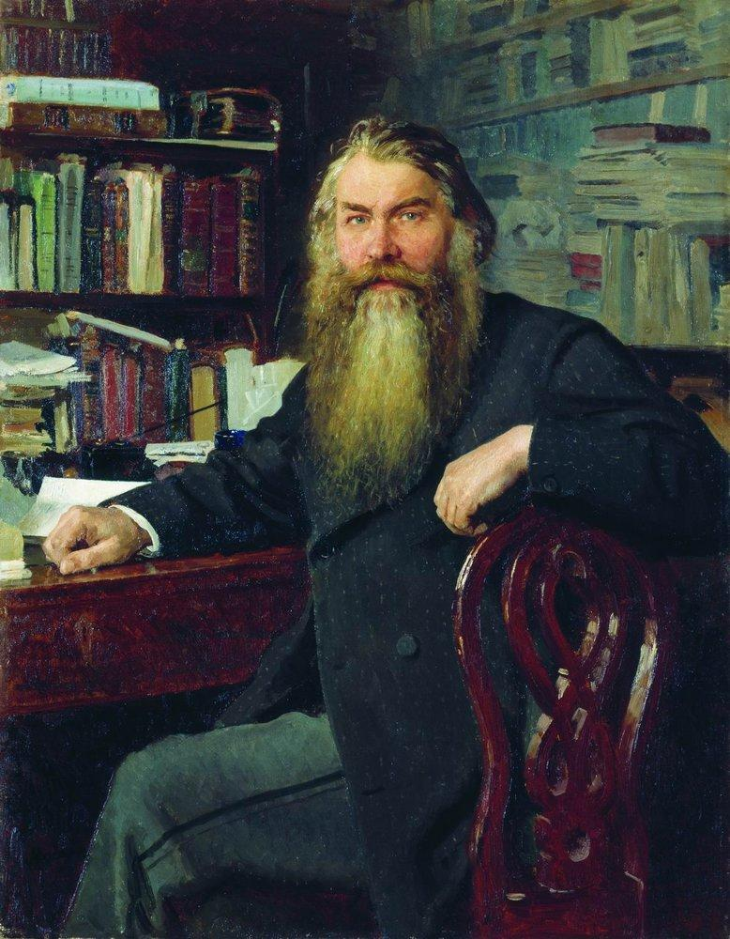
Portrait of the
historian and
archaeologist
Ivan Egorovich
Zabelin, 1877

Slide 36
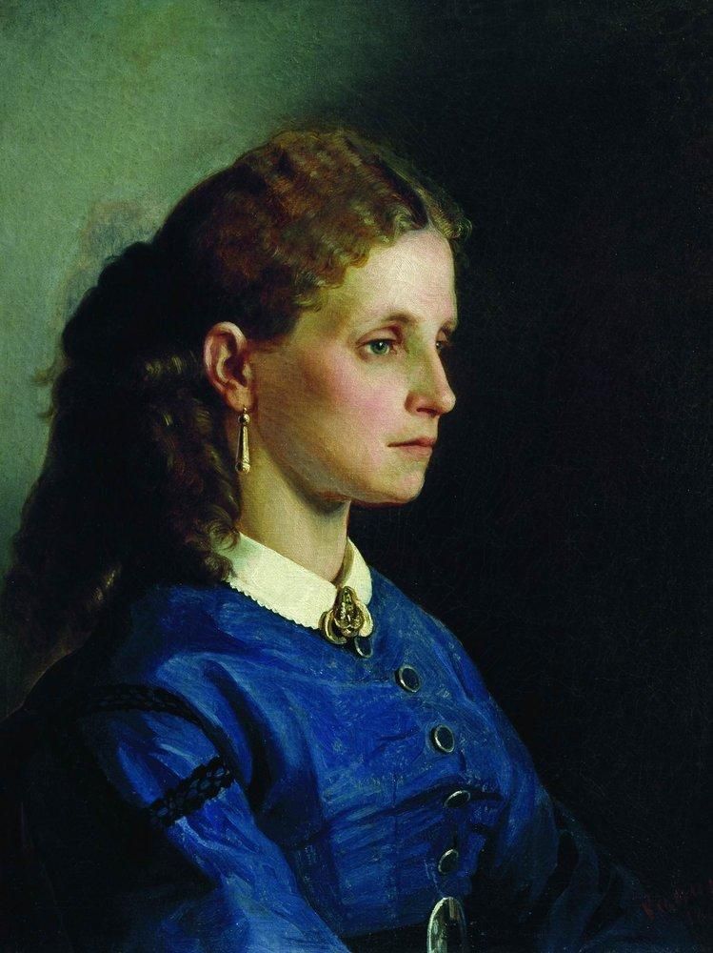
Portrait of
Yanitskaya,
1865

Slide 37
Family portraits

Slide 38
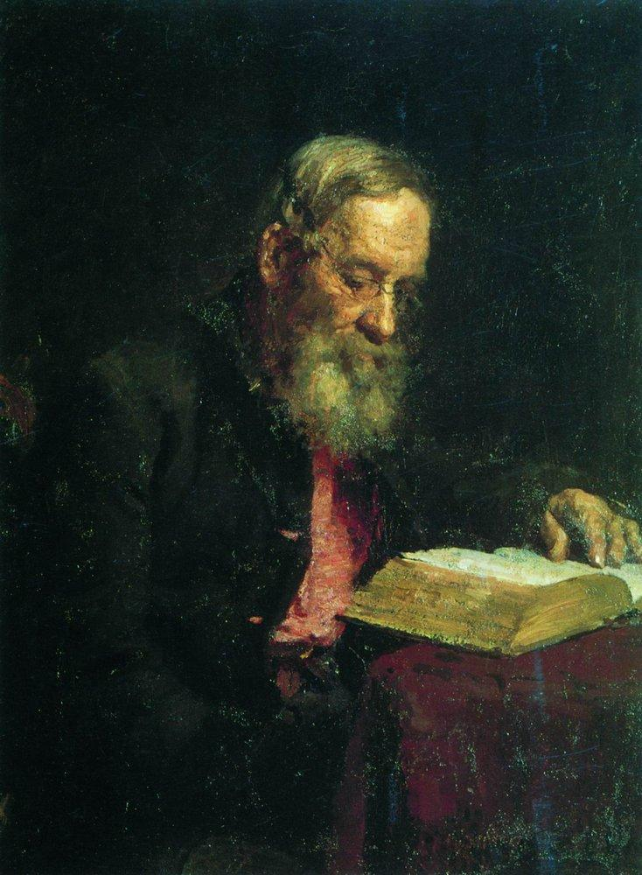
Portrait of Efim
Repin, the
Artist's Father,
1879

Slide 39
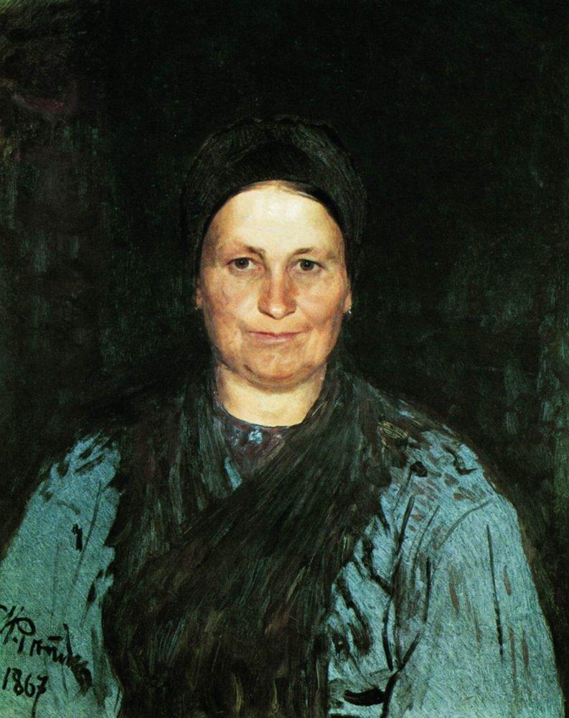
Tatyana Repina,
the Artist's
Mother, 1867

Slide 40
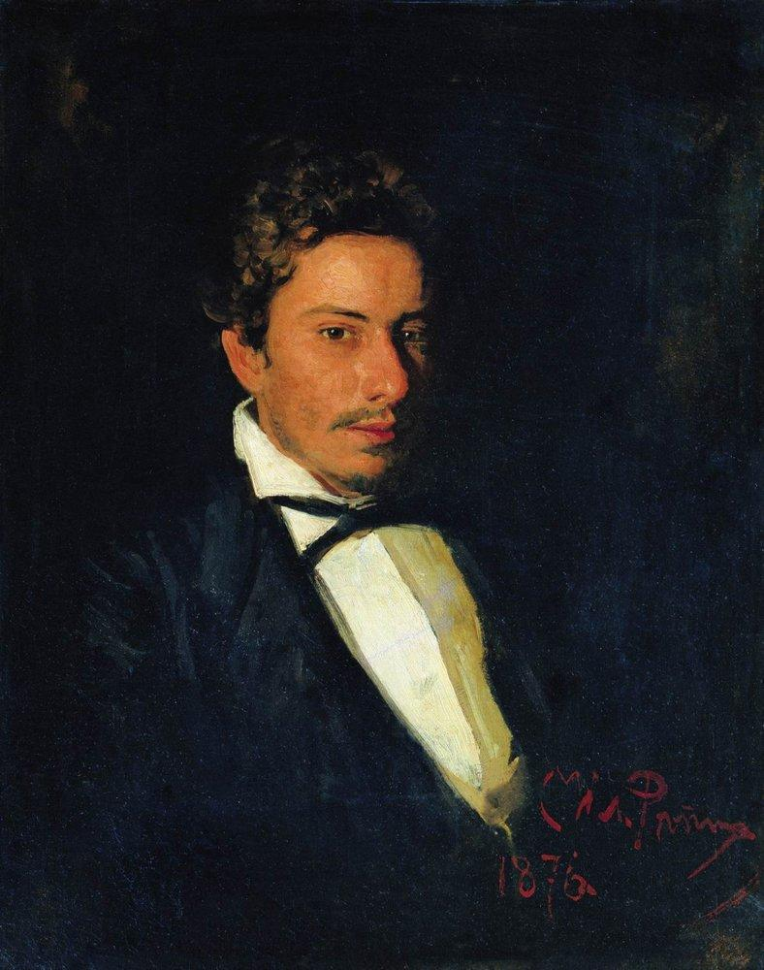
Portrait of V.
Repin, musician,
brother of the
artist, 1876

Slide 41
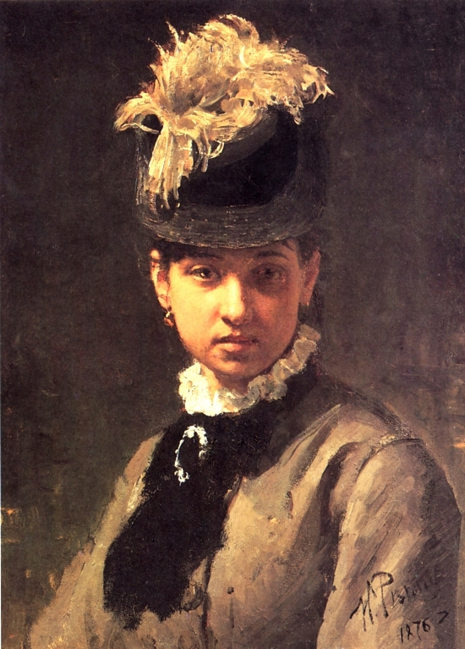
Portrait of Vera
Repina, the
Artist's Wife,
1876

Slide 42
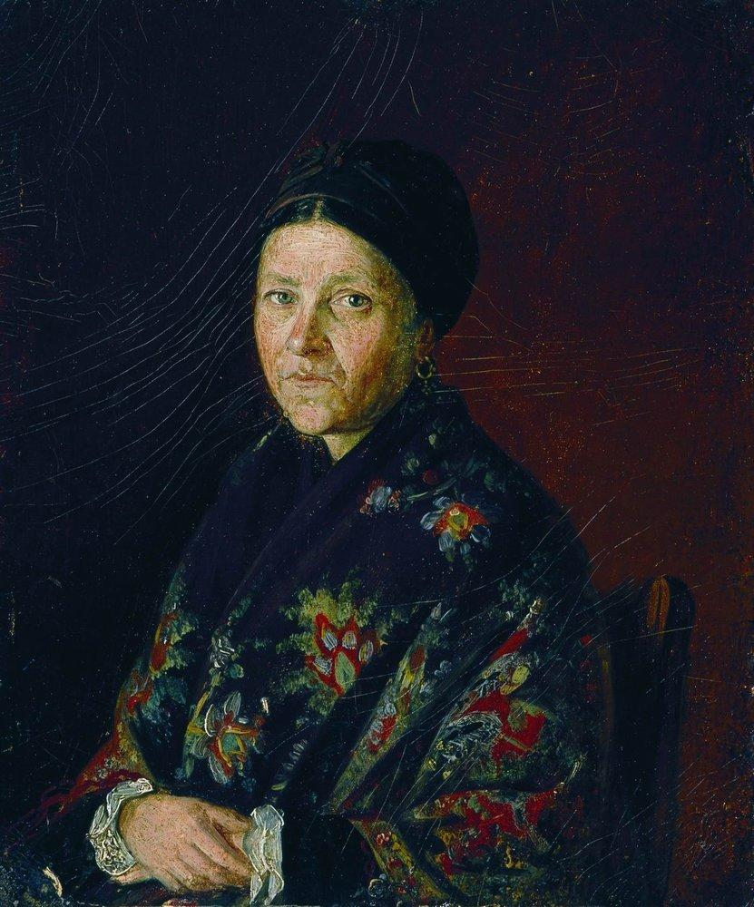
Portrait of A.
Bocharova,
artist's aunts,
1859

Slide 43
Landscapes

Slide 44
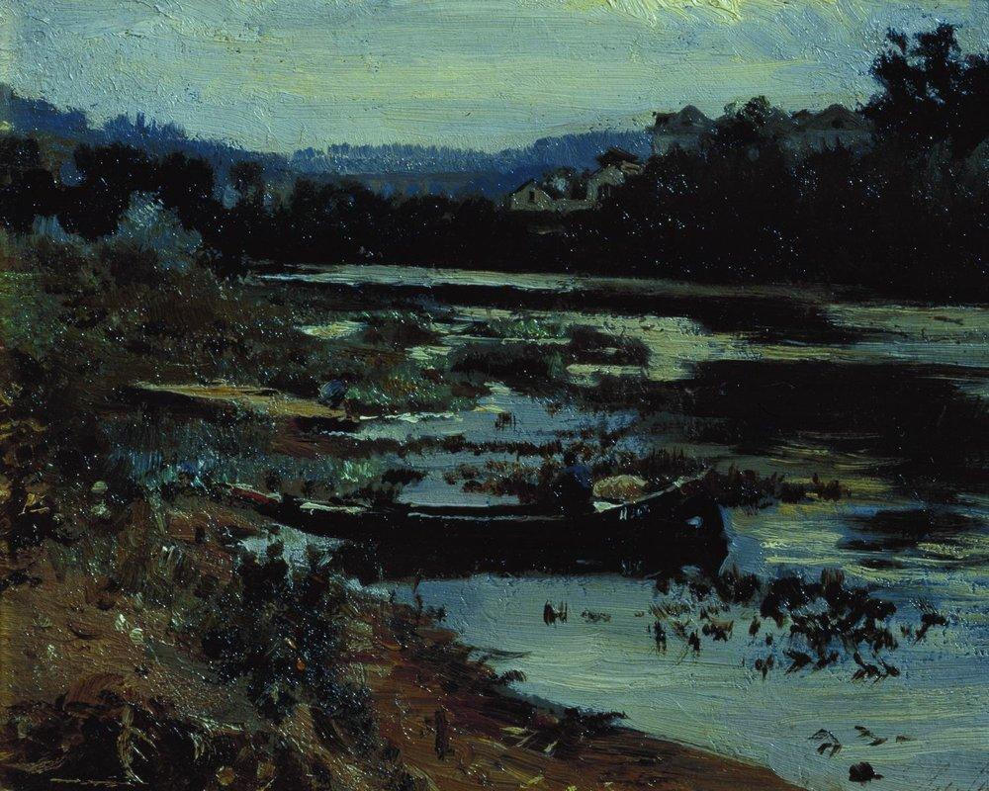
Landscape with boat, 1875

Slide 45
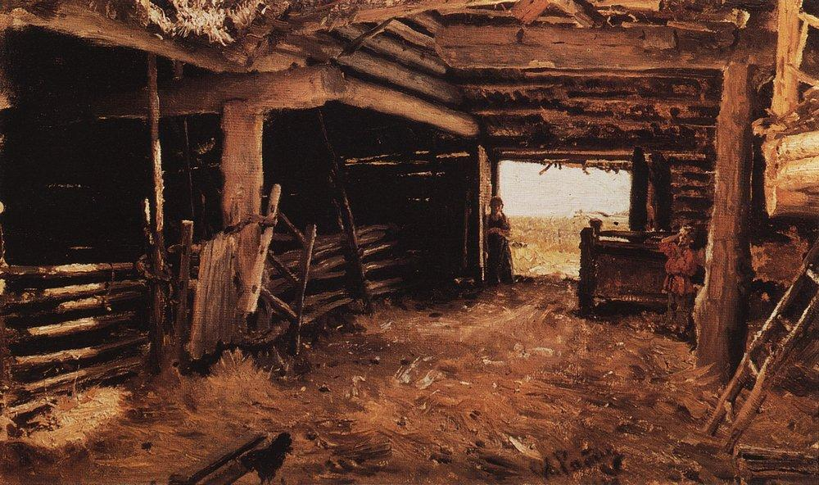
Peasant Yard, 1879

Slide 46
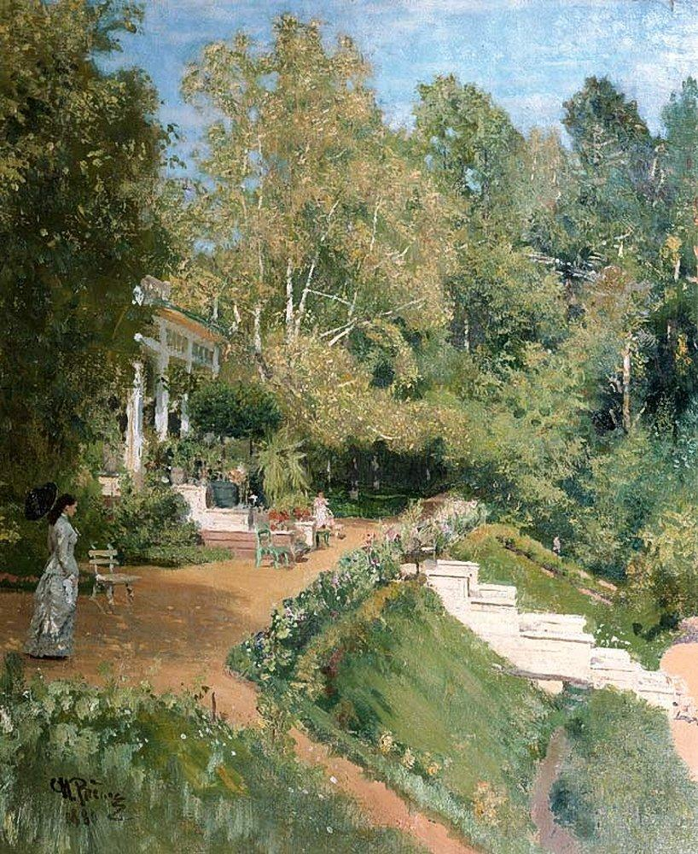
Summer day
in Abramtsevo,
1880

Slide 47
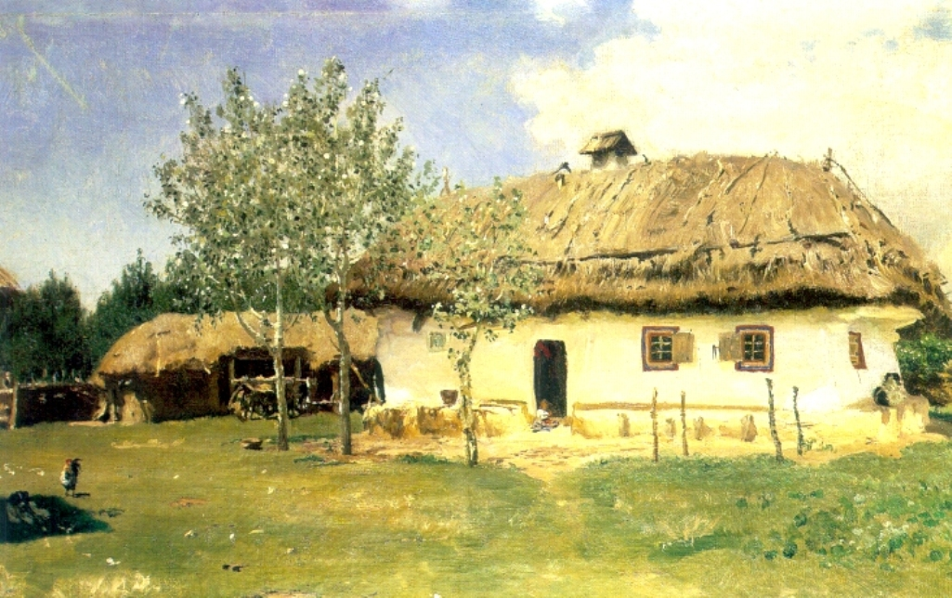
Ukrainian peasant house, 1880

Slide 48
Still life

Slide 49
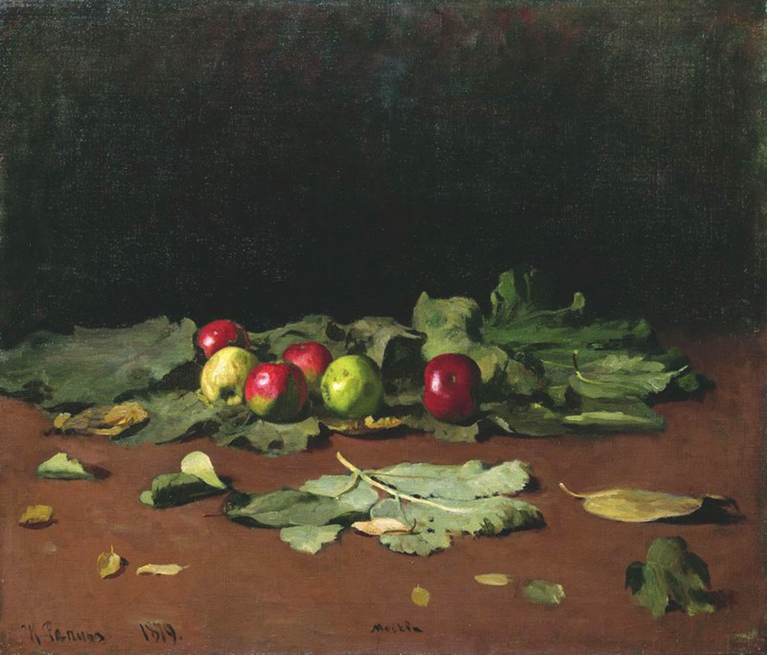
Apples
and
Leaves,
1879

Slide 50
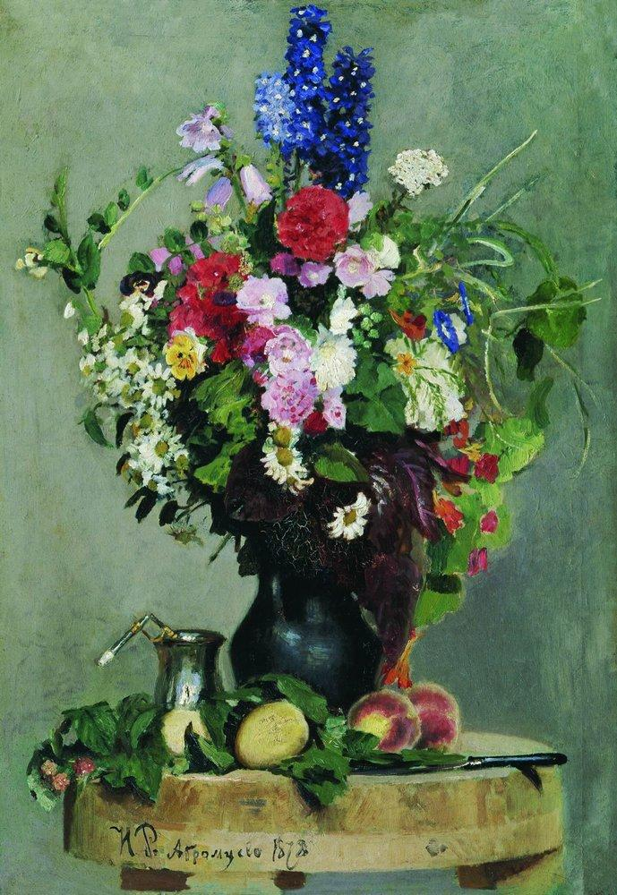
A bouquet of
flowers, 1878

Slide 51
Impressionism

Slide 52
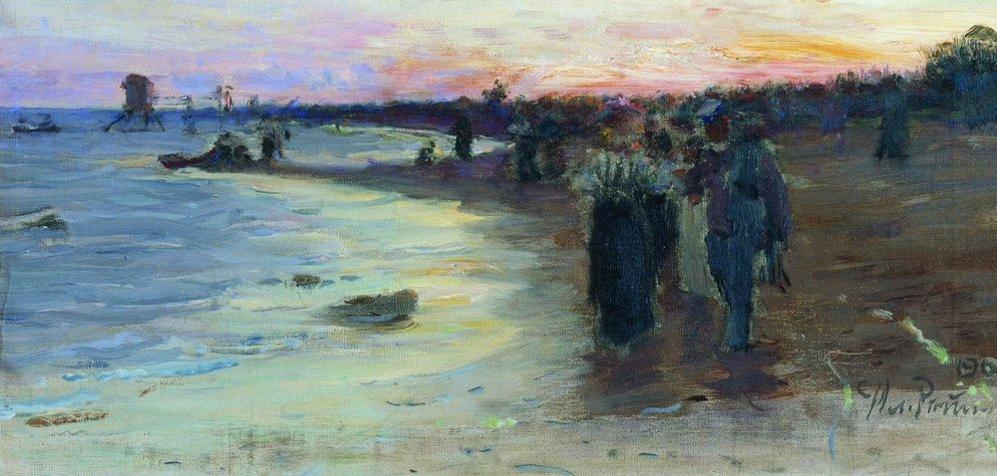
On the shore of the Gulf of Finland, 1903

Slide 53
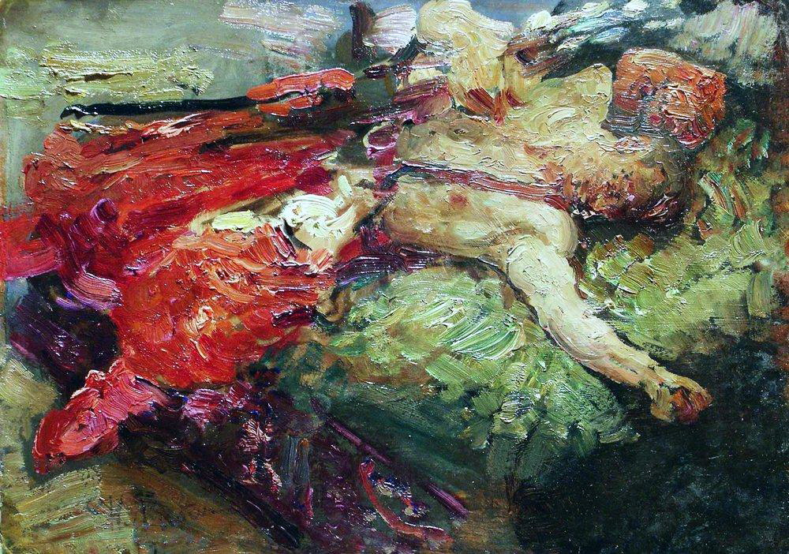
Sleeping Cossack, 1914

Slide 54
Pencil

Slide 55
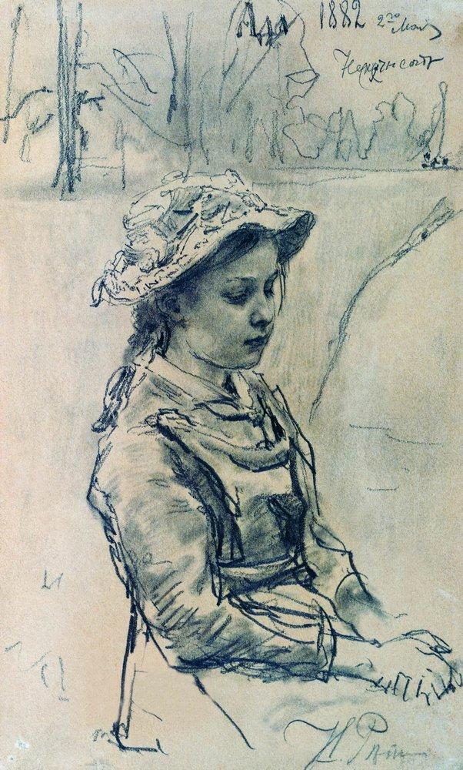
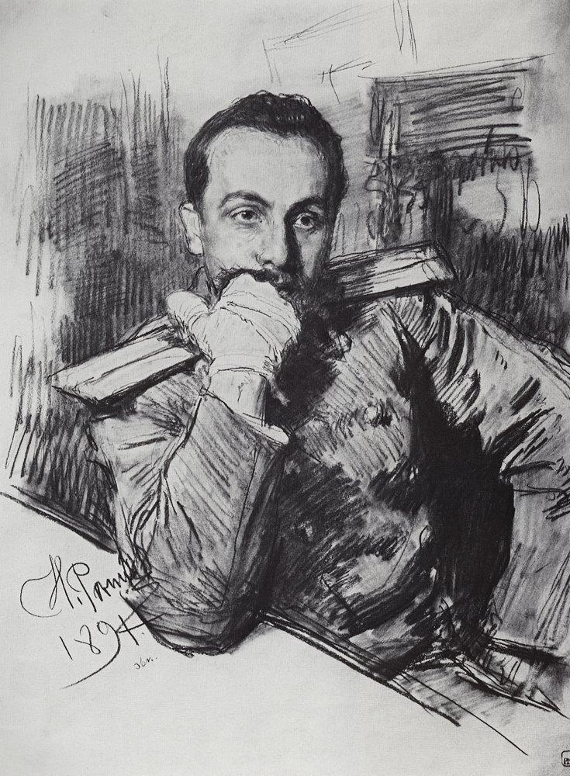

Slide 56
watercolor

