Slide 1
The Ten Highest-Paying Dirty Jobs
Done by Natalia Mal’tseva and Anastasia Pockachailo

Slide 2
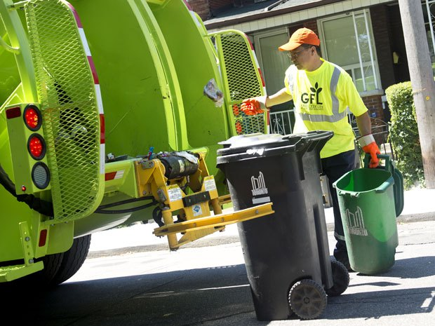
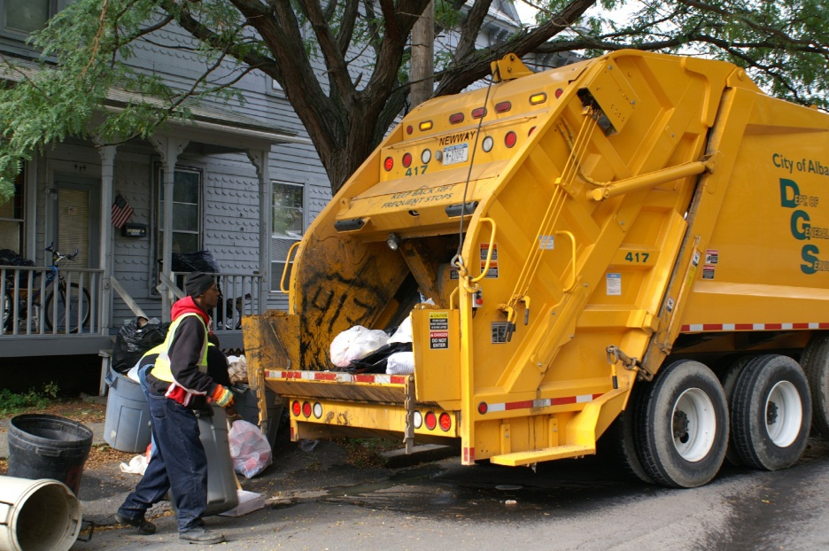
1. Garbage Collector
People sometimes fail to realize that garbage men earn money from the trash that we throw away as waste. Even though it is a thankless job, sanitation workers spend long hours making sure that our streets are not overflowed with rotting, decomposed matter and dirty, stinky garbage. A garbage collector can earn up to $40,000 to $60,000 even if it requires someone to visit every garbage bin and dumpster in the city.
2.Gastroenterologist
When it comes to getting their hands dirty, the gastroenterologist is the first one who takes care all of our embarrassing ailments and dirty experiences with what we ate. No only they help us with our digestive problems, they also have the to overcome the obnoxious smell of human feces and the uncompromising thought of putting their hands on your rear. No wonder, many patients are not too excited to have an appointment with the gastroenterologist. It is not a crappy job but they still earn up to $400,000 a year.

Slide 3
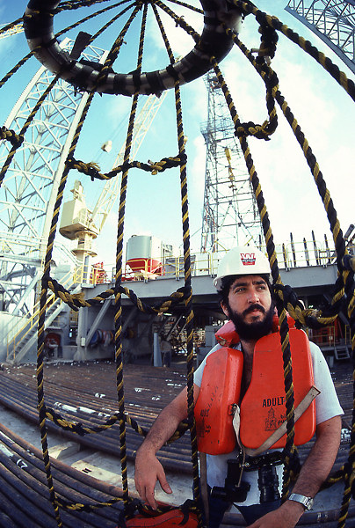
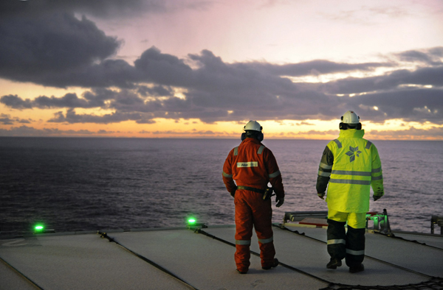
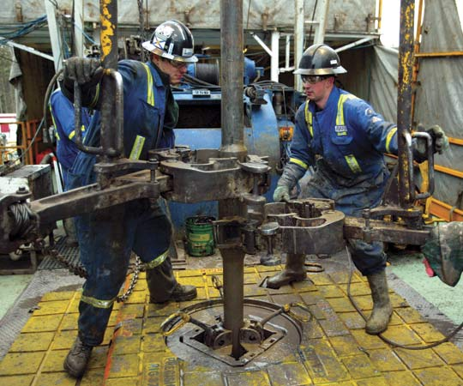
3.Oil Rig Personnel
It is very much difficult to be in an offshore oil platform in the middle of nowhere especially when you are doing a very difficult and dangerous job. You are literally on a cramped space where oil can literally rain down on you on a very good day. A daily 12-hour grind can even become more difficult with all the mechanical failures that you need to fix, much like what’s being done in auto technician jobs. Despite the strenuous and back-breaking work, an oil rig personnel can rake in over $40,000 in annual pay.

Slide 4
4. Toilet Cleaner
It is just like you are in a battlefield where it seems there is no end to it because cleaning public toilet is encountering your worst nightmare – grime, dirt, urine, and excrement. Every day, people use portable toilets to relieve themselves and toilet cleaners have to keep these public facilities spick and span day in and day out. Despite the never-ending challenges, these tireless workers earn $50,000 a year.

Slide 5
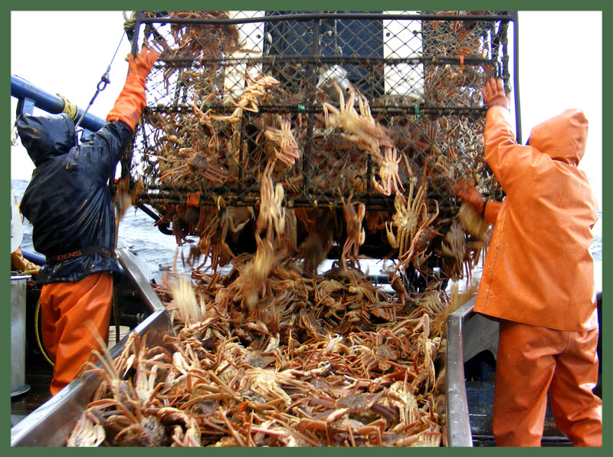
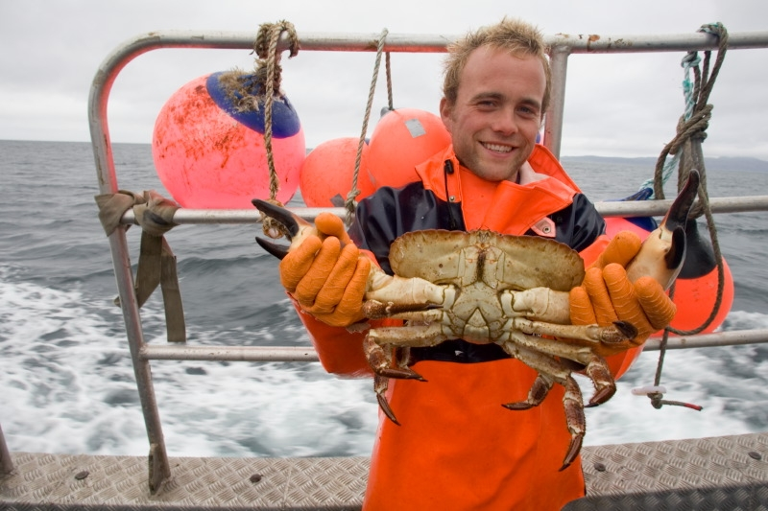
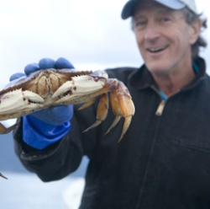
5. Crab Fisherman
Immortalized in the hit reality TV series “The Deadliest Catch,” crab fishermen comb the freezing and dangerous Alaskan sea in the hunt for crabs despite the inherent dangers of getting entangled by the crab-catching nets or thrown to the sea by the strong tidal surges and violent storms. Nevertheless, a good catch of crabs is a blessing to a crab fisherman as he can cash in about $60,000 enough to provide the needs of the family back home.

Slide 6
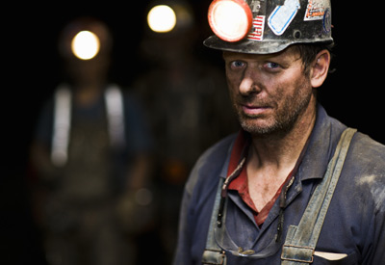
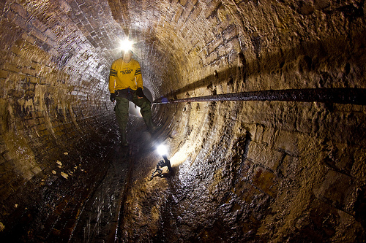
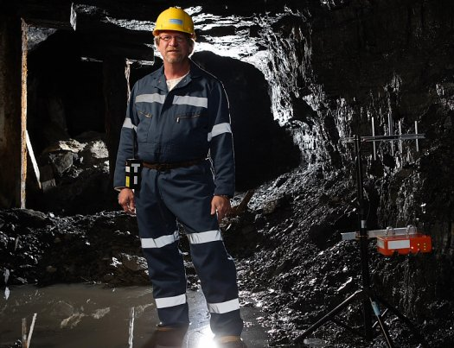
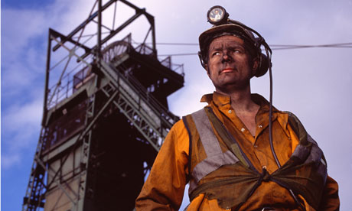
6. Sewer Inspector
Under bowels of the busy city are people who make sure our sewers won’t flood the streets with the stink of sewage. A sewage inspector will always have the company of cockroaches, rats, and decomposing matter inside the dark and dingy sewage tunnels. After dealing with the clogged drainage systems and overcoming the stench, they can earn over $60,000 a year.
7. Coal miner
Just like auto mechanic jobs, getting dirty black is part of your resume because of the coal you excavate. If not blackened by coal, coal miners have the most dangerous jobs in the world as they work in claustrophobic tunnels deep inside the earth. These men often cheat death from getting buried alive or suffocated to death from deadly fumes. However, some men may succumb to deadly diseases, like emphysema and lung cancer, from the coal dust they breathe in. A hefty $64,000 annual income may be a heavy price to pay for this very dangerous job.

Slide 7
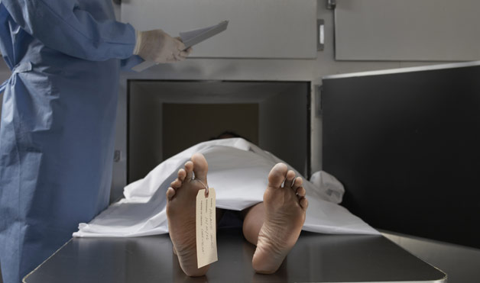
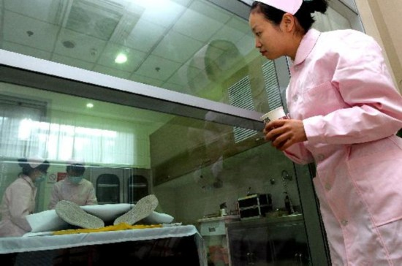
8.Embalmer
Getting up close and personal with a dead person is a specialization that embalmers do well. Though making sure that a dead person looks good for the funeral is not that dangerous, getting exposed to toxic cleaning chemicals and the possible diseases that a dead body may bring is. Along with morticians and mortuary workers, can have a hefty income of $41,000.

Slide 8
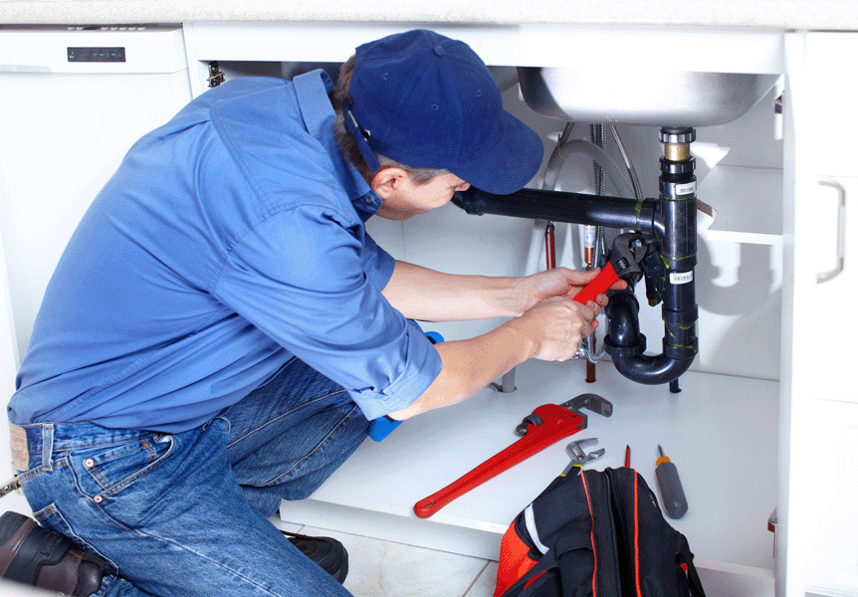
9. Plumber
Fixing leaks and plugging holes can surely get you wet if you really want to consider plumber jobs. Of course, it is the dirty job of a plumber that ensure all our water pipes are up and running. Modern living wouldn’t be convenient and comfortable without the help of these trusted handy men. Making a decent living by getting dirty can give a year’s income of $35,000 to $47,000 to an average plumber.

Slide 9
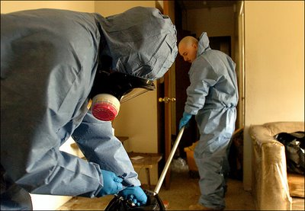
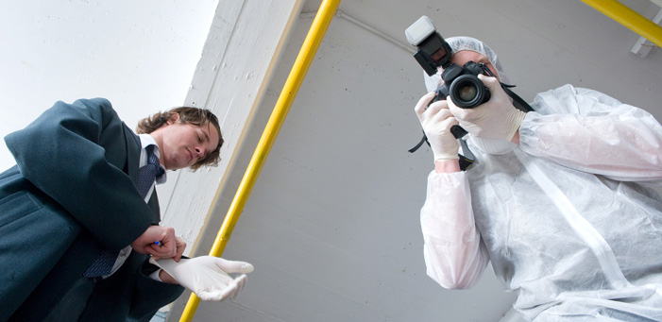
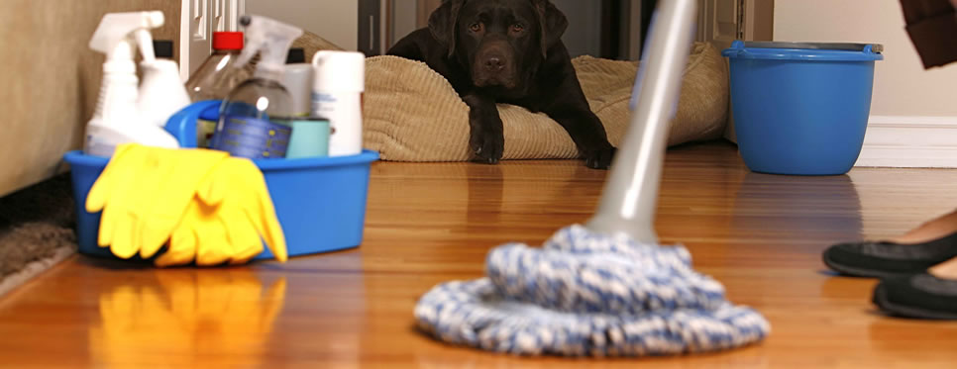
10. Crime Scene Cleaner
Being a crime scene cleaner is a very difficult and demanding job because one has to clean up a place where a very violent and bloody crime has been committed. There are times that your life will be at a serious risk when you encounter deadly chemicals and substances along the way. Messing up a crime scene cleanup can seriously compromise the evidence and trace materials being gathered by the investigators. Though not glamorous and popular as the real CSI, a crime scene cleaner make about $75,000 a year.

Slide 10
Thanks For Watching☺

