Slide 1
LANA DEL REY

Slide 2
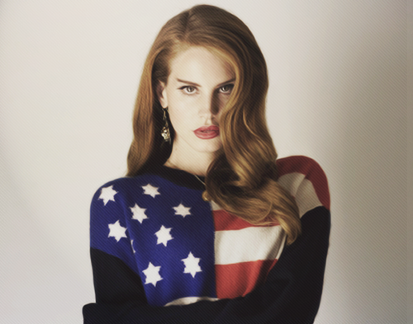

Slide 4
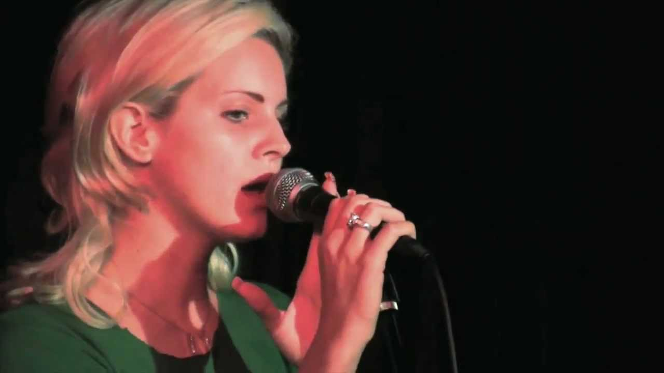
Elizabeth Grant
better known as Lana Del Rey - American singer-songwriter.

Slide 5
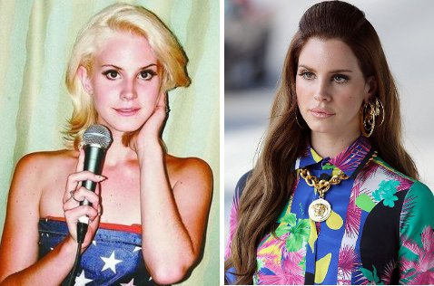
Name Lana Del Rey is taken not in honor of the actress Lana Turner and car Ford Del Rey, as it is written on many resources. As Elizabeth explains, she just likes the name. She previously performed under the name Lizzy Grant.

Slide 6
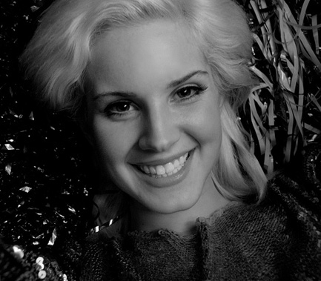
LIZZY
GRANT

Slide 7
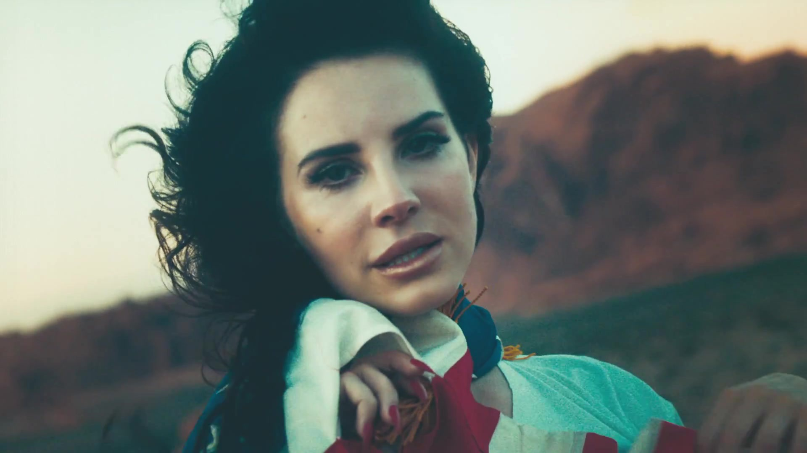
Living in New York, Lizzy, like many other young musicians in the evenings performed in clubs in the city. Many have remained at this level, but in 2008 she released a mini-album «Kill Kill».

Slide 8
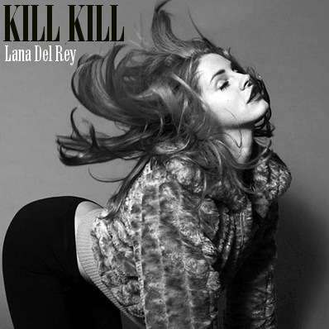
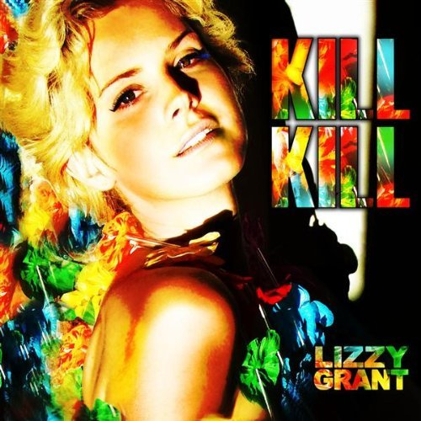

Slide 9
Failing success under this pseudonym, Lizzy realized that to become a singer,
you need to have not only a beautiful and strong voice, but also spectacular, memorable appearance and name.

Slide 10
That's why plastic surgery is the paramount task for budding stars, like Lizzy.

Slide 11
It has changed a lot: if the first studio album, which was released in 2010, was not noticed, but the output of the second - Born To Die - did not leave anybody untouched.

Slide 12
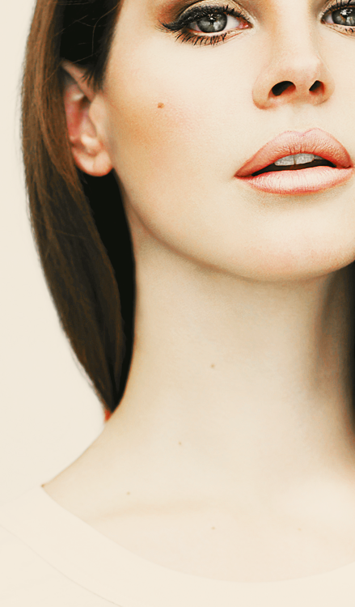
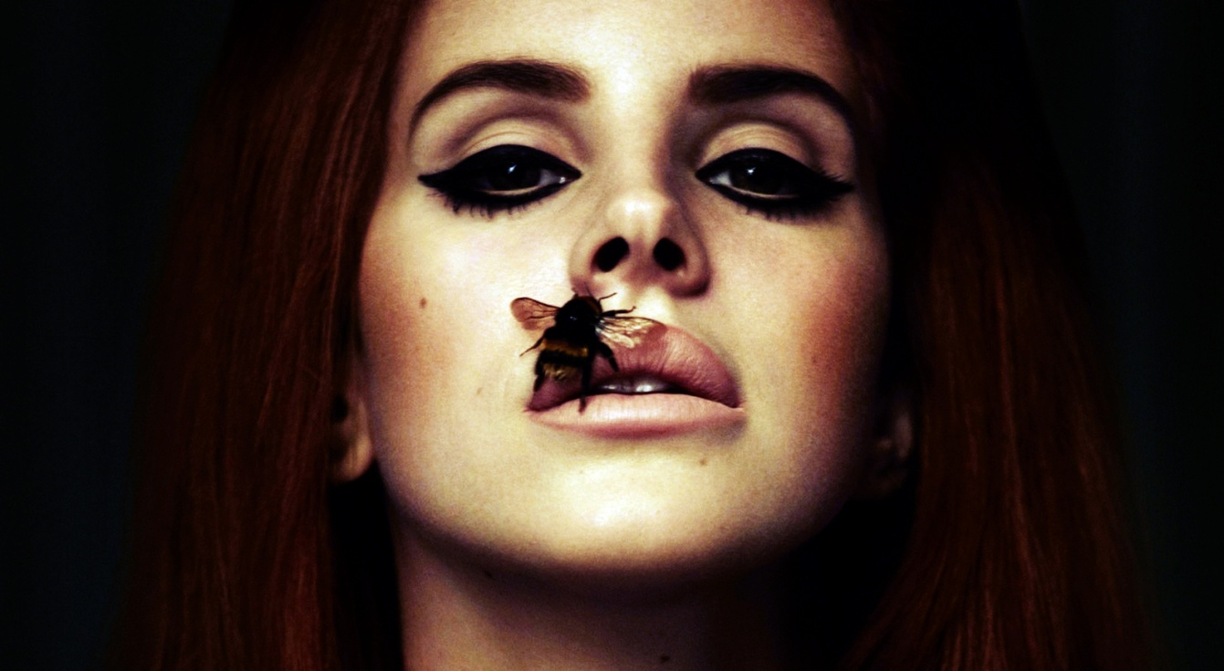

Slide 13
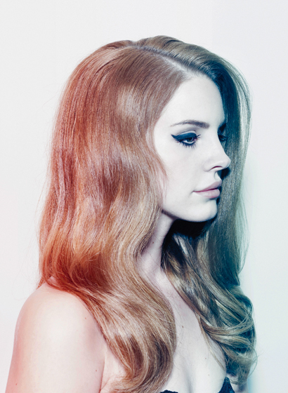
Studio albums
Lana Del Ray
a.k.a. Lizzy Grant (2010)
Born to Die (2012)
Extended plays
Kill Kill (2008)
Lana Del Rey (2012)
Paradise (2012)

Slide 14
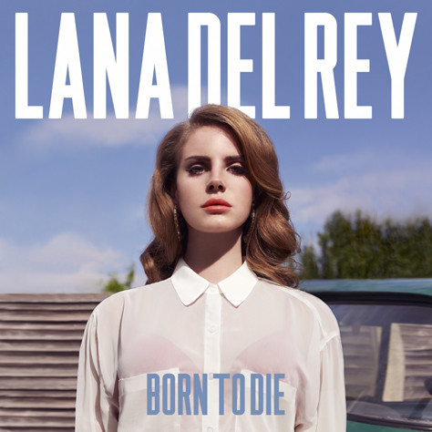
ALBUMS

Slide 15
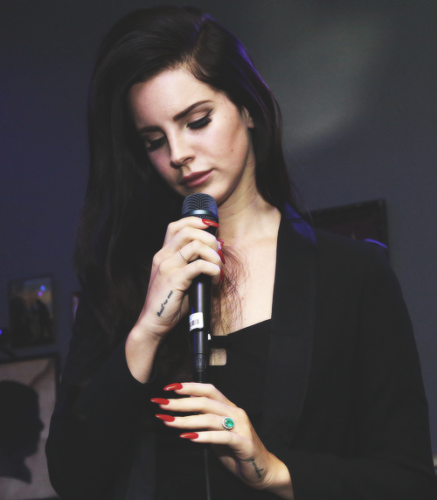
Del Rey has stylized her musical sound as "Hollywood sadcore."

Slide 16
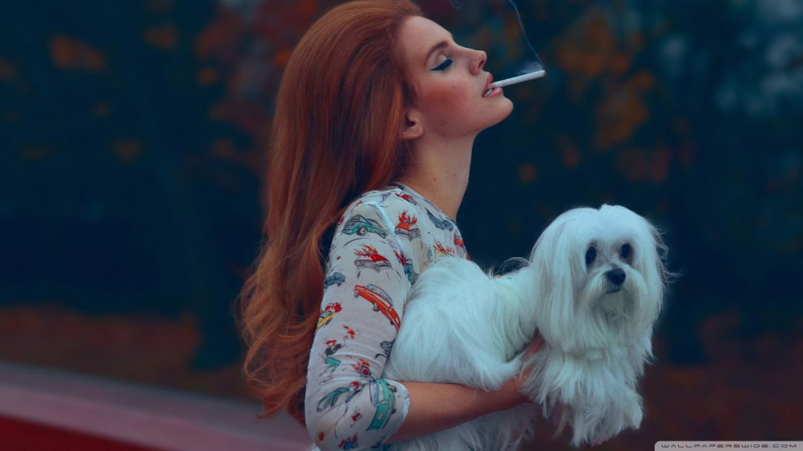
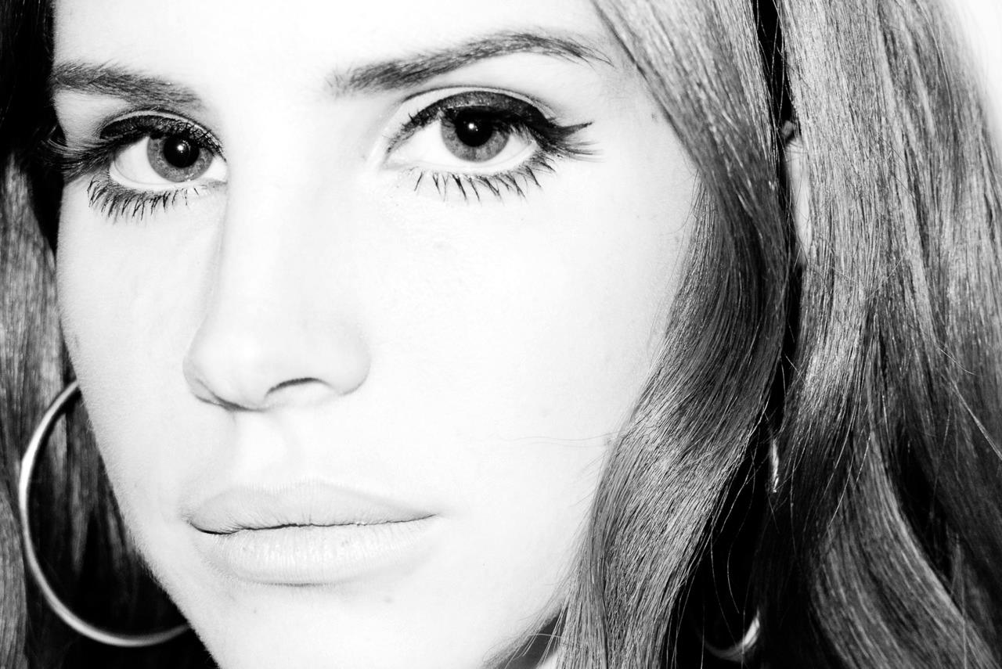

Slide 17
Lana Del Rey has been described as "a self-proclaimed gangster version of Nancy Sinatra" and her music has been featured cinematic sound and its links to various aspects of pop culture of the 1950s and 60s.

Slide 18
“ I was a big drinker at the time. I would drink every day. I would drink alone. I thought the whole concept was so fucking cool. A great deal of what I wrote on Born To Die is about these wilderness years. When I write about the thing that I've lost I feel like I'm writing about alcohol because that was the first love of my life. My parents were worried, I was worried. I knew it was a problem when I liked it more than I liked doing anything else. I was like, 'I'm fucked. I am totally fucked'. Like, at first it's fine and you think you have a dark side – it's exciting – and then you realise the dark side wins every time if you decide to indulge in it. It's also a completely different way of living when you know that...a different species of person. It was the worst thing that ever happened to me.”

Slide 19
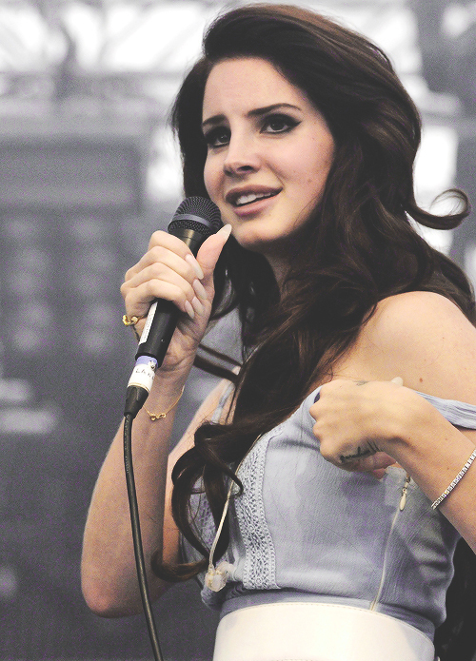

Slide 20
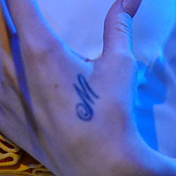
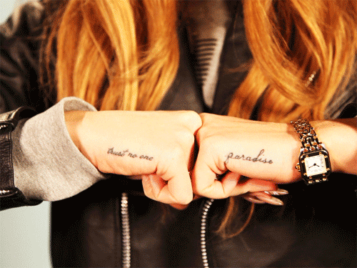
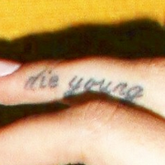
Del Rey's left hand is tattooed with the letter "M", referencing her grandmother, Madeleine, and the word "paradise". Her right hand is tattooed with the phrase "trust no one". She also has the phrase "die young" tattooed on her right ring finger

Slide 21
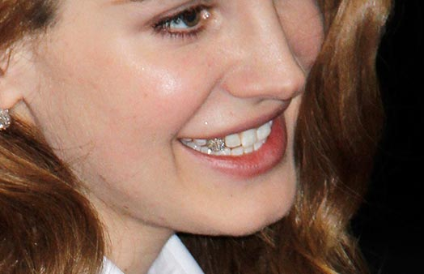
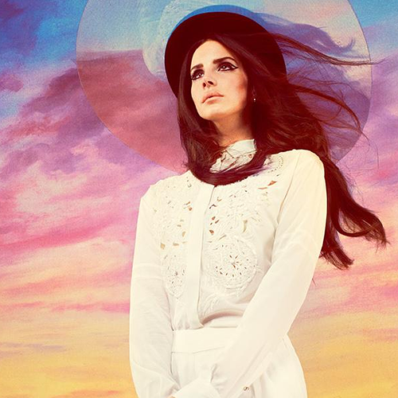

Slide 22
THANKS FOR ATTENTION♥

