Slide 1
BRISTOL
Lysenko Polina

Slide 2
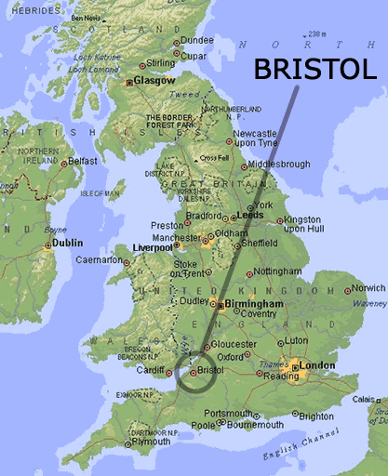
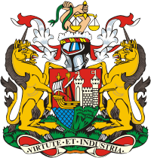
Coat of Arms of the City Council
Location of Bristol

Slide 3
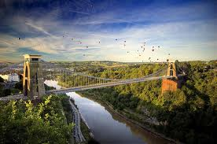
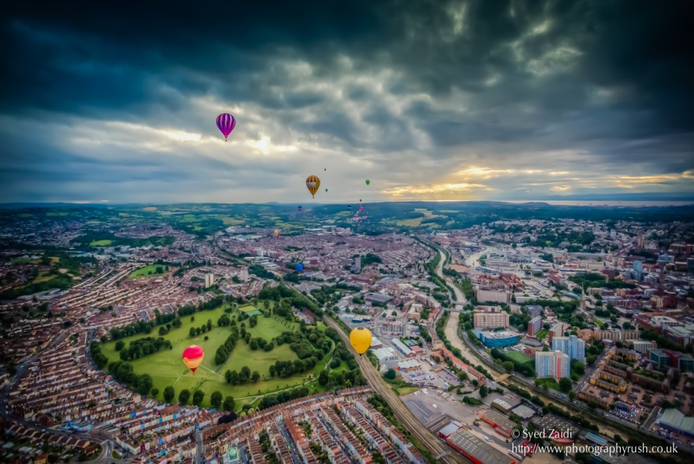
Bristol is the largest city in South West England. It has been an important port and trading centre for 900 years and today it is the cultural and business heart of the West of England with a population of one million.The city is situated on the rivers Frome and Avon.

Slide 4
Also Bristol is the largest centre of employment and education. Its prosperity has been linked with the sea since its earliest days. The city played an important role in England's maritime trade in tobacco, wine, cotton.

Slide 5
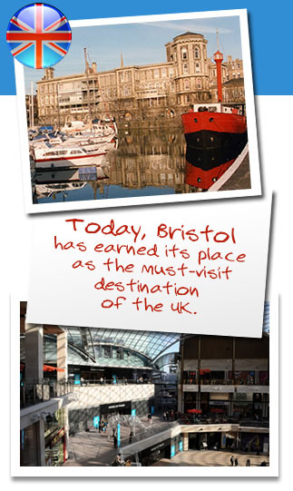
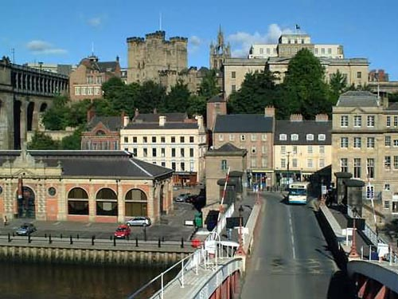
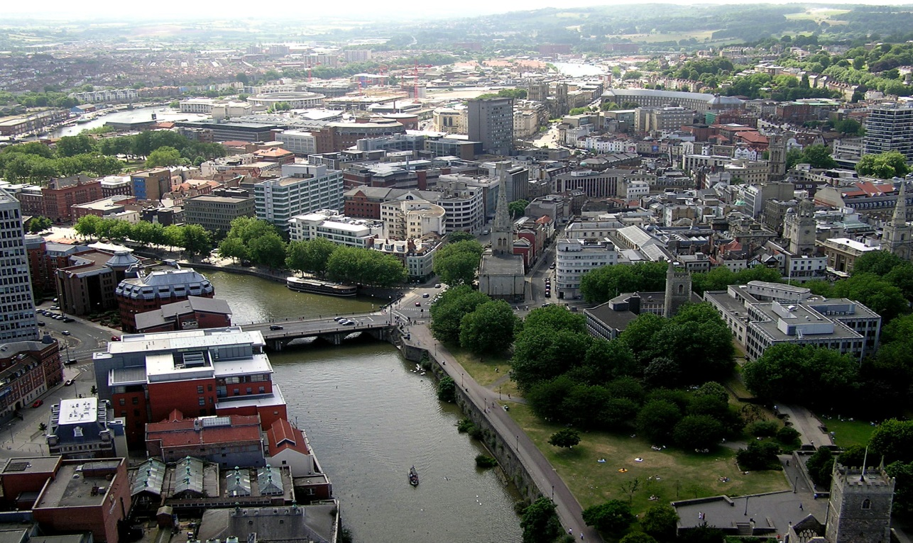
Interesting places

Slide 6
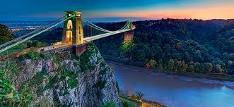
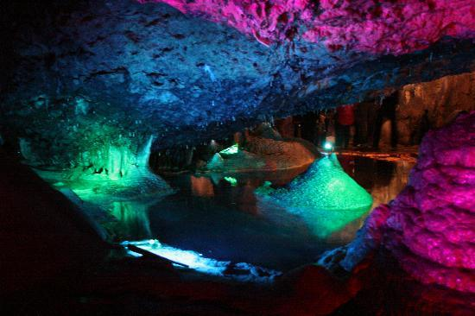
Clifton Suspension Bridge
Wookey Hole Caves

Slide 7
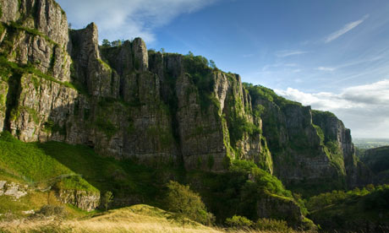
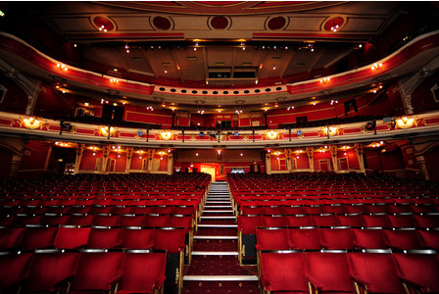
Cheddar Gorge
Bristol Hippodrome

Slide 8
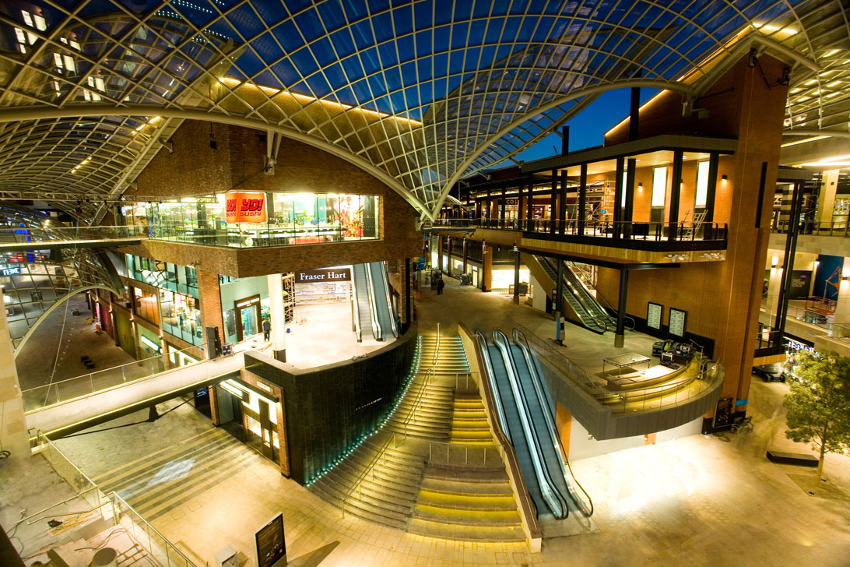
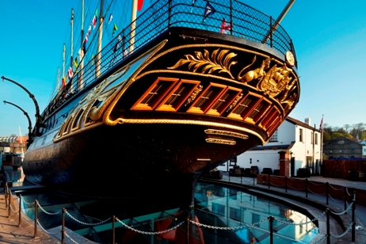
Cabot Circus
SS Great Britain

Slide 9
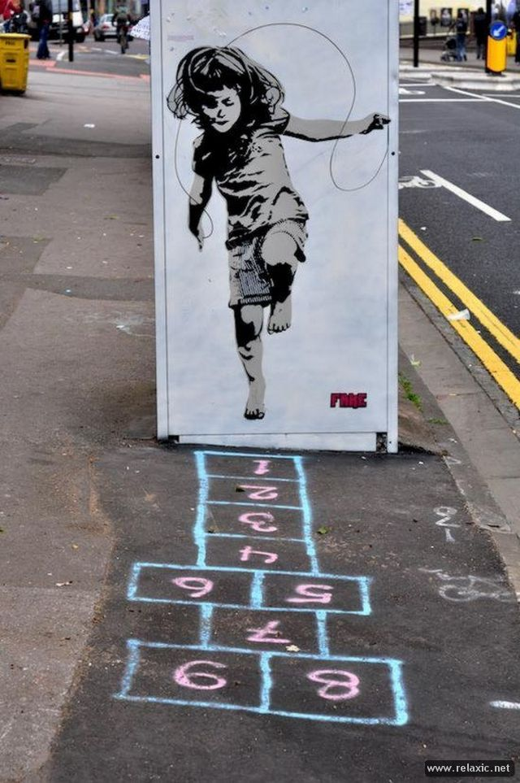
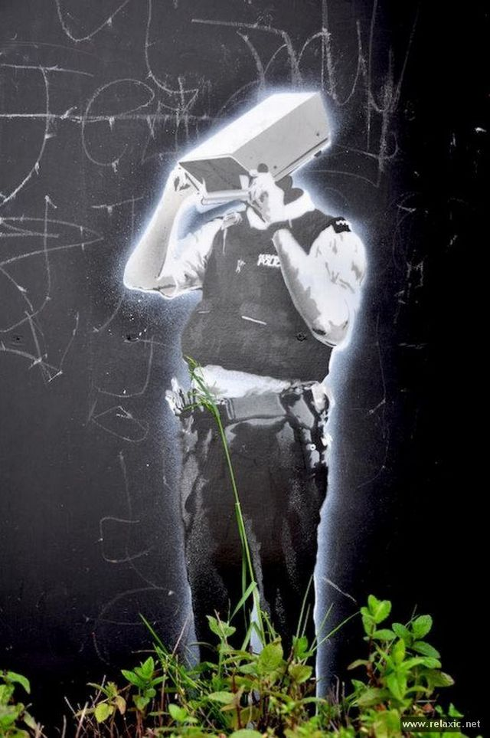
Bristol's street art scene is extremely diverse and has many talented street artists.

Slide 10
