Slide 1
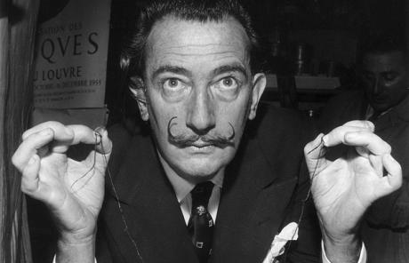
Salvador Dalí

Slide 2
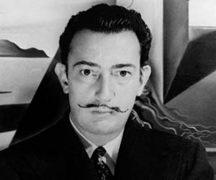
Salvador Domingo Felipe Jacinto Dalí i Domènech, 1st Marqués de Dalí de Pubol (May 11, 1904 – January 23, 1989) known as Salvador Dalí, was a prominent Spanish surrealist painter born in Figueres, Spain.

Slide 3
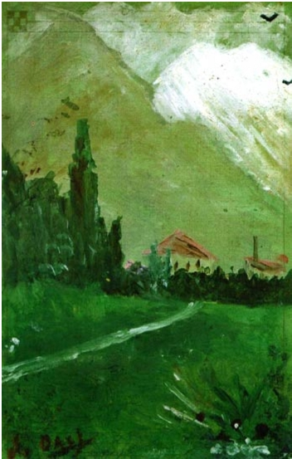
Dalí attended drawing school.
In 1916, Dalí also discovered modern painting on a summer vacation trip to Cadaqués with the family of Ramon Pichot, a local artist who made regular trips to Paris. The next year, Dalí's father organized an exhibition of his charcoal drawings in their family home. He had his first public exhibition at the Municipal Theater in Figueres in 1919.

Slide 4
- As a child, Dali was smart, but arrogant and uncontrollable child. He achieved his whims and simulation, always wanted to stand out and attract attention.
- Dalí was a skilled draftsman, best known for the striking and bizarre images in his surrealist work. His painterly skills are often attributed to the influence of Renaissance masters.
- Dalí was highly imaginative, and also enjoyed indulging in unusual and grandiose behavior. His eccentric manner and attention-grabbing public actions sometimes drew more attention than his artwork.

Slide 5
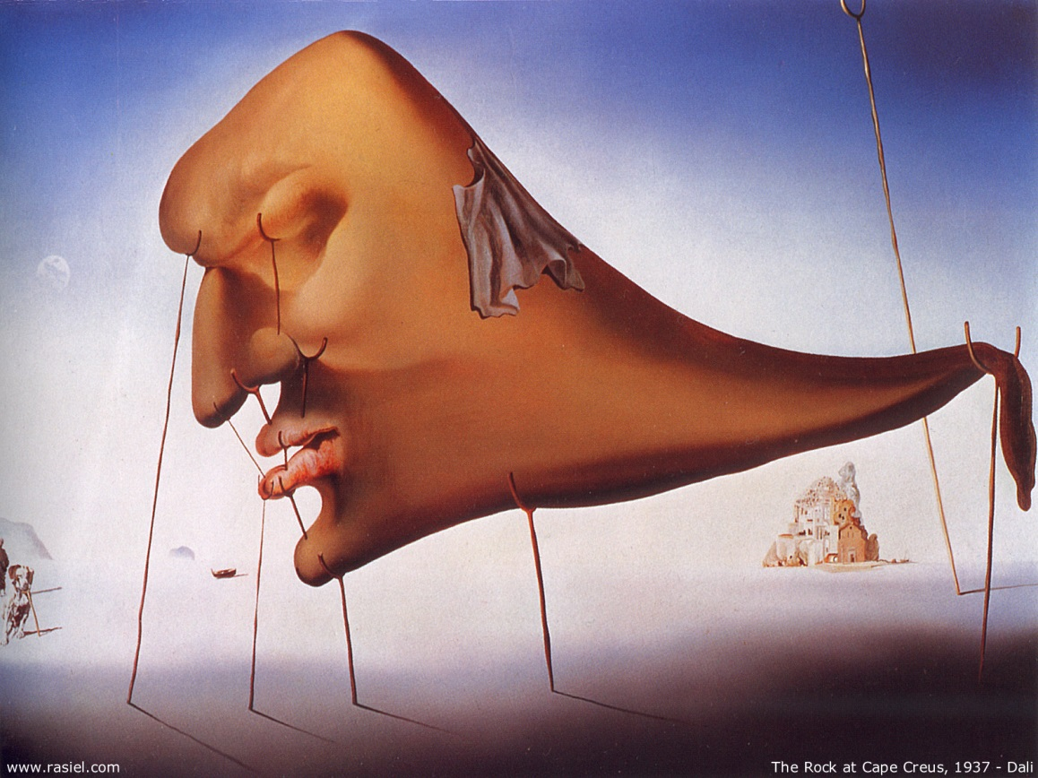
Surrealism is a cultural movement that began in the early 1920s, and is best known for its visual artworks and writings.
Surrealist works feature the element of surprise, unexpected juxtapositions and non sequitur; however, many Surrealist artists and writers regard their work as an expression of the philosophical movement.

Slide 6
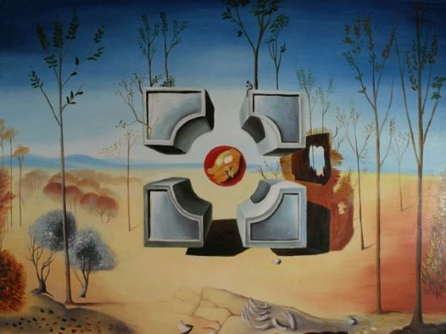
Creativity Salvador Dalí

Slide 7
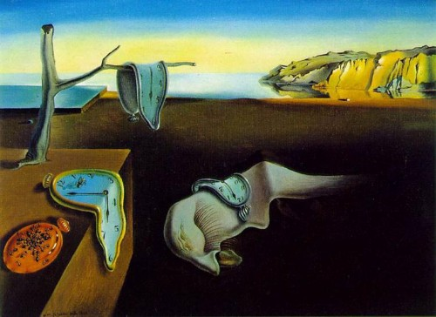
His best-known work, The Persistence of Memory, was completed in 1931.

Slide 8
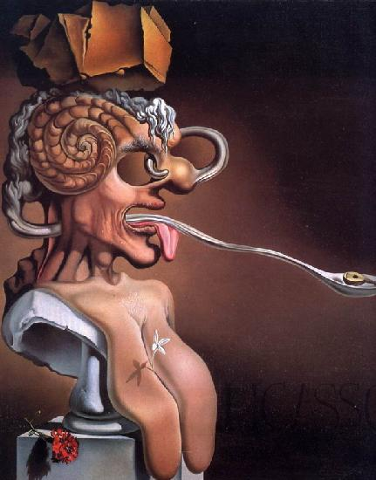
"Portrait of Picasso“
(1947)

Slide 9
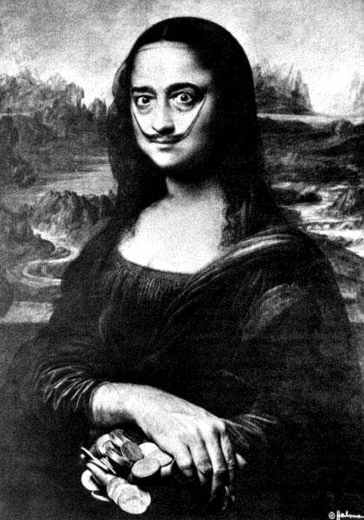
Salvador Dali as Mona Lisa
Salvador Dali executed in 1954 his "Self-Portrait as Mona Lisa."

Slide 10
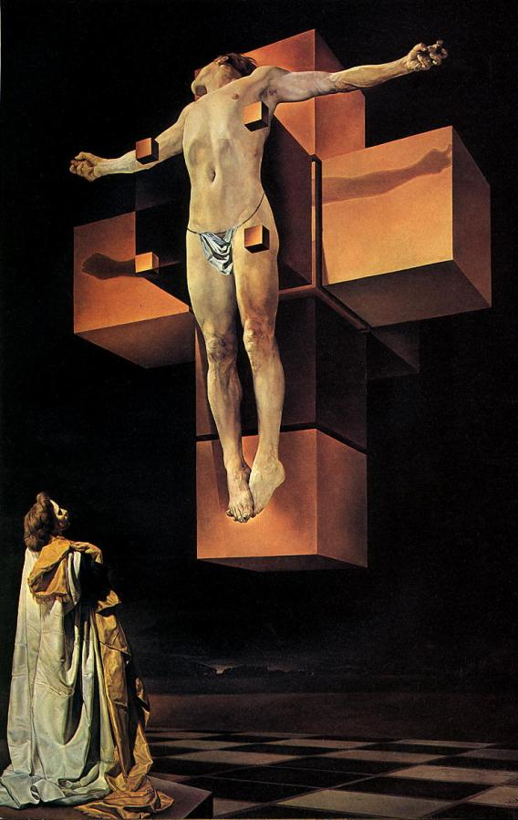
«Corpus Hypercubus»
(1954)
Painting «Corpus Hypercubus» written in 1954. Crucifixion of Jesus Christ on the unfolding of the hypercube. At the bottom left of Dali's wife Gala. In the background, bay Portligat. Is at the Metropolitan Museum in New York.

Slide 11
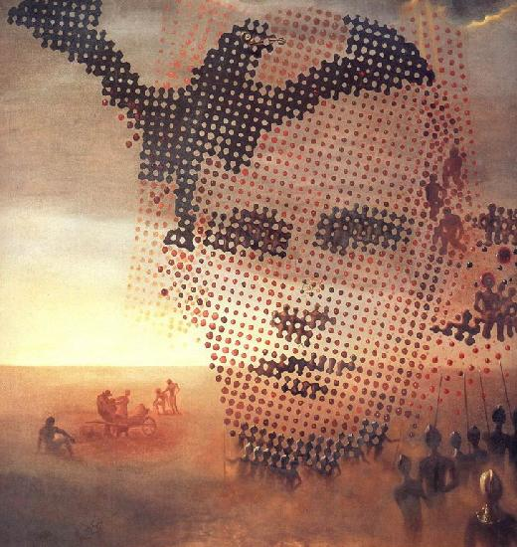
"Portrait of my late brother“(1963)

Slide 12
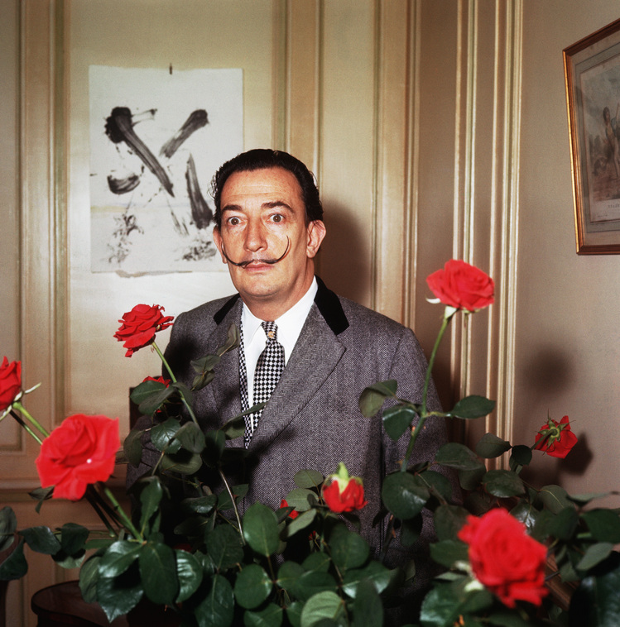
Recent years

Slide 13
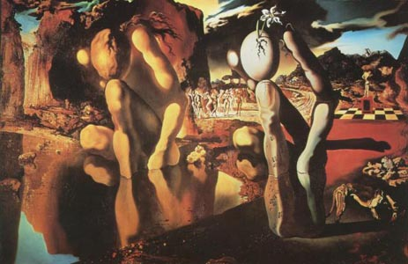
After his wife is going through a deep depression Dali. His paintings themselves are simplified, and they long dominated by the motive of sorrow (variations on "Pieta"). Parkinson's disease also interferes Dali painting. His most recent work ("Cockfights") are simple squiggles in which veiled body of characters - the last attempt of expression poor sick person.

Slide 14
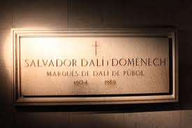
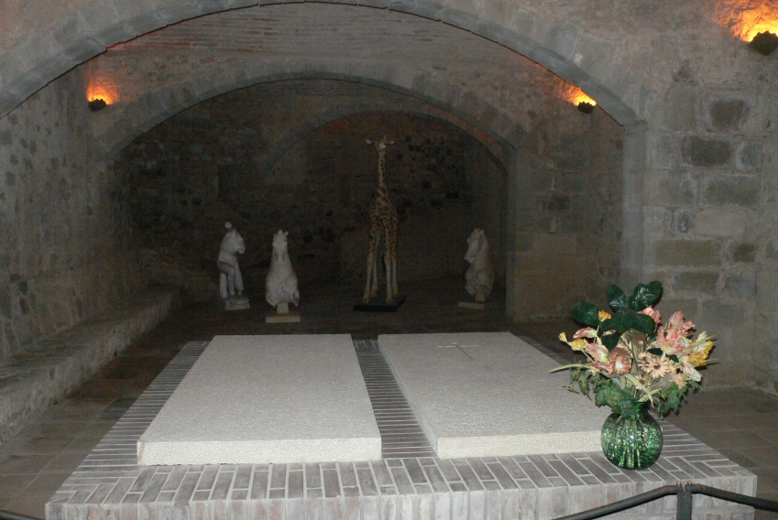
Sick, weak, Dali died January 23, 1989 of a heart attack. The only legible phrase he uttered during the years of the disease, was "My friend Lorca": artist remembered the years of happy, healthy youth, when he was friends with the poet Federico Garcia Lorca. Dali walled body on the floor in one room of the theater, the Dalí Museum in Figueres. Artist bury it so that on the grave of people could walk.

