Slide 1

My Healthy Lifestyle

Slide 2
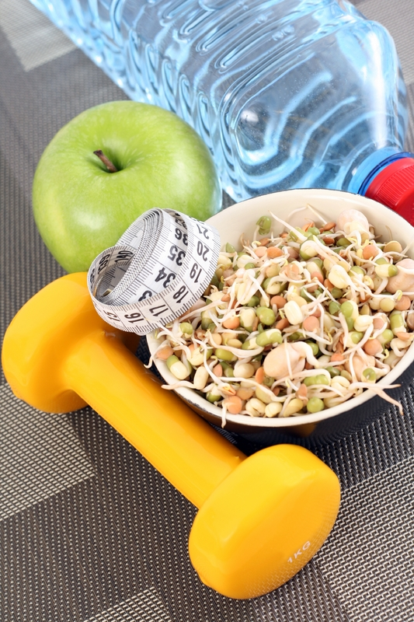
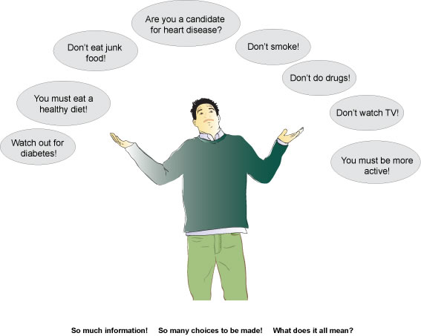
You hear a lot about living a healthy lifestyle, enough that the phrase 'healthy lifestyle' may be one we'd like to permanently retire. The problem is, that phrase describes the life we need to live if we want to feel good and look good. So, what does it actually mean? Well, there are the obvious things that describe a healthy person: He or she doesn't smoke, is at a healthy weight, eats healthy foods and exercises on a regular basis. It sounds so simple, it's funny just how hard it is to do all of those things in our current world.
The good news is, you don't have to change everything at the same time. In fact, the trick to healthy living is making small changes. Take more steps each day, adding fruit to your cereal, having an extra glass of water or saying no to that second helping of buttery mashed potatoes. So, what else can you be doing to live healthy? I will tell you and show my own examples.

Slide 3

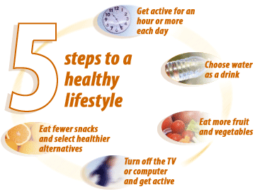
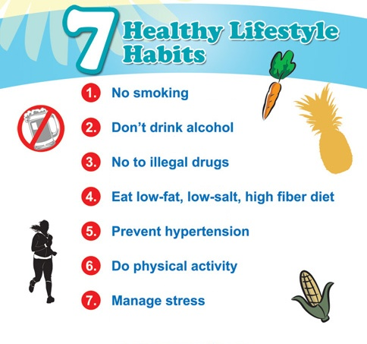

Slide 4
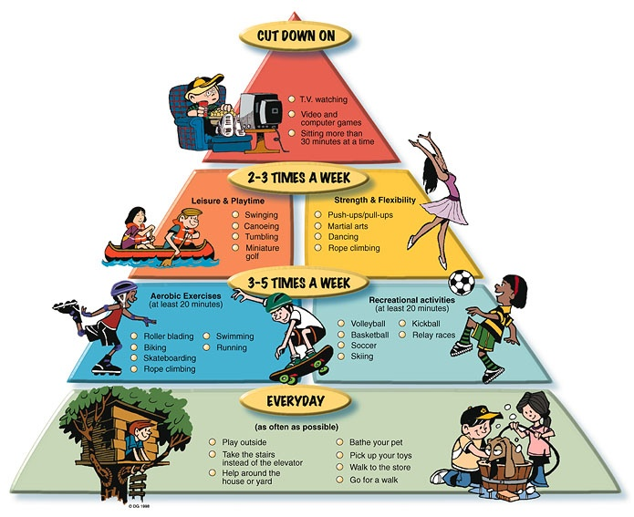
Exercises!
One of the biggest reasons we're have a weight problem these days is because we sit around too much. We know we need to exercise, but we have so many excuses not to do it. We're too busy, don't know where to start, we're not motivated or we're afraid we'll injure ourselves. The truth is, everything counts and the more you move, the healthier you'll be.

Slide 5
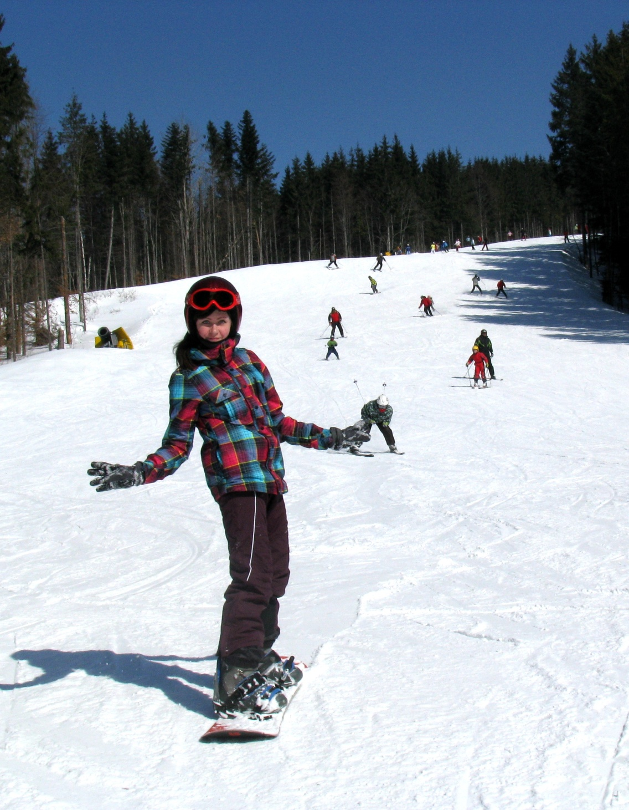
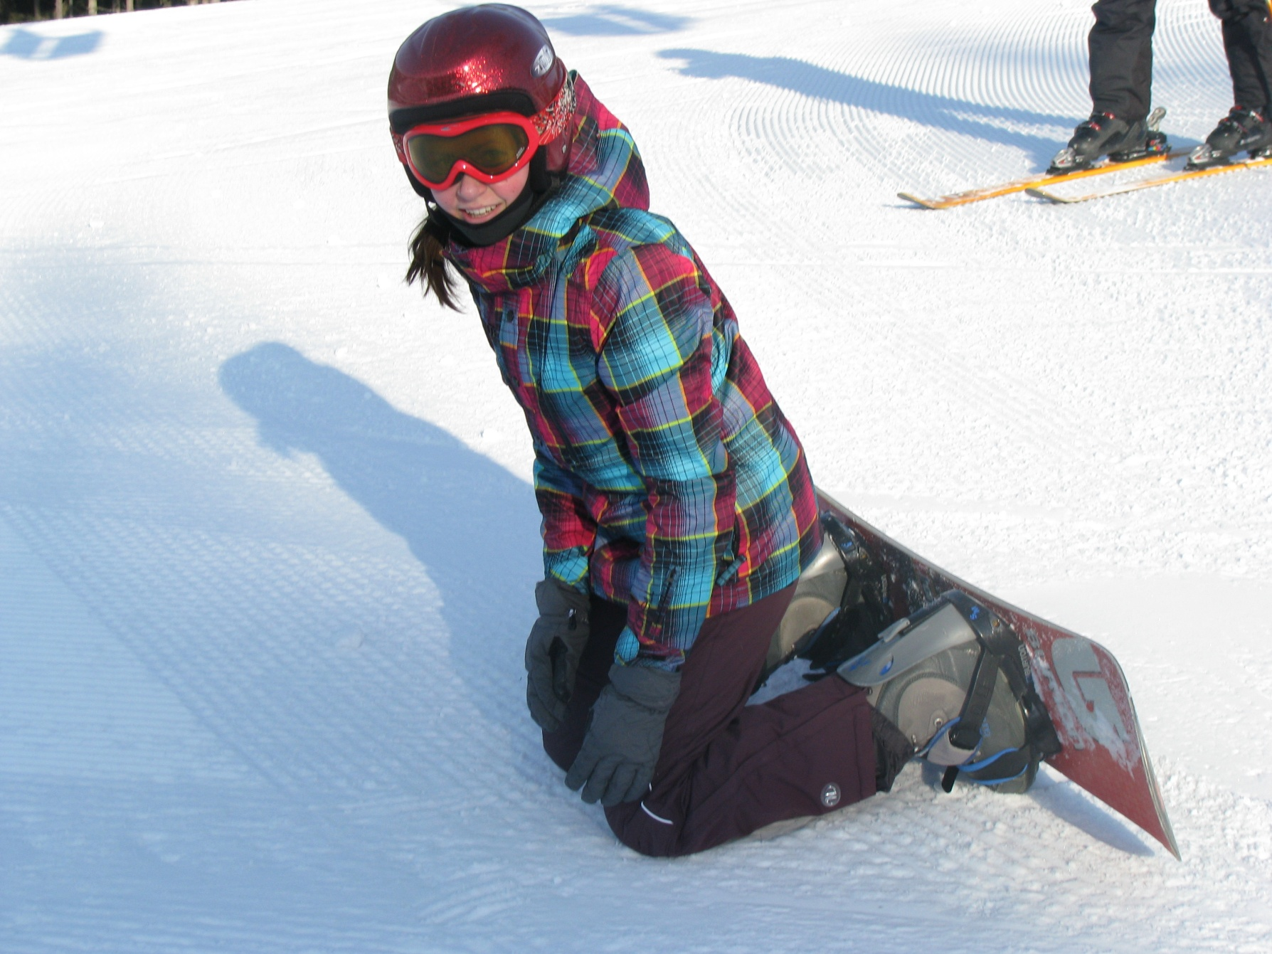
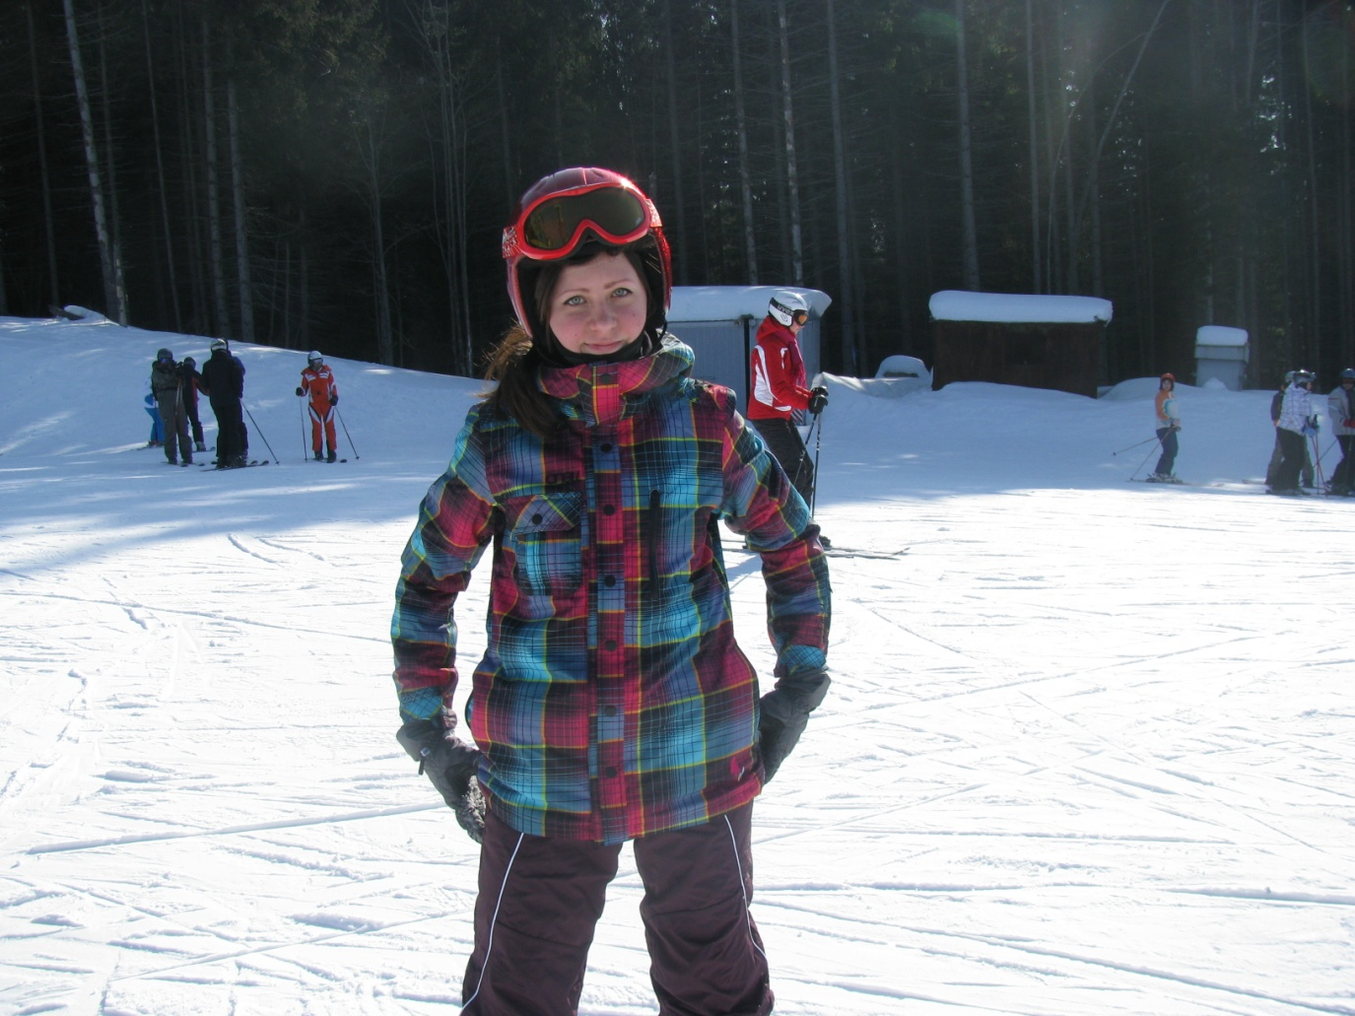
Skiing resort ‘’Bukovel’’
Of course not without fallings…

Slide 6


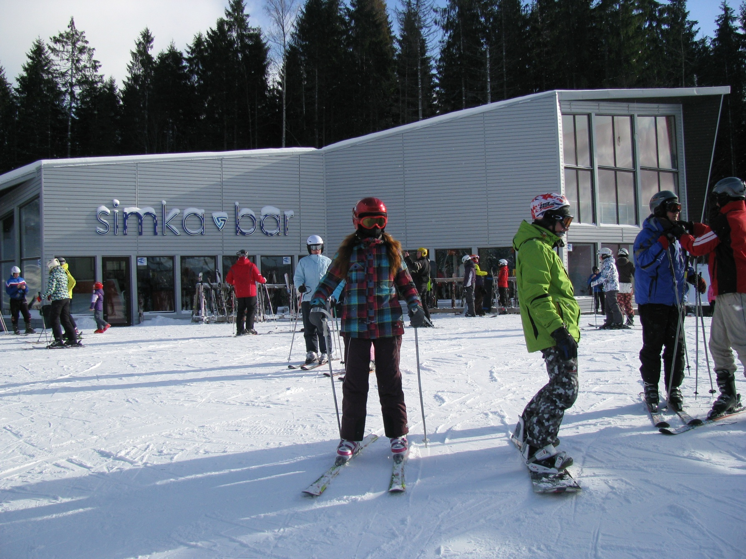


Slide 7
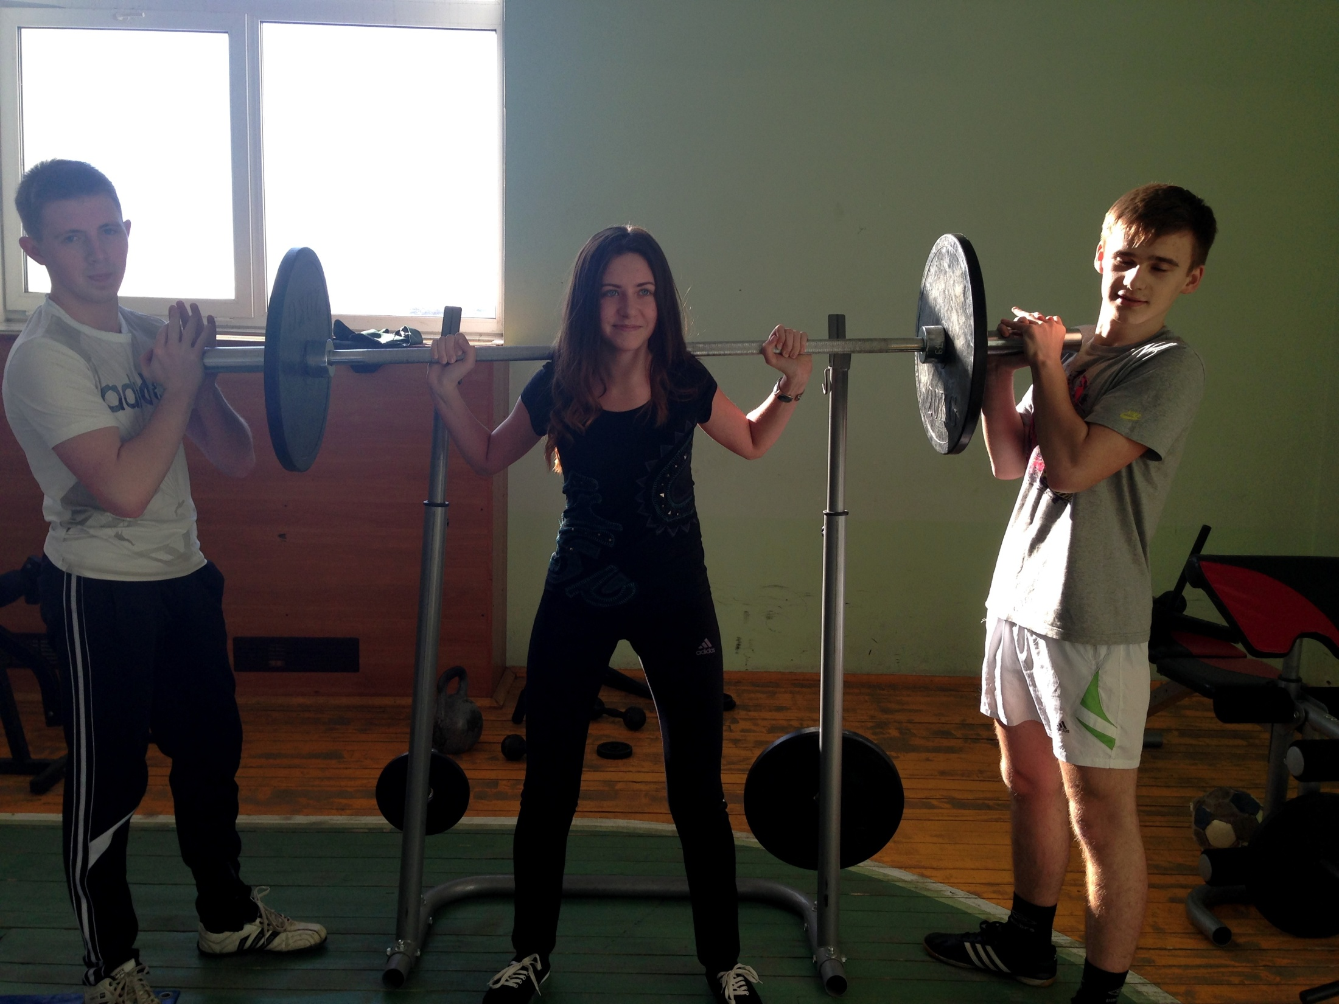
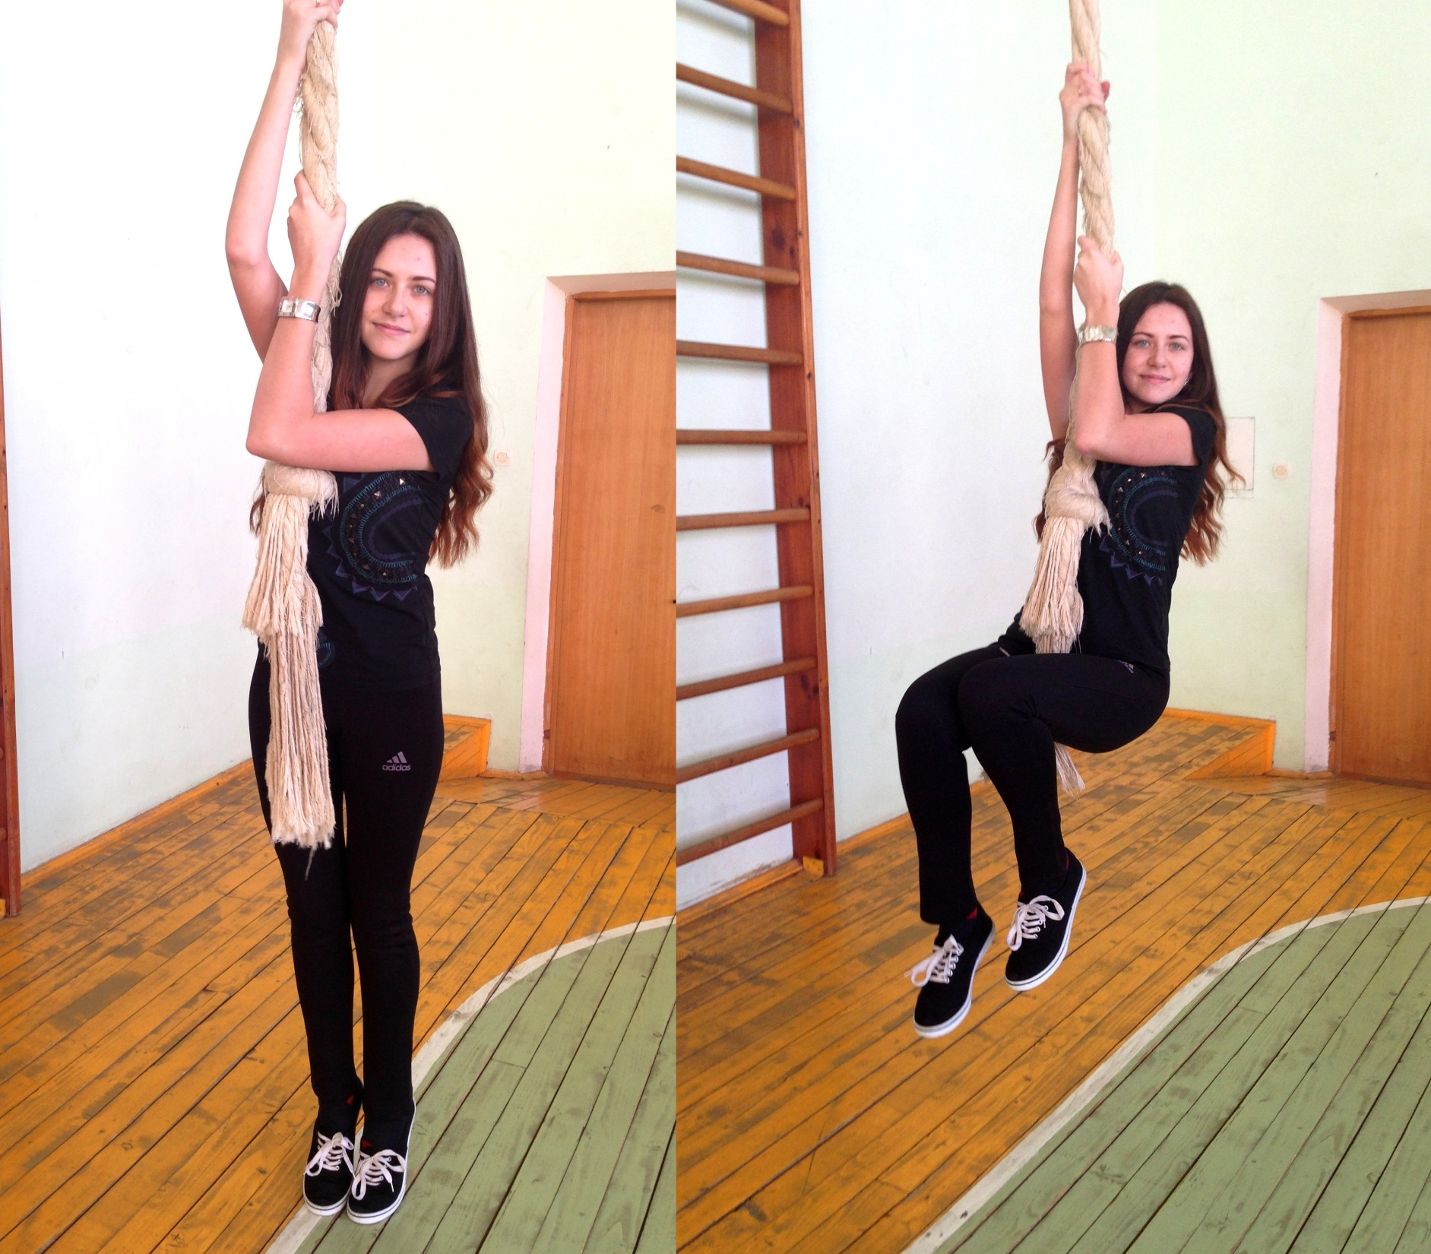
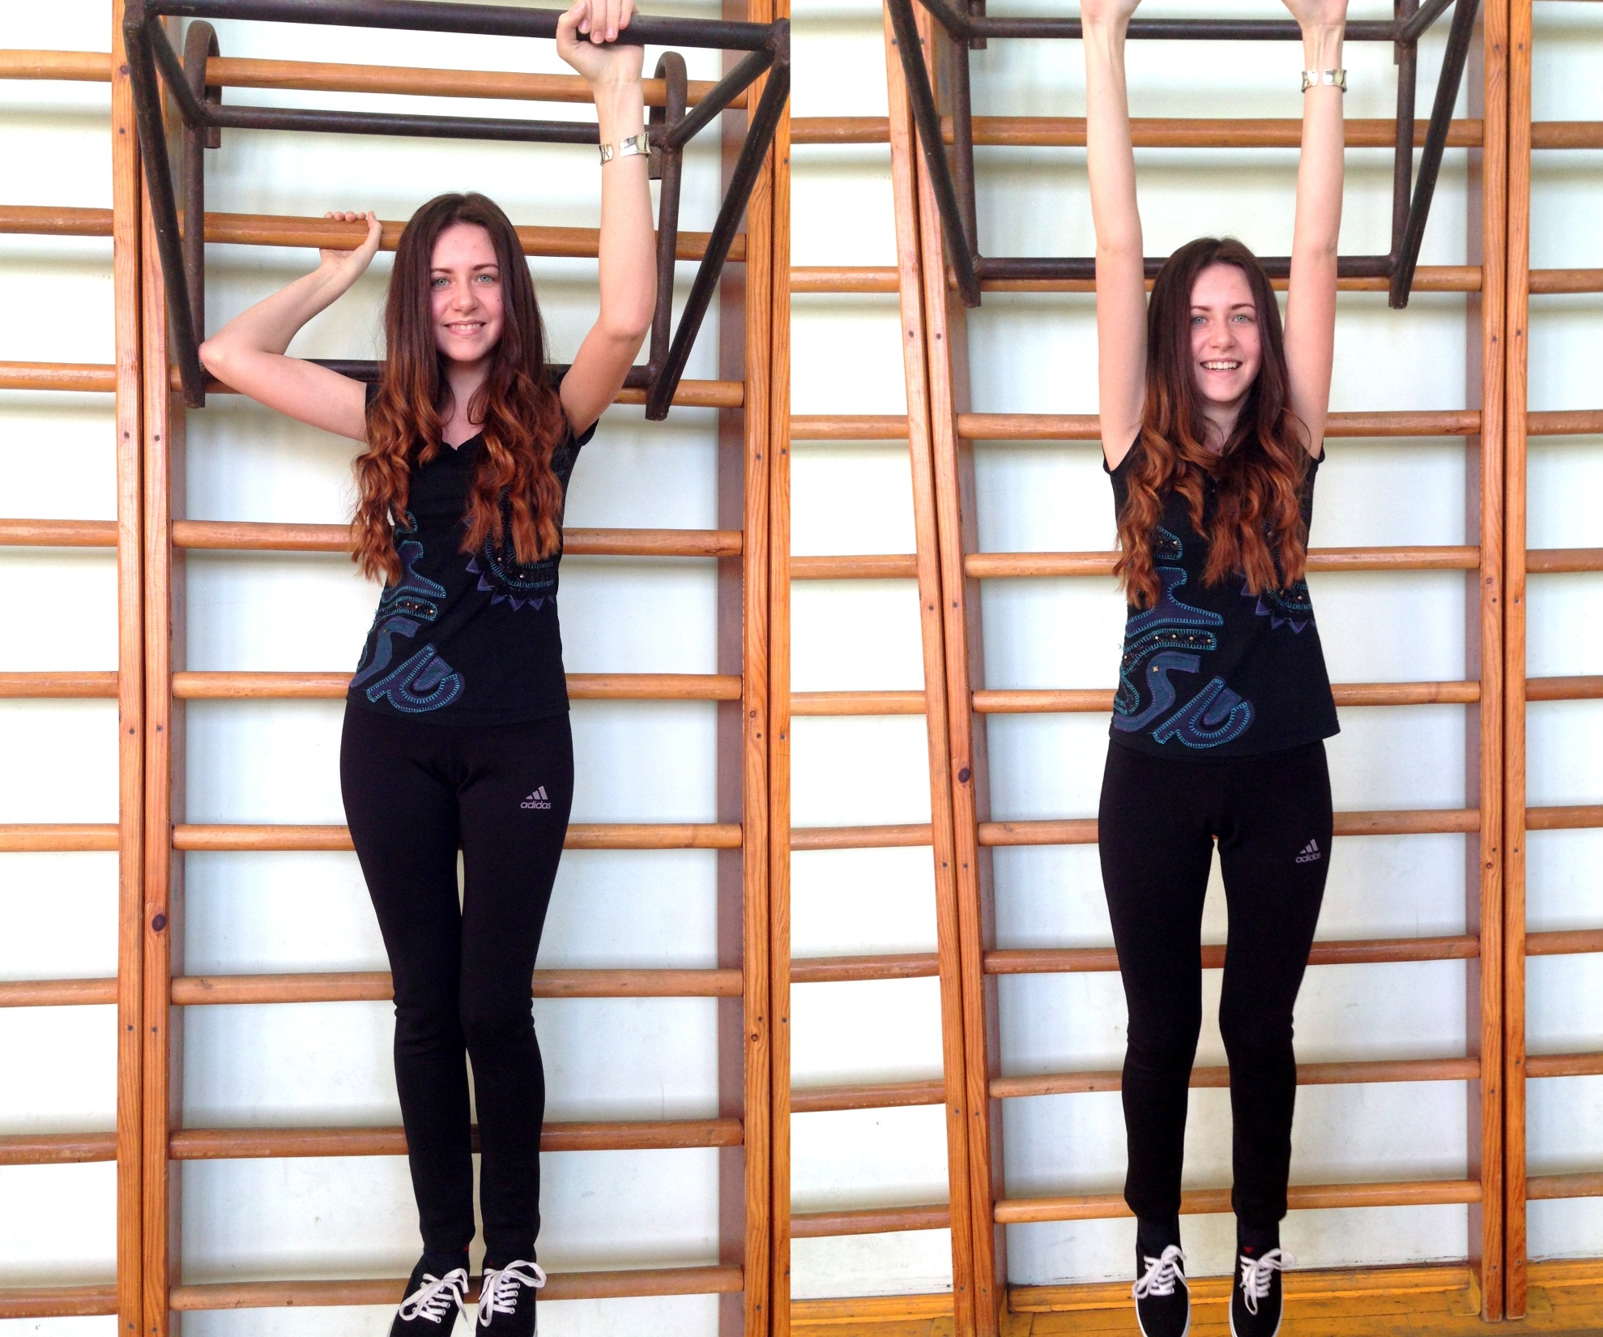
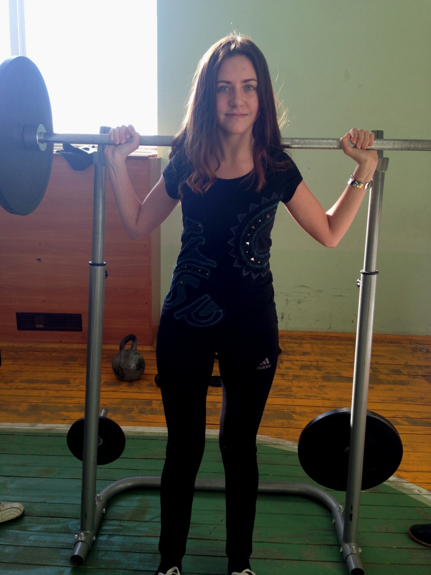

Slide 8

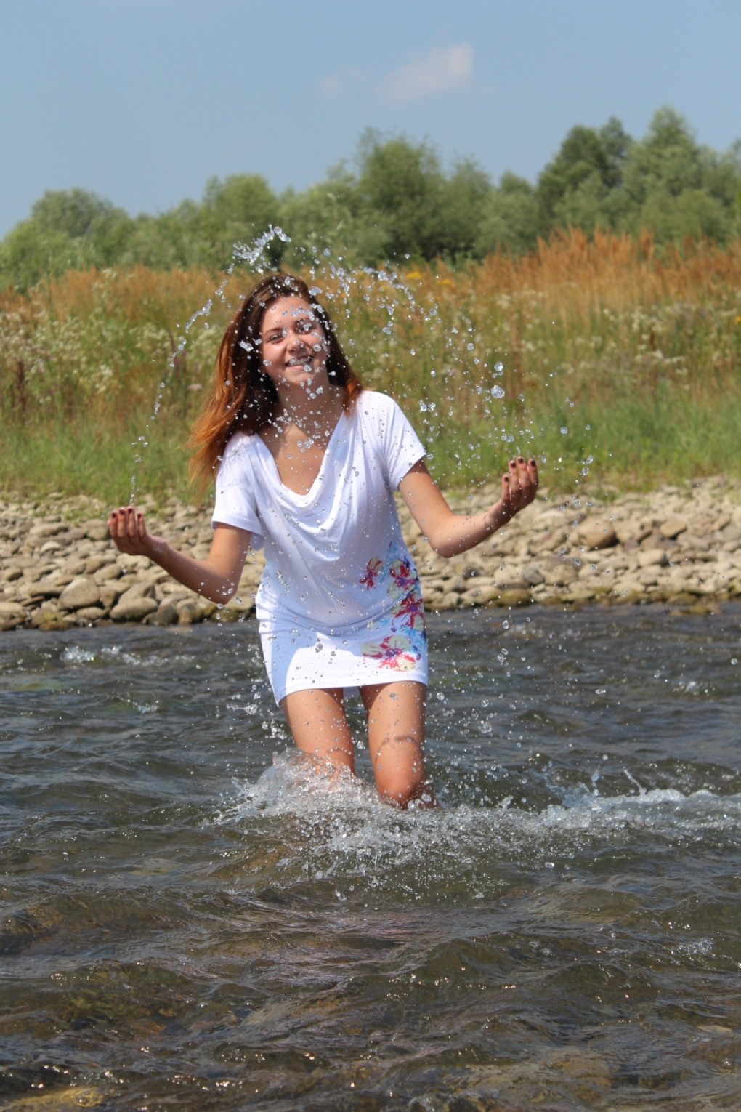

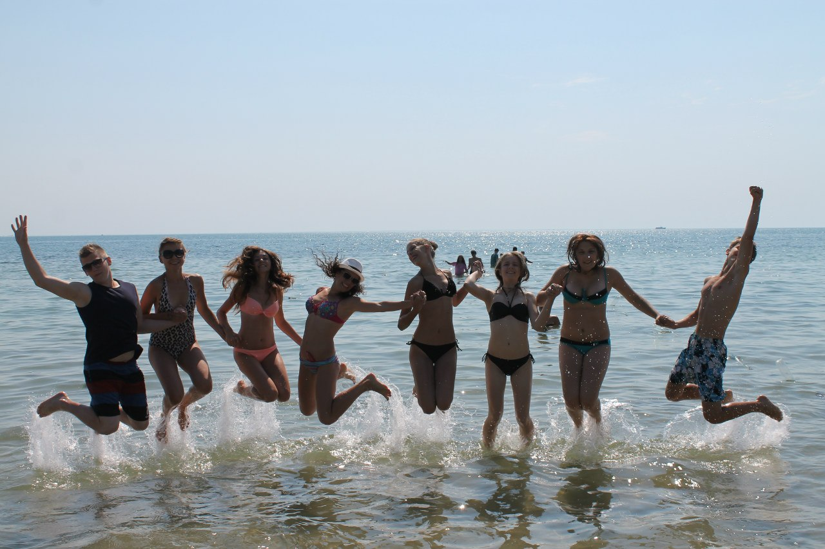
Relax and have a rest!

Slide 9

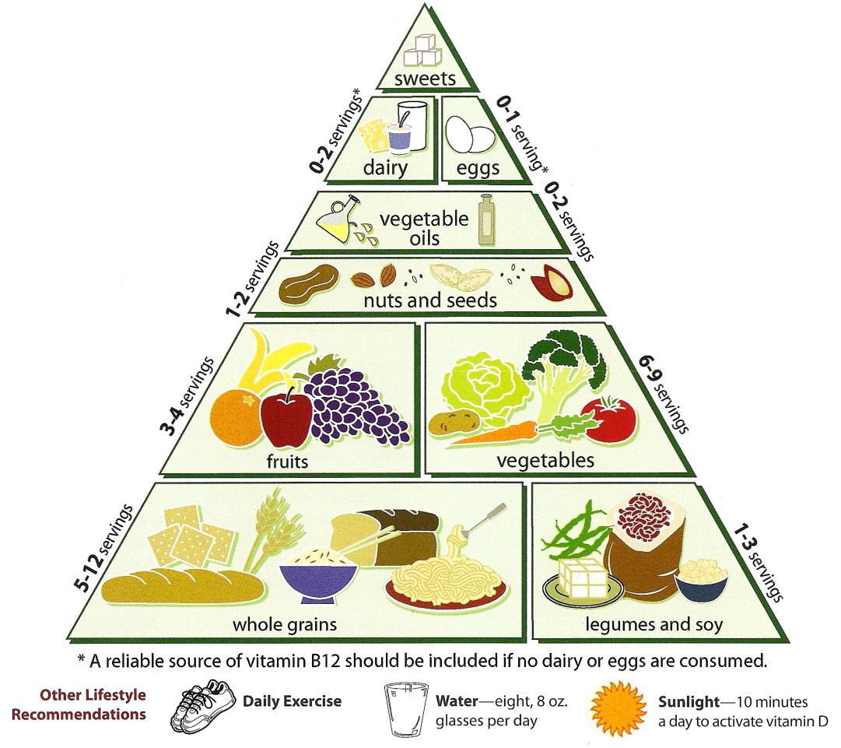
Eat well!
Eating a healthy diet is another part of the healthy lifestyle.

Slide 10
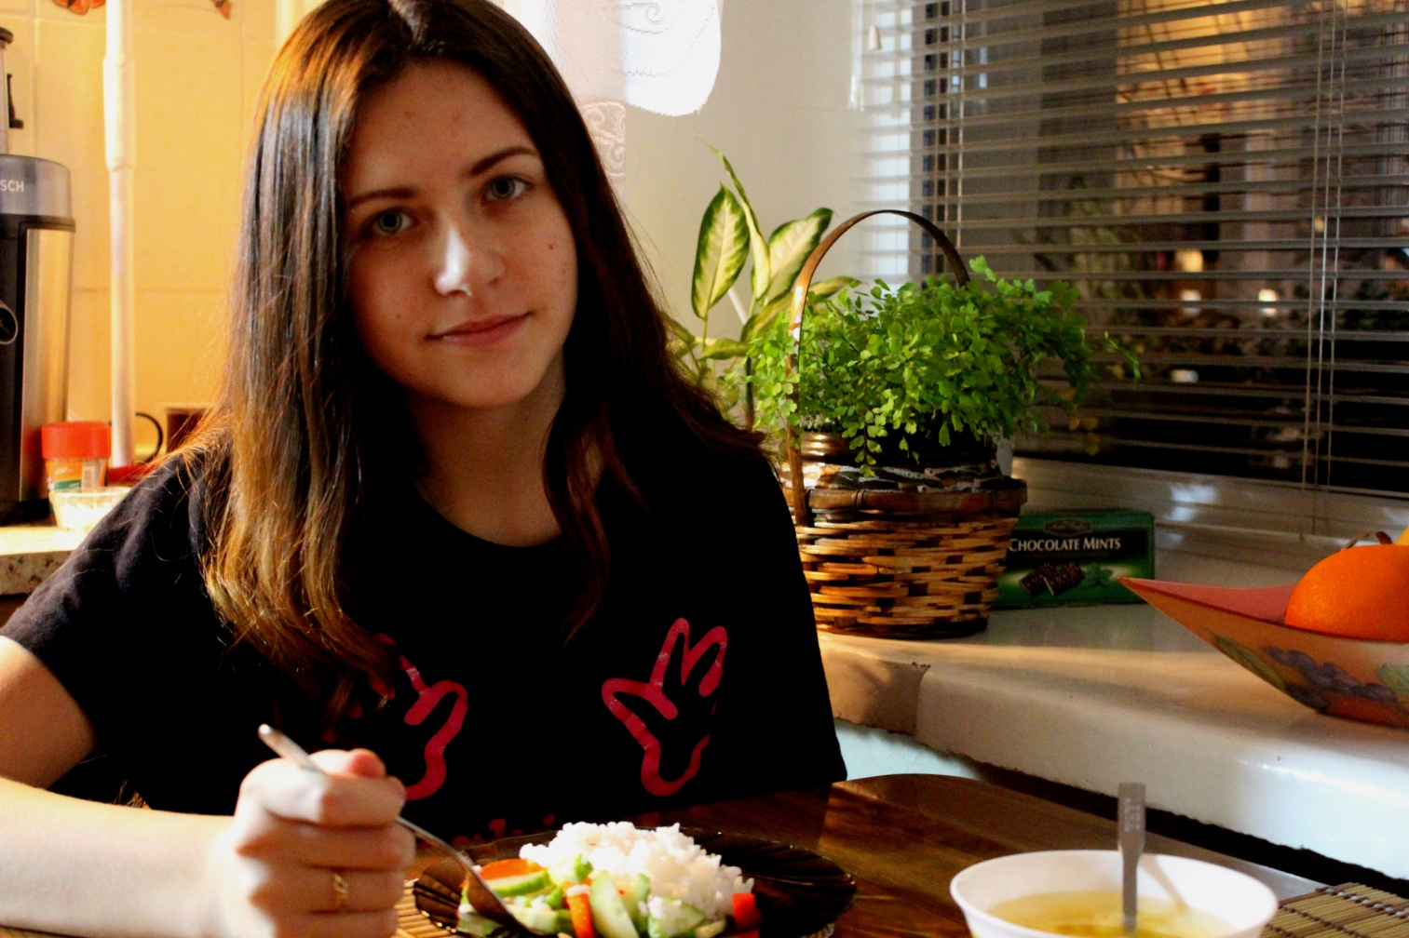
To keep fit I try to eat only healthy food. But sometimes it can be untasty.
However Mark Twain said:“The only way to keep your health is to eat what you don’t want, drink what you don’t like and do what you’d rather not’’.

Slide 11
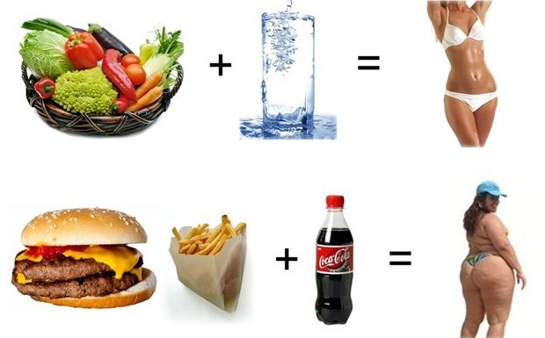
Don’t forget: Early to bed, early to rise makes a man healthy, wealthy and wise!
And this one..

Slide 12

Thanks for attention!

