Slide 1
Environmental problems
in Ukraine

Slide 2
Nowadays there are a lot of environmental problems in Ukraine. The byproducts pollute the air we breathe, the water we drink, the soil we grow grain and vegetables.

Slide 3
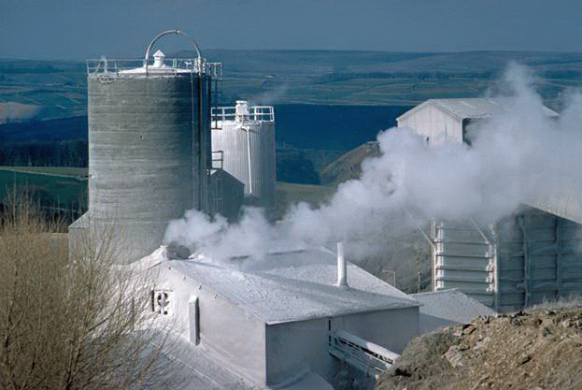
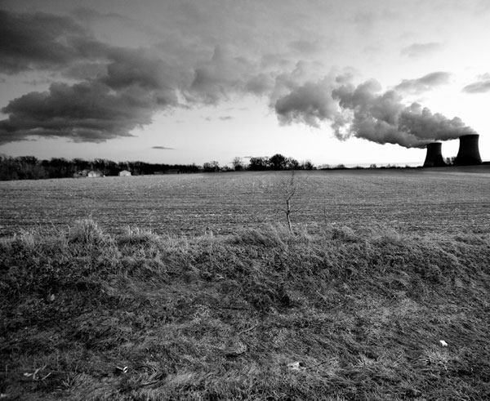
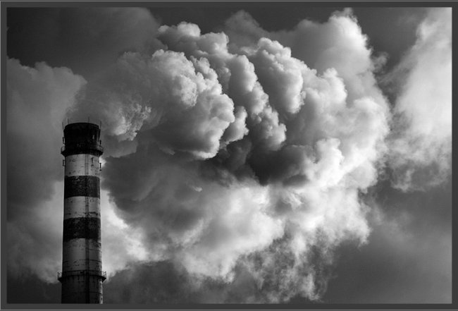
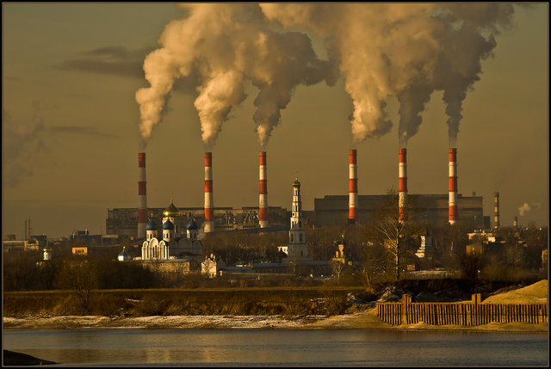
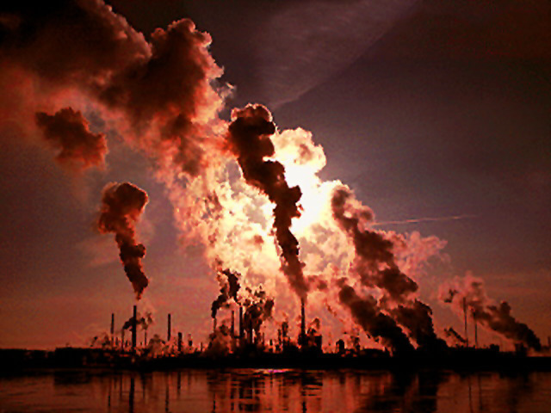
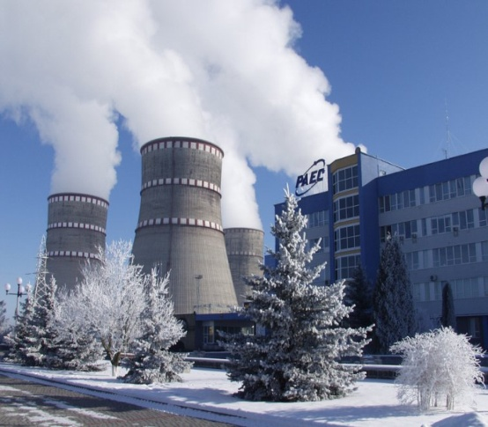
Large cities with smoky industrial enterprises appeared in our country

Slide 4
Many cities suffer from smog
Vast forests are cut

Slide 5
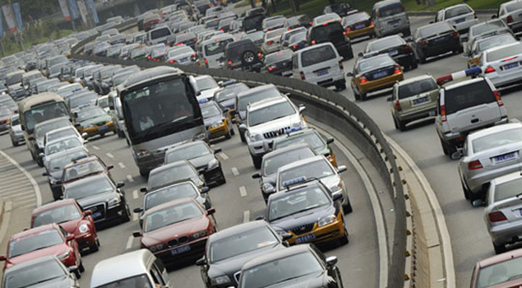
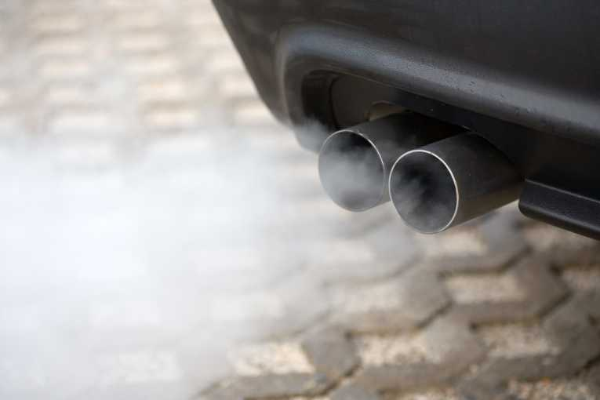
Urban air pollution continues to expand as a result of the increased number of motor vehicles
Exhaust fumes from the engines of automobiles contain a number of polluting substances

Slide 6
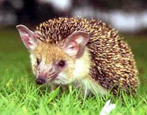
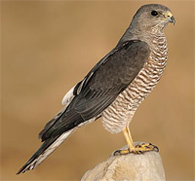
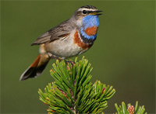
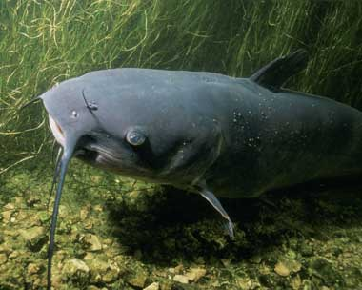
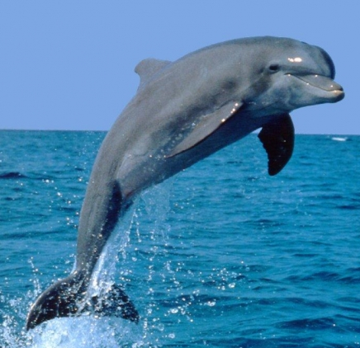
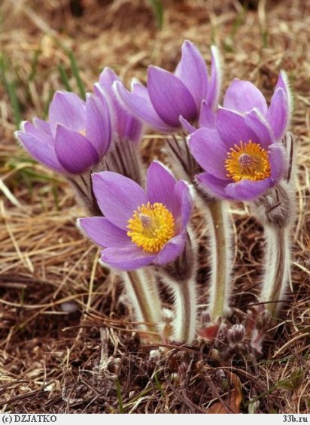
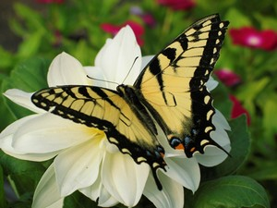
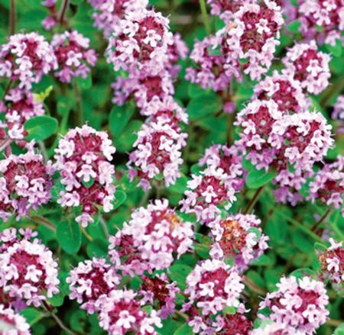
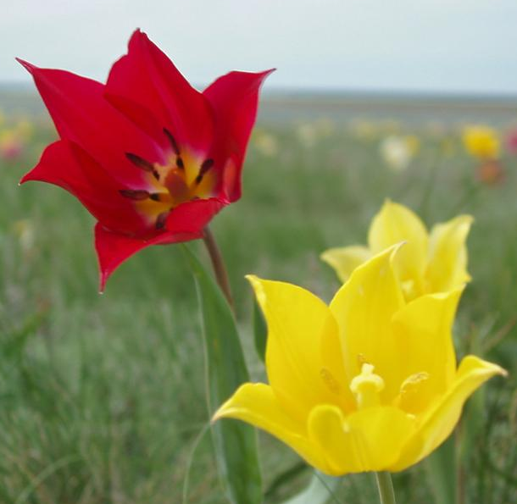
As a result some rare species of animals, birds, fish and plants disappear forever.

Slide 7
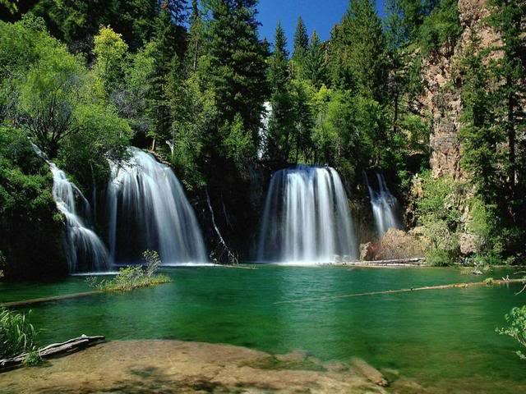
Environmental protection is a global problem. That is why the most serious measures to create a universal system of ecological security should be taken.

Slide 8
The activity of various environment organizations help to improve the situation. Among them are
The Greenpeace and The Green Party.

Slide 9
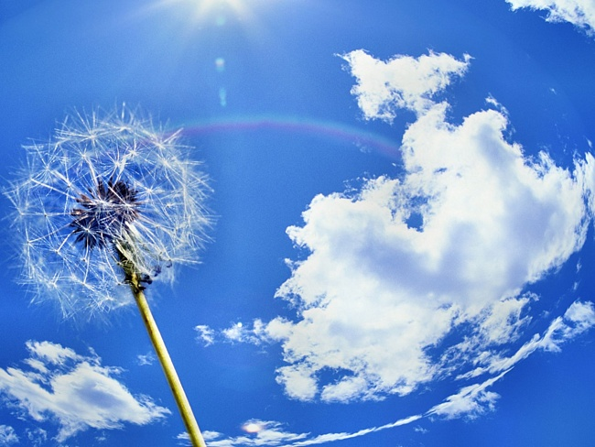
To protect nature people should change their attitude to it!

Slide 10
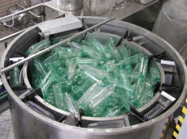
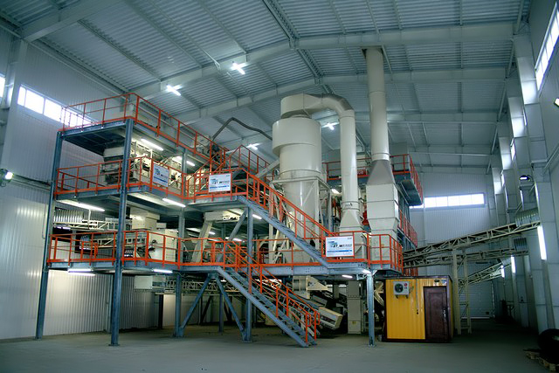
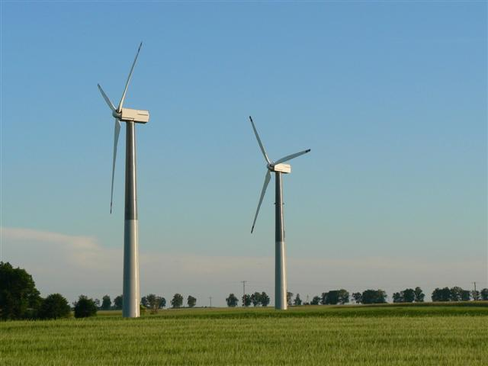
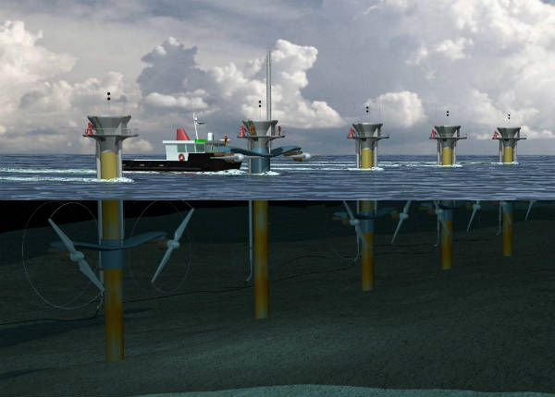
For example:
provide special filters on factories to reduce the pollution of rivers and air;
- recycle the used paper, plastic and glass;
reduce the usage of electricity;

Slide 11
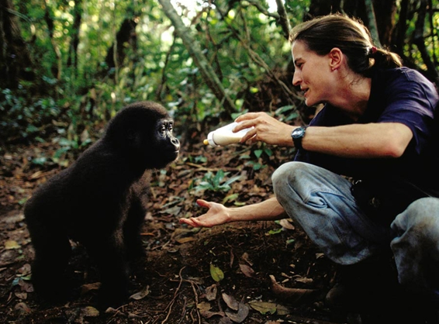
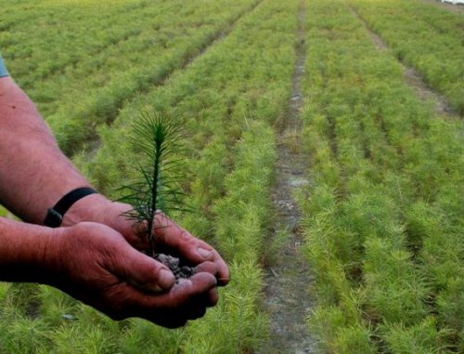
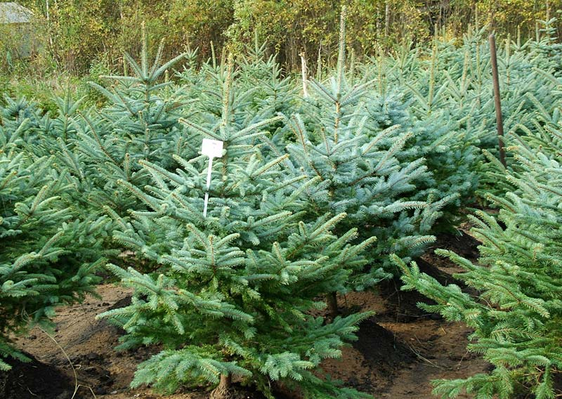
- encourage the usage of more pollution-free fuel than petrol;
take care of extinct animals and plants ;
- deal with problems of reforestation.

Slide 12
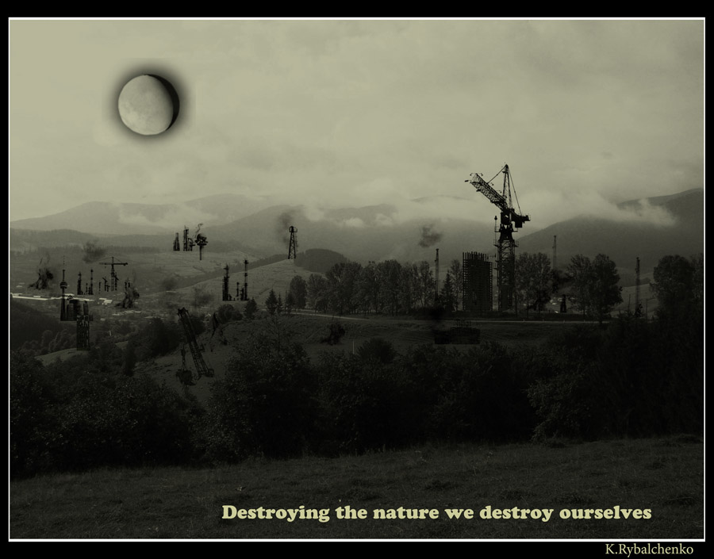
If we are unable to learn to use the environment carefully and to protect it from destructive mans activities, very soon we’ll have no world to live in!

Slide 13
The future is in our hands!

