Slide 1
My future
profession

Slide 2
To start with, choosing a future profession is one of the most important decisions in our life. A person passes almost half of her/his life at work. There are a lot of interesting and useful professions, and it is not an easy task to choose the right one.

Slide 3
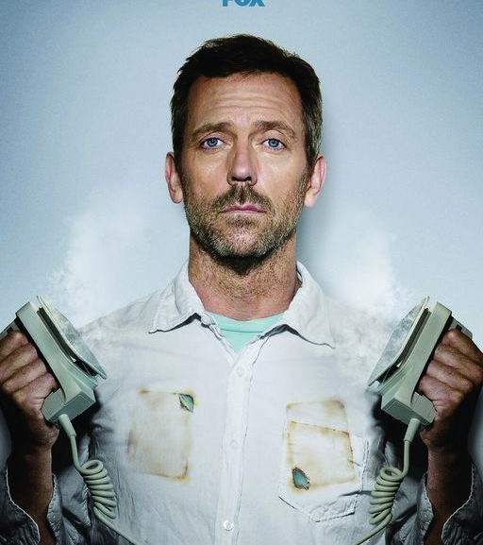
As for me,I want to be a doctor. It is our family tradition: my mother, father and grandmother are doctors,and I hope I will continue the dynasty. This profession requires a big responsibility,so people who want to be a doctor have to be reliable and kind-hearted. I think that I have such trades of character. There is no one on the Earth who does not need a doctor, so that is why this profession is demanded, noble and valued.

Slide 4
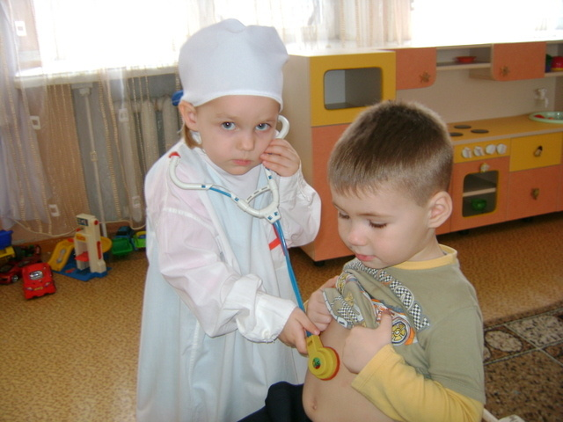
A doctor must be a qualified specialist ,because he is responsible for people’s life and his aim is to diagnose and institute therapy correctly. This profession requires the courage, the necessity for a single correct solution. The doctor examines human body, fights with diseases, improves health of people, prolongs their life. Certainly to become a professional I have to make efforts, and first of all: get a higher education and then improve own skills.

Slide 5
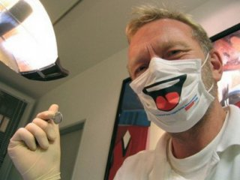
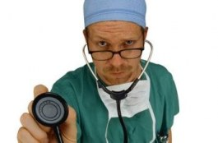
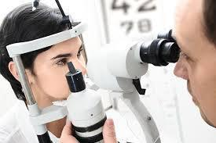
This profession has a lot of advantages. Being a doctor you can take care of my family. When you become a doctor you learn something new every day because the human body is full of astonishing facts. You will never get bored working as a doctor because a doctor always faces challenging situations. There are so many complicated things that the doctors have achieved.

Slide 6
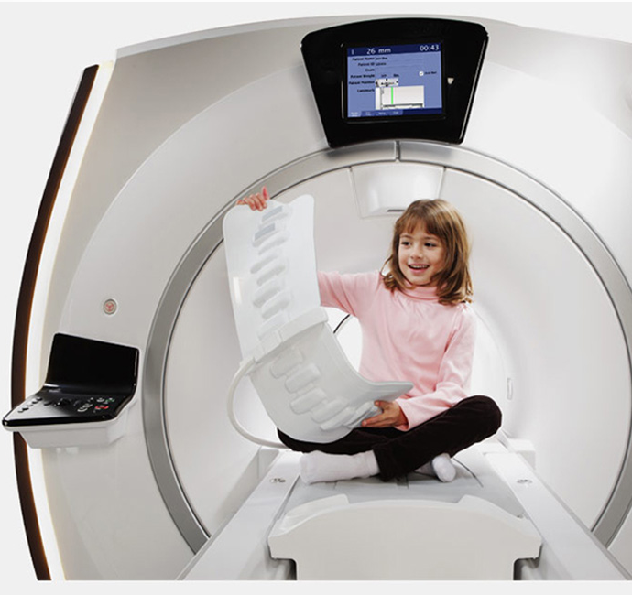
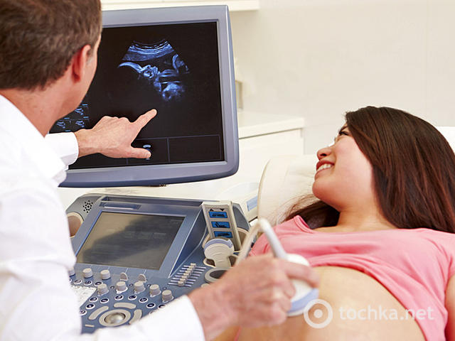
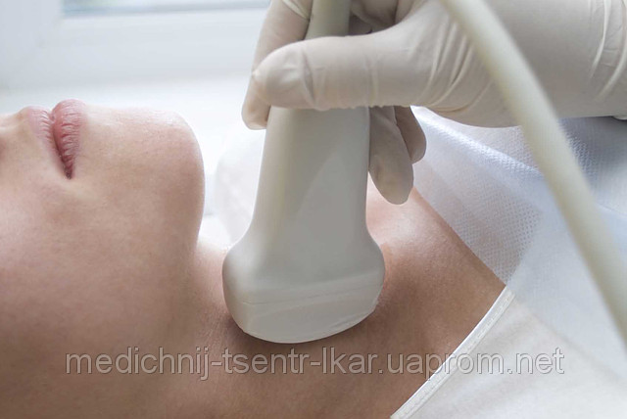
Nowadays there is a huge progress in the medical field. Using new technologies doctors found care for cancer and conduct unique surgeries.(19)I think that I and future doctors have big perspectives in the fight with dangerous and incurable diseases. Medicine is a very wide area and for the present moment I want to be a doctor of ultrasound diagnosis.

