Slide 1
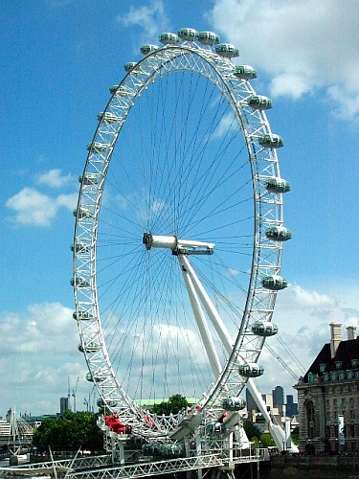
London Eye
by Julia Tachyns’ka

Slide 2
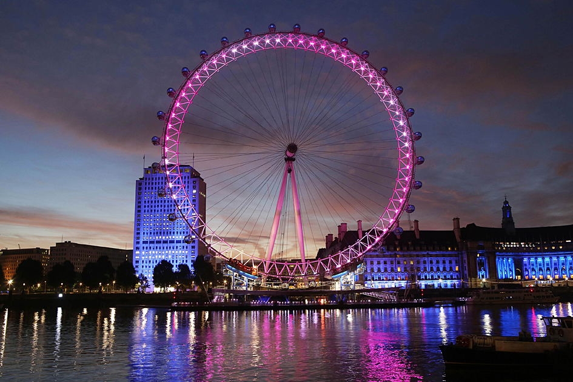
The London Eye
General information
Status | Complete
Type | Ferris wheel
Location | South Bank of the River Thames,London Borough of Lambeth, UK
Coordinates | 51.5033°N 0.1197°WCoordinates: 51.5033°N 0.1197°W
Inaugurated | 31 December 1999 Opened: 9 March 2000
Cost | £70 million
Height | 135 metres (443 ft)
Technical details
Diameter | 120 metres (394 ft)
Design and construction
Architect | Frank Anatole, Nic Bailey, Julia Barfield, Steve Chilton, Malcolm Cook, David Marks, Mark Sparrowhawk
Architecture firm | Marks Barfield Architects
Engineer | Arup

Slide 3
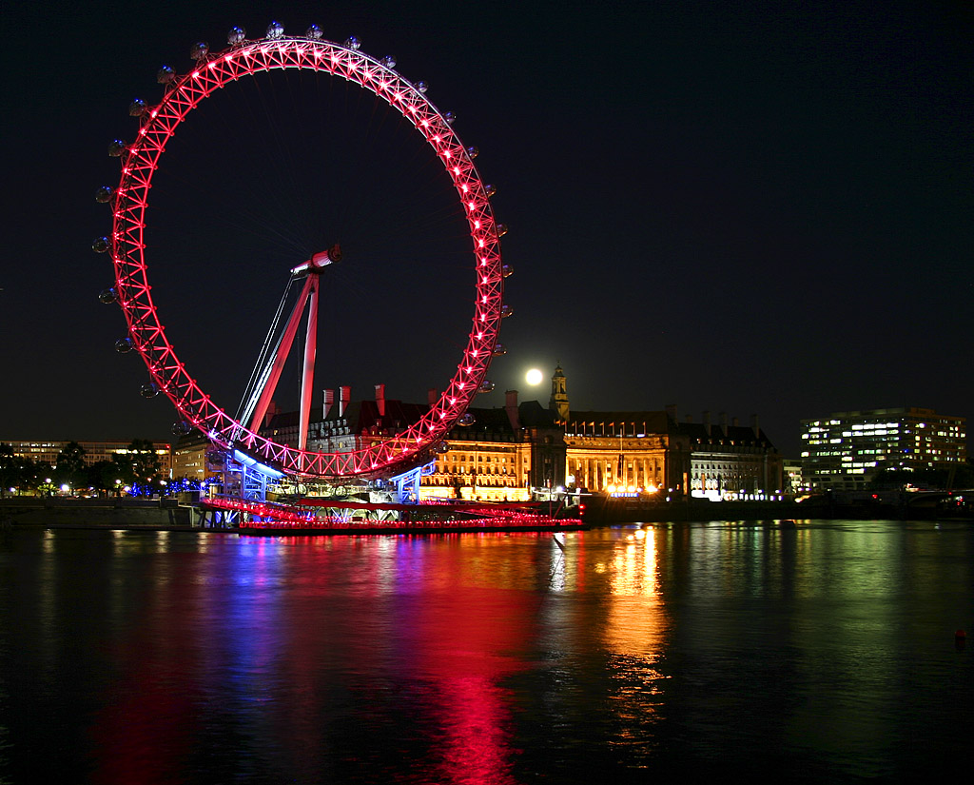
A modern but already very popular tourist attraction is the London Eye, a giant observation wheel located in the Jubilee Gardens on the South Bank. The 135 meter (443ft) tall structure was built as part of London's millennium celebrations.

Slide 4
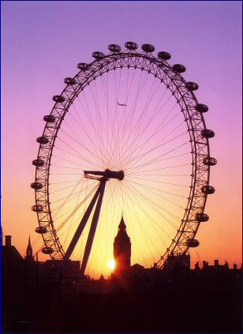
A Landmark for the new Millennium
The structure was designed by the architectural team of David Marks and Julia Barfield, husband and wife. They submitted their idea for a large observation wheel as part of a competition to design a landmark for the new millennium. None of the entrants won the competition, but the couple pressed on and eventually got the backing of British Airways, who sponsored the project.

Slide 5
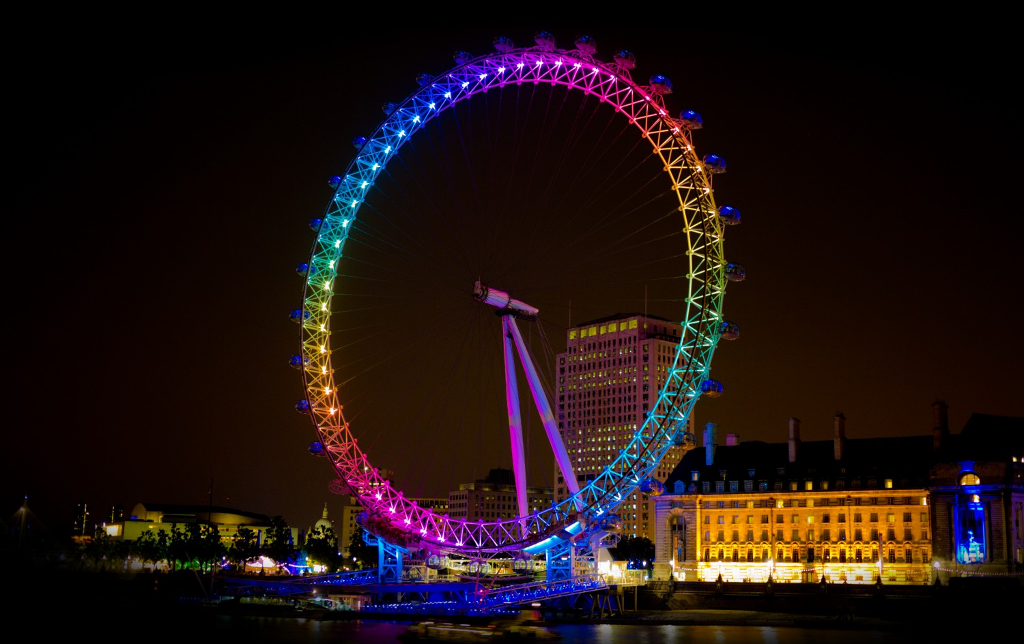
Construction
Construction of the observation wheel took more than a year and a half to complete. In the process over 1700 tonnes of steel were used for the structure and more than 3000 tonnes of concrete were used for the foundations. The futuristic looking capsules, accommodating up to twenty-five passengers, were transported all the way from France by train through the chunnel. Each egg-shaped capsule is eight meters long and weighs five hundred kilograms. The twenty-five meter (82 ft) long spindle was built in the Czech Republic. The rim has a diameter of 122m (400ft), about two hundred times the size of a bicycle wheel. Eighty spokes connect the rim with the spindle.

Slide 6
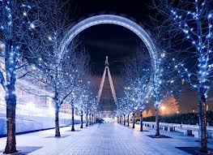
The Observation Wheel
The observation wheel turns slow enough for people to embark while it is moving. A complete turn takes about thirty minutes. Thanks to the construction of the glass capsules on the outer side of the rim, London Eye Capsule Capsule the passengers have a great 360 degree view over London. Many famous landmarks are clearly visible, including Buckingham Palace, St. Paul's Cathedral and the Houses of Parliament. On a clear day you can see as far as forty kilometers (25 miles). Make sure you get your tickets in advance, lines can be very long, both the lines for embarking and for ticket purchases. It's less crowded at night when the views are even more spectacular.

Slide 7
Panoramic skyline seen from the Eye, with Palace of Westminster and Big Ben to the left, Charing Cross railway station centre, and Waterloo railway station to the right

