Slide 1
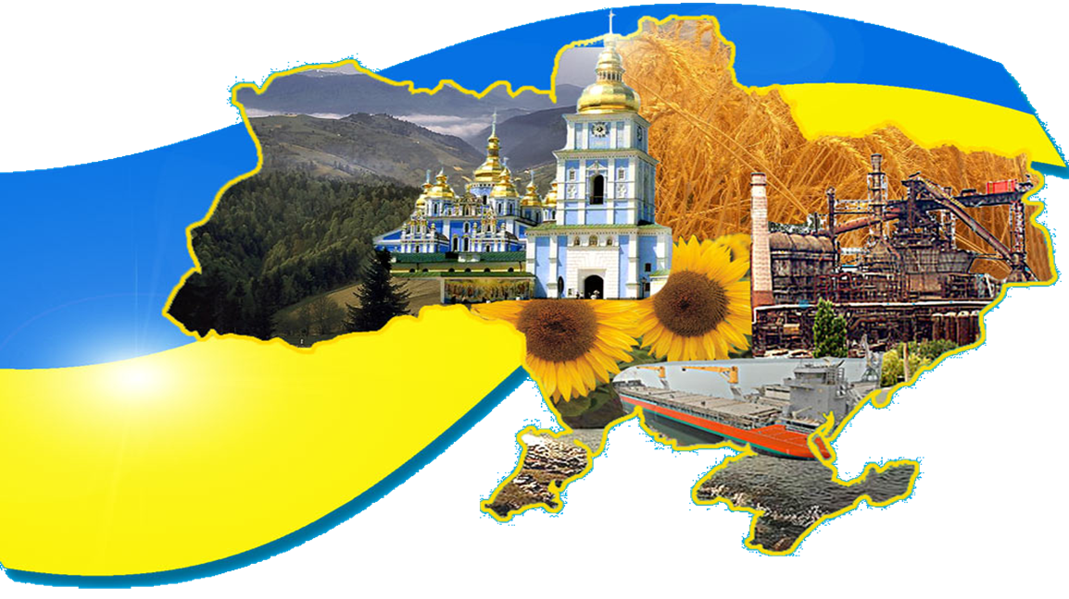
UKRAINE

Slide 2
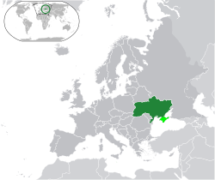
Ukraine is a country in Eastern Europe. Ukraine borders Russia to the east and northeast, Belarus to the northwest, Poland, Slovakia and Hungary to the west, Romania and Moldova to the southwest, and the Black Sea and Sea of Azov to the south and southeast, respectively.
Its population is about 46 mln people. Ukraine covers about 603.700-sq. km being larger than any country in Western Europe. From east to west Ukraine stretches for more than 1300 km and from north to south for almost 900 km.

Slide 3
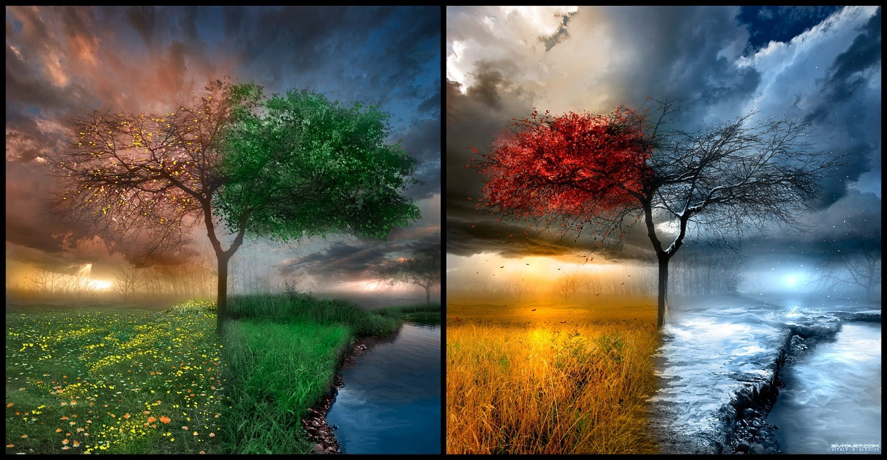
Climate
Ukraine has a mostly temperate continental climate, although the southern coast has a humid subtropical climate. Precipitation is disproportionately distributed; it is highest in the west and north and lowest in the east and southeast. Western Ukraine receives around 1,200 millimetres of precipitation annually, while Crimea receives around 400 millimetres . Winters vary from cool along the Black Sea to cold farther inland. Average annual temperatures range from 5–7 °C in the north, to 11–13 °C in the south.

Slide 4
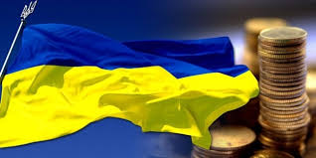
Politics
Ukraine is a republic under a mixed semi-parliamentary, semi-presidential system with separate legislative, executive and judicial branches.
The President is elected by popular vote for a five-year term and is the formal head of state. Ukraine's legislative branch includes the 450-seat unicameral parliament, the Verkhovna Rada.The parliament is primarily responsible for the formation of the executive branch and the Cabinet of Ministers, headed by the Prime Minister. However, the President still retains the authority to nominate the Ministers of the Foreign Affairs and of Defence for parliamentary approval, as well as the power to appoint the Prosecutor General and the head of the Security Service.
Laws, acts of the parliament and the cabinet, presidential decrees, and acts of the Crimean parliament may be abrogated by the Constitutional Court, should they be found to violate the constitution. Other normative acts are subject to judicial review. The Supreme Court is the main body in the system of courts of general jurisdiction. Local self-government is officially guaranteed. Local councils and city mayors are popularly elected and exercise control over local budgets. The heads of regional and district administrations are appointed by the President in accordance with the proposals of the Prime Minister.

Slide 5
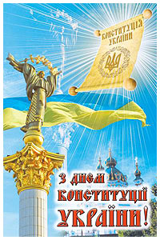
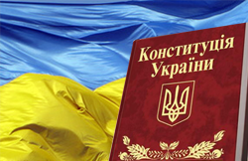
The constitution of Ukraine
The adoption of a new constitution of Ukraine on the 28th of June 1996 became an important event in the life of the people of Ukraine. Our country has long-standing constitutional traditions.Common to all mankind principles of democracy are embodied in the Constitution. The basic economic, social, cultural, public and political rights are guaranteed by the Constitution. According to the Constitution of Ukraine is a sovereign, independent, democratic, social and juridical state. Territorial integrity and inviolability of Ukraine are proclaimed in the Constitution. The power in Ukraine belongs to people. It is exercised through democratic elections and referendums and by state government bodies and self-government institutions. The form of state government is a republic. The head of state is the president. The Verkhovna Rada of Ukraine is the highest legislative body in the country. The principles of economic, political and ideological multiformity are proclaimed in the Constitution. All citizens have equal rights. People are proclaimed to be the greatest social value in Ukraine. These and other regulations are successively developed in the chapters of the Constitution. The best national traditions are embodied in the Constitution, it creates the legal bases of regulation of social relations.

Slide 6
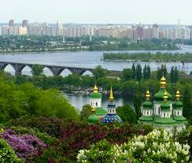
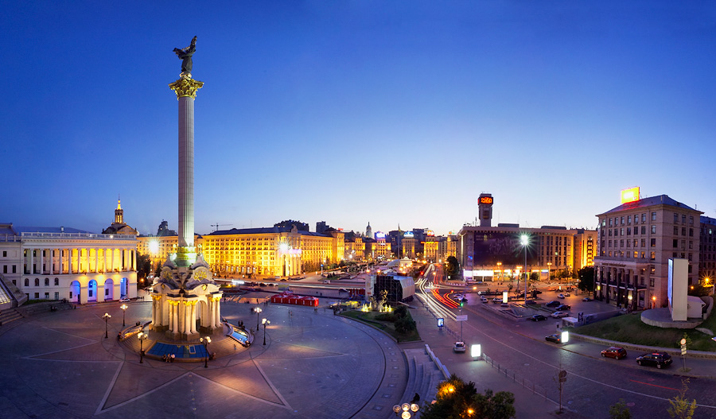
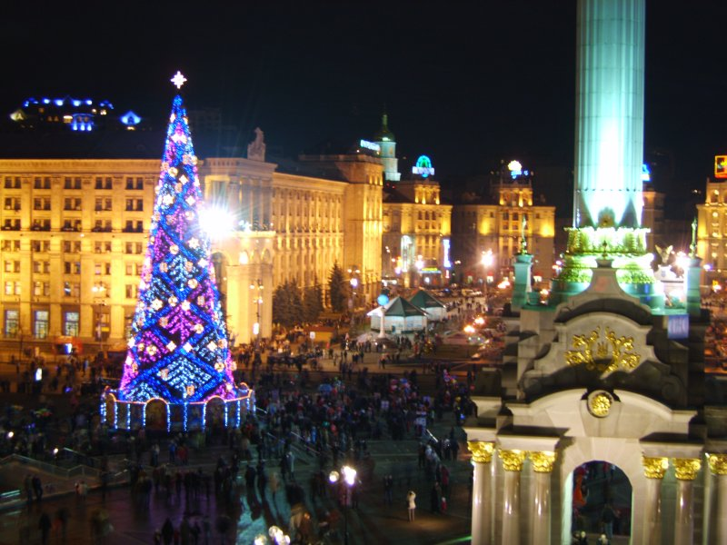
Kiev, Khreschatyk
Kiev is the capital of our country. It is the largest city in Ukraine. More than three million people live there. It is the political, economic, industrial and cultural centre of our country. There are many factories in Kiev. They make different products. In Kiev there are many museums, monuments, theatres, cinemas, libraries and palaces. Thousand of students study at Kiev-Mohila academy, at Kiev University, many institutes and colleges. Kiev is a large transport centre. Kiev metro is very beautiful. Kiev is on the banks of the river Dnieper. The city is very green. It is one of the most beautiful cities of Ukraine. Ukrainian Verkhovna Rada, president and government are in Kiev. We are proud that our capital is one of the best and oldest cities in the world. Khreschatyk is the main street in Kiev. You can see many cars and trolley buses in Khreschatyk. There are many big green trees in it. A lot of people go to Khreschatyk every day. Some of them go shopping because there are many good shops and big market there. Other people go to the cinema, look at the fountains or sit on the benches. In the evening many people walk in Khreschatyk. There you can see many bright lights. People like the main street of Kiev because it is nice and green.

Slide 7
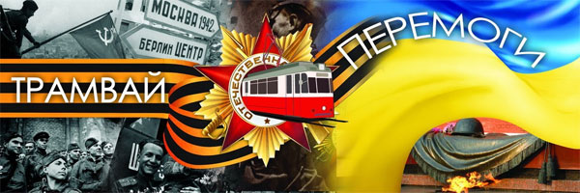
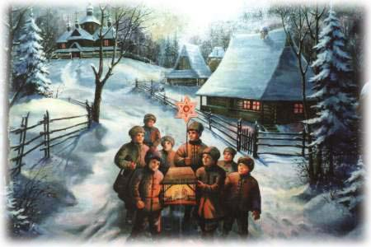
Holidays in Ukraine
We have many holidays in Ukraine, but I would like to tell about the main of them. First it is the New Year. It is my favourite holiday. It is merry to decorate the New Year Tree, to dance near it and to receive presents. Then in a week there is Christmas. In Ukraine it is an old and popular holiday. In the morning boys go from house to house, from flat to flat, sing traditional holiday songs and wish everything good to the people they visit. The people give them sweets, cakes and money.
The 8th of March is the Women"s Day. Men give presents to our mothers, grandmothers, teachers, sisters and girl-friends and wish everything good to them.
On the 1st of May we celebrate May Day. On the 9th of May we have Victory Day. It is a great holiday. We say, "Thank you very much" to old people who took part in the Great Patriotic War and defended our Motherland against the fascists. In spring we have one more traditional holiday. It is Easter. Usually people bake cakes and paint and colour eggs for the holiday.
On the 24th of August we celebrate Independence Day.
The 1st of September is a holiday for everybody who studies. Each holiday is interesting in its way but all of them are good and merry.

Slide 8
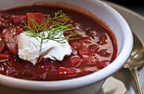
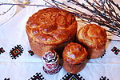
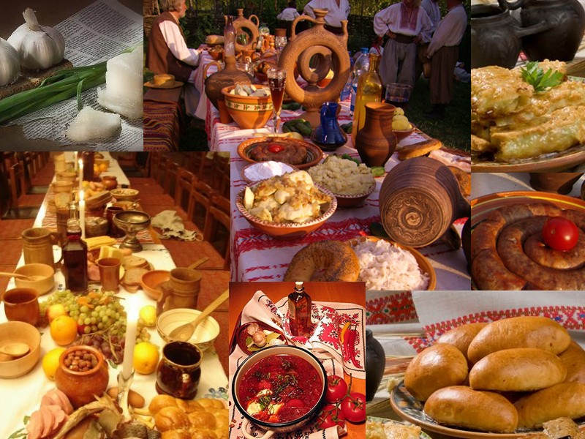
Cuisine
Ukrainian borscht soup with smetana
Traditional Ukrainian Paska for Easter
The traditional Ukrainian diet includes chicken, pork, beef, fish and mushrooms. Ukrainians also tend to eat a lot of potatoes, grains, fresh and pickled vegetables. Popular traditional dishes include varenyky (boiled dumplings with mushrooms, potatoes, sauerkraut, cottage cheese or cherries), borsch (soup made of beets, cabbage and mushrooms or meat), holubtsi (stuffed cabbage rolls filled with rice, carrots and meat) and pierogi (dumplings filled with boiled potatoes and cheese or meat). Ukrainian specialties also include Chicken Kiev and Kiev Cake. Ukrainians drink stewed fruit, juices, milk, buttermilk (they make cottage cheese from this), mineral water, tea and coffee, beer, wine and horilka

Slide 9
by Aniuta Nevmerzhitska

