Slide 1

Shakira Isabel Mebarak Ripoll is a Colombian singer-songwriter, dancer, record producer, choreographer, and model

Slide 2
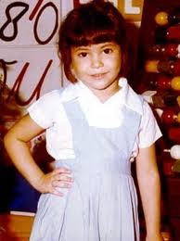
Shakira was born on February 2, 1977 in Barranquilla, Colombia
She is the only child of William Mebarak Chadid and Nidia Ripoll

Slide 3
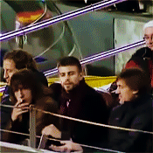
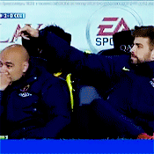

Shakira is currently in a relationship with the Spanish football player Gerard Piqué, centre back for FC Barcelona and the Spanish national team.

Slide 4

"It started about four years ago, when he took part in his first World Championship. And I sang there, and he told me:" I'm going to win this World Cup, because I want to see you in the finals. "And he did it, he won. Then we started dating, and he told me: "The next World Cup, we'll go along with our son." and so it was. All that Gerard promises, he always performs "- Shakira

Slide 5
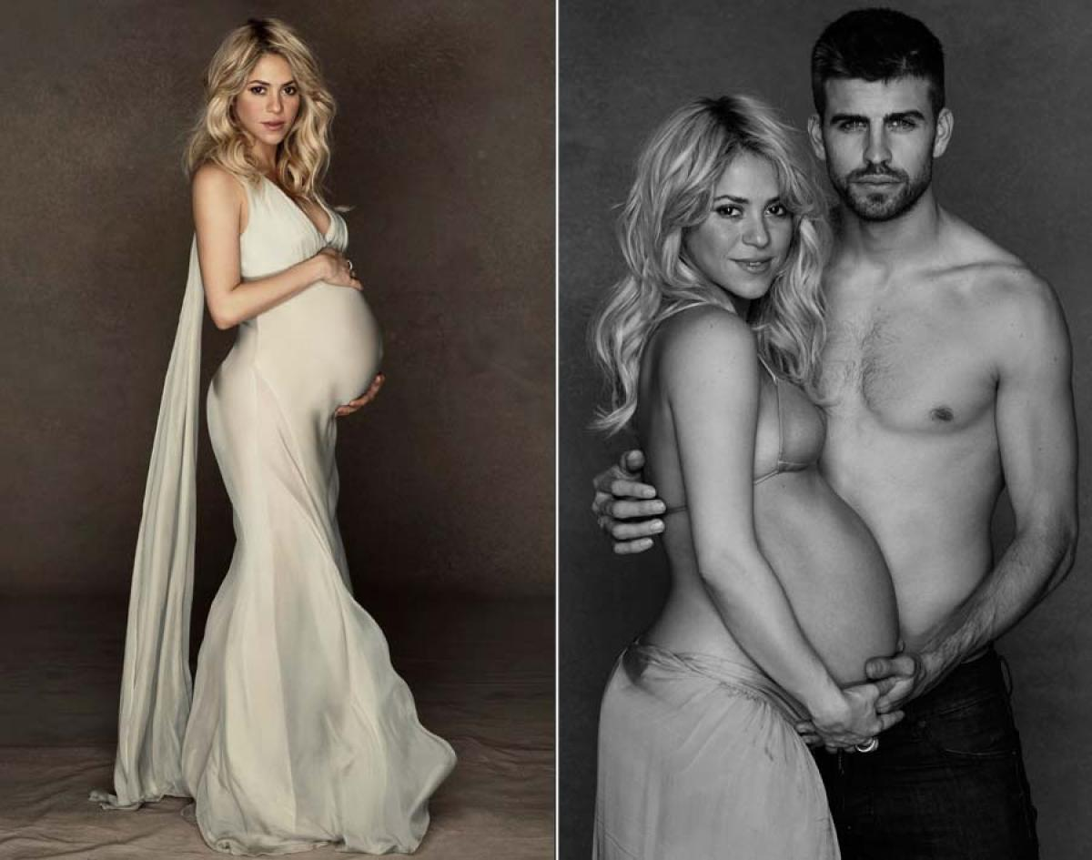

Slide 6
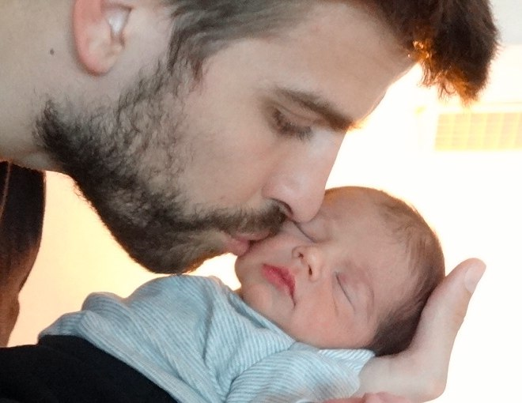
January 22, 2013 in Barcelona, Shakira gave birth to a boy, who was named Milan Pique Mebarak

Slide 7
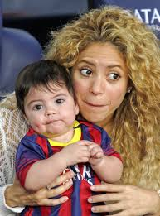
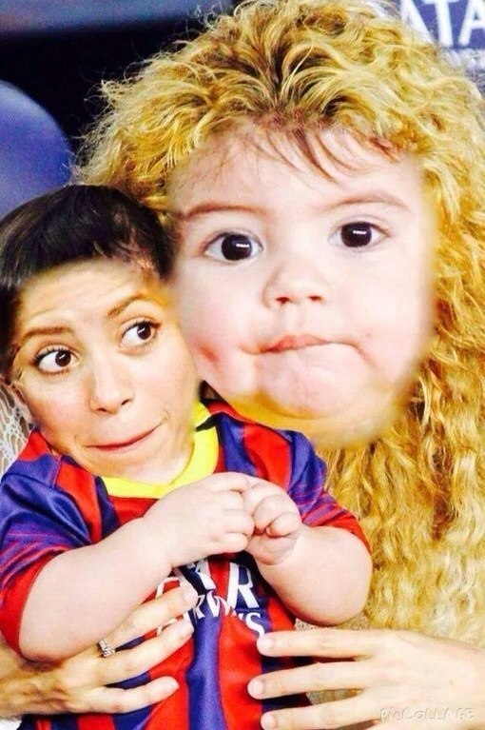

Slide 8
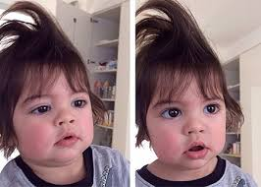

Slide 9
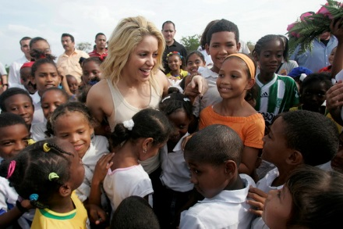
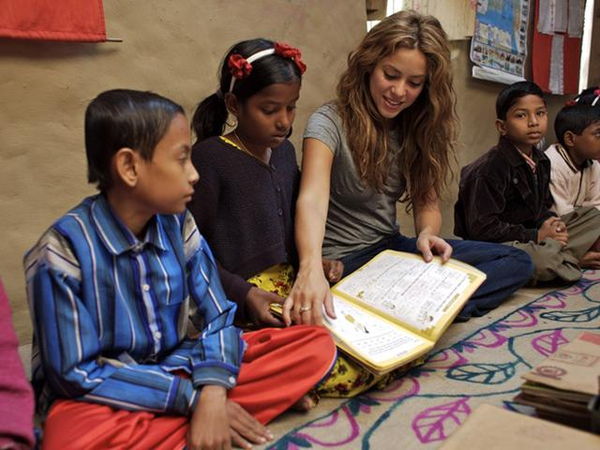
In 1997, Shakira founded the charity "Fundación Pies Destsalzos" main activity of which - raising funds to finance schools for underprivileged children in Colombia and other Latin American countries.

