Slide 1
«My restaurant»
Peredera Ihor
10

Slide 2
Menu
            First courses :
Solyanka……………………………………………35,00
Borsch……………………………………………….30,00
Okroshka meat………………………………….30,00

Slide 3
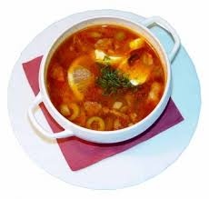
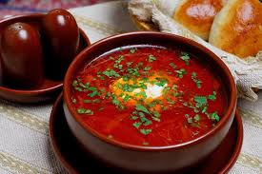
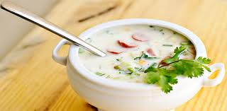

Slide 4
Menu
                Salads :
Salad "Patrick“……………………………………65,00
Salad "Caesar“…………………………………….55,00
Salad of fresh vegetables…………………….27,00

Slide 5
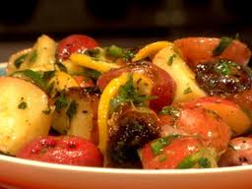
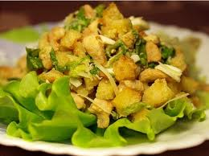
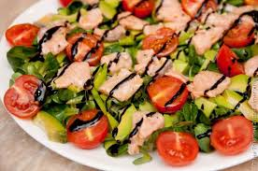

Slide 6
Menu
                Specialites
Cheesecake……………………………..………….40,00
Grilled vegetables……………………………….74,00

Slide 7
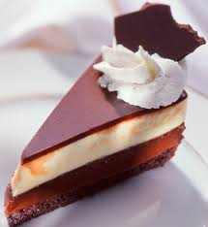
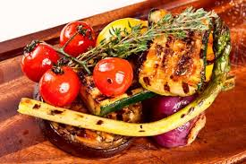

Slide 8
Welcome to my
future restaurant

