Slide 1
Project work on Global Warming

Slide 2
Global Warming
Global warming - the gradual increase in the average temperature of Earth's atmosphere and the position of the Intergovernmental Panel on Climate Change. Is that the average temperature on Earth has risen by zero point seven degrees Celsius since the Industrial Revolution.

Slide 3
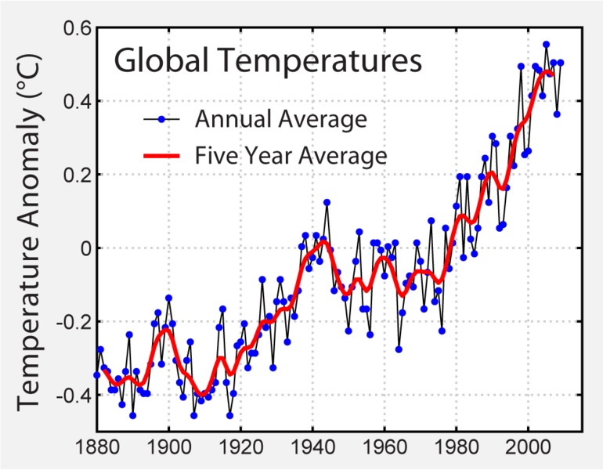
Temperature graph according to NASA

Slide 4
Effects of global warming
In addition to sea level rise, global temperature rise will also lead to changes in the amount and distribution of precipitation. This can result in more frequent natural disasters: floods, droughts, hurricanes and others. Warming should, in all probability, increase the frequency and magnitude of such phenomena.

Slide 5
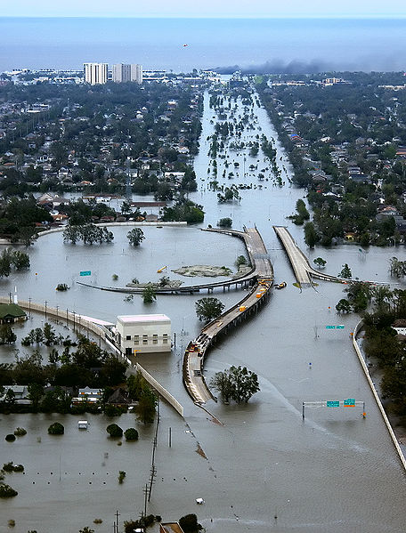
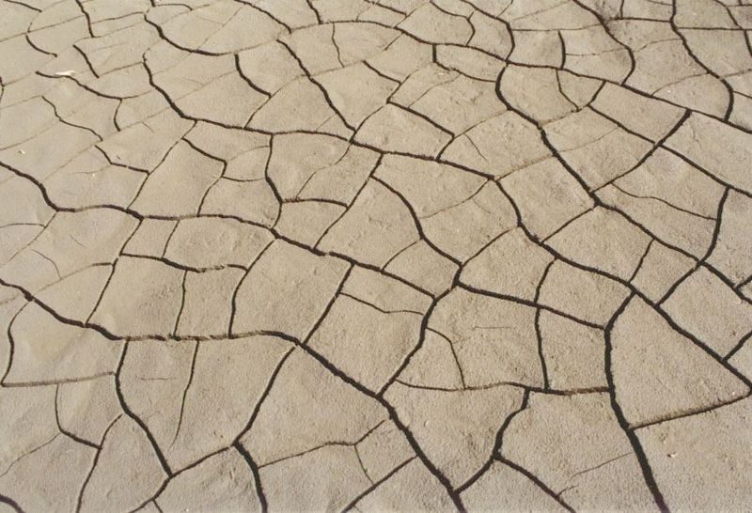
New Orleans, Louisiana, flooding during Hurricane Katrina in 2005.
Cracked earth during drought

Slide 6
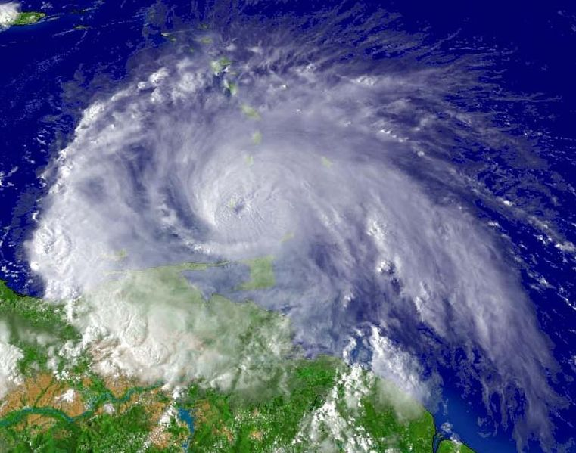
Hurricane Ivan on Grenada September 7, 2004

Slide 7
Causes of global warming
Climate system change as a result of natural internal processes or in response to external stimuli (anthropogenic and non-anthropogenic).
The reasons for such climate change remain unclear, but among the main external influences - change the Earth's orbit, solar activity, volcanic emissions and the greenhouse effect.

Slide 8
Emissions of greenhouse gases
This is a process in which the absorption and emission of infrared radiation heats the atmospheric gas atmosphere and the surface.

Slide 9
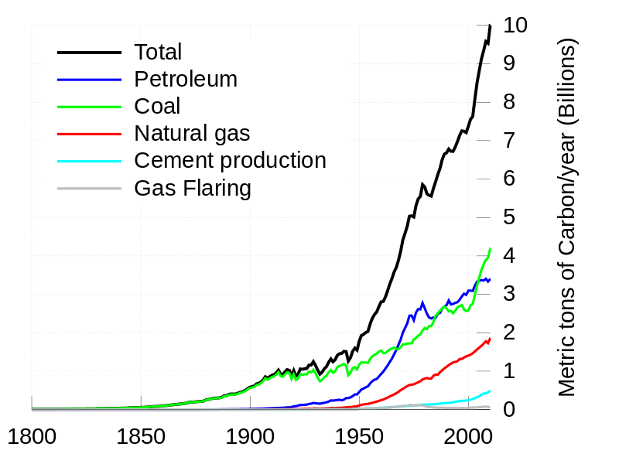
Carbon emissions into the atmosphere from burning fossil fuels from 1800 to 2007, in billions of tons.

Slide 10
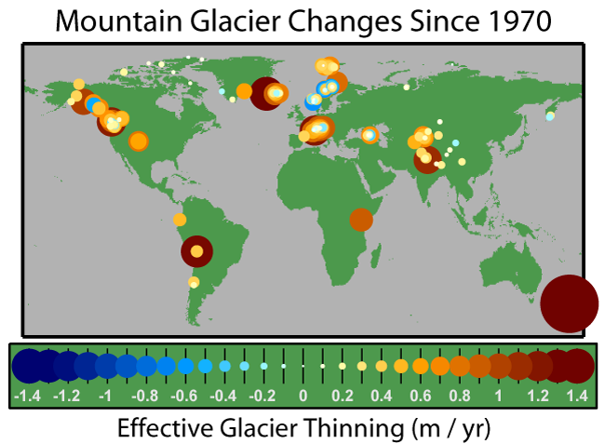
Map of the thickness variation of mountain glaciers since 1970. Thinning in orange and red colors, thickening - in blue.

Slide 11
Prevention of global warming
Broad consensus among climate scientists regarding the continued growth in global temperatures has led to the fact that a number of states, corporations and individuals trying to prevent global warming or to adapt to it. To date, the main international agreement on combating global warming is the Kyoto Protocol.

Slide 12
The Kyoto Protocol
Kyoto Protocol - an international agreement adopted in Kyoto (Japan) in addition to the UN Framework Convention on Climate Change. It commits developed countries and countries with economies in transition to reduce or stabilize greenhouse gas emissions.

Slide 13
Thank you for your attention!

