Slide 1

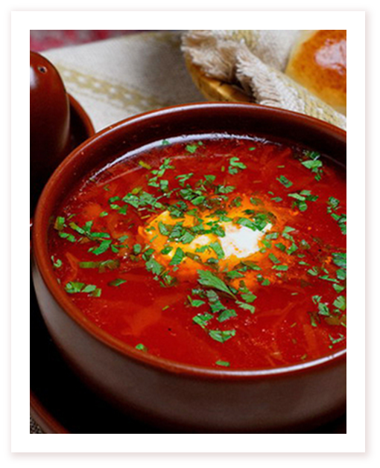
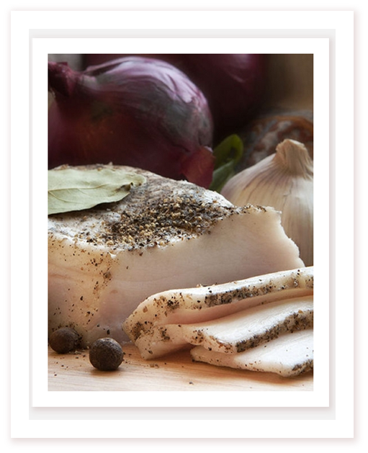
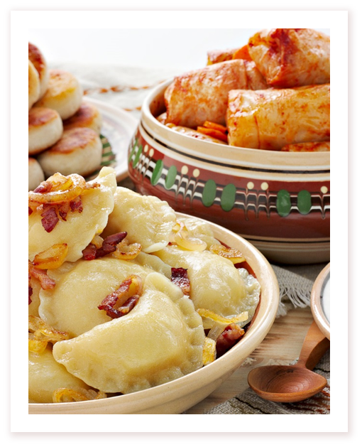
Ukrainian traditional menu

Slide 2
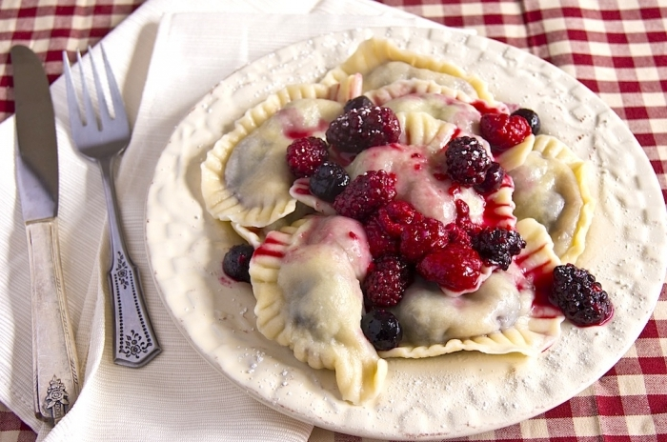
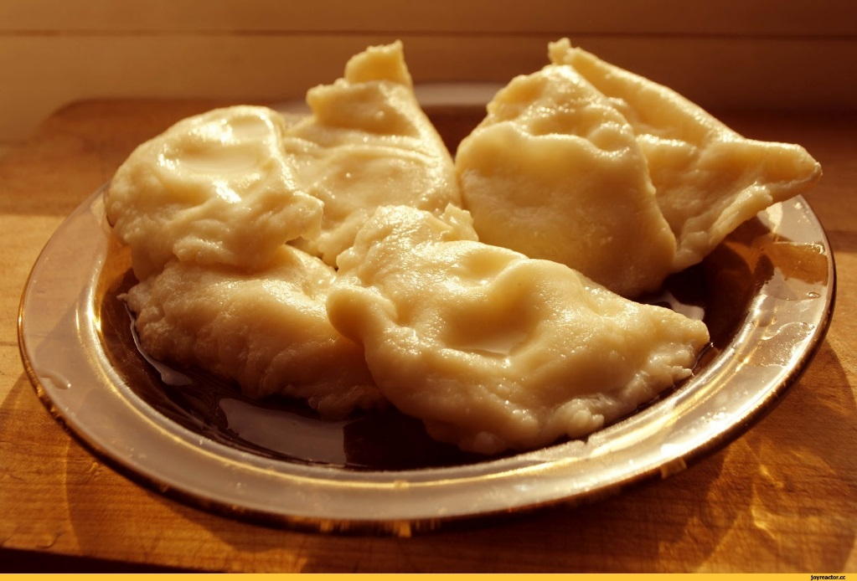
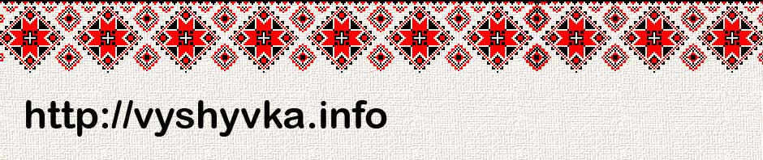
Varenyky
Favourite food of Ukrainians is varenyky that on Galychina was named "pies". Dough for them was involved from a wheat, buckwheat, rye torment, thinly loosened and cut groups. Varenyky prepared with filling: by cheese, potato, cabbage, kidney bean, cherries and other fruit. Cooked them in boiling water. ate varenyky with sour cream, oil, fried lard with a bow. Varenyky are considered one of the most characteristic for the Ukrainian kitchen foods.

Slide 3
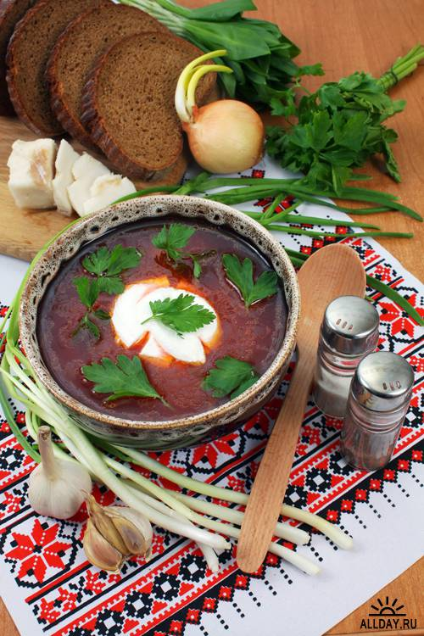
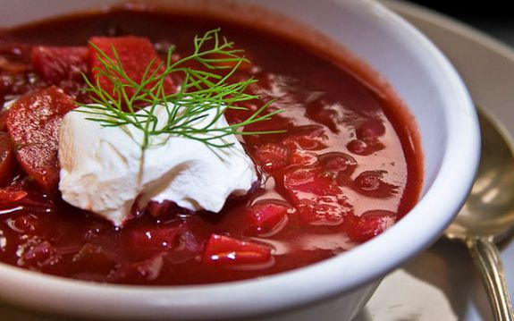
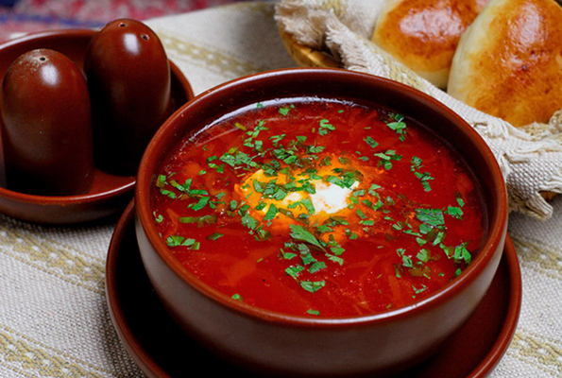
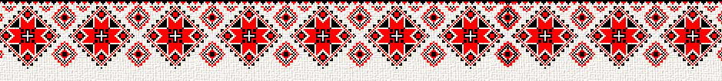
Borsch
Borsch was and remains one of the most widespread liquid boiled vegetable foods. His basic components are a beet and cabbage. At the same time used quite a bit and other products: kidney bean, tomatoes, potato, carrot, garlic. Traditionally borsch was prepared on a beet kvass. He was inundated in a pot, diluted to liking water, cooked in a stove. Then gave up a beet, potato, cabbage, carrot, other components. The prepared food was refuelled by fried on oil or lard by a bow or bow and garlic, old lard. Borsch was cooked mostly without meat, and a lard was laid only to liking. ate food hot, seasoned by a cayenne and whitening sour cream. During a post prepared borsch with fish or mushrooms

Slide 4
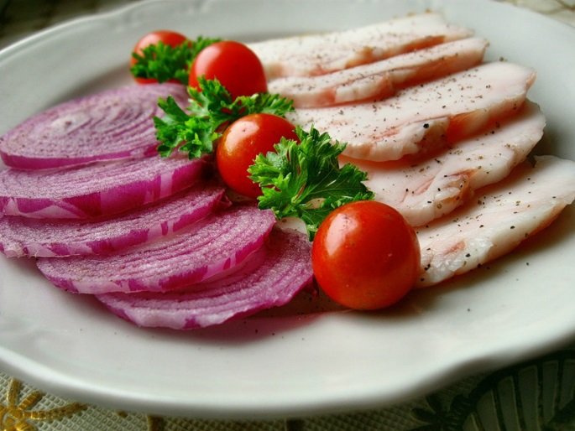
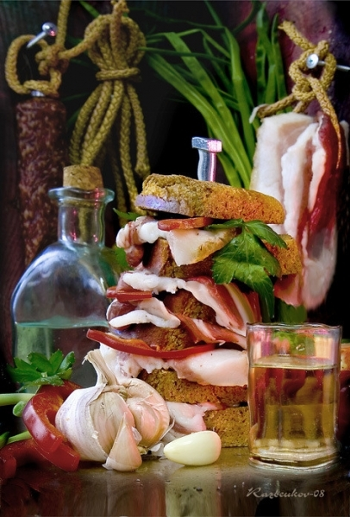
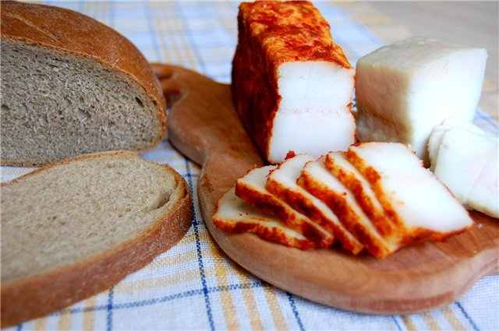
Lard
In the Ukrainian culture a lard purchased something cult value. A lard is unique food Ukrainians eat him hunches, often with bread, garlic and salt vegetables.
A lard since olden times used the special popularity in the ukrainian people. Advantage was given him, even unaware, that it contains many useful substances, such necessary for a human organism.

Slide 5
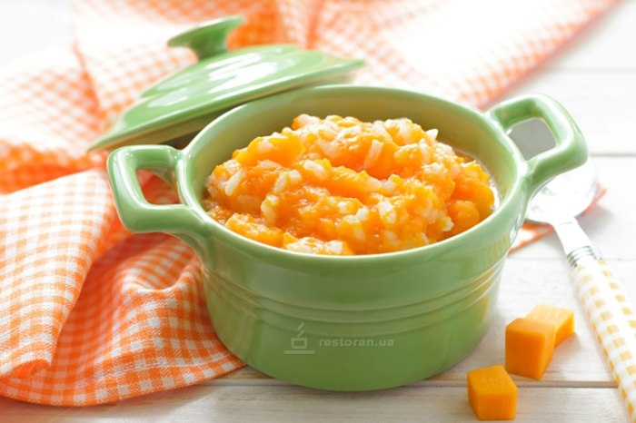
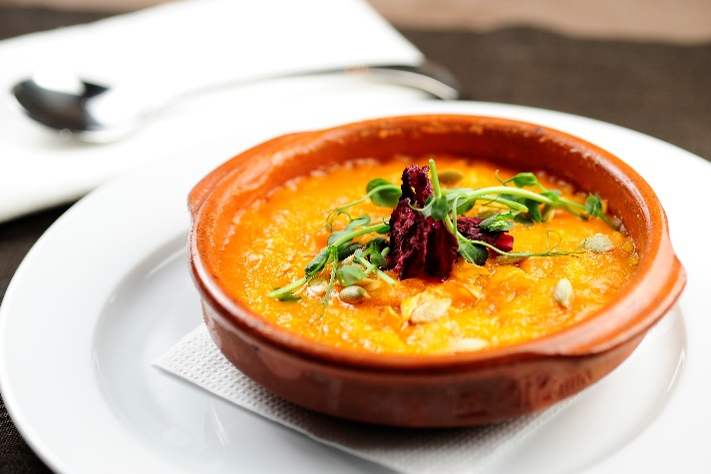
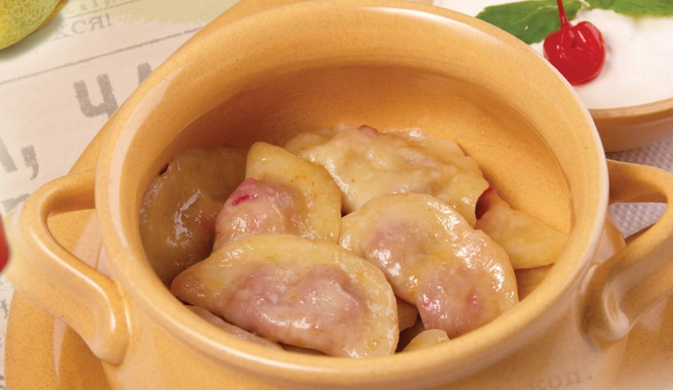
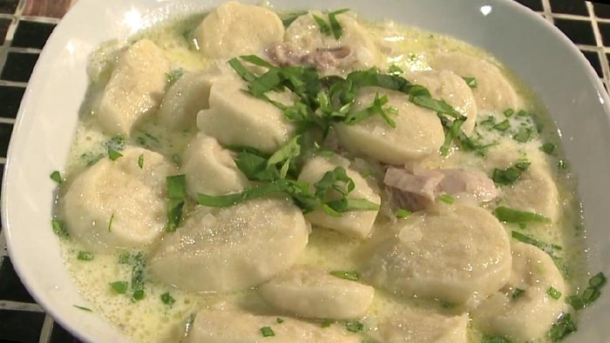
Pumpkin porridge
Pumpkin porridge. Pumpkins grew in each without an exception peasant economy. The baked or boiled pumpkin was consumed almost whole-year - due to possibility of the protracted storage
Dumplings
Dumplings are typical for the Ukrainian kitchen food. The fresh dough involved on water or serum with an egg was loosened by a rolling-pin, that thickness of dough it was a 1 - 1,5 cm.

Slide 6
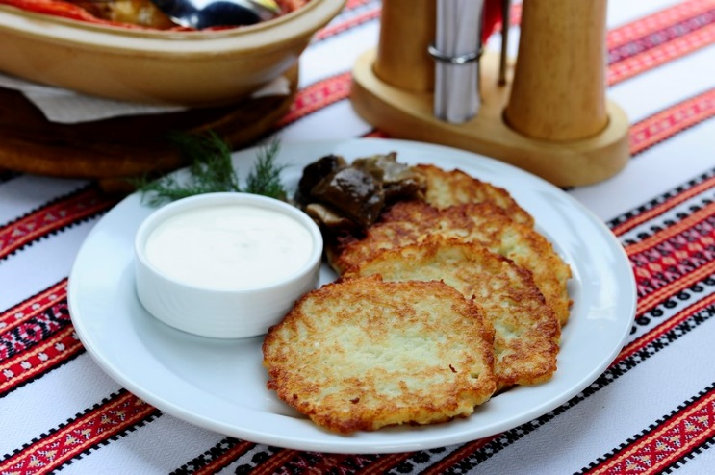
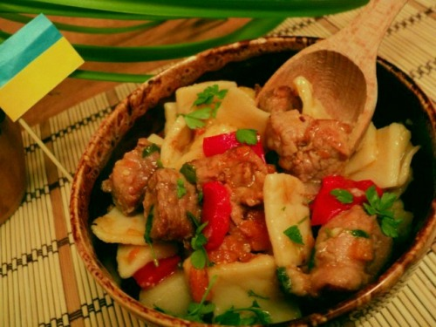
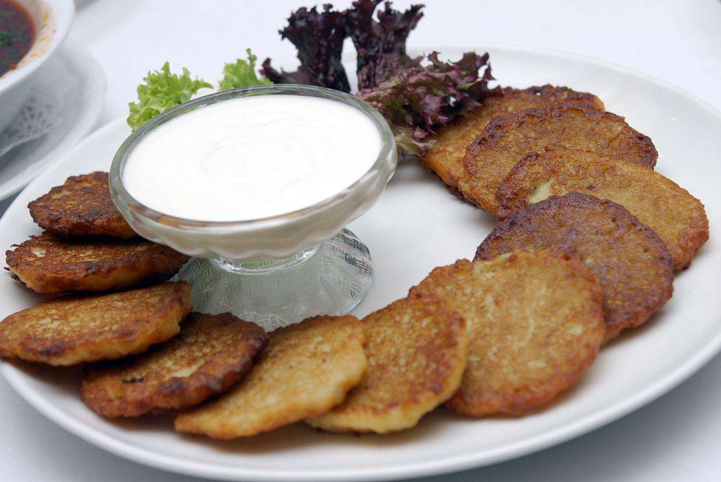
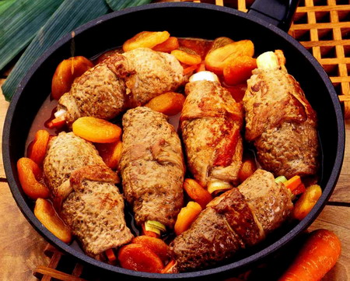
Potato of pancake Dushenina.
Potato of pancake used large popularity in a folk kitchen, especially in Northlands of Ukraine.
Dushenina. Meat (mostly pork) was cut on average pieces, caused to fall in a flour, folded in a pot, inundated boiling water, quite often by a serum or sour cream, laid a raw bow, carrot, spices, salt and extinguished to readiness

Slide 7
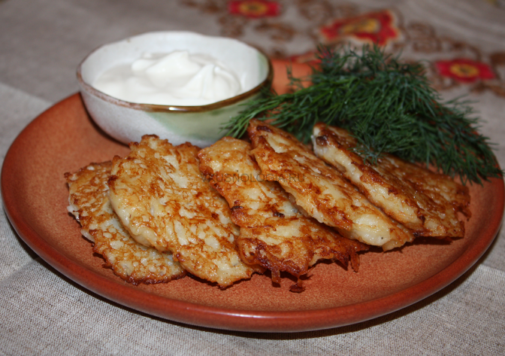
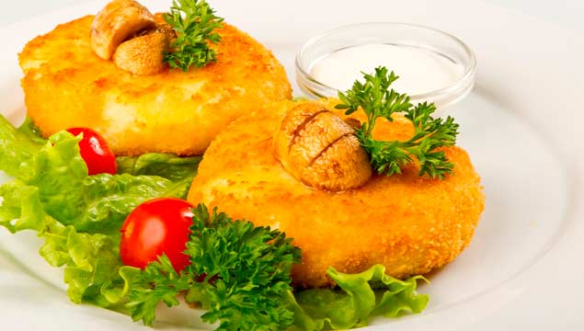
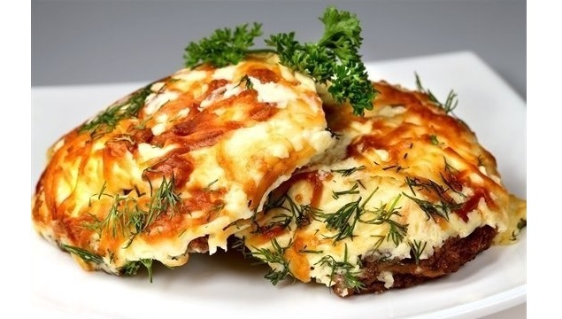
Patties
A veal or finely cut pork was involved with the toasted bow, salt and spices, then added the well pounded boiled potato, egg, mixed to formation of homogeneous mass, produced small chops and fried them on oil or lard

Slide 8
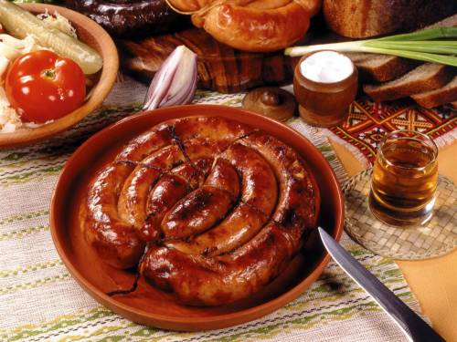
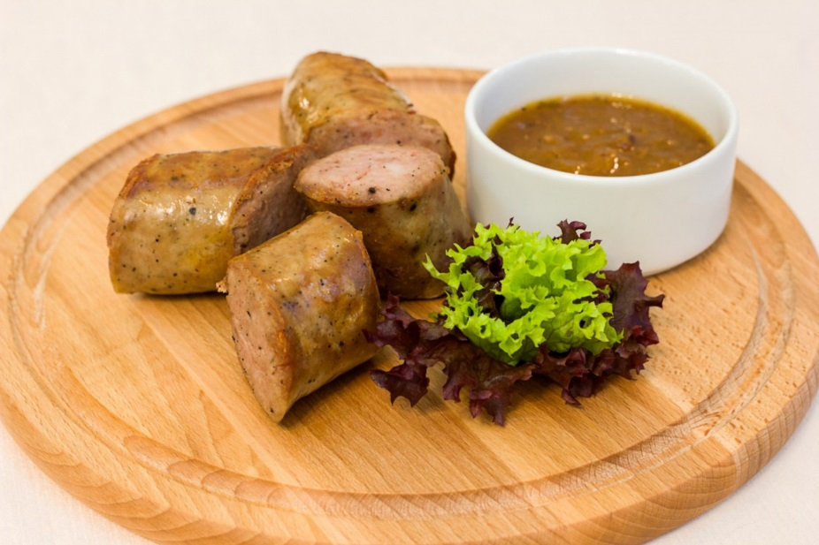
Sausage
Sausage is foods that was made mainly on a supply. Then to the coalface of wild boar thin bowels washed carefully, steeped, cleared and stuffed raw meat, ground with salt, garlic, pepper. Laying down sausage rings, she was fried on a frying pan in a hot stove on either side.

Slide 9
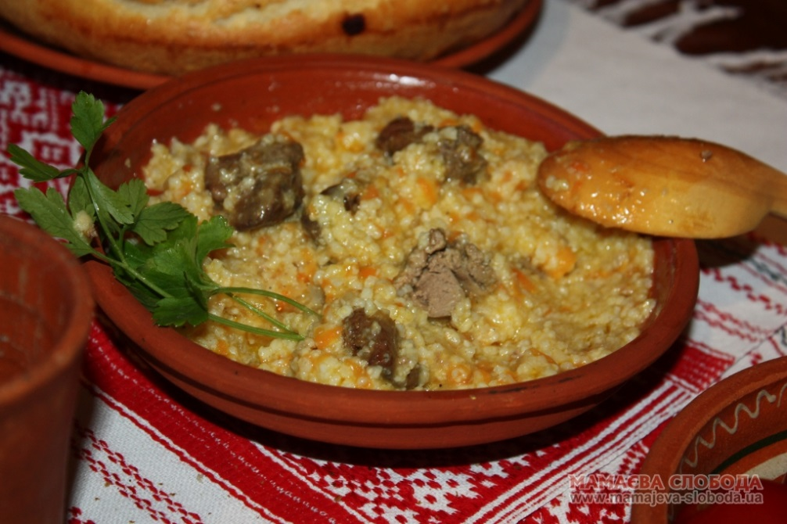
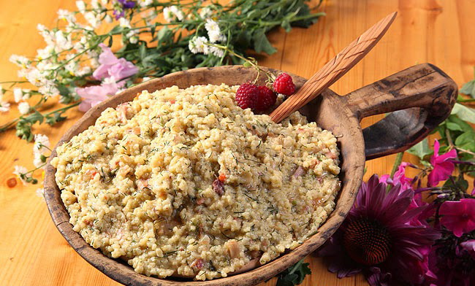
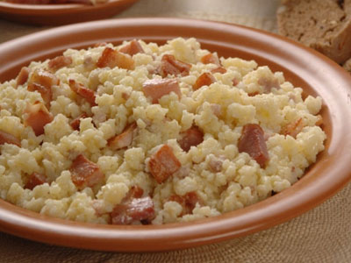
Kulish
Kulish - food is made out of millet croups. Kulish it was easily to prepare not only in home terms, that is why he had another name is the field porridge. The washed millet was filled up in a cauldron with boiling water, for taste added one or two potatoes, salt, root, on possibility greenery

Slide 10
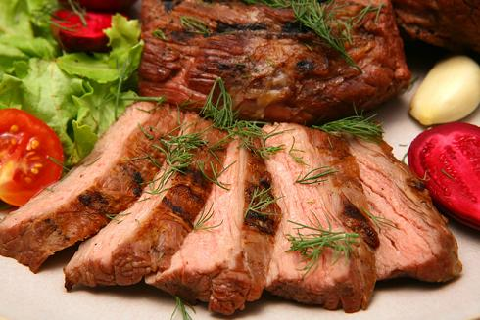
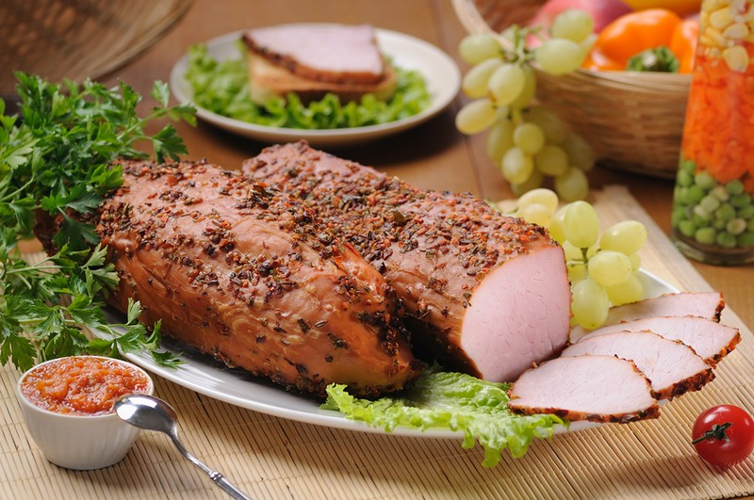
Ham
Ham - one of varieties of meat food supplies. A pork ham was spied by a garlic, wiped salt with a pepper and baked in a stove. Ate during winter holidays. In the districts of Prykarpattya and East Volyn food after pickling in a salt brine with spices was prepared in stoves or in flues. she was kept long, up to a haying season and reaping, when an especially high-calorie feed was needed

Slide 11
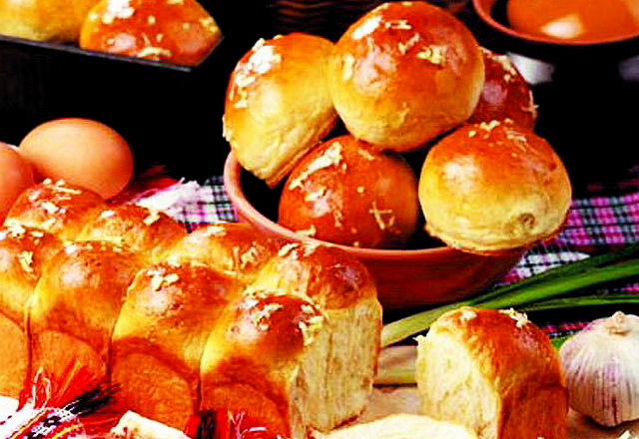
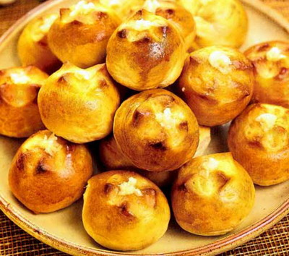
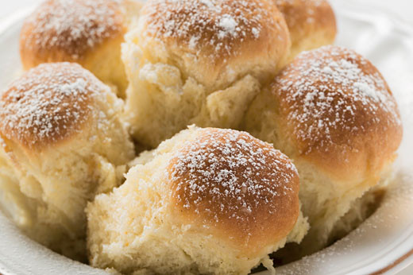
Buns
Buns are the small round and magnificent rolls made from sour dough from a rye, wheat, buckwheat or wheat-buckwheat torment.

Slide 12
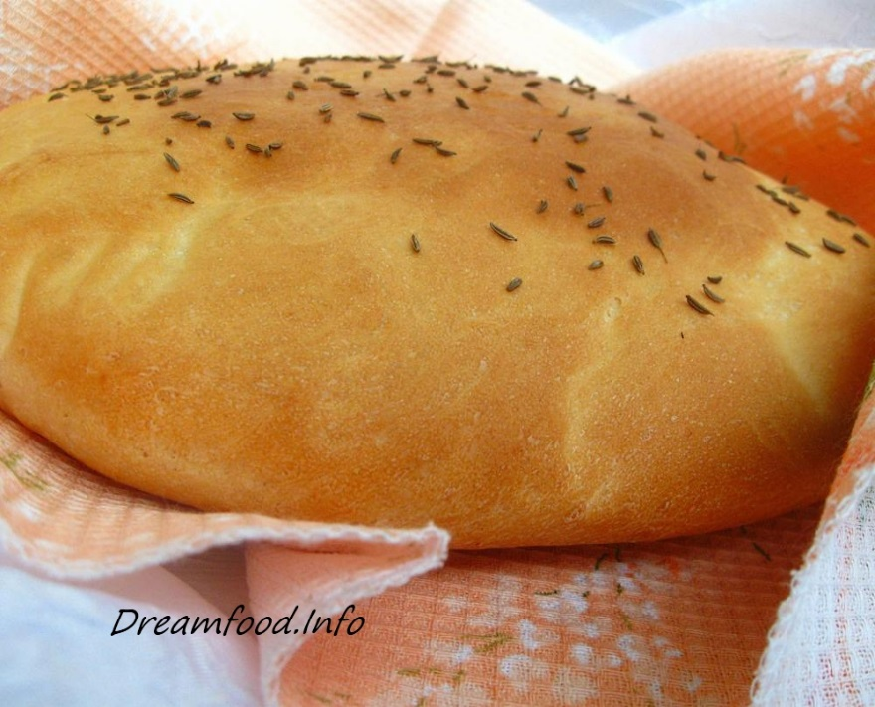
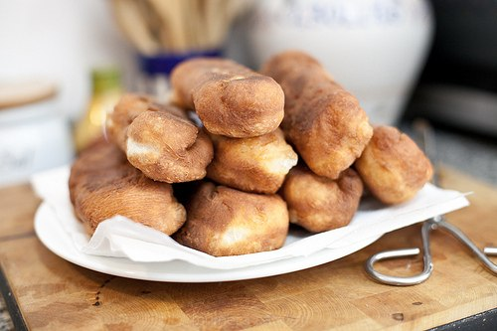
Flat Cakes
Flat Cakes are substitutes of bread. Made them out of soluble dough then, when bread was not enough to the new baking. A ferment was not maintained a few hours, as fit at making of bread, and did considerably quicker

Slide 13
Thank you for attention!

