Slide 1
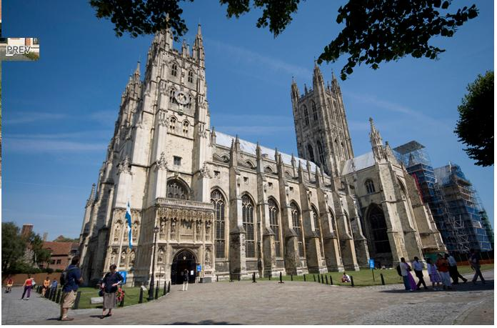
The King's School, Canterbury
prepared: Alena Rudenko

Slide 2
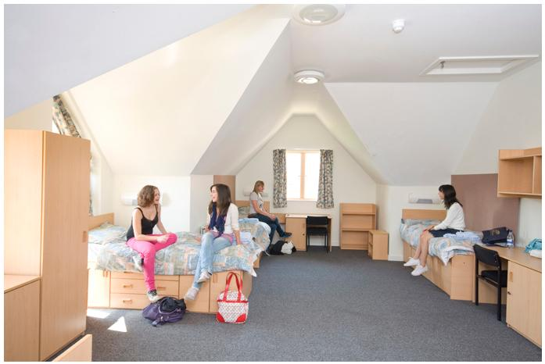
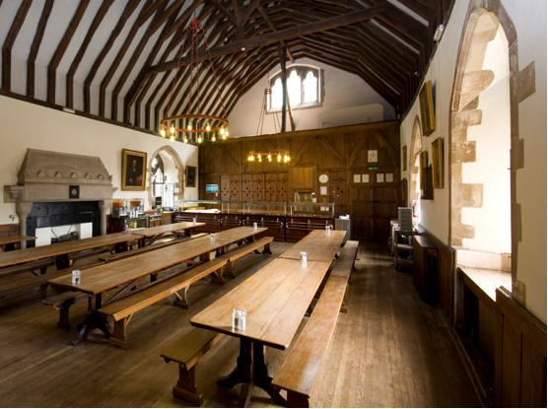
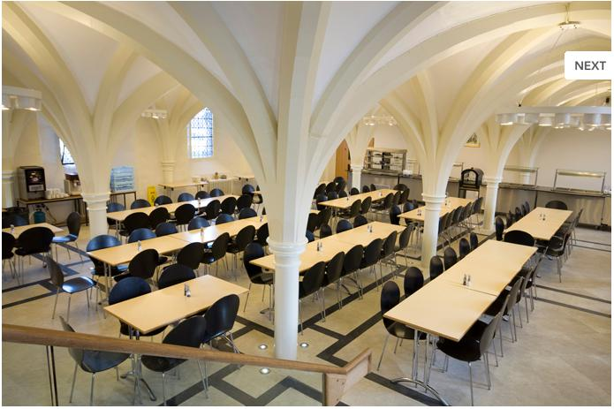
The King's School includes:
Live and learn in the grounds of Canterbury Cathedral
Safe and secure campus
Excellent sporting and leisure facilities

Slide 3
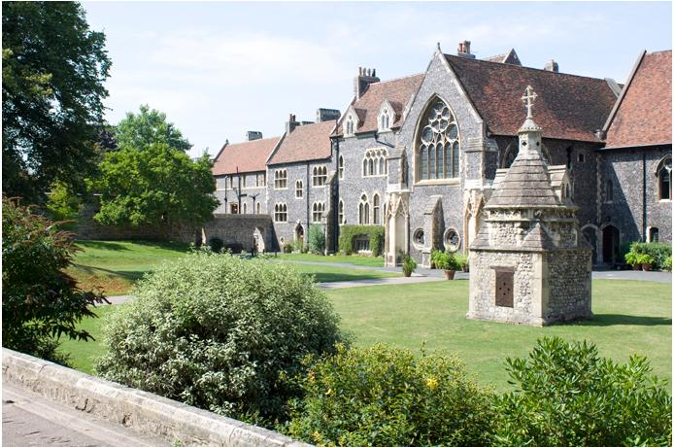
Modern rooms, teaching, and recreation in the medieval school buildings offer a magical experience. Sporting facilities school include an indoor swimming pool, gym, tennis and squash courts, and outdoor playing fields.

Slide 4
One full day and one half-day excursion per week
Full day excursions include London Sightseeing, Cambridge, Stonehenge, Brighton
Half-day excursions include Windsor Castle, historic Hastings and Leeds Castle, Dover
A full afternoon and evening activity programme is organised which will include a choice of sports (swimming, table tennis, basketball, volleyball, football) as well as other activities such as movie nights, drum workshops, karaoke night, student discos and bowling.

Slide 5
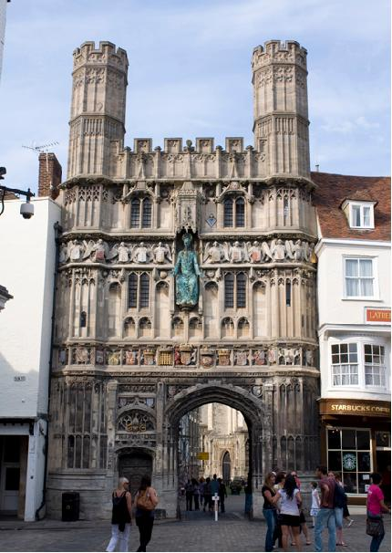
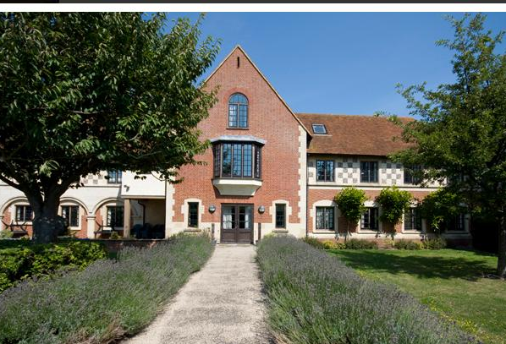
The King’s School is Britain’s oldest boarding school. The school is in the grounds of Canterbury Cathedral and St Augustine’s Abbey

Slide 6
The end

