Slide 1
My Free Time and Hobbies I Take Up
By (name)

Slide 2
Usually I don`t have any free time, but when it happens I try to make it colorful and funny.

Slide 3
Mostly I go out with my friends

Slide 4
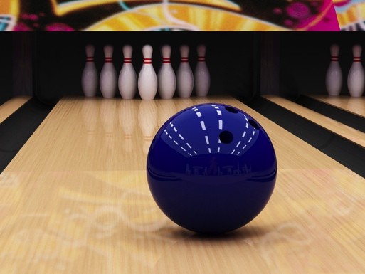
We like bowling…

Slide 5
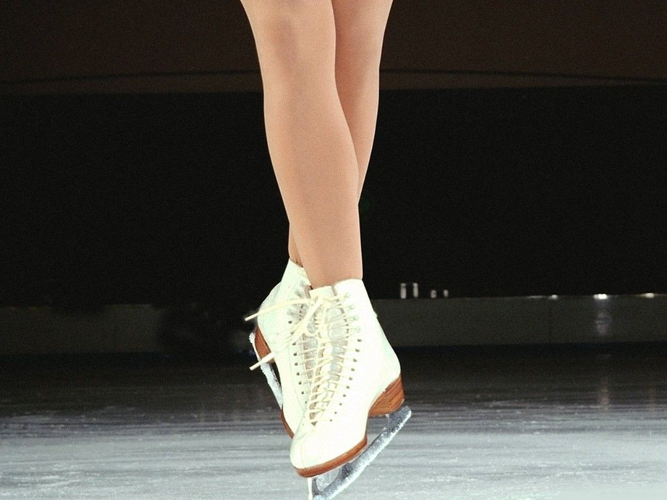
…ice-skating…

Slide 6
We try to do our best, but…

Slide 7
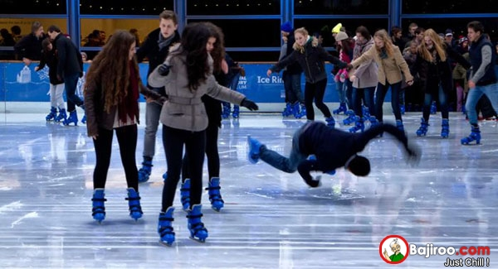
It`s not so easy…

Slide 8

Also we love cinema!

Slide 9
(Some photos)

Slide 10
But when I stay at home and have a free time I try to spend it to improve my skills:

Slide 11
I like to draw and to paint…

Slide 12



Another my hobby is reading

Slide 13
There are a lot of different activities I like doing during my free time but it will take so much time to talk about everything

Slide 14
Thank you for your attention:)

