Slide 1
House of my dream
Roman Kotenko
11 ‘C’ grade

Slide 2
Introduction
Everybody wants to live in a perfect house. I would like to tell you about the house of my dream. My favorite style is futuristic, so the interior should match it.

Slide 3
Bedroom
As for me, the most important room in the house is, of course, bedroom. Even ancient people thought that a healthy man is the man who sleeps enough.

Slide 4
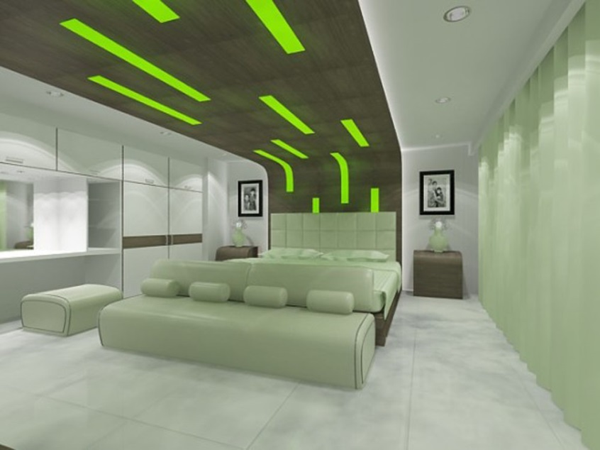

Slide 5
Living room
Happy man is entertained man, so my living room should contain a big screen TV and a cozy sofa to relax after a hard day.

Slide 6
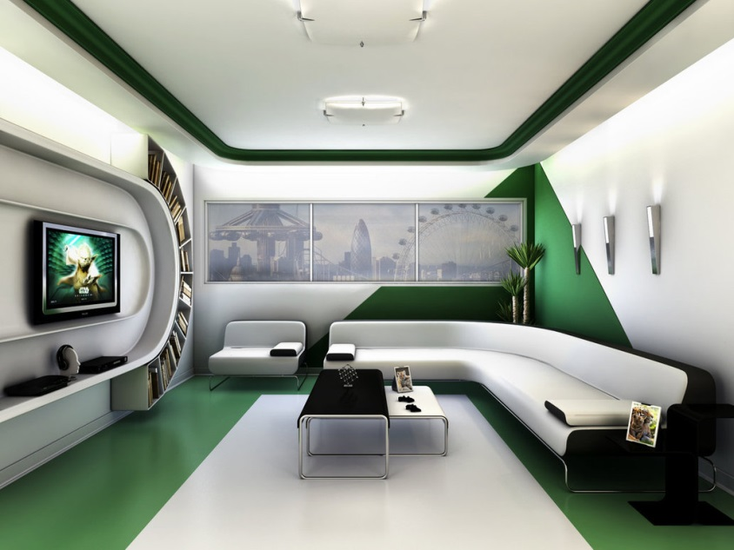

Slide 7
Dining room
The way to male’s heart passes through his stomach, so every square inch of my dining room should be brilliantly perfect.

Slide 8
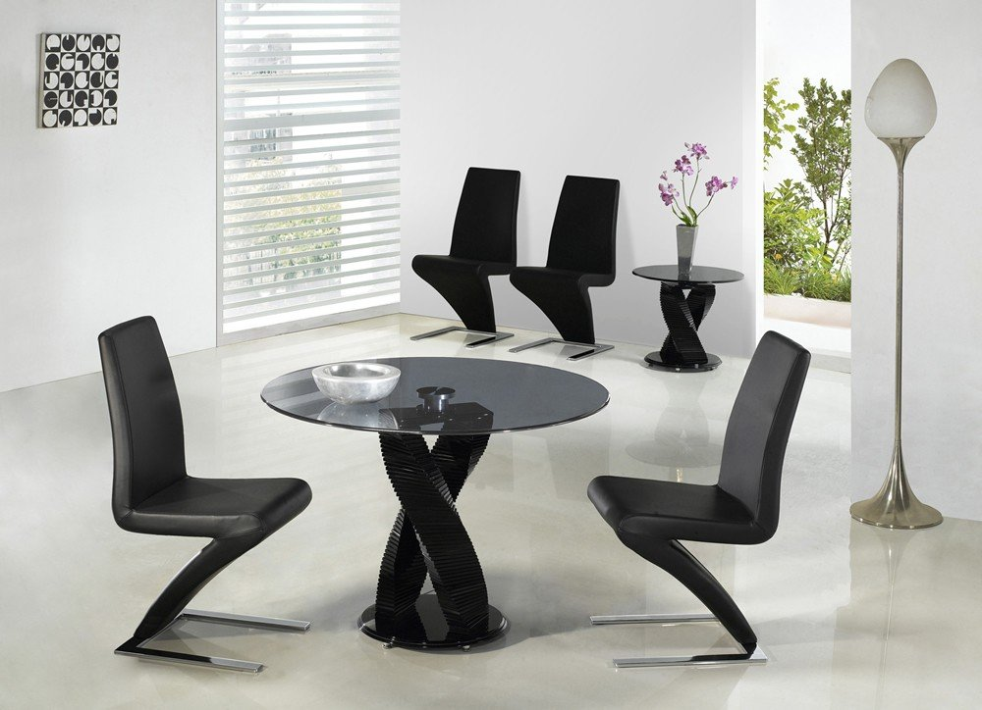

Slide 9
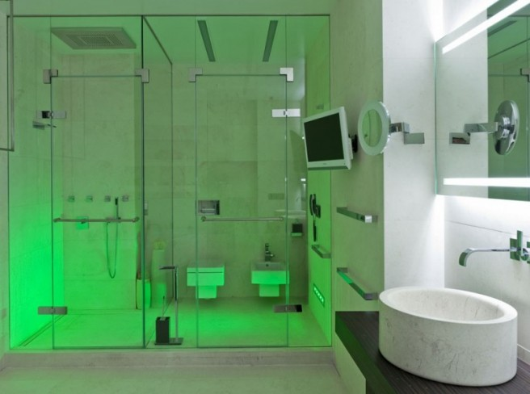
Bathroom

Slide 10
Conclusion
So, I don’t want a huge three-storey mansion, but I want a comfortable house which I’ll just feel happy to live in.

