Slide 1
Project
Crime

Slide 2
Plan
Crime
Kind of crime
The most famous representatives of Crime

Slide 3
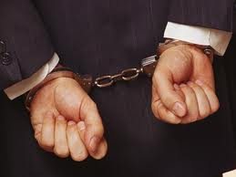
Crime
Crime is the breaking of rules or laws for which some governing authority (via mechanisms such as legal systems) can ultimately prescribe a conviction. Crimes may also result in cautions, rehabilitation or be unenforced. Individual human societies may each define crime and crimes differently, in different localities (state, local, international), at different time stages of the so-called "crime", from planning, disclosure, supposedly intended, supposedly prepared, incomplete, complete or future proclaimed after the "crime"

Slide 4
Kind of crime
Kinds of Crimes
Theft Restorative justice and theft victims and perpetrators.
Burglary Restorative justice and burglary victims and perpetrators.
Corruption Restorative justice and victims and perpatrators of corruption.
Driving While Intoxicated Restorative justice and DWI victims and perpetrators.
Domestic Violence Restorative justice for domestic violence victims and perpetrators.
Hate Crime Restorative justice and hate crime victims and perpetrators.
Violent Crimes Restorative justice and victims and perpetrators of violent crime
Environmental Crimes Restorative justice and environmental crime victims and perpetrators.
White Collar Crime Restorative justice and white collar crime victims and perpetrators.

Slide 5
In Ukraine
Mishka Yaponchik
Jap (real name Moses Wolfovitch Vinnitsa, * 1891, Holta (now city Pervomaysk) - † 1919, Ascension) - famous Odessa hijacker. Jap dubbed by characteristic shape of the eyes. In 1917 Jap amassed a large gang of raiders and became a storm of Odessa. Since January 1918 collaborated with the Bolsheviks, leading the Jewish self-defense against the White Army, but Jap regiment collected from Odessa criminals, showed indiscipline and jumped in front of 27 September 1919 on two captured trains. In Ascension train was stopped by the KGB and Jap was shot. Jap was the prototype of literary and cinematic characters - Benny Crick from the stories of Isaac Babel and Popandopulo from the operetta B. Aleksandrov "Wedding in Malinovka" and namesake movie (1967).

Slide 6
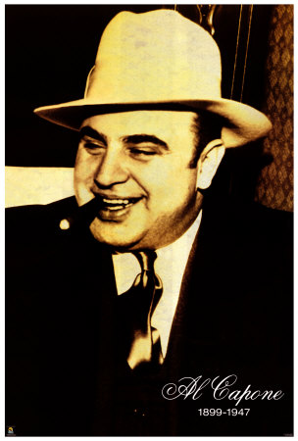
Alphonse Gabriel "Al" Capone - (born Alphonse Gabriel «Al» Capone; January 17, 1899 - January 25, 1947) - American gangster of Italian origin, who led the criminal syndicate that involved smuggling, including the smuggling of alcohol and other illicit affairs in period of Prohibition in the U.S. in 1930 and 1920h, respectively. Born into a family of immigrants from southeastern Italy Gabriele and Teresina Capone began his career in Brooklyn before moving to Chicago and became the boss of the criminal organization known as the Chicago Autfit, as his business card indicated that he was a trader old furniture. [1] After 1920h rokiv Capone drew attention of the FBI, which placed it in the list of public enemies. Although he was never convicted of racketeering, his criminal career ended in 1931, when Capone was convicted and sentenced by the federal government for evading income tax.

