Slide 1
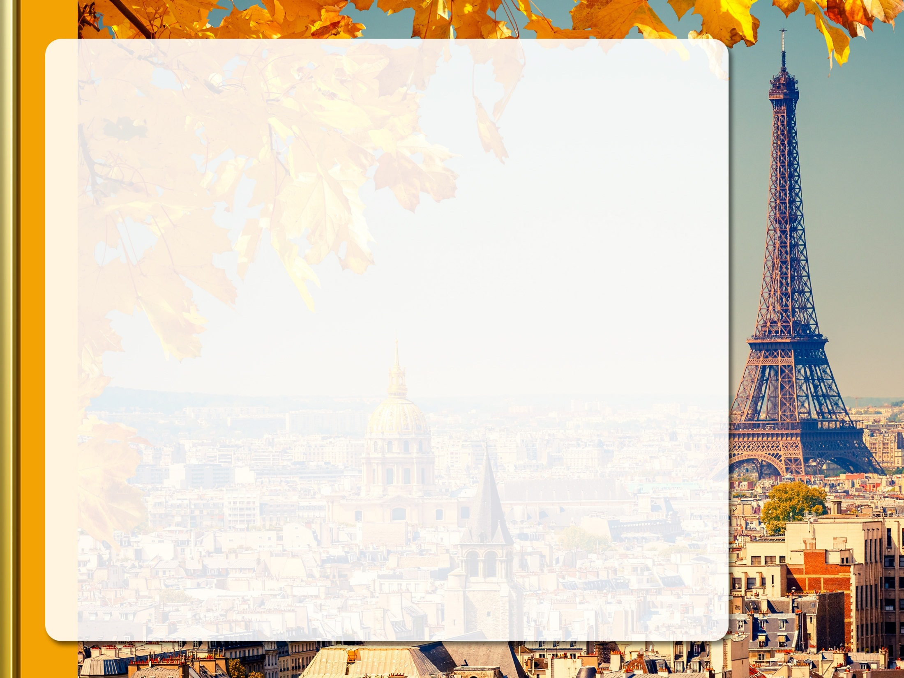
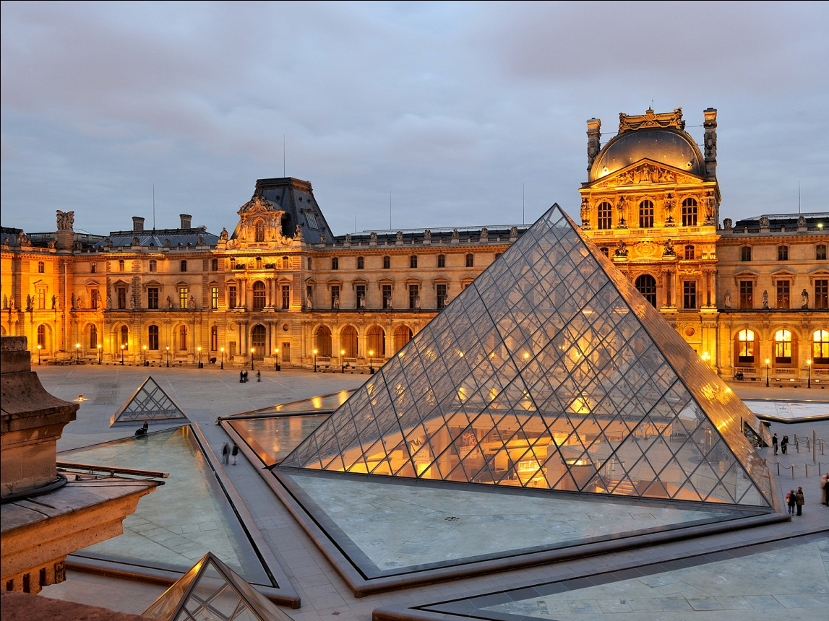
Тhe Louvre Museum
Official name Great Louvre

Slide 2
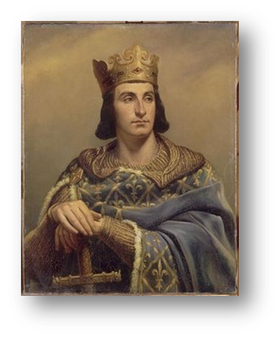
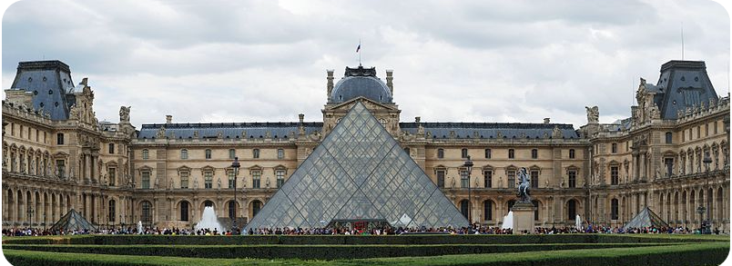
The history of the Louvre Museum
Louvre Museum is the national museum and art gallery of France.
It is situated in the palace in Paris that was built in the 12th century by Philip II.

Slide 3
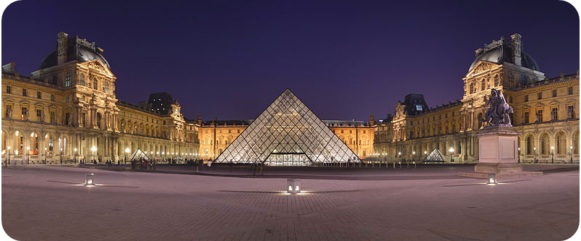
The reconstruction of the Louvre Museum
The Louvre building complex underwent a major reconstruction in the 1980s and 1990s in order to make the old museum more comfortable to its visitors.
A vast underground complex of offices, shops, exhibition spaces, storage areas and parking areas was built.

Slide 4
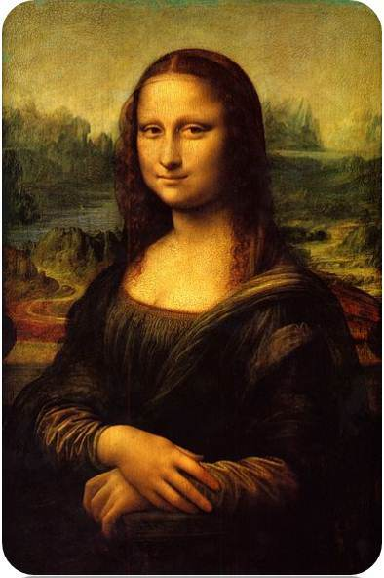
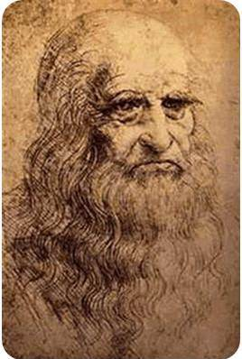
The collections of the Louvre Museum
The Louvre contains the famous Mona Lisa by Leonardo da Vinci and other great paintings from Italy, France, Netherlands and Great Britain.
It is a painting in oil on a poplar panel, completed circa 1503–1519.

Slide 5
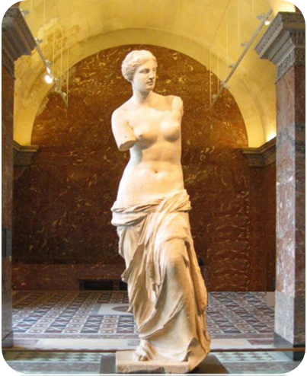
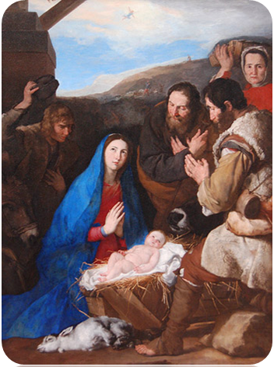
The Louvre’s painting collection is one of the richest in the world, representing all periods of European art up to Impressionism.
It also has many masterpieces by Italian Renaissance painters and Dutch painters of the Baroque period.

Slide 6
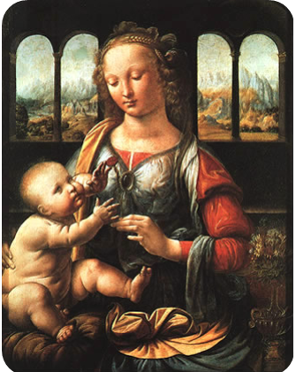
The department of Renaissance
It displays the treasures of the French kings—bronzes, pottery, jewelry and furniture.

Slide 7
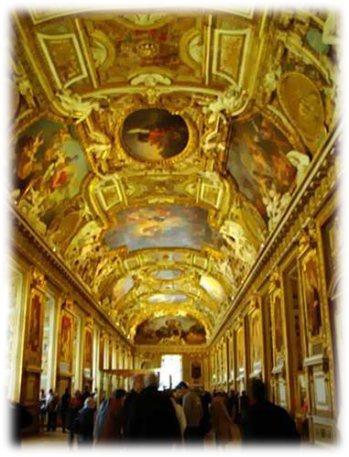
The Greek and Roman art of the Louvre Museum
The department of Greek and Roman art is one of the oldest in the museum. It houses architecture, sculpture, mosaics, bronzes, and pottery.
One of the masterpieces of this department is «The Winged Victory of Samothrace».

Slide 8
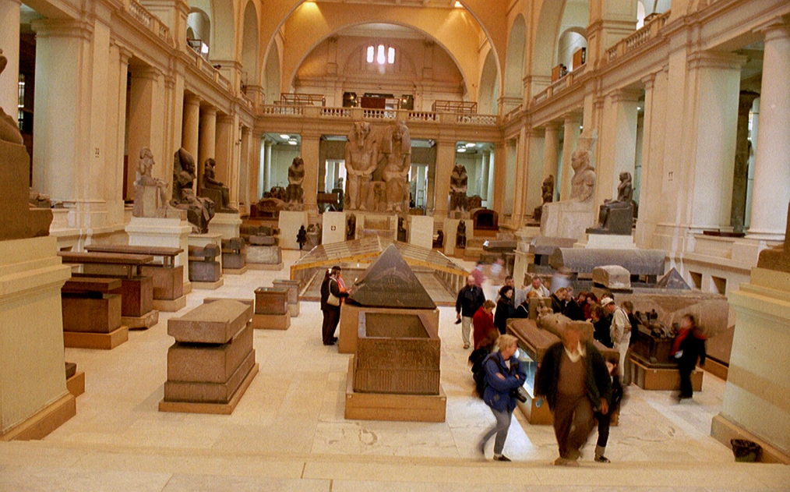
The Egyptian art of the Louvre Museum
The department of Egyptian art was established in 1826 to organize the collections acquired during Napoleon’s Egyptian campaign.
The department of Oriental antiquities is most important for its collection of Mesopotamian art.

