Slide 1
The mass media

Slide 2
What is the media?

Slide 3
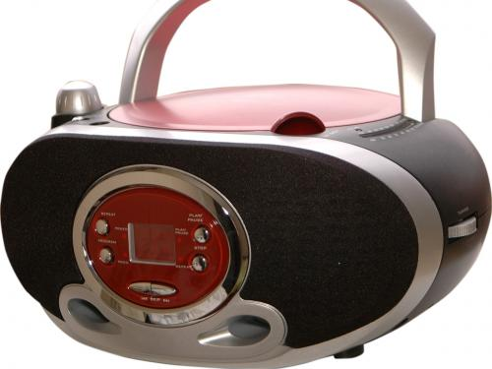
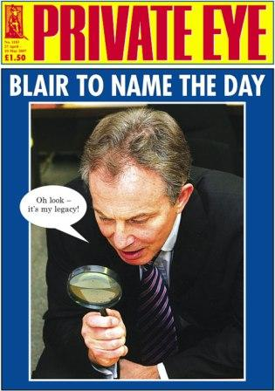
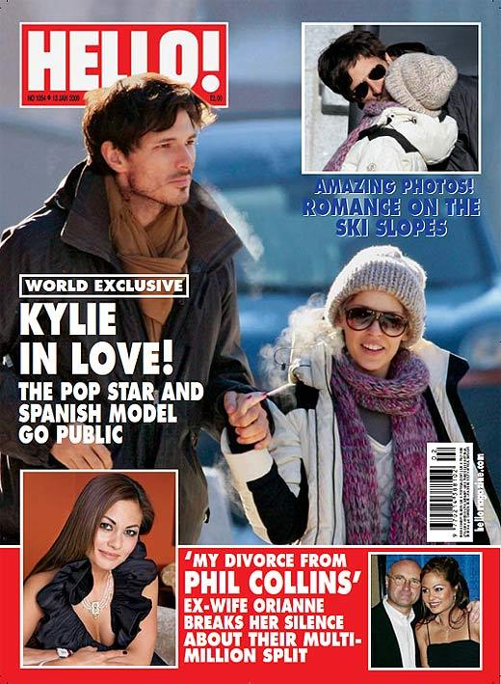
educate
inform
The role of the Media in our life
entertain

Slide 4
How do people use the media?
?

Slide 5
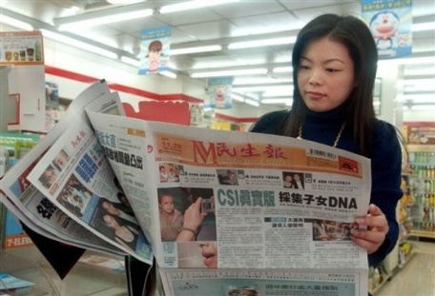
The media help people
To receive information
To relax
To travel around the world without wasting money

Slide 6
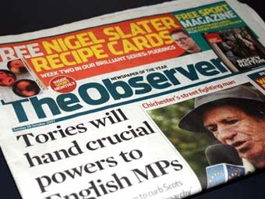
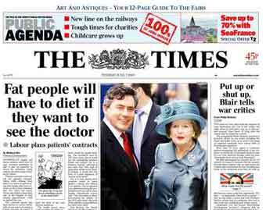
What is a Newspaper ?
It is a paper printed and sold daily or weekly with news , advertisements , articles about political, crime, business , art, entertainment , sport events.

Slide 7
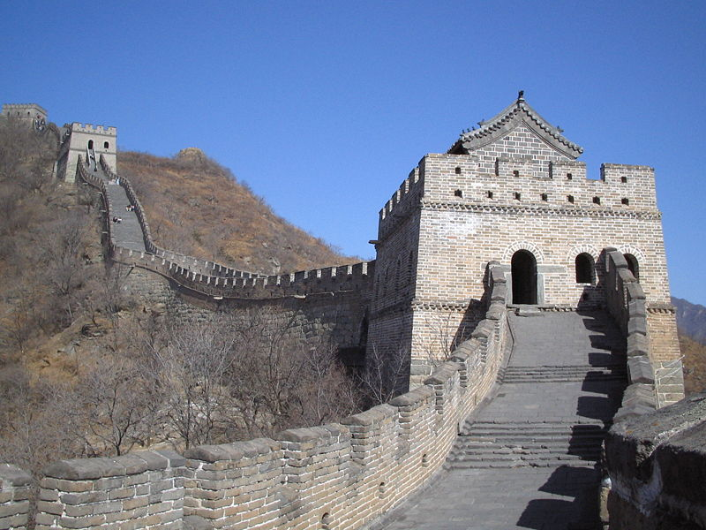
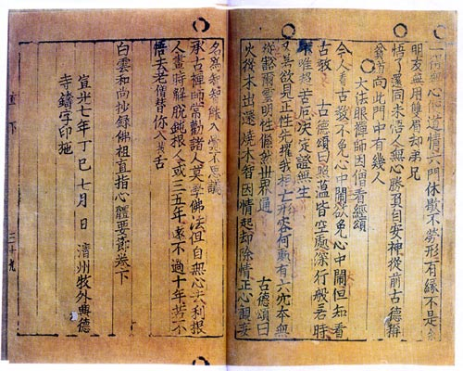
From history of newspaper…
In ancient Rome, announcement bulletins of the Acta Diurna government were made public by Julius Caesar. They were carved on stone or metal and posted in public places.
In China, early government-produced news sheets, during the late Han dynasty (second and third centuries AD).
Between 713 and 734, the Chinese Tang Dynasty published government news; it was handwritten on silk and read by government officials.

Slide 8
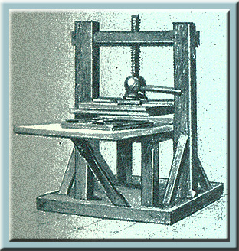
Newspapers in Britain
Printing press was invented in the15th century in Germany
!
The first newspaper in Britain appeared in 1513.

Slide 9
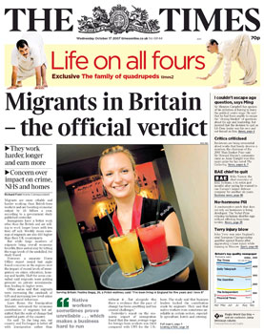
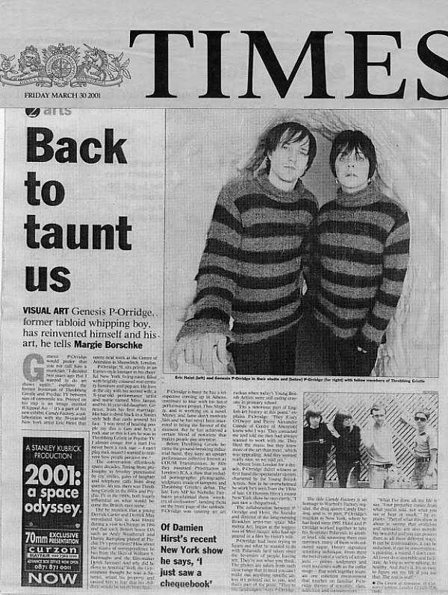
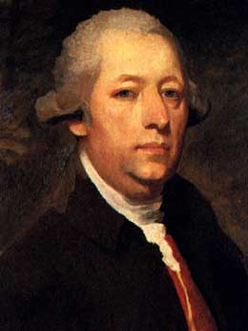
Newspapers in Britain
The longest running British newspaper is The Times began in 1785.
John Walter was a founder of The Times newspaper, London.

Slide 10
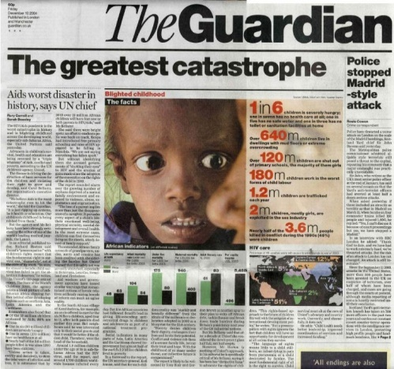
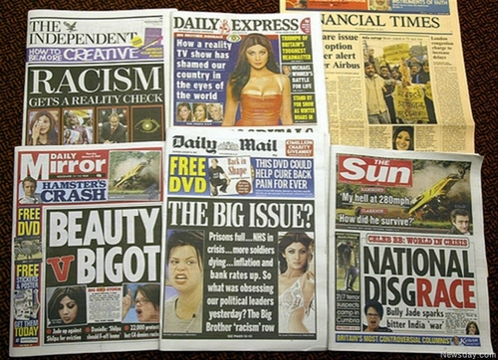
More credible
Contain political, industrial, financial and cultural news
Quality papers
There are two kinds of newspapers in Britain
Tabloids
Less credible
Sensationalism

Slide 11
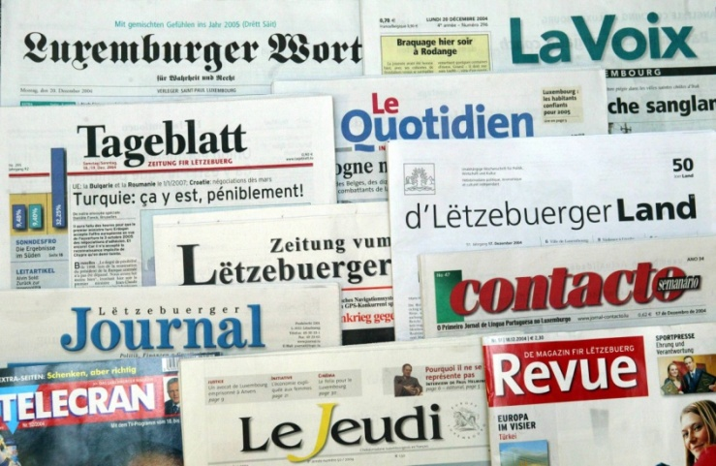
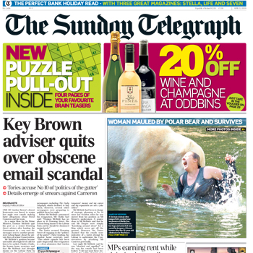
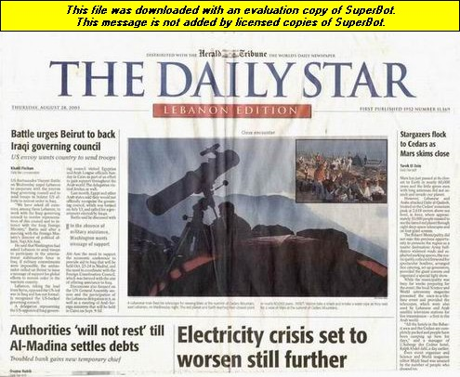
Newspapers are divided
Daily
Sunday
Published on every day of the week except Sunday
They are larger then daily ones

Slide 12
What is a radio?
The process of sending and receiving messages through the air , broadcasting programmes for people to listen to
People can
listen to music
get news
take part in talk shows

Slide 13
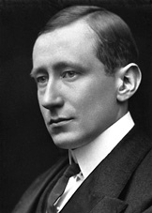
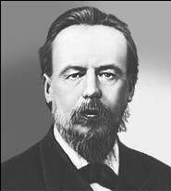
Who invented
a radio ?
Guglielmo Marconi was an electrical engineer and Nobel laureate known for the development of a practical wireless telegraphy system.
In 1896, he was awarded a patent for radio with British Patent .
On May 7, 1895 the Russian physicist Alexander Popov performed a public demonstration of transmission and reception of radio waves used for communication .This day has since been celebrated in Russia as “Radio Day”
Nikola Tesla developed means to reliably produce radio frequencies, publicly demonstrated the principles of radio, and transmitted long distant signals.

Slide 14
A Radio in the UK
BBC radio
A service of the British Broadcasting Corporation which has operated in the United Kingdom
BBC operates more than 40 stations that comprise 50% of all radio listening in the UK
The BBC radio services began in 1922.
Commercial Radio:
Started in 1970s, now includes over 300 private stations.

Slide 15
An advertisment
a commercial interruption, where a a thing, a product or a service are advertised . It helps people to choose best things.

Slide 16
A documentary
A programm which gives facts and information about a particular subject

Slide 17
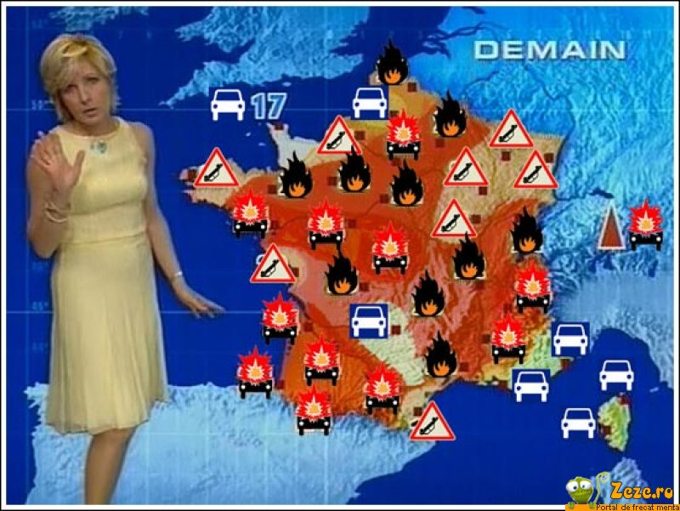
A Weather forecast
A programm ,where the announcer says what the weather will be like the next day.

Slide 18
Talk show
It is a discussion, where different problems are discussed by participants . They express their opinions, ask and answer questions.

Slide 19
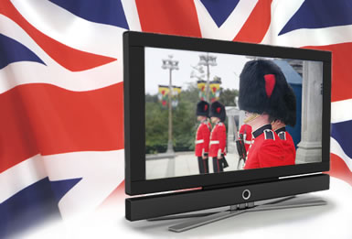
The British Television
There are 940 television broadcasts stations; 400 different TV channels in The UK.
Major British TV Channel is BBC.
BBC operates 14 different television channels

Slide 20
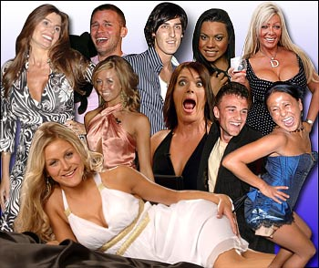
Reality TV in Britain
Programmes which ordinary people into the public eye are enjoying a wave of popularity
Popular reality TV shows in the UK
X Factor
Strictly Come Dancing
Big Brother

Slide 21
It was invented in the USA in 1965
A worldwide system of interconnected networks and computers.

Slide 22
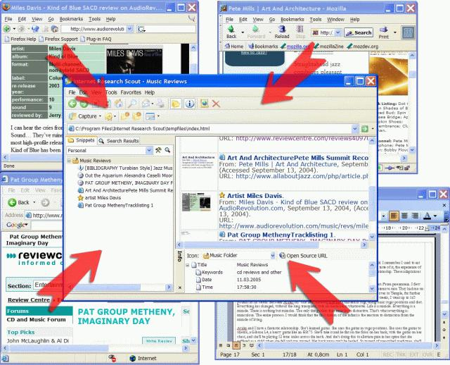
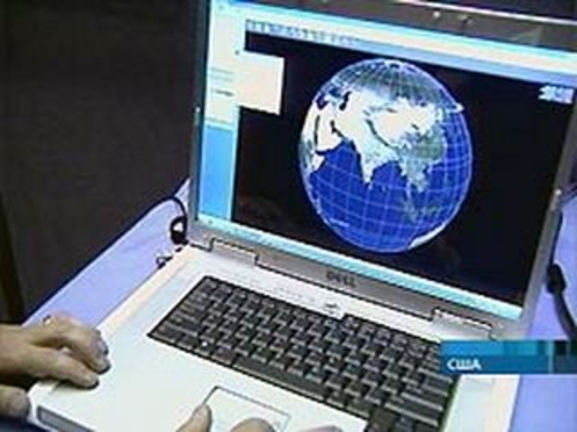
Research ,getting necessary information
Online shopping
Talking to friends
What can you do
in internet?
Download music
Downloading/
listening to music
Watching Videos

Slide 23
Thank you for your attention

