Slide 1
History of Big Ben

Slide 2
Contents
Nickname
Journey back
Accommodation
2 clock towers
Fire
Only Westminster Hall
Architect for new tower
Tower without clock
Unusual architecture
Watchmaker
Ending
Conclusion
Infuriation

Slide 3
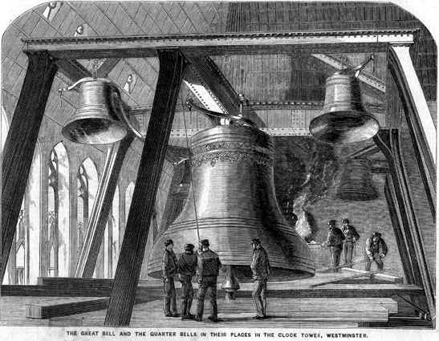
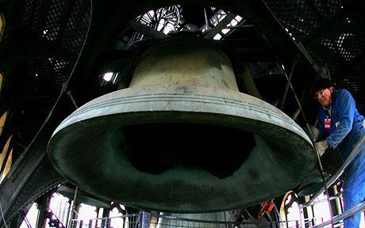
Big Ben is the nickname for the great bell of the clock. It is in Elizabeth Tower.
Contents

Slide 4
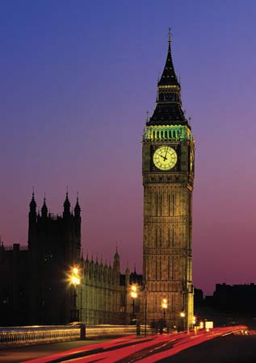
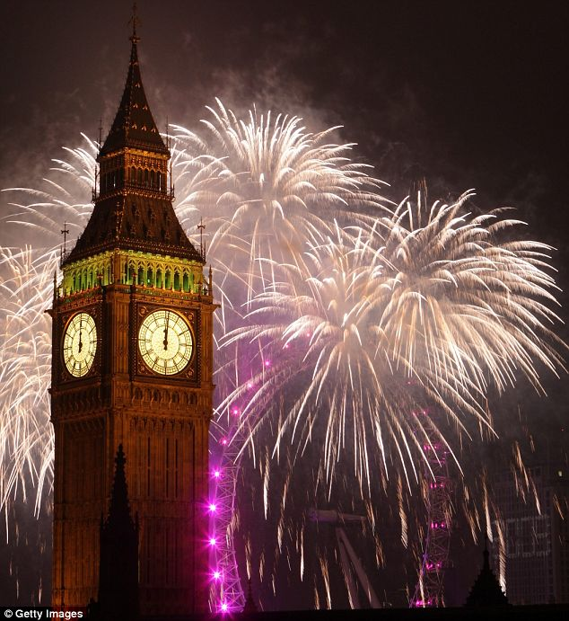
Amongst the trivia about this British landmark, its building and creation is a story worth telling. Let's trace back to the mid 1800's, to the year of 1834, to learn about the building of Big Ben.
Contents

Slide 5
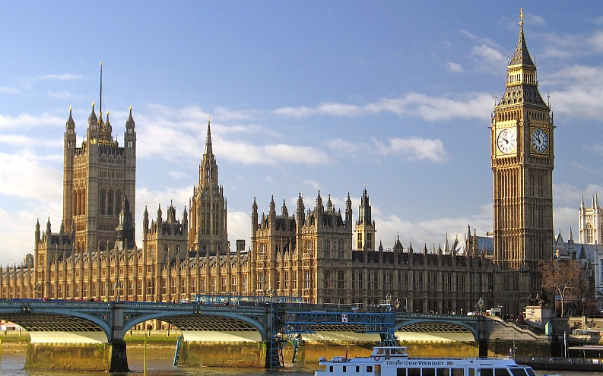
Contents
Big Ben, situated in the Palace of Westminster, is one of the best known icons of London

Slide 6
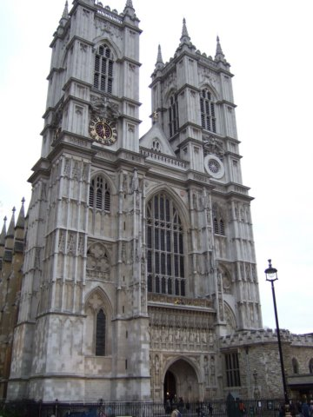
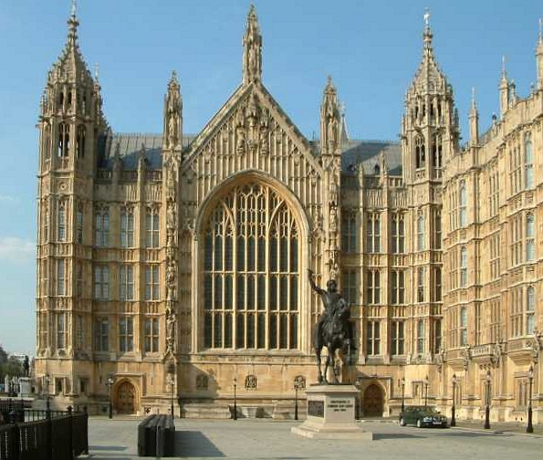
The Palace of Westminster had 2 clock towers during the time of King Edward I. They were rebuilt in 1397 and later a sundial was built in 1707.
Contents

Slide 7
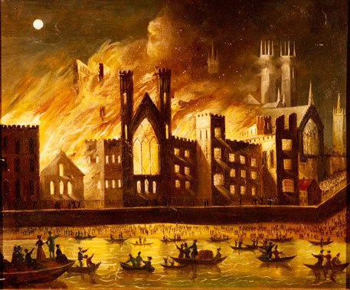
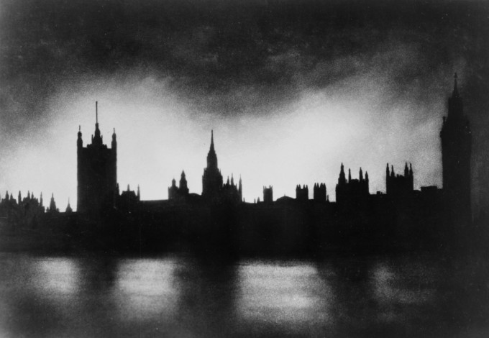
On the 16th of October 1834, the Palace of Westminster, British Houses of Parliament were destroyed by fire. There was nothing left but ruins.
Contents

Slide 8
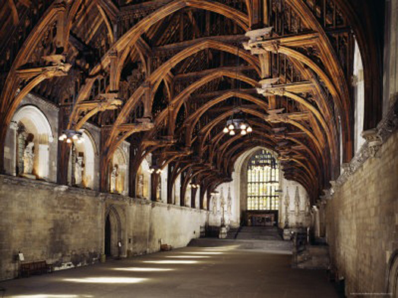
Only Westminster Hall remained.
Contents

Slide 9
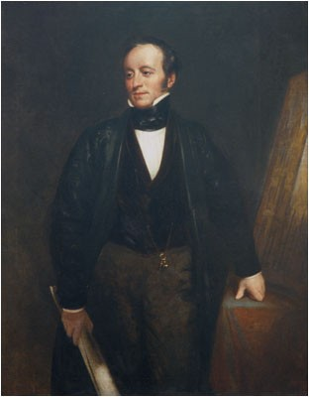
The English Parliament decided to rebuild the Palace and using various designs. The architect chosen was Charles Barry
Contents

Slide 10
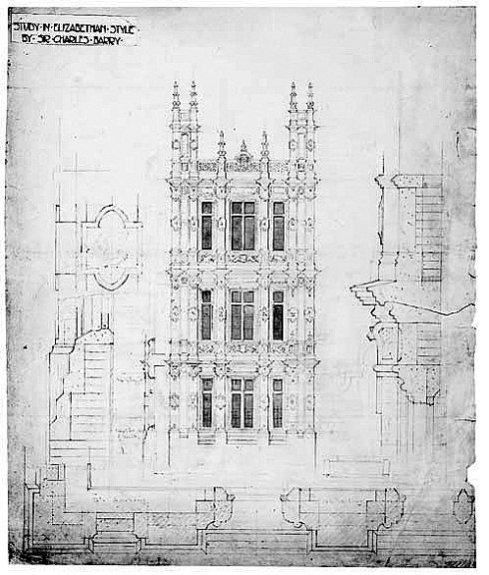
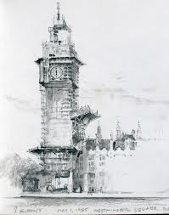
Charles Barry's winning design did not feature a clock tower.
Contents

Slide 11
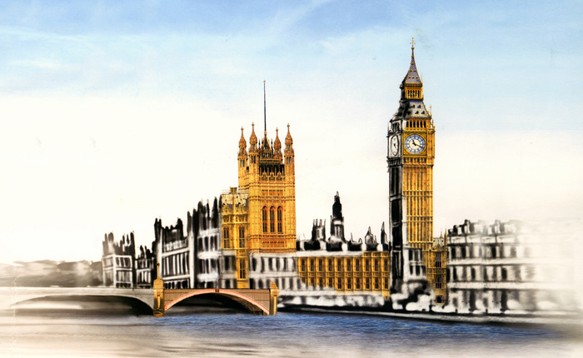
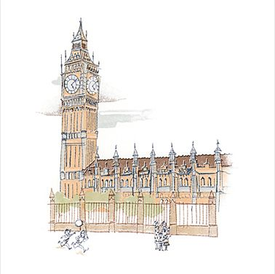
But the Parliament made him change his design to include a clock tower in 1836. His assistant Augustus Pugin was in charge of the clock tower's construction. It started in full scale in the year of 1843. Unlike normal constructions, the tower's interior was constructed first, then the exterior was formed.
Contents

Slide 12
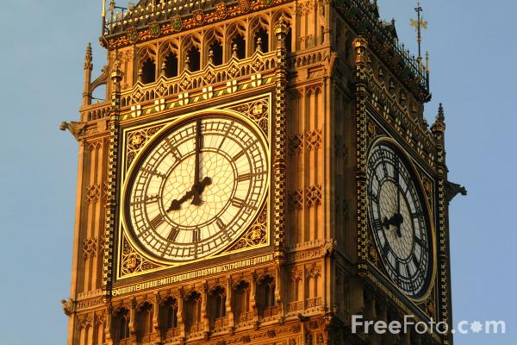
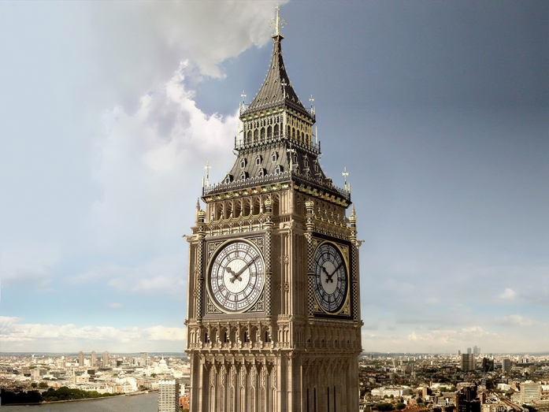
A clock tower needs a clock.Recognizing that this part of the construction was above their expertise, they hired Benjamin Lewis Vulliamy to create and fix the clock in the tower.
Contents

Slide 13
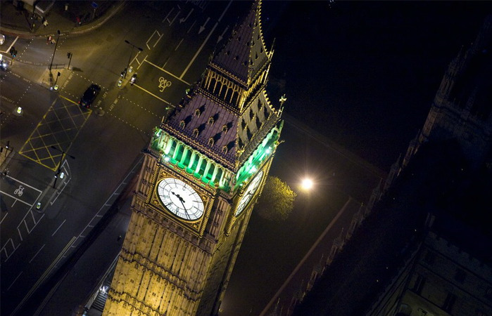
It was completed to work from May 31st, 1859. The clock weighs around 13,760 kilograms.
Contents

Slide 14
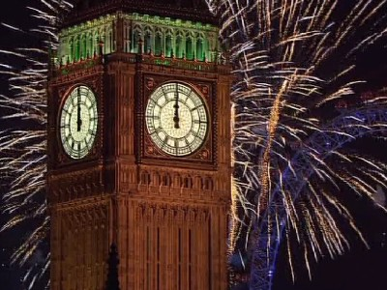
Big Ben is a good place to visit.
Contents

Slide 15
Sourses of Information
Photos from http://images.yandex.ua/yandsearch?text=big%20ben&stype=image&lr=143&noreask=1&source=wiz
information
http://en.wikipedia.org/wiki/Big_Ben
http://www.visitlondon.com/things-to-do/sightseeing/tourist-attraction/big-ben
Contents

