Slide 1

Ukrainian Americans

Slide 2

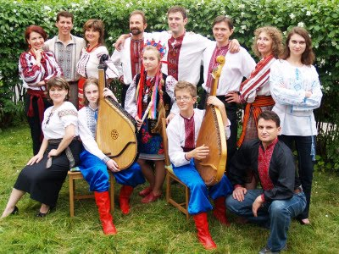
Ukrainian Americans (Ukrainian: Українці Америки, Українці у США;) are Americans who are of Ukrainian ancestry. According to U.S. census estimates, in 2006 there were 961,113 Americans of Ukrainian descent representing 0.33% of the American population. The Ukrainian population of the United States is thus the second largest outside the former Soviet Union; only Canada has a larger Ukrainian community. According to the 2000 U.S. census, the metropolitan areas with the largest numbers of Ukrainian Americans are: New York City with 160,000 Ukrainians, Philadelphia with 60,000 Ukrainians, Chicago with 46,000 Ukrainians, Los Angeles with 34,000, Detroit with 33,000 Ukrainians, Cleveland with 26,000 and Indianapolis with 19,000.

Slide 3


History
The first Ukrainian immigrant to America, Ivan Bohdan, sailed with John Smith to the Jamestown colony in 1608. Bohdan met captain Smith during the time when the latter had fought the Turks, was captured, and escaped captivity by fleeing through Ukraine, Romania, Hungary, and other countries. Large scale Ukrainian immigration to America did not begin, however, until the 1880s.
The largest wave of Ukrainians came in the early 1990s, after the fall of the Soviet Union. A large number those emigrating from Ukraine after the fall of the Soviet Union were Jewish and Protestant. Many Ukrainians of the newest immigration wave migrated to large cities and regional centers, creating ethnic enclaves. In addition, many Ukrainian Americans have come by way of Canada, which has a larger Ukrainian presence.

Slide 4

Demographics
According to the 2000 U.S. Census, there are 892,922 Americans of full or partial Ukrainian descent. The New York City Metropolitan Area contains by far the largest Ukrainian community in the United States, receiving the highest legal permanent resident Ukrainian immigrant population.
The American states with the largest Ukrainian populations are as follows:
New York | 148,700
Pennsylvania | 122,291
California | 83,125
New Jersey | 73,809
Ohio | 48,908
Illinois | 47,623
The total number of people born in Ukraine is more than 275,155 inhabitants.

Slide 5

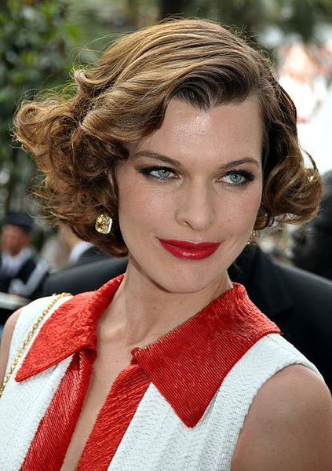
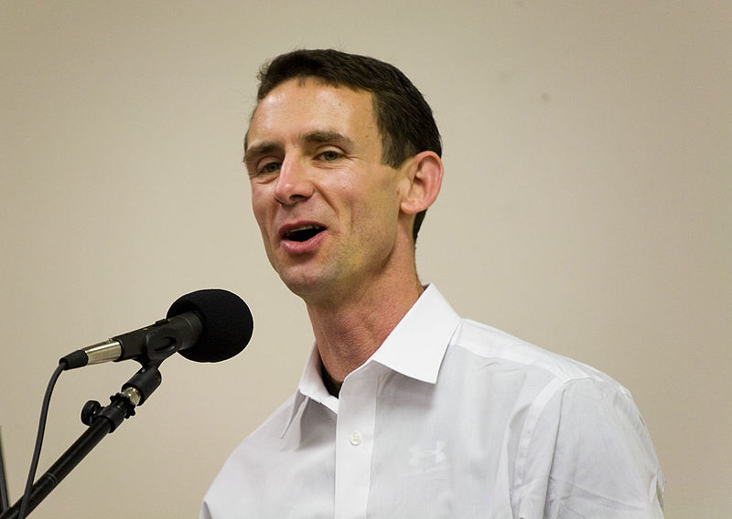
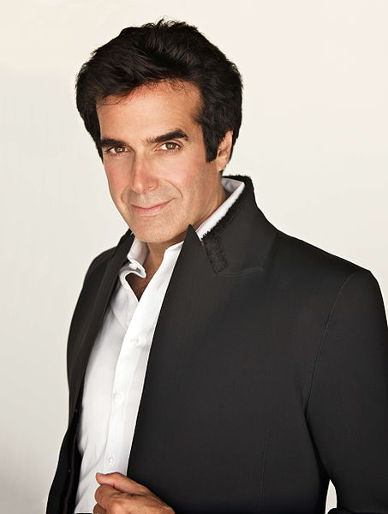


Representatives of Ukrainian diaspora in USA
Mila Kunis
Milla Jovovich
David Copperfield
Vera Farmiga
Chuck Palahniuk

