Slide 1
Swimming
It’s my life.

Slide 2

Swimming
This topic has touched me because I have been swimming since I was 4 years old.

Slide 3
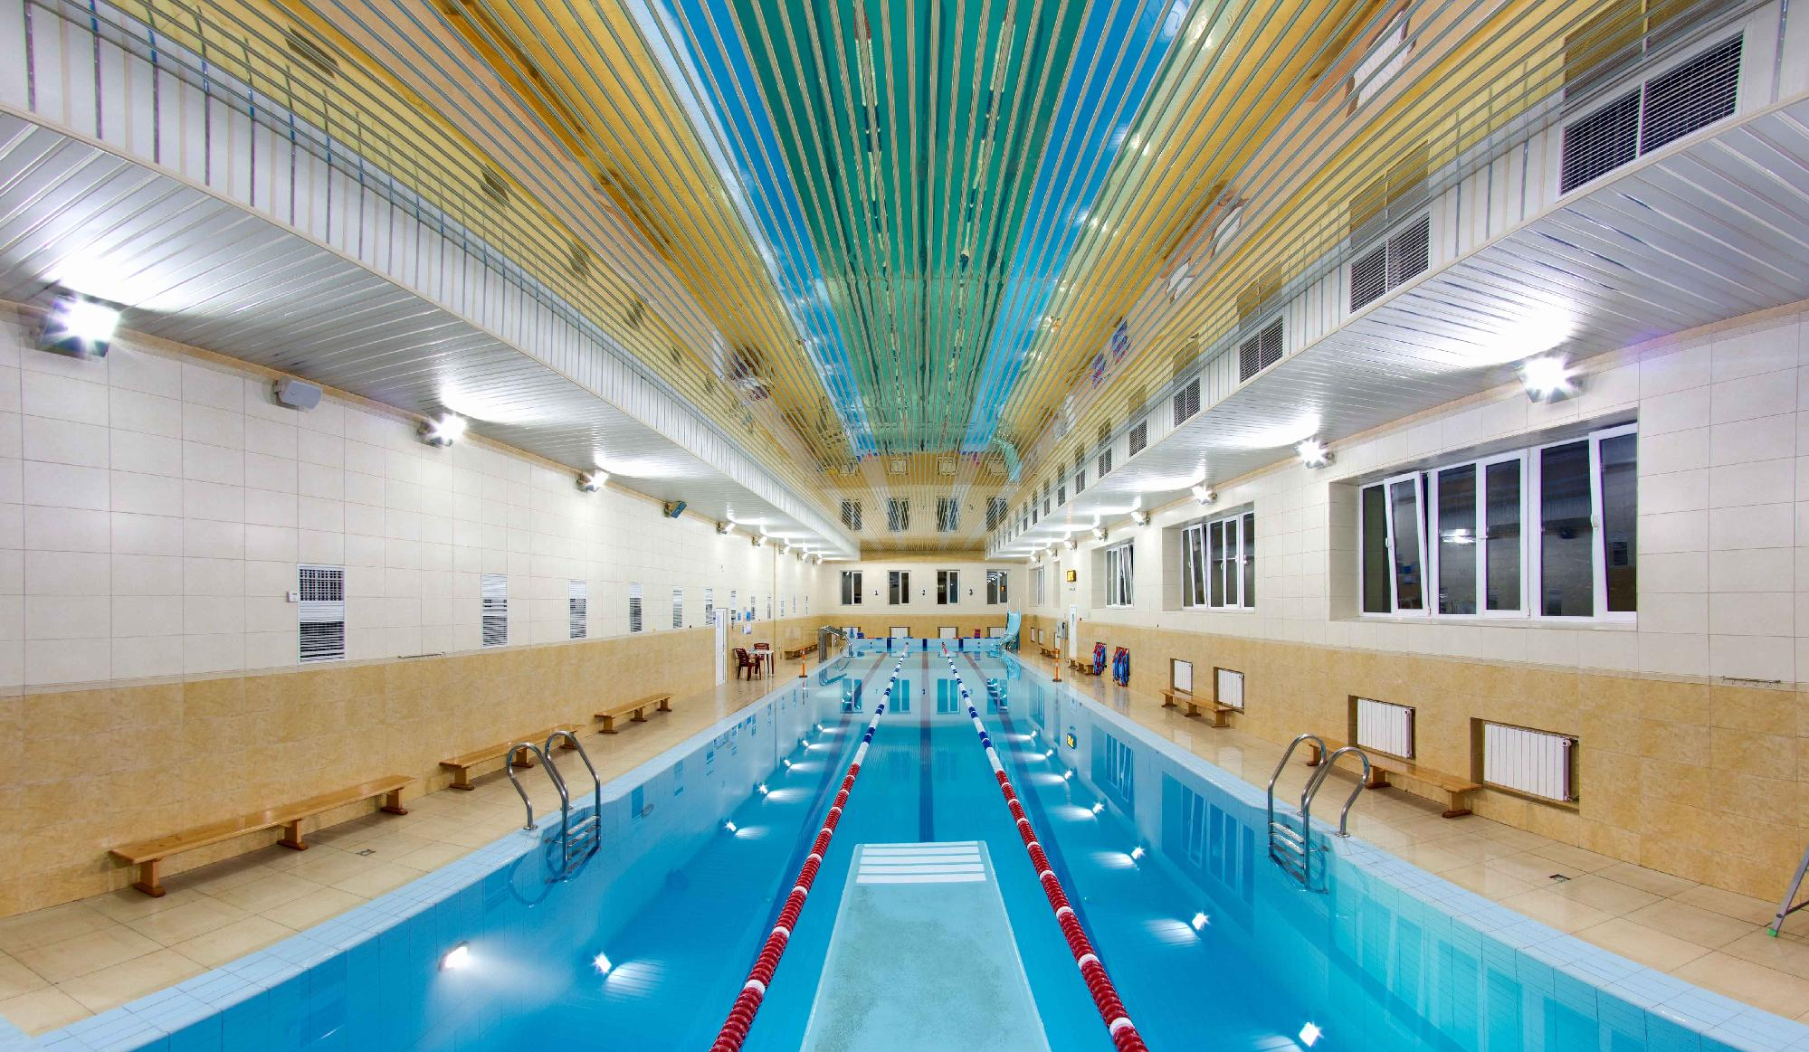
Let me tell you some interesting information about swimming…

Slide 4
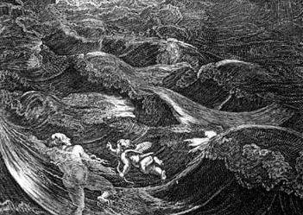
Brief Introduction
The sport of swimming has been recorded since prehistoric times; the earliest recording of swimming dates back to Stone Age paintings from around 7,000 years ago. Written references date from 2000 BC. Some of the earliest references to swimming include the Gilgamesh, the Iliad, the Odyssey, the Bible, Beowulf, The Holy Quran along with others. In 1538, Nikolaus Wynmann, a German professor of languages, wrote the first swimming book, The Swimmer or A Dialogue on the Art of Swimming

Slide 5
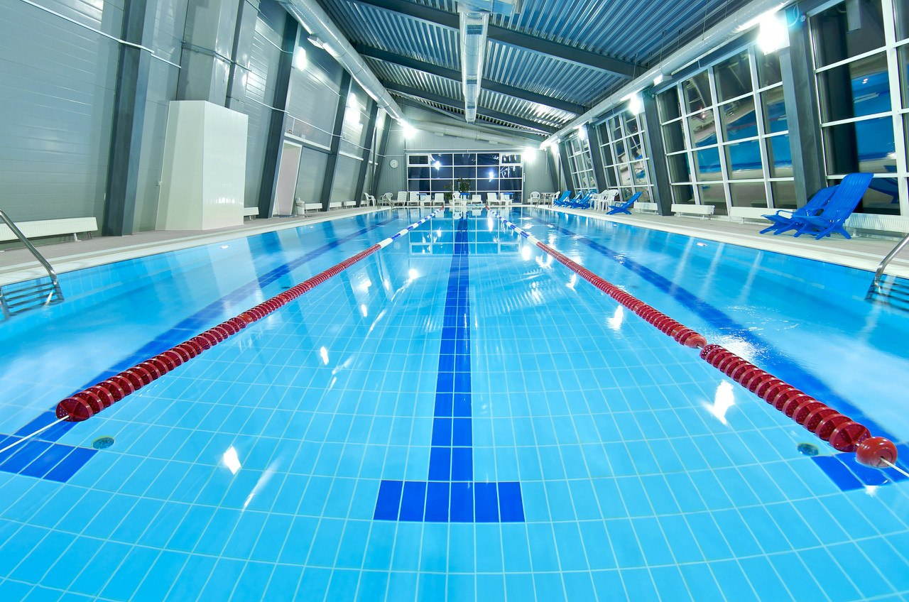
Swimming Secrets
The swimmer shouldn’t train his arms too much (doing push-ups or similar exercises);
Those who prefer breaststroke swimming have thick legs;
Those who take part in competitions can swim under the water only 15 metres;
If you don't swim about three times a week you will lose your feel for the water and your technique will begin to worsen;
Swimming is much more effective in the morning than during the day.

Slide 6
Competition
Competitive swimming became popular in the nineteenth century. The goal of it is to beat the competitors in any given event. Swimming in competition should create the least resistance in order to obtain maximum speed. However, some professional swimmers who do not hold a national or world ranking are considered the best in regard to their technical skills. Swimming is an event at the Summer Olympic Games, where male and female athletes compete in 16 of the recognized events each. Olympic events are held in a 50-meter pool, called a long course pool.

Slide 7
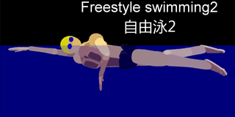
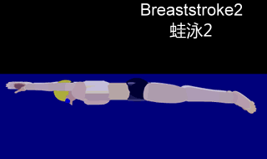
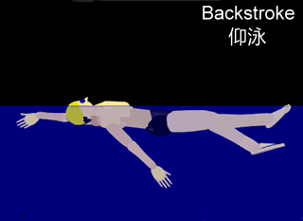
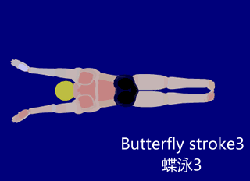
Swimming Styles
In competitive swimming, four major styles have been established.
Freestyle
Breaststroke
Backstroke
Butterfly

Slide 8
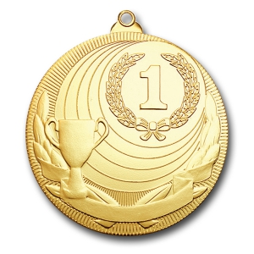
Records
The Brazilian swimmer César Cielo set a record in 50 and 100 m freestyle in 2009.
The German swimmer Paul Biedermann set his records in 200 and 400 m freestyle in 2009.
The American swimmer Aaron Peirsol set a record in 100 and 200 m backstroke in 2009.
The American swimmer Katie Ledecky set her records in 800 and 1500 m freestyle in 2013.

Slide 9
Conclusion
Swimming is a tremendous kind of sport which brings not only pleasure but also keeps everybody fit, healthy, cheerful and beautiful. So as for me, it is one of the best type of activity for the body and mind.

Slide 10

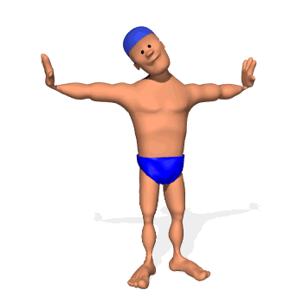
Thank you for your attention!

