Slide 1
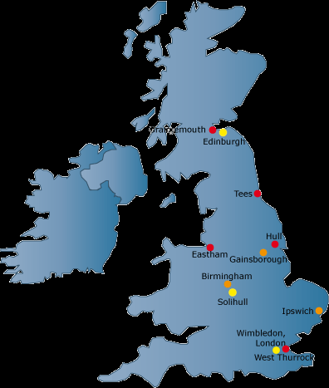
Great Britain
Project Work

Slide 2

Plan
Basic information
A brief history
Geography information
Interesting places
Famous People

Slide 3
Basic information
The capital - London
area of ​​244,100 square meters. km;
Relief: an island separated from the European continent, about 6 thousand years BC. e.;
Landscape variables in northern mountainous, with Hrampianskymy mountains in Scotland, Pennynamy the north of England, Cambrian Mountains in Wales;
Rivers Thames, Severn and Spey;
Overseas Territories: Anguilla, Bermuda, British Antarctic Territory, British Indian Ocean Territory, British Virgin Islands, Cayman Islands, Falkland Islands, Gibraltar, Hong Kong (until 1997), Montserrat, Pitcairn, St. Helena (including Ascension Island and Tristan da Cunha), Turks and Caicos Islands;
Head of State Elizabeth II (since 1952);
Head of Government, David Cameron (from 2010);
Political system - liberal democracy;
Currency - Pound Sterling.
Export: cereals, sugar beets, canola, potatoes, meat and meat products, poultry, dairy products, electronic and Telecommunications equipment, scientific instruments, oil and gas naftohimikaty, pharmaceuticals, fertilizers, movies and television programs, aircraft ;
Population of 57,121 thousand (1990), 59.055 million people. (2001). (81.5% English, 9.6% Scottish, Welsh 1.9%, 2.4% Irish, 1.8% olstertsi);
Language : English, Welsh, Gaelic;

Slide 4
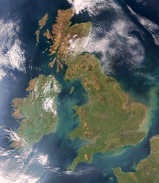
Cosmic picture
From the orbit of the planet all you can see

Slide 5
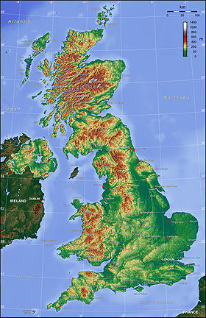
Relief
The topography of Central, and South-Eastern parts of Great Britain gorbisto-plain; in Scotland, Wales and Ulster are dominated by low hills and upland, smooth glaciers and rìčkovoû with. Peninsula Wales busy Kebrìjs′kimi mountains to the South of Scotland are the Pennine and Kamberlends′kì mountains. The highest mountain in Great Britain are on the North Scottish Highlands. A mountain of Ben Nevis, located near the headwaters of Loch Lìnne, rises to a height of 1343 m above sea level, and in the vicinity of the crossing of the plateau and the Grampìans′kih mountains, several peaks exceeding 1200 m. Major rivers: the Thames, Severn and Trent, Mersey. The features of the terrain, the territory of the United Kingdom is divided into two main areas. High Kingdom (including Northern Ireland), located in the North and West of the country, pìdstilaêt′sâ resistant by the ancients indigenous breeds and is mostly heavily dissected upland and less common lowland. To the South and East is Low, x.

Slide 6
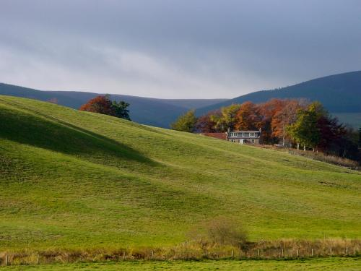
Climate
UK climate is classified as serednoshyrotnyy oceanic climate (classification Koppena) with warm summers, not too cold winters, but regular rainfall throughout the year. The main factors that affect the climate of Great Britain is the country's northern location (50 ° to 60 ° north latitude), proximity to the Atlantic Ocean and Gulf Stream currents.
Since the UK is on the islands, the climate here is very specific. In a climate affects heat flow Gulfstream. The climate in the country wet and soft. Lakes and rivers freeze very rare in all seasons often raining. The total average annual rainfall is 1100 mm. Nayvolohishi months from September to January. In addition, Britain is famous for its fog. Sometimes mists are thick that you can not see anything within 2 or 3 meters. Everyone who arrives in the UK says that it seems only a beautiful park. The country has too Oceanic and humid climate, with mild winters and sunny summers, fog and winds. His form the Atlantic cyclones. Most of the rainfall in the west, especially on the western slopes of mountains and highlands (average 2000 - 3000 mm per year). The least humid part of the country - southeast (average 625 mm of precipitation annually). The UK is dominated by precipitation as rain, just to the north in the mountains for 1 - 2 months snow falls. The average January temperature ranges from +7 ° C in the peninsula of Cornwall to +3,5 ° C in eastern England, but there are frosts to -15 °...- 18 ° C. Summer in the country cool, the average July temperature is +16 ° C and around London - +11 °...+ 13 ° C.
On picture: Purchase Scotland in autumn: green hills, coloured trees (United Kingdom)

Slide 7
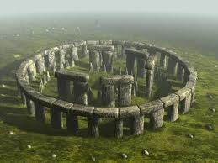
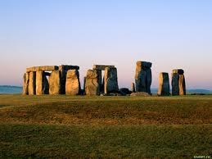
Stonehenge
Interesting places of Britain
Formerly and now

Slide 8
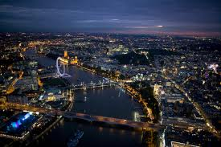
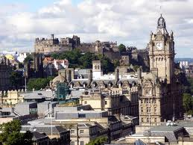
The largest city in Great Britain
London
Edinburgh

Slide 9
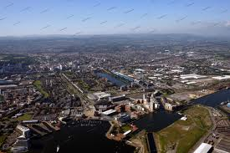
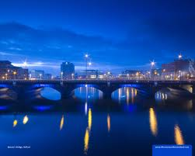
Interesting places of Britain
Cardiff
Belfast

Slide 10
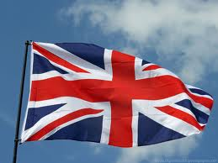
History
United Kingdom was formed in 1801. The composition of its included England, Scotland, Wales and all Ireland. In 1921 Southern Ireland left the union. Union of England, Scotland and Wales known as the "United Kingdom". Documented history of Britain begins in 55 BC when the Romans invaded it. They conquered the whole UK, but its most northern regions. Roman traders and soldiers helped spread Christianity here and the construction of many cities. In the V century BC The Roman Empire fell, and German tribes anhlov and Saxons conquered country, which became known as England. Scandinavian Vikings devastated the northern and eastern regions of England, while Wales and Scotland remained under the authority of the Celts.
In 1066 England seized the Normans (Vikings, who occupied Northern France). In medieval England often waged war with neighboring countries. However, in the middle of the XVI century it was united with Wales, and in 1707 the Union became Scotland formed as a result the UK government. Since XVI century, Britain was transformed into a powerful maritime empire. In the XVIII century, thanks to the efforts of scientists and engineers in the country shifted from agricultural to industrial production. In XX century British political influence weak, although she played an important role in two world wars. By 1960-ies most British colonies gained independence. In 1973, the United Kingdom joined the European Economic Community (now European Union).

Slide 11
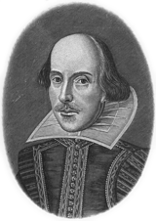
The famous people of England
William Shakespeare
William Shakespeare was born, according to reports on April 23 [2], in the meantime by a wealthy family of John Shakespeare, rukavychnyka and wool merchant. His father was elected to various public positions, was once elected mayor. He attended a church service, by paying large fines. His mother, congenital Arden, belonged to one of the oldest English families. William attended grammar school («grammar school»), in which taught Latin and Greek language, literature and history. Living in a provincial town, close contact with people from whom learned English folklore and richness of folk speech. Of the fifteen ruin father William was forced to earn his own living. As a younger teacher, he married in 1582 with Ann Hetevey, he had three children. In 1587 he went to London and began playing on stage, although a great success as an actor was not. From 1593 he worked in the theater Burbage as an actor, director and playwright. When James I of Shakespeare troupe gained royal status. In 1599 he participated in building the London theater "Globe", became its shareholder - and the next 10 years was registered in the lists of his troupe. For many years Shakespeare was engaged in usury, and in 1605 became the leaseholder tithe.
In 1612 Shakespeare left for unknown reasons, resigned and returned to his native Stratford, where lived his wife and daughter. Will Shakespeare on 15 March 1616 year was signed by illegible handwriting, on the basis that some scholars believe that he was then seriously ill. April 23, 1616 Shakespeare died. Three days later, Shakespeare's body was buried under the altar stratfordskoyi church. ...

Slide 12
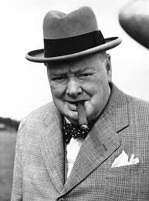
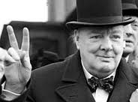
Winston Churchill
Winston Leonard Spencer-Churchill was born November 30, 1874 prematurely in Blenheim Palace, Woodstock, Oxfordshire. He came from a dynasty of the dukes of Marlborough, was the son of Lord Randolph Churchill British and American Jenny. Churchill attended private schools and continued his education at the Royal Military Academy Sendherst.
In 1894 Churchill began service in the fourth hussar regiment in Bangalore, India.
In India, the main occupation of the regiment Churchill was a game of polo. This situation did not suit the young man who wanted to engage in hostilities. He devoted his time, self-education. In 1895 he obtained leave to observe the Spanish battles against Cuban guerrillas. Churchill agreed to write about the conflict with the newspaper Daily Hrefik (Daily Graphic). Churchill went under fire for the first time in its twenty-first birthday. On his way to Cuba as he first visited the United States, where he represented New York society. In 1897 Churchill officer hussar regiment participated in the conquest of the insurgent tribes in India, then was transferred to the 21th Uhlan Regiment, which participated in the punitive expeditions of General Kitchener in the Sudan. There he took part in the Battle of Omdurmanom. In October 1898 Churchill returned to England, where he wrote and published the following year the book "The River War."
In '26 Churchill was elected as Member of Parliament from the Conservative Party in Oldhemi. Within the walls of the British Parliament, he spent 64 years with breaks and left it at age 90. After the election, Churchill made a tour of lectures in Britain and the United States, earning ten thousand pounds. (Parliamentarians were nevysokooplachuvani in those days and Churchill was not rich by the standards of the time.)
In 1911, Churchill became First Lord of Admiralty. He gave impetus to military reform, in particular supported the development of naval aviation, tanks and fleet transition from coal to oil.
The development of battle tanks was funded marine research funds through the Committee of Ground Vehicles, and, though now a decade later saw the development of tanks would be a genius, while it was treated as a wasting of budget funds. Churchill was annoyed that the tanks in the army appeared in very small quantities, while he wanted to have a sufficient number of tanks to suddenly escape from under the smokescreen, crossed the German trenches, crush barbed wire and create a breakthrough sector .
Once World War II began, Churchill 3 September 1939 joined the government and again led the admiralty. Finally it was his stellar time: 10 May 1940, when German panzer armada invaded France and Belgium, Churchill replaced Chamberlain as British prime minister. Entering into this position in the most dangerous moment of British history, Churchill warned the fellow that awaits them "blood, hard work, tears and sweat." But he assured the British that his government will lead the uncompromising war against Nazism until his defeat, to win at any cost.

Slide 13
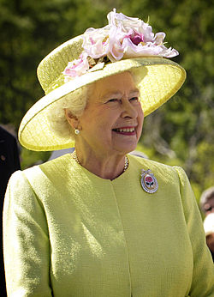
Elizabeth II (Queen of Great Britain)
Elizabeth was born at Bretton Street, 17 London, April 21, 1926, in the family of Prince Albert, Duke of York and his wife the Duchess of York (Elizabeth Bowes-Lyon, the future Queen Mother). Her baptism in the Music Room of Buckingham Palace spent Cosmo Lang, Archbishop of York on April 29 that year. Princess godparents were: George V, Queen Mary, Princess Mary, Earl Stratmorskyy, Duke and Lady Konnoutskyy Elfinstoun. His name is in honor of his mother, Queen Olesandry - his great-grandmother on the father and the Queen Mary - grandmother. The family called her pet name 'Lilibet »(Lilibet). Elizabeth made her first foreign visit in 1947, when together with his father visited South Africa. In honor of his age, which came when she turned 21, she made a radio address to the Commonwealth and the Empire with the words: "I declare before you that my whole life, it will be long or short, shall be devoted to serving you and our great imperial family to which we belong. "
November 20, 1947 she married to Philip Duke of Edinburgh (Prince of the birth of Greek and Danish), who is also her brother chotyryyuridnym (they are both great-great-grandchildren King of Denmark Christian IX) and was also great-great-grandson of Queen Victoria. Many who opposed the marriage because Prince Philip was Orthodox, had no money, and his sisters married German princes-Nazi supporters. Even princesses have been against and even, as evidenced by recent biography, called Philip "hunom." Today, the Queen is one of the most popular of the UK. According to recent polls, it supports about 80% of subjects. Although the case of Princess Diana for some time shattered its popularity and prestige of the monarchy, but in the long run, as the study of public opinion, not affected it.
At the time of the reign of Queen Elizabeth II ended with the collapse of the British Empire and Commonwealth fully formalizuvalasya Nations, which united most of the former British possessions. Now the main role of chairman of the Commonwealth, which is the Queen, was the need to maintain links with each other Commonwealth countries and former parent. The Queen is often played an important role in the restored damaged relations with Commonwealth countries and smoothing conflicts.
In 2007 she discovered the secret documents show that in 1956 the French Prime Minister Guy Molly and British Prime Minister Anthony Eden discussed the possibility of Union of Great Britain and France. It is not vyklyuchalosya that Elizabeth II may become head of state in France

Slide 14
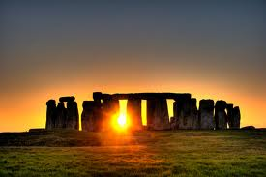
The End

