Slide 1
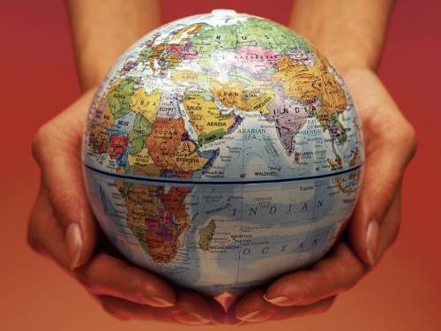
Some details of New Zealand
Made by Maryna Zimenko

Slide 2
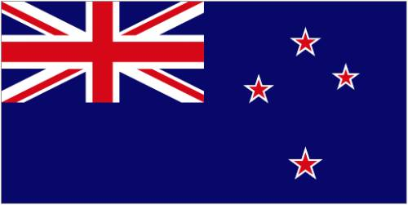
Here is information about natural resources, landmarks, culture and political system.
New Zealand

Slide 3
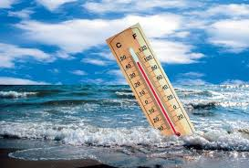
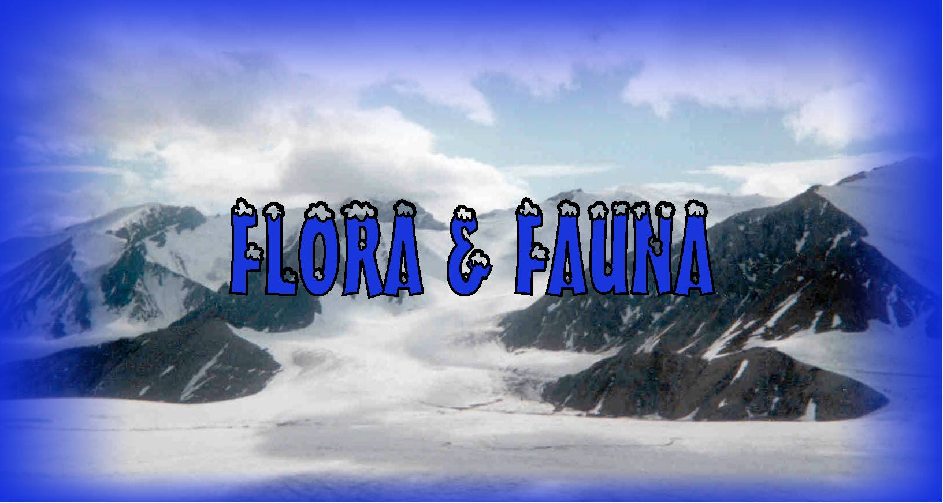
Natural resources
There are
climate
flora
fauna

Slide 4
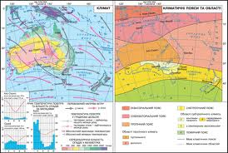
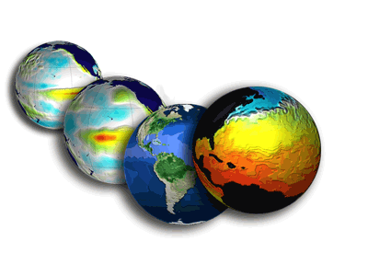
Climate
New Zealand is known for its maritime climate. It is moist and temperate. The difference of winter and summer temperatures is about 10 degrees. There are heavy rainfalls in New Zealand.

Slide 5
Flora in New Zealand is very rich. There are about 2,000 species where 1,500 are endemic (which are only found in this country). It also has some of the oldest trees.
Fauna in this country is also special. Long time ago, without enemies, some birds lost their ability to fly, and some insects became gigantic.

Slide 6
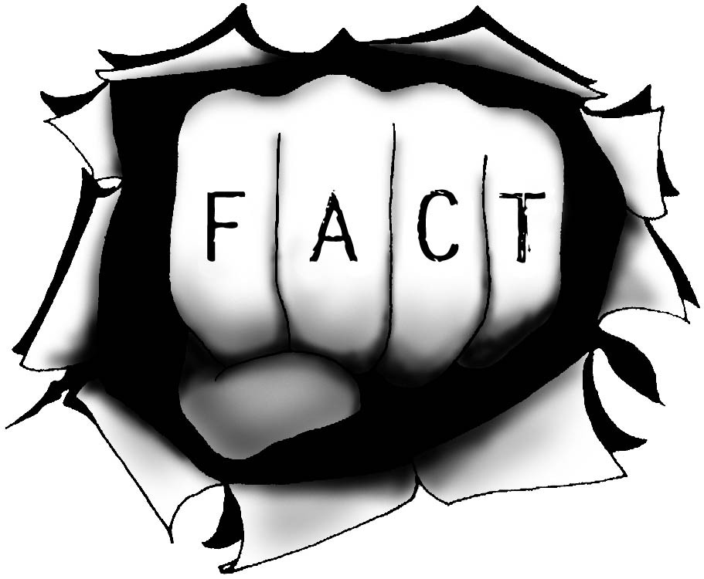
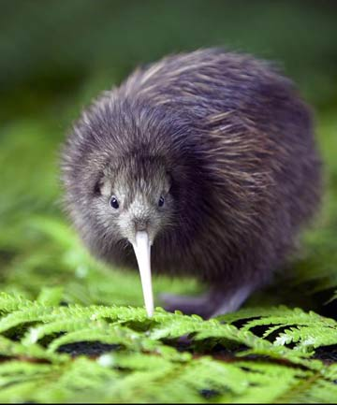
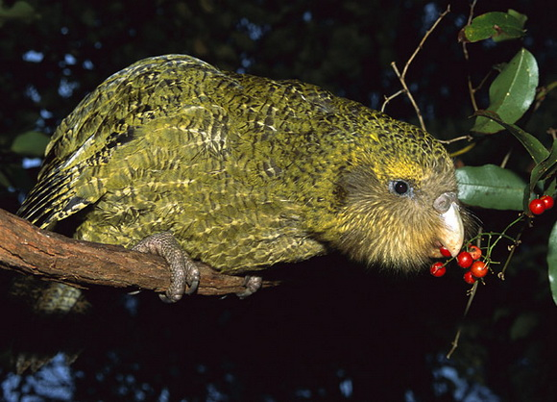
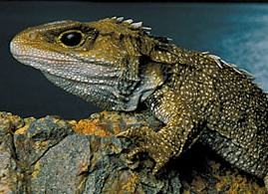
It’s interesting to know…
Many of New Zealand’s native animals are found nowhere else in the world:
the kiwi – its egg is about one fifth of its own weight
the kakapo – the world’s largest flightless parrot
the tuatara – the oldest reptile. She live for 300 years.

Slide 7
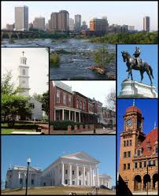
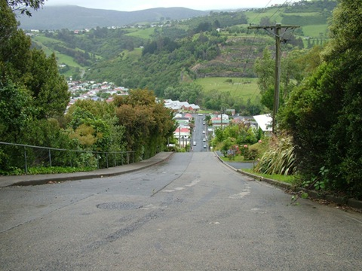
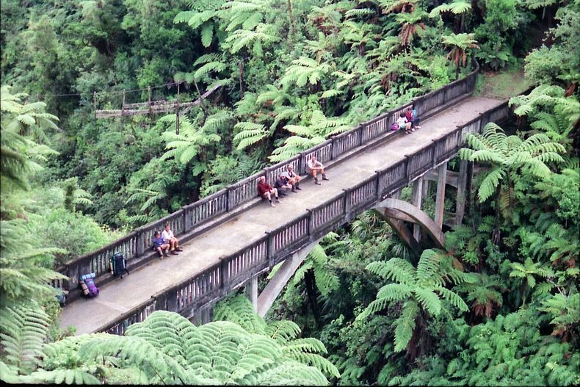
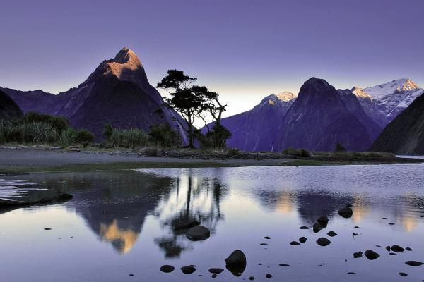
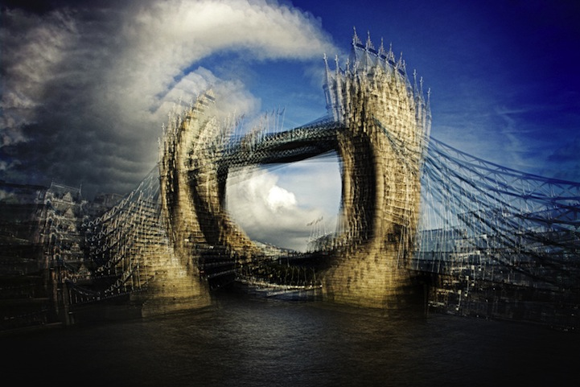
Attractions of New Zealand

Slide 8
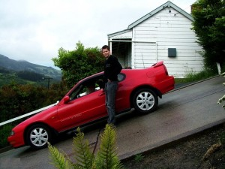
Baldwin Street
Baldwin Street is a street in the city of Dunedin in the south of New Zealand. It is entered in the Guinness Book of Records as the steepest street in the world .

Slide 9
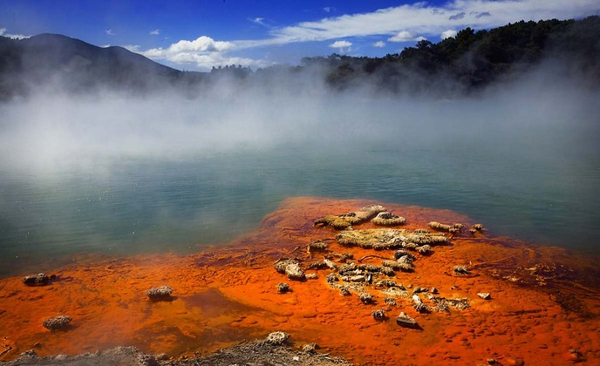
Valley of Geysers Vaymangu
Near the city of Rotorua is one of the most interesting natural attractions New Zealand - Valley of Geysers Vaymangu.

Slide 10
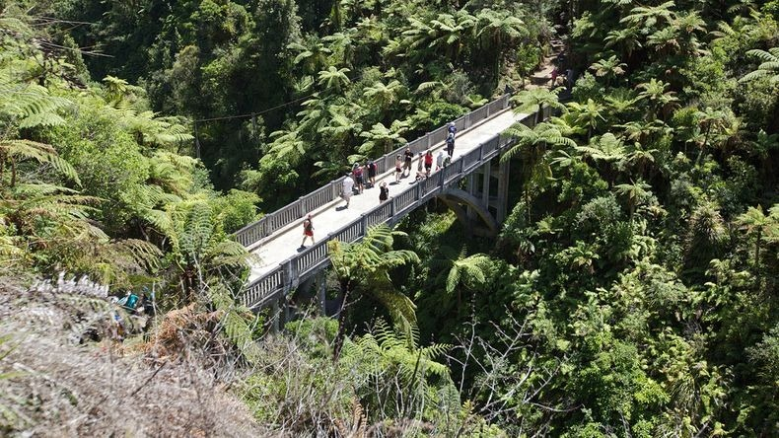
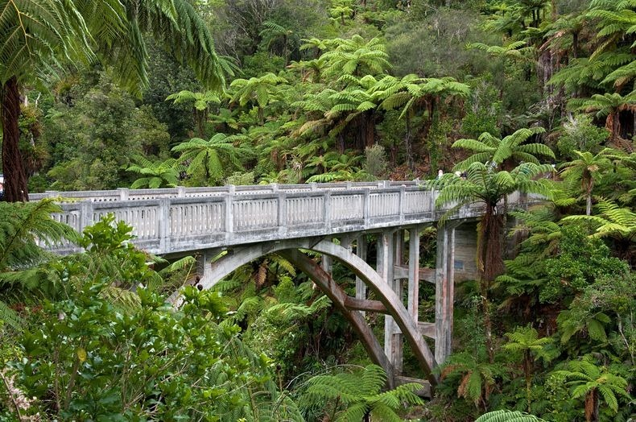
"Bridge to Nowhere"
It is one of the most visited attractions in the National Park Wanganui. It is abandoned and isolated bridge in the middle of the rainforest.

Slide 11
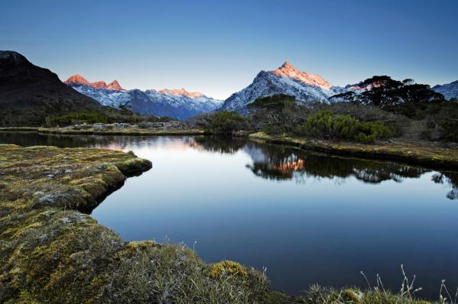
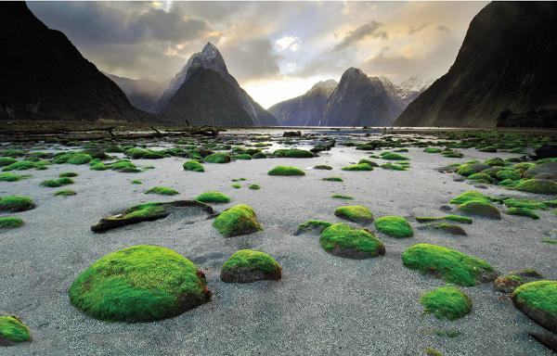
The National Park Fiordlend
R.Kipling called the National Park Fiordlend "the eighth wonder of the world“.

Slide 12
Culture of New Zealand
The culture of New Zealand is a mixture of different cultures: British, Aboriginal and other European countries.
There is a cultural phenomenon in New Zealand known as “kiwiana”. It show their national identity, their “kiwi nationhood”.

Slide 13
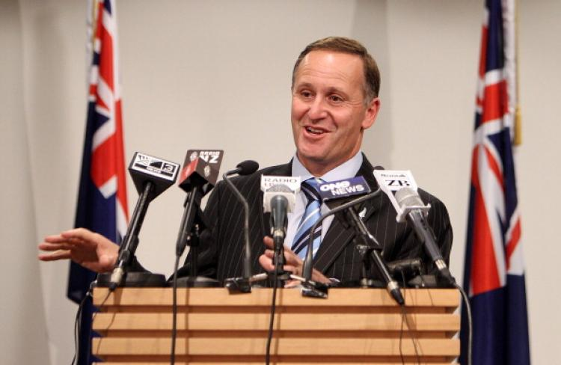
The political system of New Zealand
New Zealand is an independent state and a member of the Commonwealth of Nations and the United Nations.
This country is a constitutional monarchy. The British monarch is the Head of State.
The government consists of the Governor-General, the Prime Minister, Cabinet of Ministers and the Parliament.
John Key, the Prime Minister

Slide 14



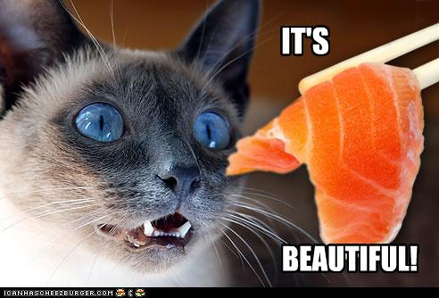
My
My impression of New Zealand is beautiful.
I believe that New Zealand is a rich country. Although it is a small country, but it holds a good position in the world.

Slide 15

Thank you for attention!

