Slide 1
Typical teenagers

Slide 2
The teenager years are a unique period of growth and development that are filled with energy, excitement and new experiences. No two teens are alike and each experience their teen years uniquely. Parental and cultural influences affect teenage development in different ways. However, all of them go through hormonal changes and physical changes that contribute to forming their sense of independence and identity.

Slide 3
The results of sociological studies increasingly indicate that American young people do not associate themselves with religious beliefs. A new study conducted among Americans aged 18 to 24 years shows that many young people in this age group generally reject Orthodox religious teachings. However, they do not deny the spirituality completely.

Slide 4
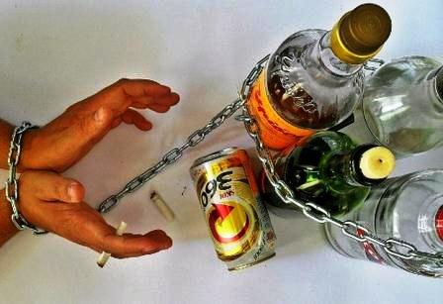
Young people have difficulties in their relationship with their parents or problems at school which many lead to use of alcohol or drugs, the refusal to attend school or even to running away from home.

Slide 5
In 2012, nearly 3/4 of students (72%) have consumed alcohol (more than just a few sips) by the end of high school, and more than 1/3 (37%) have done so by 8th grade. According to a study by Columbia University, underage drinkers account for 11.4% of all of the alcohol consumed in the U.S. The average age teen boys first try alcohol is age 11, for teen girls it’s 13. Nearly 10 million young people, ages 12 to 20, reported that they've consumed alcohol in the past 30 days. Teens who start drinking before age 15 years are 5 times more likely to develop alcohol dependence or abuse later in life than those who begin drinking at or after the legal age of 21.

Slide 10
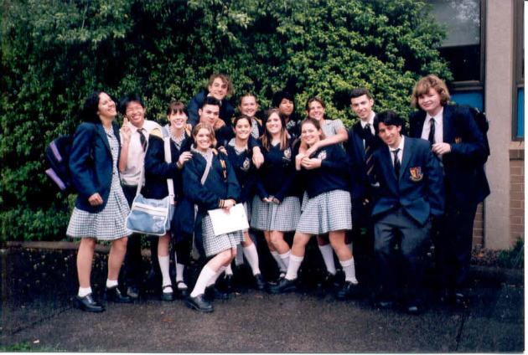
The typical American student spends 6 hours a day, 5 days a week, 180 days a year in school. More than 80 per cent of all students participate in student activities, such as sports, student newspaper, drama clubs, debate teams.

Slide 11
American young people prefer football, basketball, baseball, tennis, soccer, boxing, hockey, track and golf. The average American teenager listens to music on the radio about three hours a day and spend much time watching TV.

Slide 12
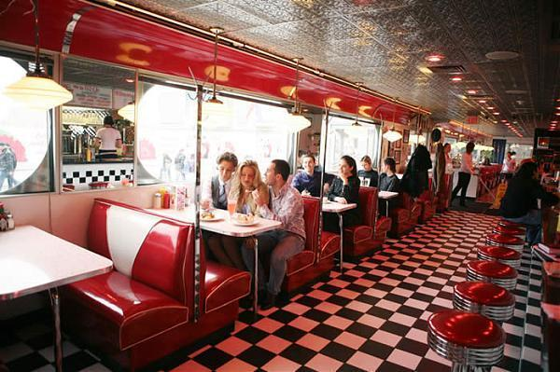
American`s young people are mostly hard-working. Many have after-school jobs. Many youths work part-time on weekends or after school at fast-food restaurants, baby-sit for neighbors, hold, delivery jobs or work in stores.

Slide 13
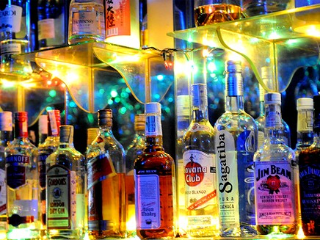
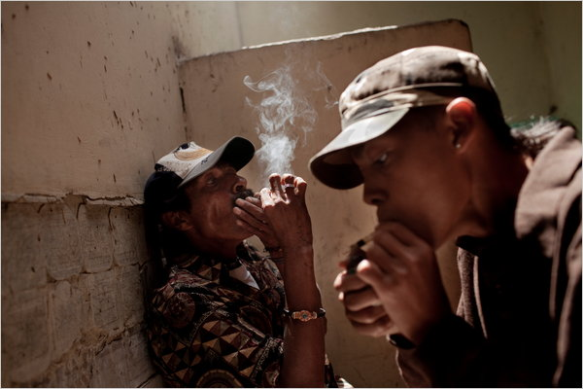
However, most young people in the US do not have problems with drinking, drag abuse, teen pregnancies. Drug use has decreased among young people in the US within the last 10 years, though alcohol abuse has increased.

