Slide 1
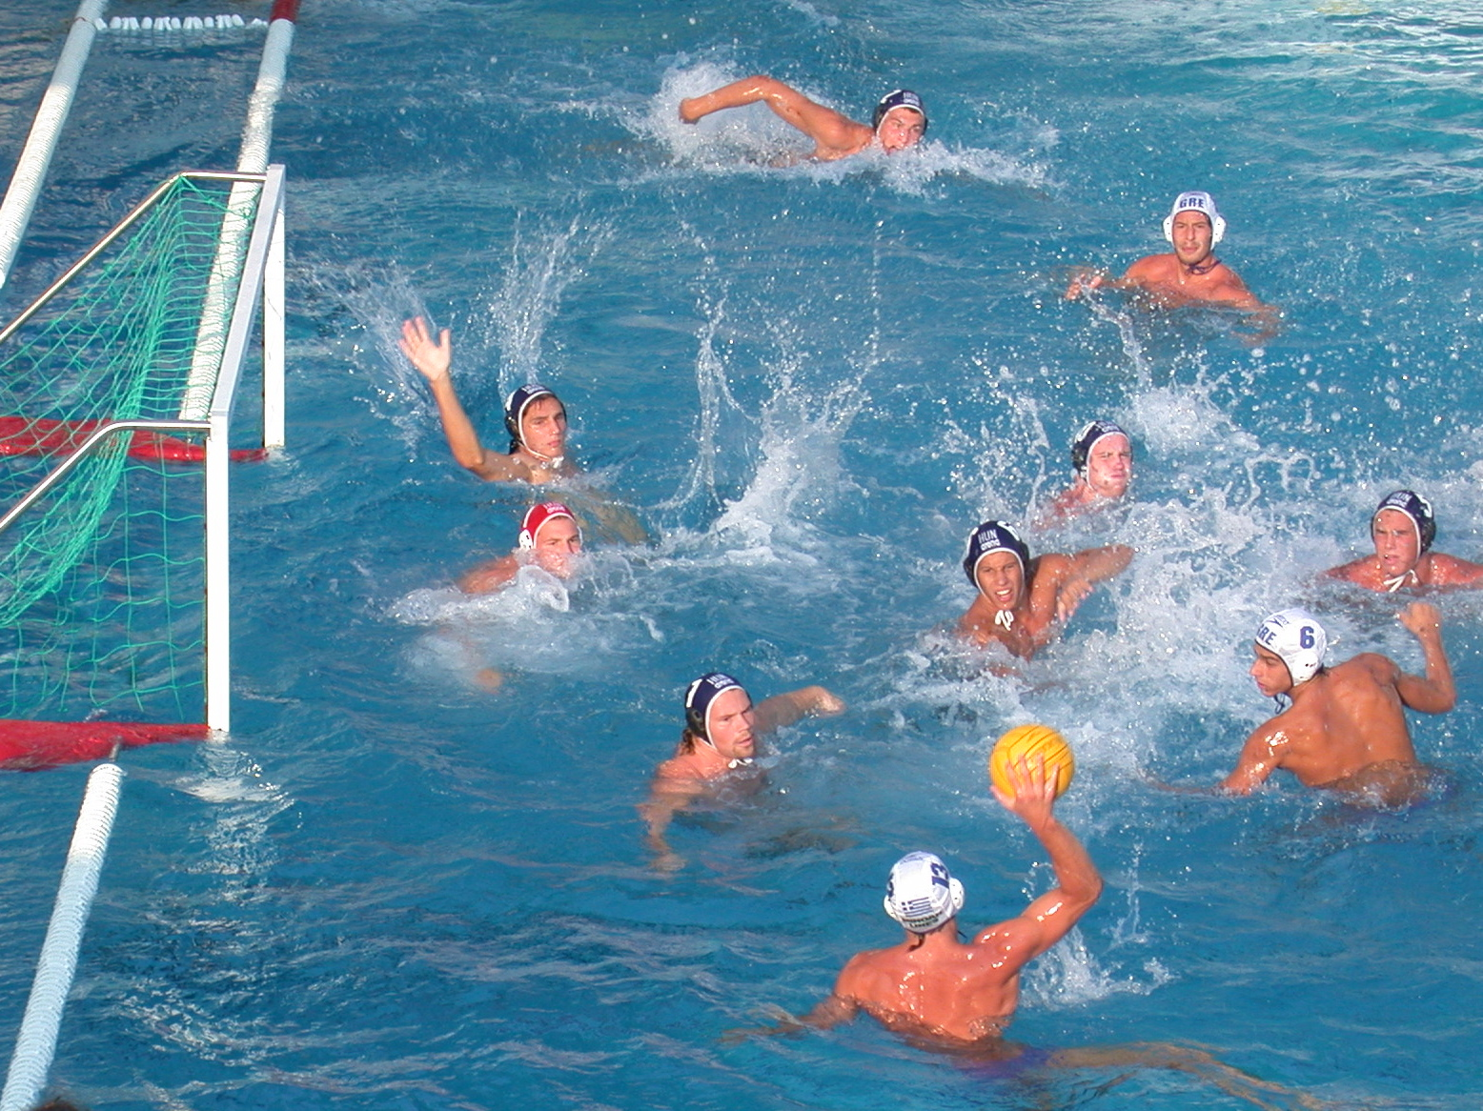
Water polo

Slide 2
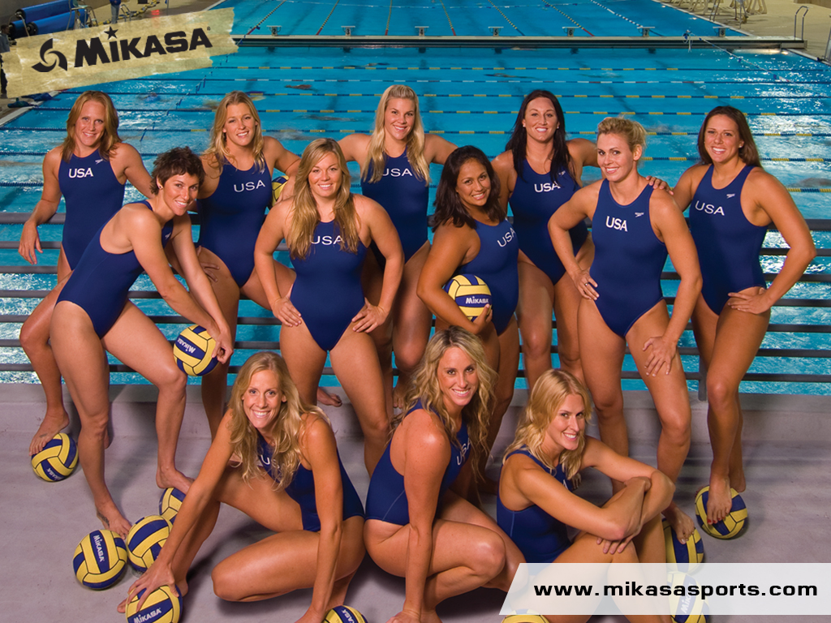
Water polo is played in a swimming pool. Two teams of seven players play a water polo match.

Slide 3
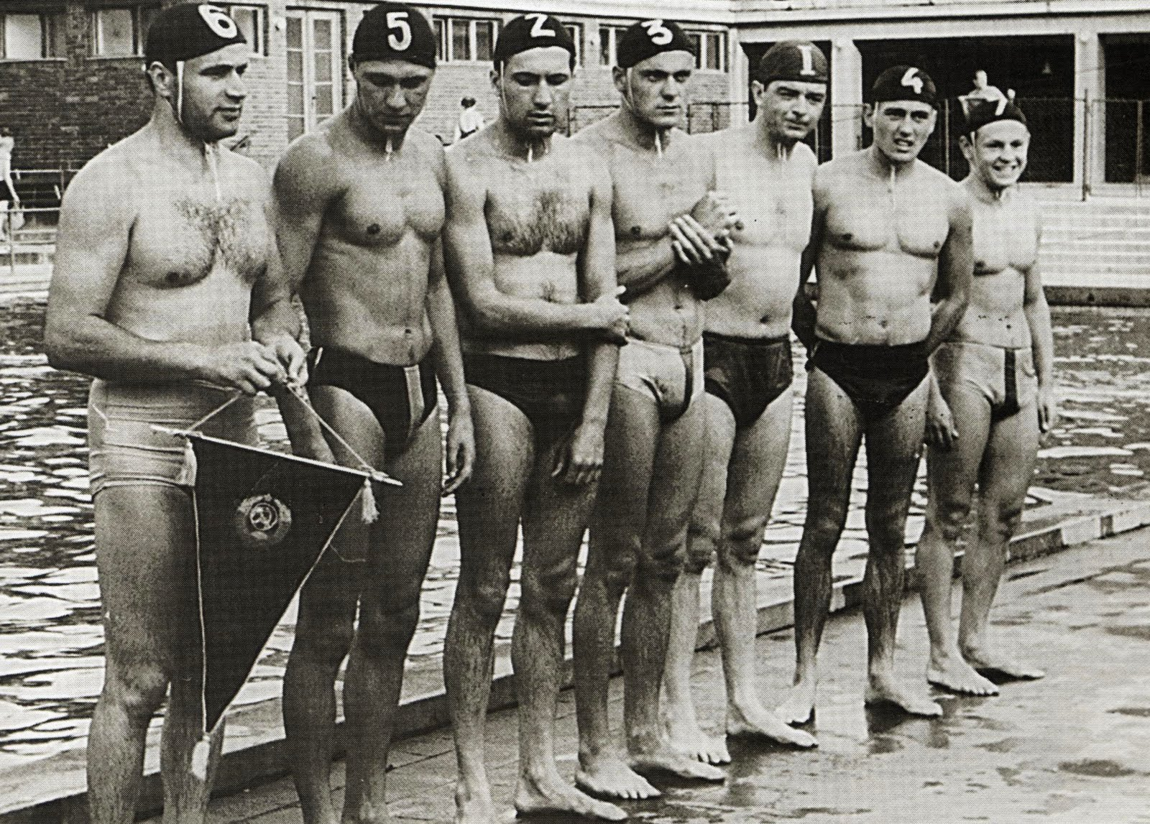
The origins of water polo can be traced back to the late 19th century when a Scottish man named William Wilson constructed the rules for the game, as a result of the public’s growing disinterest of swimming carnivals.

Slide 4
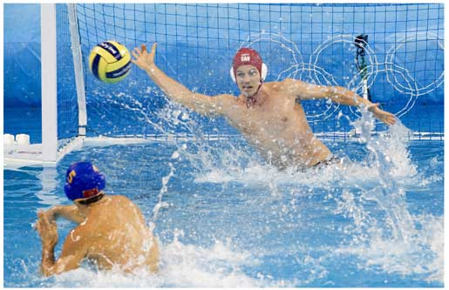
The sport was introduced onto the Olympic scene in 1900 during the Paris game, making it one of the longest running team games in the Olympics and can be played by both men and women (Smith, 1998).

Slide 5
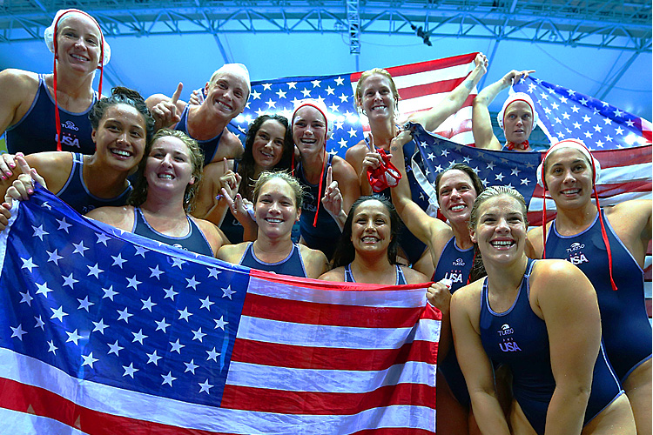
Women's water polo was included in the Olympic Games for the first time at the 2000 Olympic Games in Sydney.

Slide 6
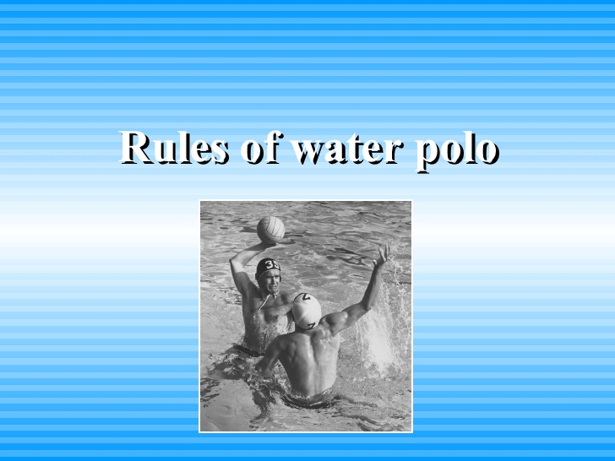

Slide 7
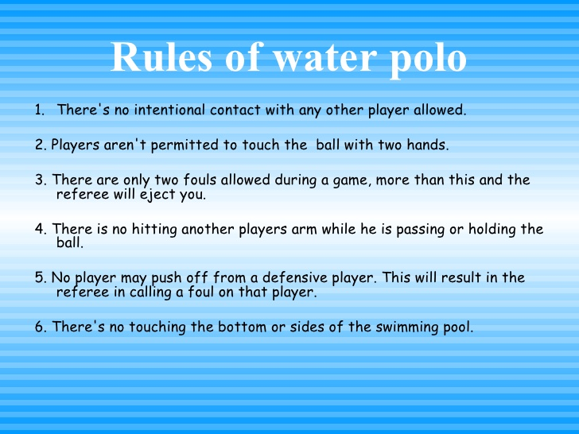

Slide 8
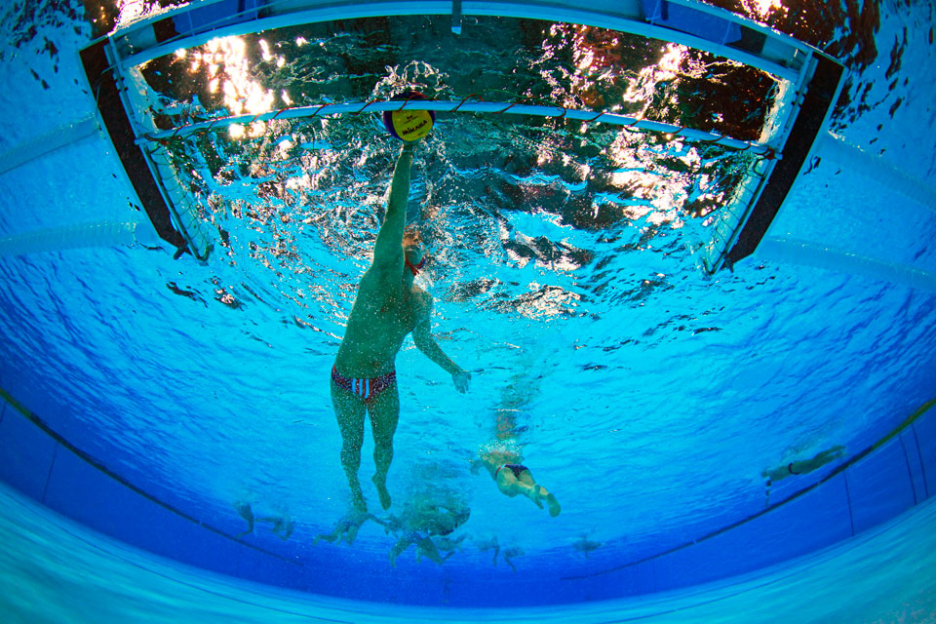
In Olympic competition a water polo match is played for four quarters. Each quarter lasts 8 minutes.

Slide 9
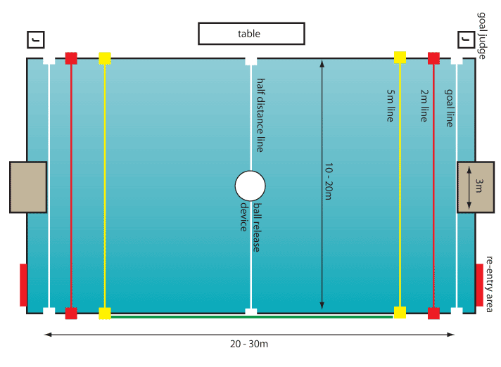
Pool

Slide 10
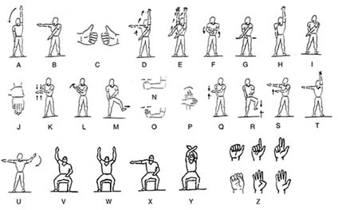
Signal to be used

Slide 11
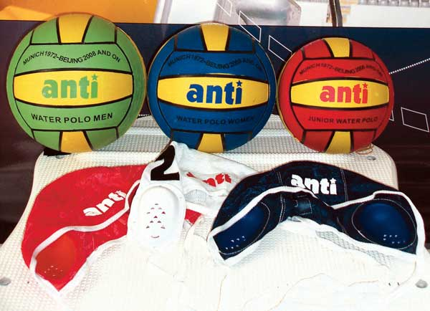
Water polo equipment
Ball. The ball weighs between 400g and 450g.
Bathing caps. Coloured bathing caps with individual numbers and ear protectors.
Swimsuits. The swimsuit should be non-transparent or with a separate undergarment.

Slide 12
