Slide 1



Education of New Zealand

Slide 2

The education in New Zealand

Slide 3
The Educational system of New Zealand
Primary/ Intermediate ( Ages 5-12 )
Secondary ( Ages 13-18 )
Tertiary :
1. Polytechnics, Institutes of Technology and Private Education Providers.
2. Universities and colleges of education

Slide 4
The system of education can be divided into four parts:
AGE | YEAR
5 | 1 | Primary school commences
6 | 2 | Primary school
7 | 3 | Primary school
8 | 4 | Primary school
9 | 5 | Primary school
10 | 6 | Primary school
11 | 7 | Primary or intermediate school
12 | 8 | Primary or intermediate school
13 | 9 | Secondary school
14 | 10 | Secondary school
15 | 11 | NCEA* Level 1
16 | 12 | NCEA* Level 2
17 | 13 | NCEA* Level 3
Notes:
*New Zealand Certificate of Educational Achievement

Slide 5

Secondary education curriculum
Years 9-10
Students in Years 9 and 10 study a basic core of subjects: English, social study, general studies, maths, music, art and crafts and physical education.
Years 11-13
The NCEA is New Zealand’ s main national qualification for secondary students
in Years 11-13

Slide 6

National Certificate of Educational Achievement
NCEA Level 1 is offered in Year 11
Level 2 in Year 12
Level 3 ( and 4 Scholarship qualification) in Year 13
These 3(4) levels are first steps of eight levels in the National Qualifications Framework.
NCEA enables students to link their secondary education to their tertiary education, with all levels recognised by universities and other tertiary education providers around New Zealand.

Slide 7
Secondary education as a pathway to further study
There are numerous educational opportunities at tertiary level.
Options available for further study include:
Foundations Studies are an introduction to the NZ education system and courses are useful for students looking to enter the tertiary education system.
Universities (There are about eight State Universities. More then 110 thousand students study there(3-10% are foreigners)).
Institutes of technology and polytechnics
Private training establishments ( most run on a similar timetable to state tertiary institutions.

Slide 8
Courses of English language
As a rule studying for foreign students in NZ starts with these courses.
There is a wide choice of special language centres and departments of studying English at Polytechnics or Universities. Training is conducted in groups or individually.
They are :
Business English
English during holidays
Languages International - IELTS or TOEFL preparation course.
General English

Slide 9


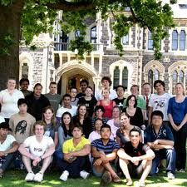
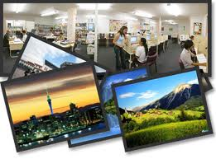

Thank you for attention

