Slide 1
ECOLOGIC PROBLEMS
ECOLOGICAL PROBLEMS Виконав:
in the plant and animal world Учень 9-А класу
Гудзенко Роман

Slide 2
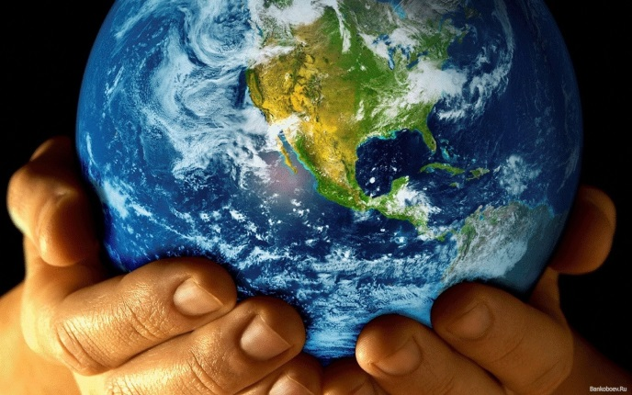
The Earth is a home to millions of different kinds of living things which are linked in many ways. Together they make up the complex world of nature. Some are rivals or enemies, while the others depend on each for survival.

Slide 3
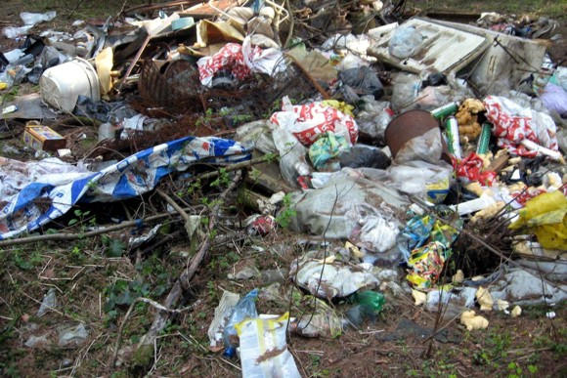
People create pollution which travels through the air and water from one habitat to another. We need certain things to stay alive and healthy. We need clean air to breathe and pure water to drink. We need also food that is safe to eat and housing to shelter us. But we can't get all these things by ourselves. We live in a large community, so we can solve health problems only working together.

Slide 4
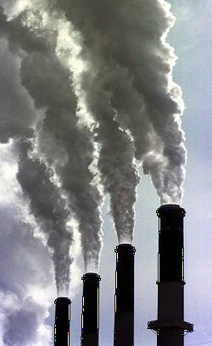
Polluted air is a community problem. Air becomes polluted in many ways. Cars, trucks, buses and airplanes are among the worst polluters. They send partly burned gases into the air. Air can be also polluted by smoke and gases from factories. Dirt, smoke and gases in the air can be carried away by wind, by air currents or settle over as a blanket of smog. Air pollution can cause diseases. But everyone may feel uncomfortable and suffer from lack of energy when air isn't clean.
What do people do to cut down on air pollution? Today many factories use devices to reduce the smoke, dust or gases. Special kinds of gasoline for cars can help to reduce air pollution. More efficient engines can help too.

Slide 5
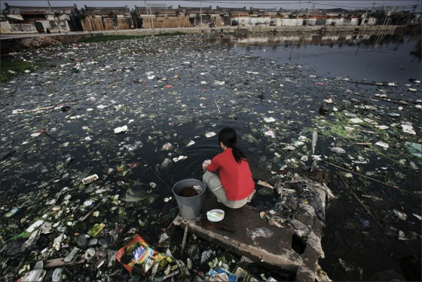
Water pollution is caused by dumping wastes into lakes, rivers and other bodies of water. Harmful wastes may also soak into the soil, or drain or run off from fields that have been sprayed with pesticides. Pesticides are often used to kill insects and weeds in cities or on farms. Polluted water can spread many diseases.

Slide 6
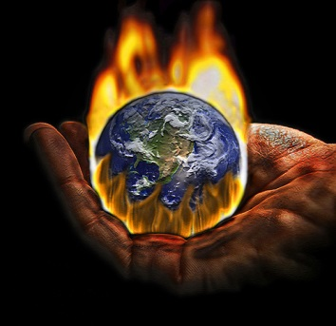
World temperatures are currently rising every year. This is called global warming. It is caused by the buildup of gases and water vapour in the atmosphere. These gases form a layer that reflects the heat back to Earth, rather than allowing it to escape into the outer atmosphere. As the planet warms up, the water in the oceans will take up more space and water locked up in glaciers and the polar ice caps will start to melt. This could cause sea levels to rise and many habitats will disappear under water.

Slide 7
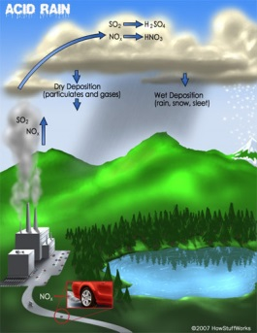
Acid rains fall when poisonous gases from power stations and vehicle exhausts mix with oxygen and moisture in the air. These gases become a part of the water cycle and may be carried a long way by the wind before they fall as acid rain or snow. Acid rains poison or kill wildlife in lakes, rivers and forests, and damage the surrounding plant life. The problem could be controlled by reducing vehicle emissions and limiting the gases released from power stations.

Slide 8
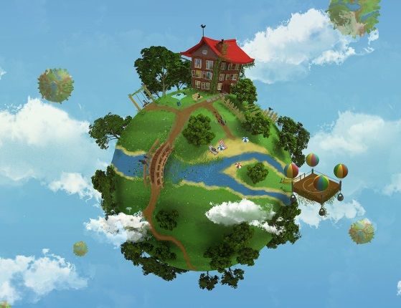
The Earth is our home but much of it is dirty and dying. By the year 2030 scientists report that 25% of all animals, birds, fish and insects may be extinct. Every year man cuts down more trees to provide paper, wood, medicines, and mineral fuel. But it isn't only trees and forests which are disappearing. Every rain forest contains millions of animals, insects and flowers. These are destroyed too. Governments in rain forests countries need to plan and work together. They should protect certain areas and plant new forests.

Slide 9
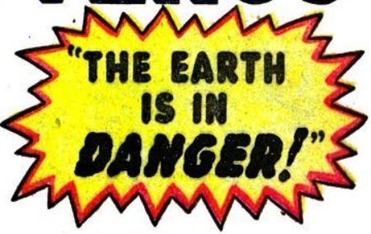
Today many scientists and world leaders realize that the Earth is in danger. It's really very simple. Either we stop killing the Earth, or we kill ourselves. We need a cleaner, healthier planet. Millions of ordinary people understand this too. Some of them belong to the so-called "Green" or earth-friendly organizations in countries all over the world. Groups, like "Green Peace", have already helped to stop the hunting of some animals, such as whales. What else can be done? I think that everyone should decide for himself how he or she can help our planet. And it is important not only to decide but also to carry out the decisions.

