Slide 1
Generation gap
There is always a misunderstanding between the children and the older generation in the family.

Slide 2
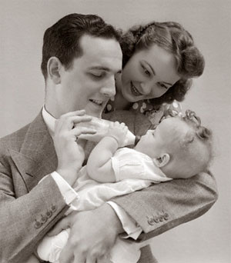

start the presentation
In this presentation I want think about this very interesting topic. Because this problem has between each generation. Always had problems of parents and children. In this presentation, I want to show these problems. Maybe then parents and children will know about them and be able to solve all problems

Slide 3


First problem - Music
Sometimes parents don’t understand the musical tastes of children. Because children maybe love listening rock, rap, pop, jazz, classical music. And your parents like to listen to the music of his generation. Out of this situation: you can explain to parents their musical tastes. Let your parents listen to your music. And you hear them. For one day or two days have changed musical tastes.

Slide 4







Second problem-Books
Sometimes parents don’t understand our books. Because children of the twentieth century love read books like "twilight“. I love read books and I have one funny situation with my parents. I read a book in one day, and my mum said me: «You already tired of constantly reading». I never laugh so loudly as then. Out of this situation: you can read classic books like "Crime and Punishment". Our your parents can read your favorite books.

Slide 5
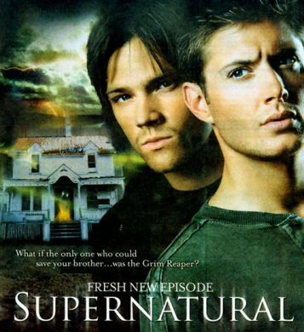
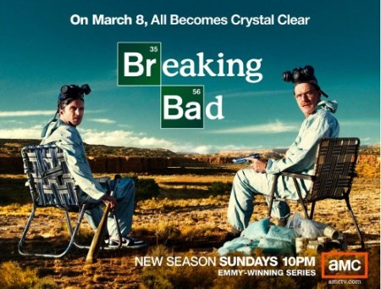
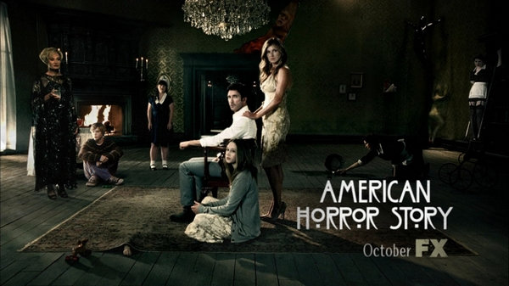


Third Problem- TV series
My opinion half of all parents hate TV series. My parents hate serials. And I can not explain to parents that the series is not so bad. . Out of this situation: I don’t know about this.

Slide 6
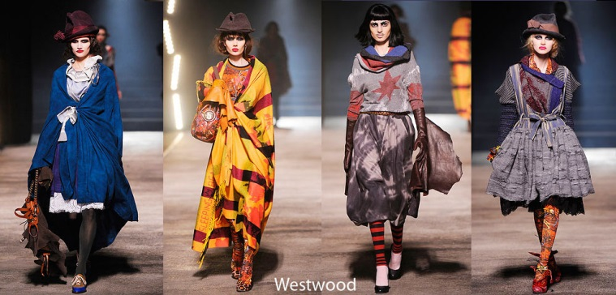
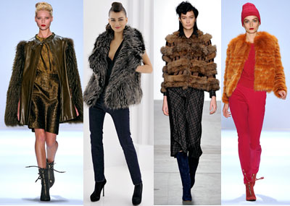
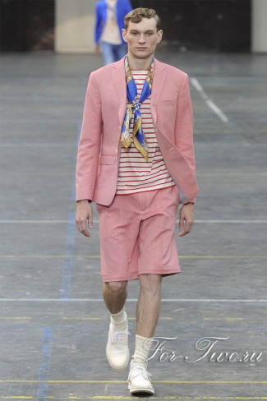
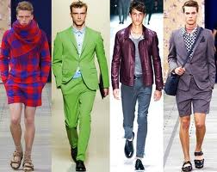
Fourth problem-clothes
Sometimes parents don’t understand twentieth-century clothing. Sometimes I don’t understand it too. Because sometimes clothes of famous designers are very tasteless. And it isn’t pretty. Out of this situation: don’t wear clothes like this.

Slide 7

Last problem- values ​​of life
I believe that this is the biggest and most important problem. Earlier was an important family and work. Now teenagers have same values. But teens believe that life should be easy and it's not very good. Out of this situation: often talk with their parents and grandparents.

Slide 8

In the end I want to say a few words. Love your parents and never forget about them. Even when you do not understand each other, know THEY LOVE YOU.

Slide 9

Thank you for your attention!
Made by Bonk Veronika

