Slide 1
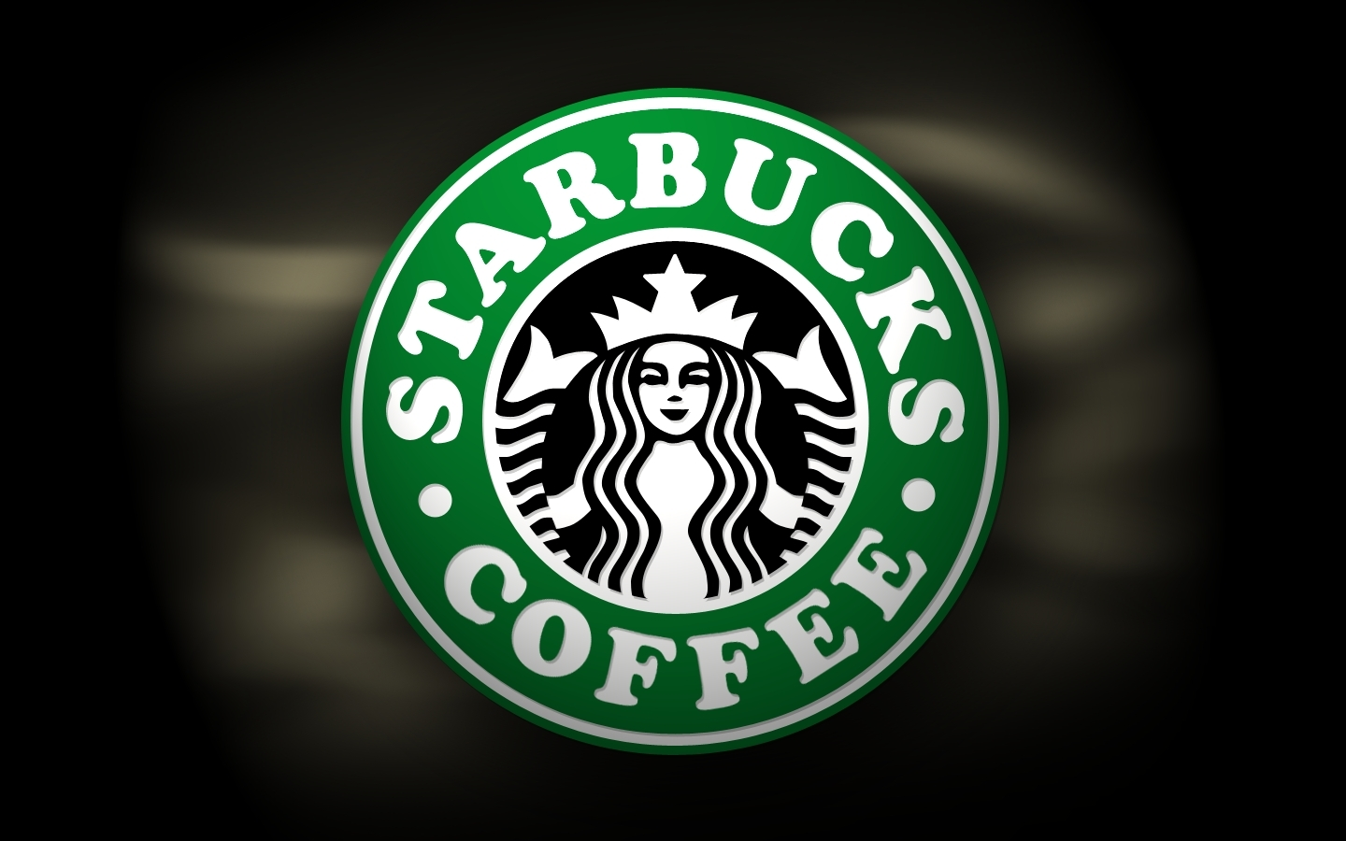
Made by Taya Klimnyova

Slide 2
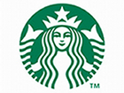
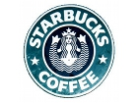
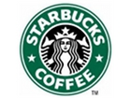
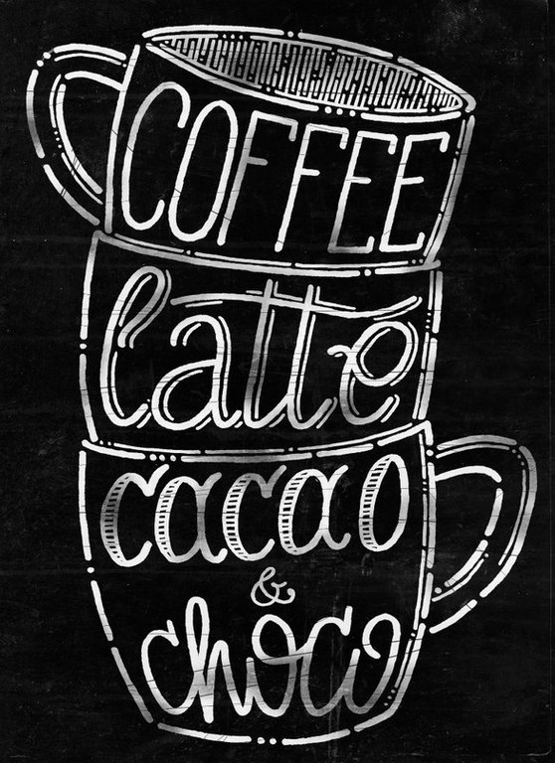
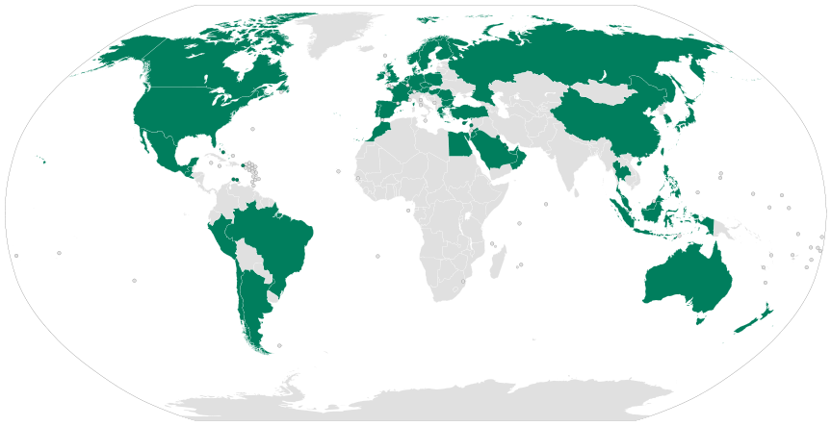
Starbucks coffee
Starbucks is considered to be the largest coffee chain in the world. It is believed to be the "third place " between home and work. In the last few decades, Starbucks has become a symbol of America, which also hasn’t infrared to the famous McDonald's.

Slide 3
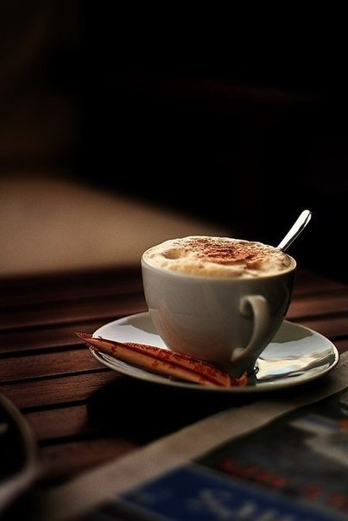
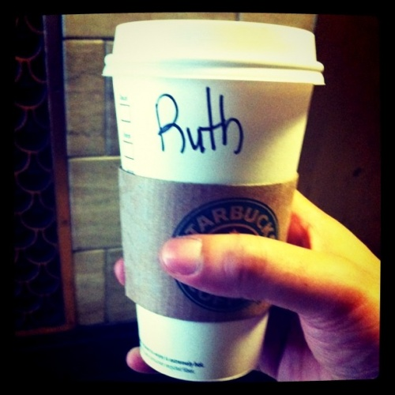
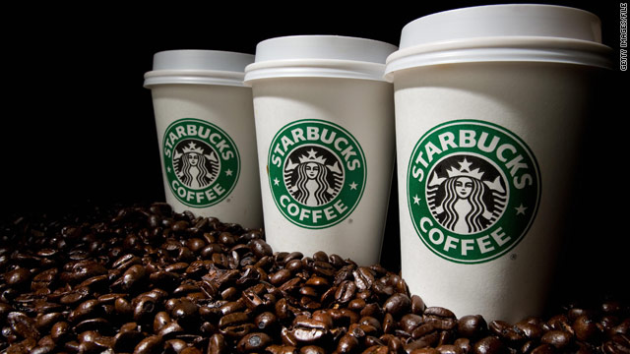
Starbucks was founded by three coffee lovers: English teacher Jerry Baldwin, history teacher Zev Zigalom and writer Gordon Boukerom.
The first Starbucks opened its doors on the 30 of March in 1971 in Seattle Pike Place Market. It was a small shop selling high-quality coffee beans and equipment for its preparation.
For a long time this shop was not only the first but also the only one. But ten years later five Starbucks stores were opened , in addition, the company got its own factory. Besides coffee sales in its stores, the company is also a supplier of coffee beans for many coffee shops, bars and restaurants.

Slide 4
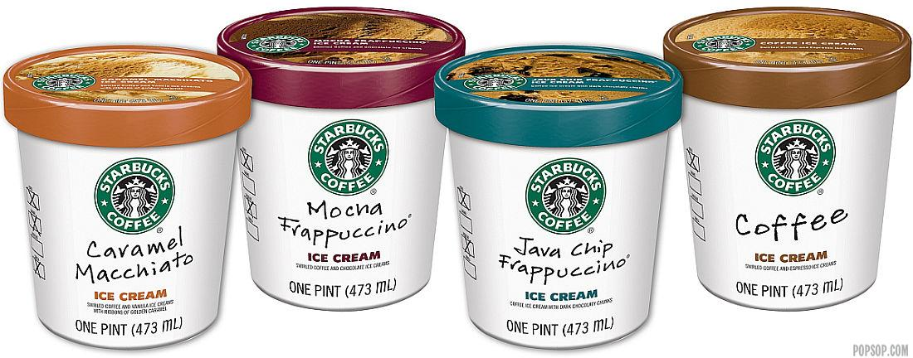
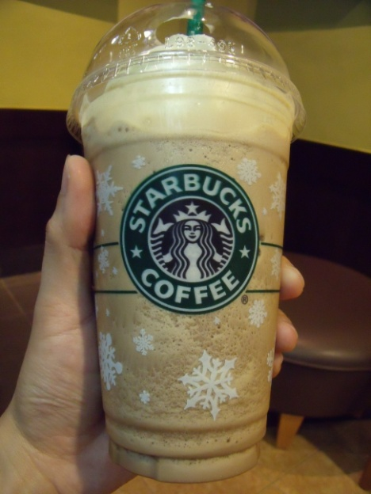
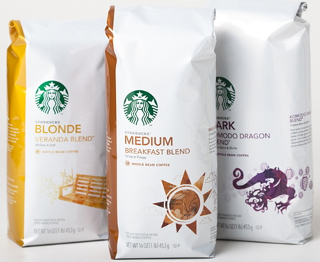
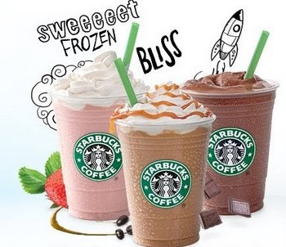
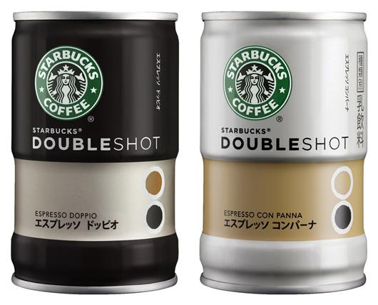
In 1987, there comes a turning point in the history of Starbucks. Howard Schultz became the owner of this company, who made ​​Starbucks the way we know it today. Schultz worked at Starbucks several years as director of retail sales and marketing, but could not realize his dream .I mean, he wanted to create a coffeehouse chain based company. He left the company.
In 1987, he returned to the company. Moreover he found the investors and bought it.
Having bought a Starbucks, he gave it its unusual name which combined two coffee shops and related activities into one company. The alliance turned out extremely successful. So, the coffee chain Starbucks, managed to conquer the world under his leadership.

Slide 5
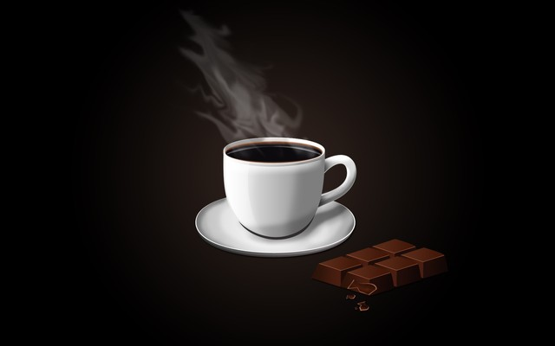
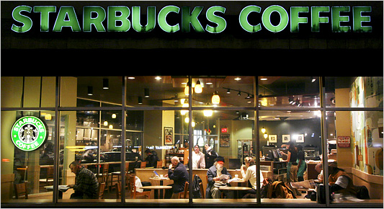
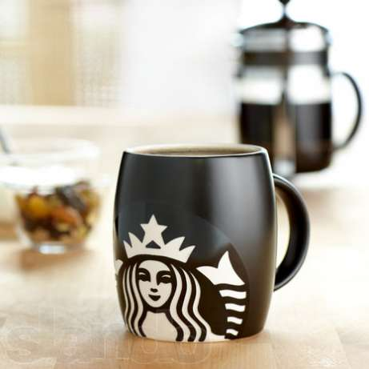
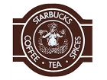
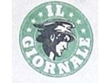
The company name was chosen in accordance with the famous novel "Moby Dick."As for the logo, it was originally shown with a mermaid and a siren with two tails. This image was found on an old engraving. It symbolizes sea theme of the company name. The mermaid with two tails is a common character of medieval folklore. It was called Melusine or Melisande. This image is often used in heraldry. Logo came up with an artist Terry Heckler.

Slide 6
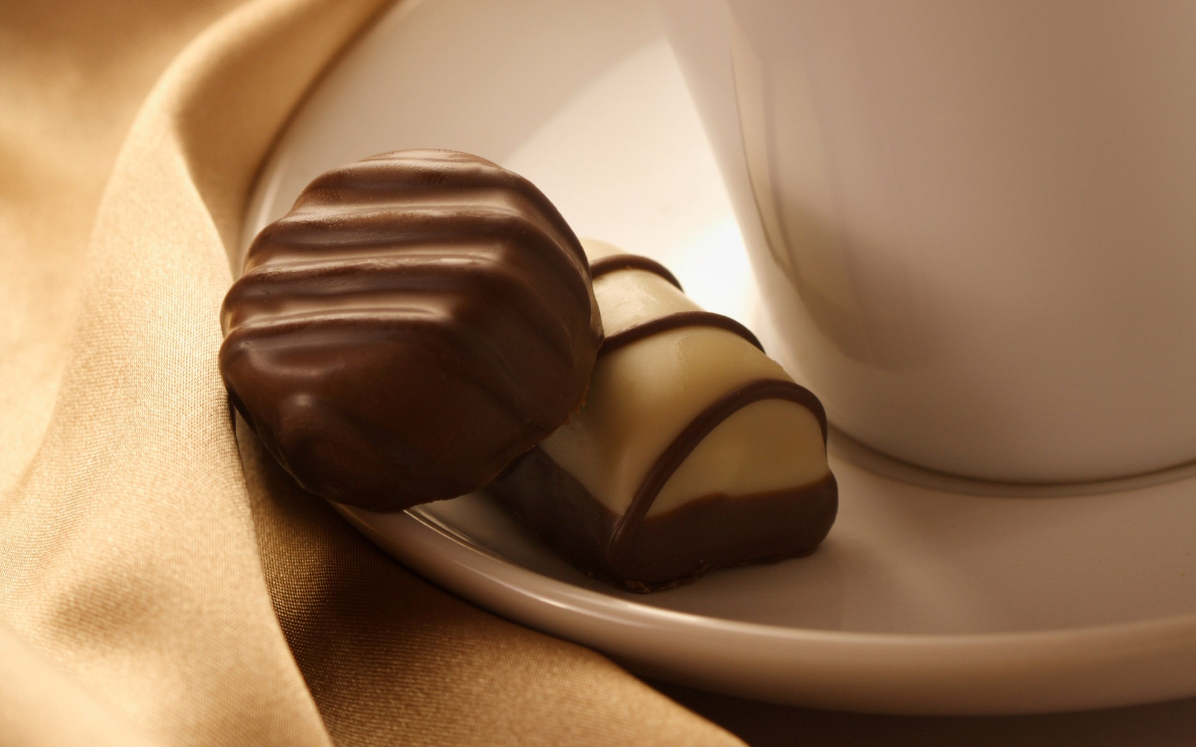
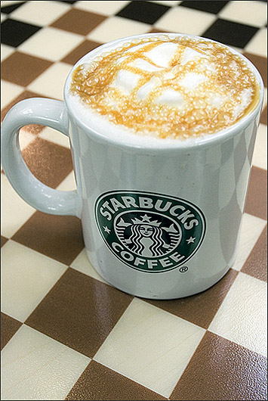
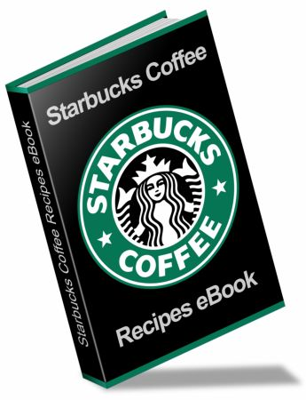
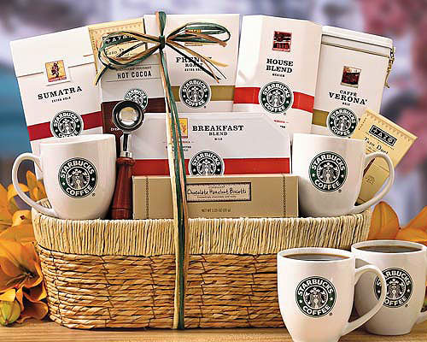
Interesting facts
The entrance door looks on the south or east. In no case, it doesn’t look to the north. The thing is that, it was done in order that visitors were able to enjoy the daylight, but the sun did not shine them in the face.
Steve Jobs used to call Starbucks, to demonstrate the capabilities of the first iPhone and play a little joke with the audience at the conference, Apple MacWorld 2007. Showing how iPhone owners can use the service of Google Maps on your device, Jobs defined his (and a few thousand people) current location. Furthermore, he found the nearest Starbucks coffee shop and began to recruit the number of it on his iPhone.
Nowadays, Starbucks represents not only coffee, coffee drinks, desserts and snacks, but also the company is engaged with books, cinema, music.

Slide 7
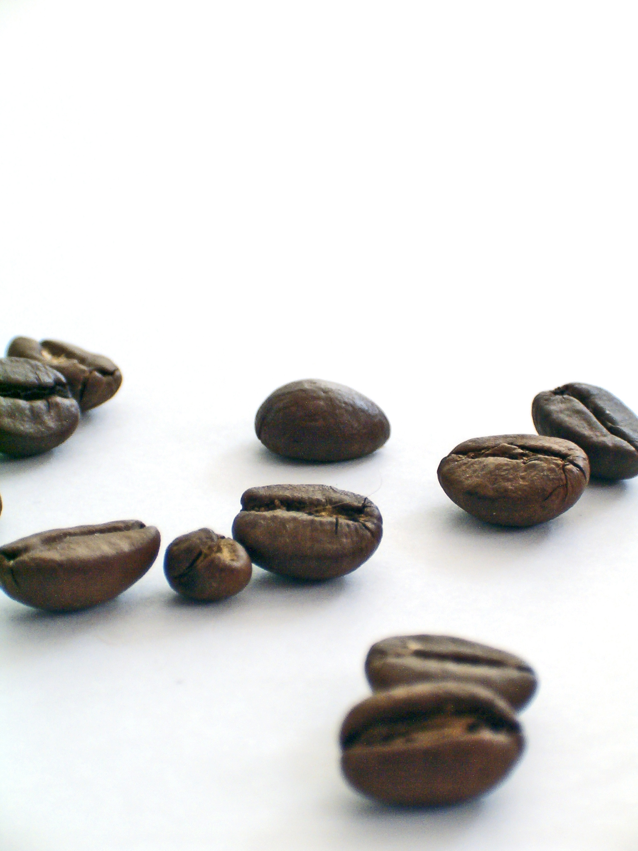
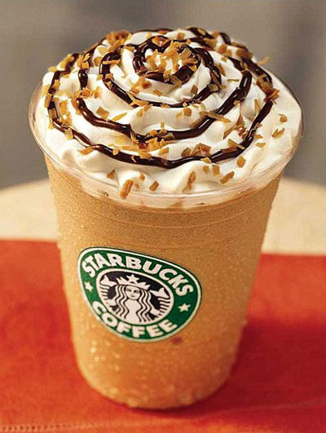
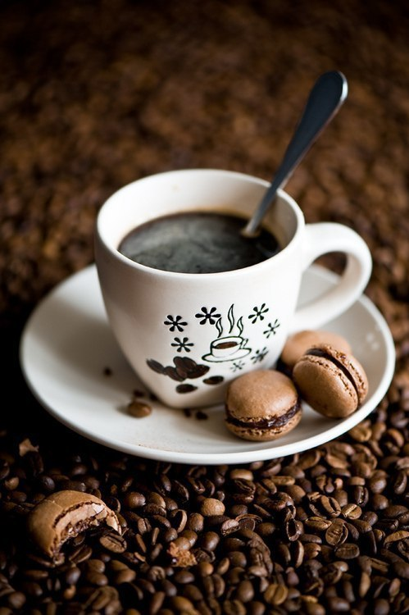
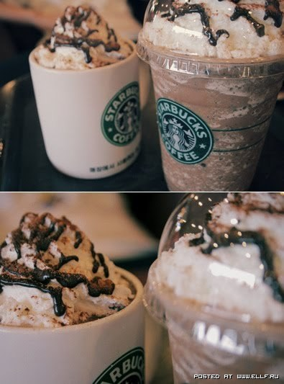
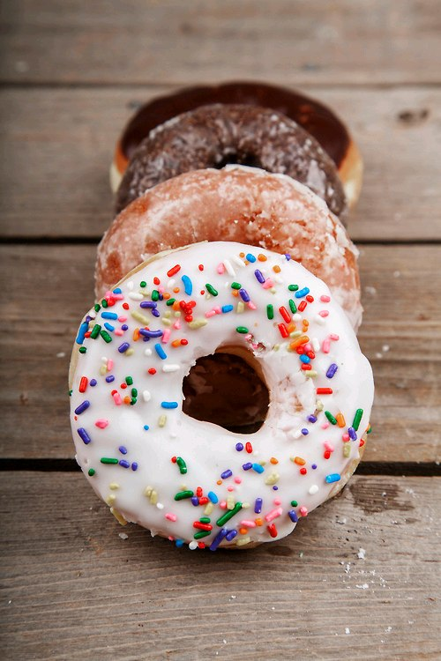
Starbucks coffee is very good, which is undisputable. According to the poll of the visitors, people attend this place is a social experience. I mean, people come at the Starbucks to communicate, to work and just to look at the people. From the very beginning, Howard Schultz was sure that not only coffee makes people to attend this place , but also personal experience. Comfortable sofas, fireplaces, smoothly curved lines cafes, creating seemingly open, but a comfortable space, free internet made Starbucks too convenient place.
In 1996, the first coffee shop was opened in Japan.
Starbucks Coffee is opened in more than 50 countries.
There are 18 000 Starbuck’s Coffee all over the world.
The company's headquarter is still located in Seattle, Washington.

