Slide 1
British meals

Slide 2
Meal Times
Some people have their biggest meal in the middle of the day and some have it in the evening, but most people today have a small mid-day meal - usually sandwiches, and perhaps some crisps and some fruit.
We have three main meals a day:
Breakfast - between 7:00 and 9:00,
Lunch - between 12:00 and 1:30 p.m.
Dinner (sometimes called Supper) - The main meal. Eaten anytime between 6:30 and 8:00 p.m. (Evening meal)
Traditionally, and for some people still, the meals are called:
Breakfast - between 7:00 and 9:00,
Dinner (The main meal) - between 12:00 and 1:30 p.m.
Tea - anywhere from 5:30 at night to 6:30 p.m.
On Sundays the main meal of the day is often eaten at midday instead of in the evening. This meal usually is a Roast Dinner consisting of a roast meat, yorkshire pudding and two or three kinds of vegetables.

Slide 3
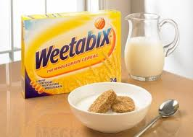
BREAKFAST
Most people around the world seem to think a typical English breakfast consists of eggs, bacon, sausages, fried bread, mushrooms and baked beans all washed down with a cup of coffee. Now-a-days, however, a typical English breakfast is more likely to be a bowl of cereals, a slice of toast, orange juice and a cup of coffee.
Many people, especially children, in England will eat a bowl of cereal. They are made with different grains such as corn, wheat, oats etc.
In the winter many people will eat "porridge" or boiled oats.

Slide 4
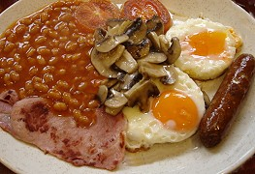
The traditional English breakfast
The traditional English breakfast consists of eggs, bacon, sausages, fried bread, baked beans and mushrooms. Even though not many people will eat this for breakfast today, it is always served in hotels and guest houses around Britain.
The traditional English breakfast is called the 'Full English' and sometimes referred to as 'The Full English Fry-up'.

Slide 5
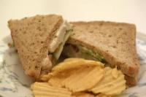
LUNCH
Many children at school and adults at work will have a 'packed lunch'. This typically consists of a sandwich, a packet of crisps, a piece of fruit and a drink. The 'packed lunch' is kept in a plastic container.
Sandwiches are also known as a 'butty' or 'sarnie' in some parts of the UK.
My favourite sandwich is prawn and mayonnaise. I also love tuna and mayonnaise and ham and pickle sandwiches.

Slide 6
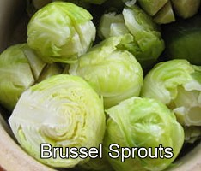
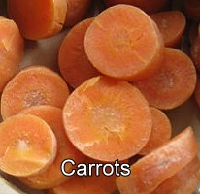
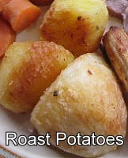
DINNER
A typical British meal for dinner is "meat and two veg". We put hot brown gravy, (traditionally made from the juices of the roast meat, but more often today from a packet!) on the meat and usually the vegetables. One of the vegetables is almost always potatoes.

Slide 7
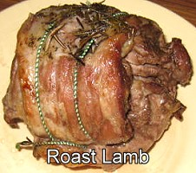
The Sunday Roast Dinner
Sunday lunch time is a typical time to eat the traditional Sunday Roast.

Slide 8
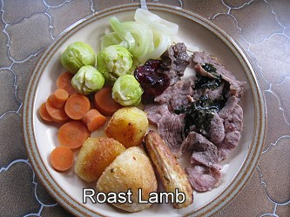
Traditionally it consists of roast meat, (cooked in the oven for about two hours), two different kinds of vegetables and potatoes with a Yorkshire pudding. The most common joints are beef, lamb or pork; chicken is also popular.

Slide 9
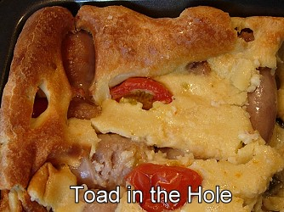
Main meal dishes in England

Slide 10
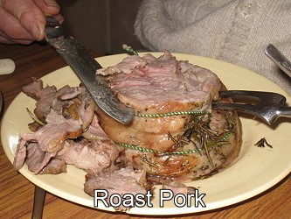
Roast Gammon

