Slide 1
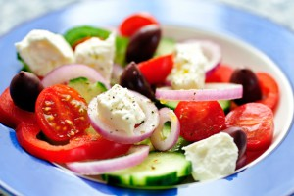
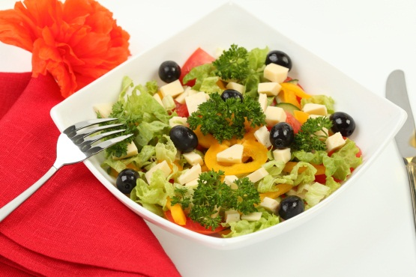
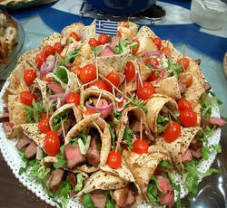
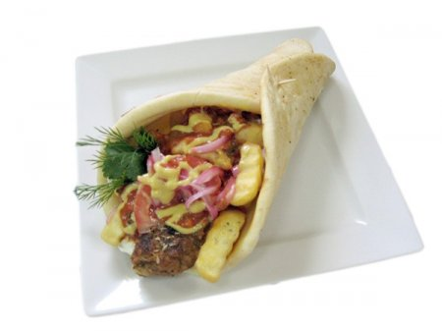
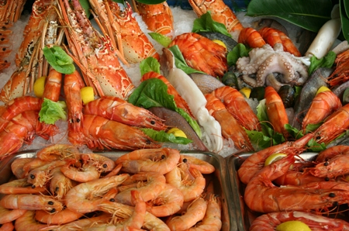
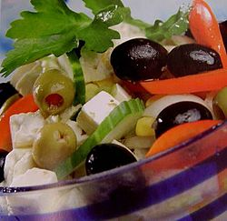
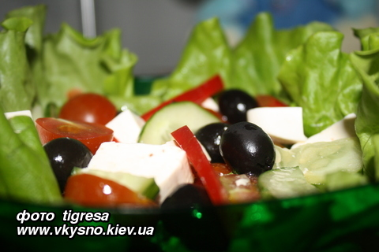
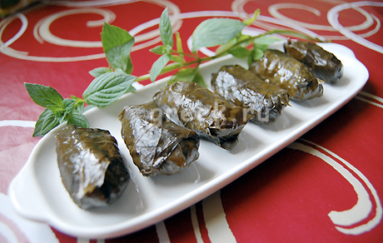
Greek cuisine

Slide 2

Greek cuisine - the traditional cuisine of Greece. Is a typical Mediterranean cuisine and has a lot to do with the kitchen south of France, Italy, Balkans, Anatolia and the Middle East.

Slide 3
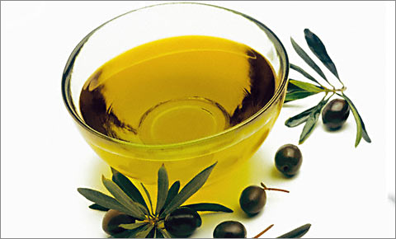
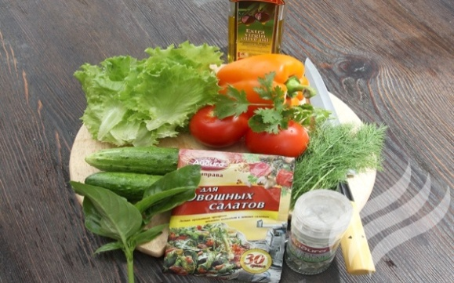
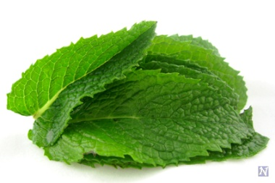
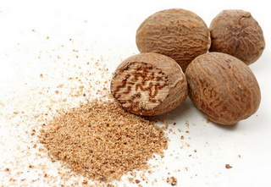

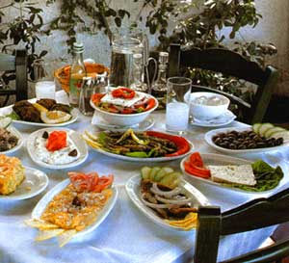
Overview cuisine
The most characteristic and ancient element of
Greek food is olive oil, which is present in almost
all dishes. It is made from the fruit of the olive tree.
In Greek cuisine herbs and spices are used much
more frequently than in other Mediterranean
cuisines. Most often it is oregano, mint, garlic,
onion, dill, salt and bay leaves.
Greek dishes are characterized by the frequent
use of mint and nutmeg.
Dessert dominated honey and nuts.
Typical Greek food is simple, colorful and fragrant.
Many dishes influence of Greek history.

Slide 4
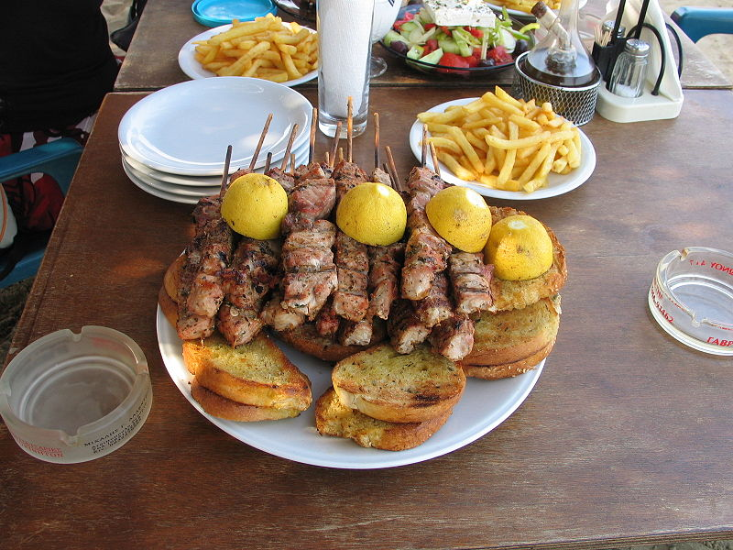
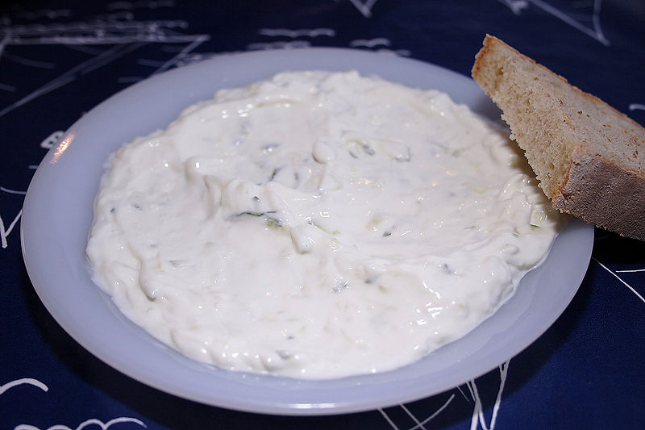
Notable dishes
Snacks
Dzadziki
Souvlaki
cold sauce, snack of yogurt, cucumber and garlic, a typical dish from the Greek cuisine.
small kebabs on wooden skewers, typical of Greek cuisine.

Slide 5

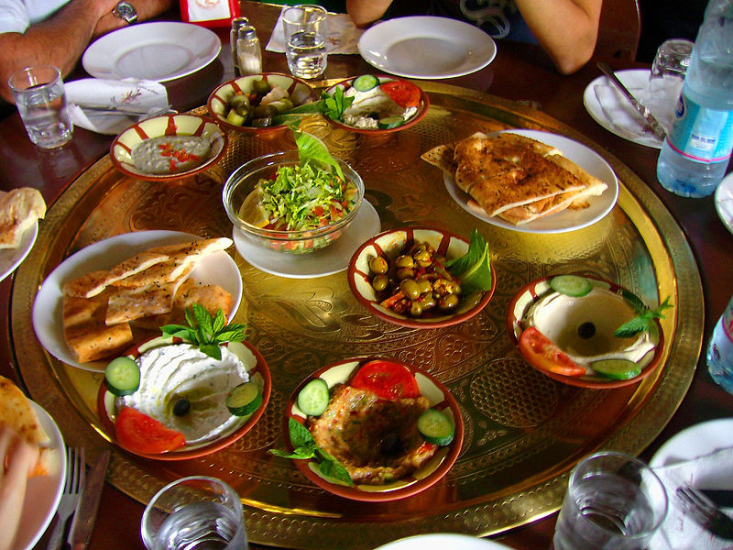
Meze
is a collection of appetizers or small dishes often served with alcoholic drinks.
Greek salad
Greek salad with tomatoes, cucumber, feta, olives and shallots, olive oil and salt, black pepper and oregano.

Slide 6
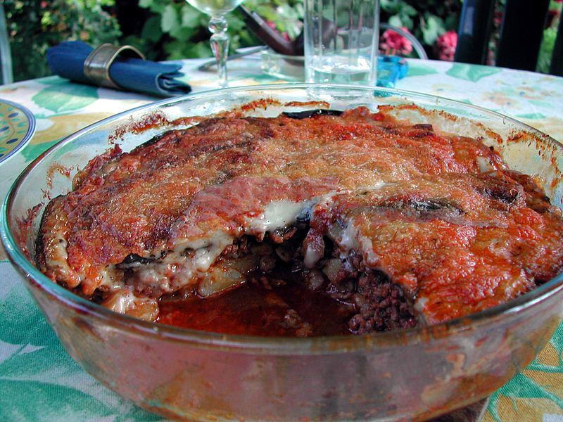
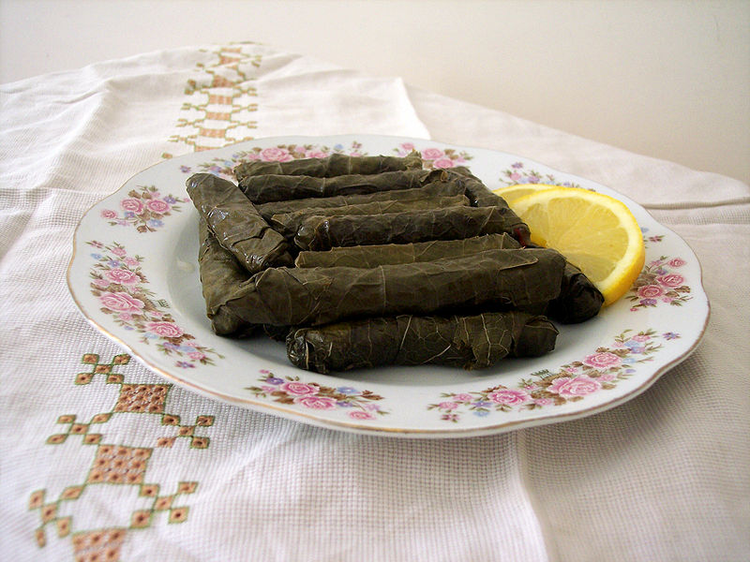
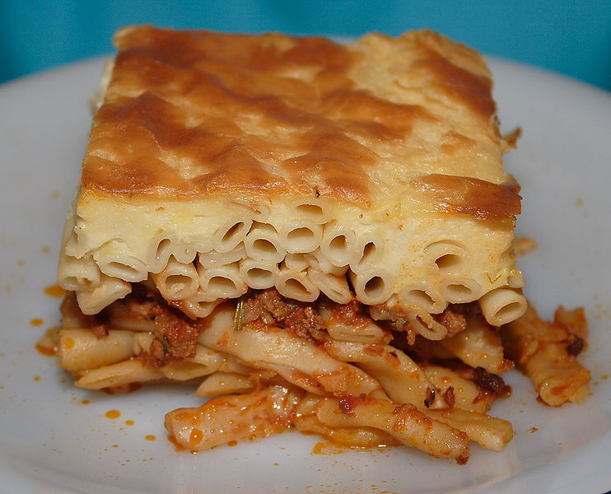
Main courses
Moussaka
a traditional dish of eggplant
in the Balkans and the
Middle East.
Dolma
the dish, which is a stuffed
vegetables or leaves,
stuffed grape leaves.
Pastitsio
a traditional Greek dish,
pasta, baked with minced
meat and béchamel sauce.

Slide 7
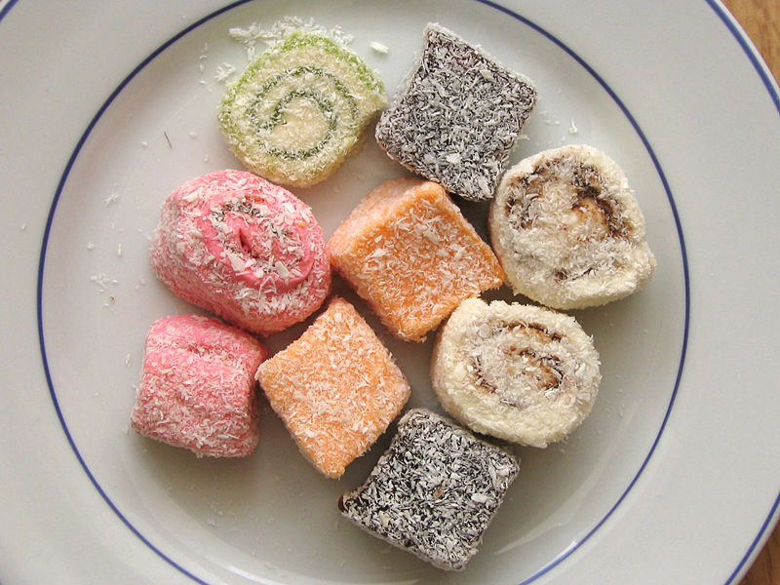
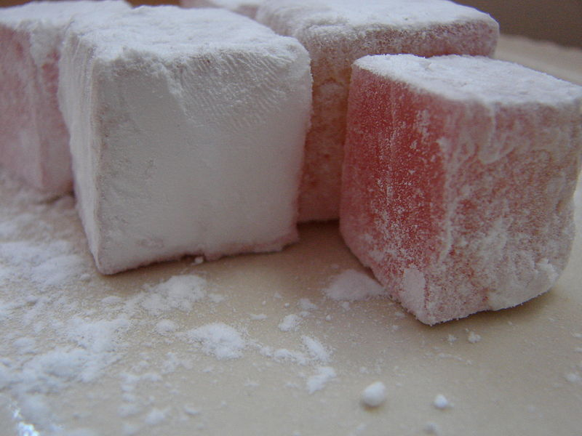
Desserts
Delight - sweetness of sugar or flour, with the addition of starch and nuts

Slide 8
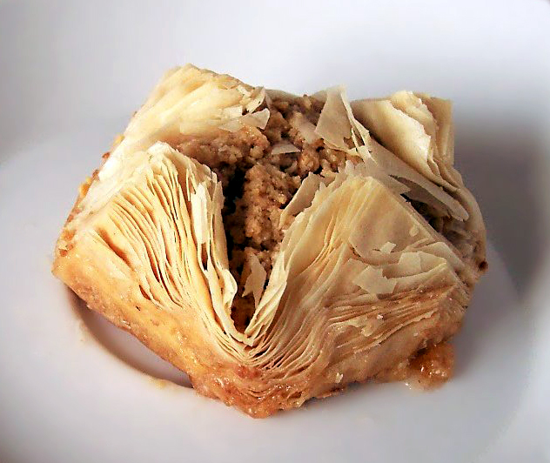
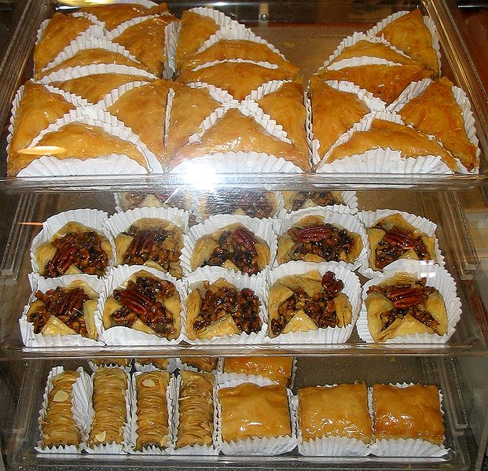
Baklava - a popular confection of puff pastry with nuts in syrup.

Slide 9
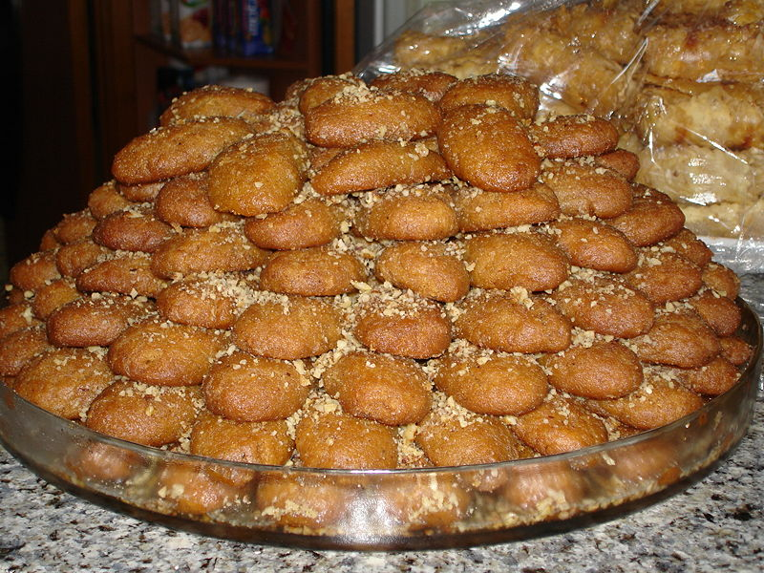
Melomakarona - Greek cuisine, the kind of sweet pastry with honey.

Slide 10


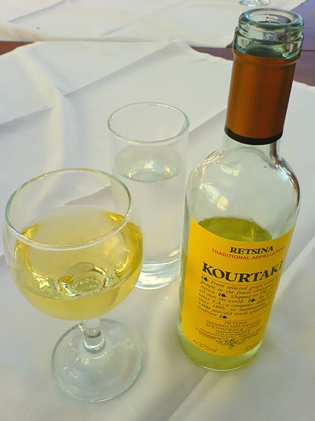
Significant drinks
Metaxa
Ouzo
Rezin

Slide 11


