Slide 1
Royal Family

Slide 2
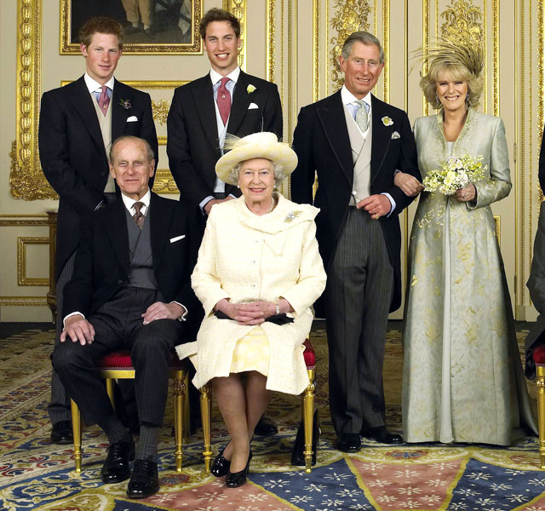

Slide 3
She is one of the members of the Royal Family. She is one of the world’s richest woman. Three quarters or more of her working life is spent in an office reading and singing state papers. She never gives interviews. She likes to spend time with her grandchildren, watch horse-racing, go for a walk and watch TV. Her title in the UK is: “Elizabeth the Second, by the Grace of God of the United Kingdom of Great Britain and Northern Ireland and of her other Realms and Territories Queen. Head of the Commonwealth Defender of the Faith”. She is…
Queen Elizabeth II

Slide 4
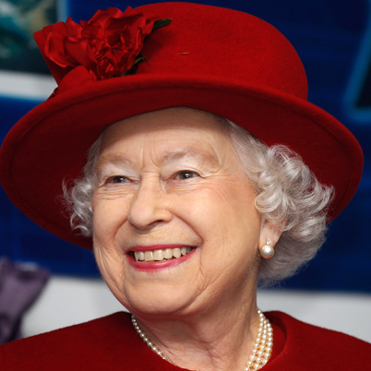

Slide 5
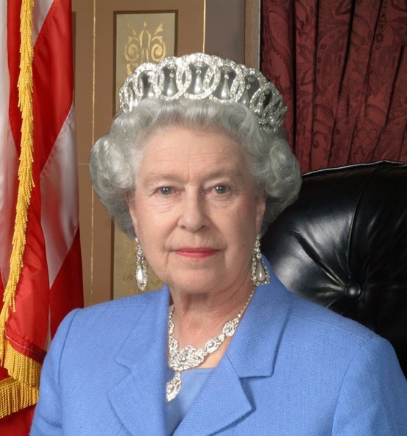
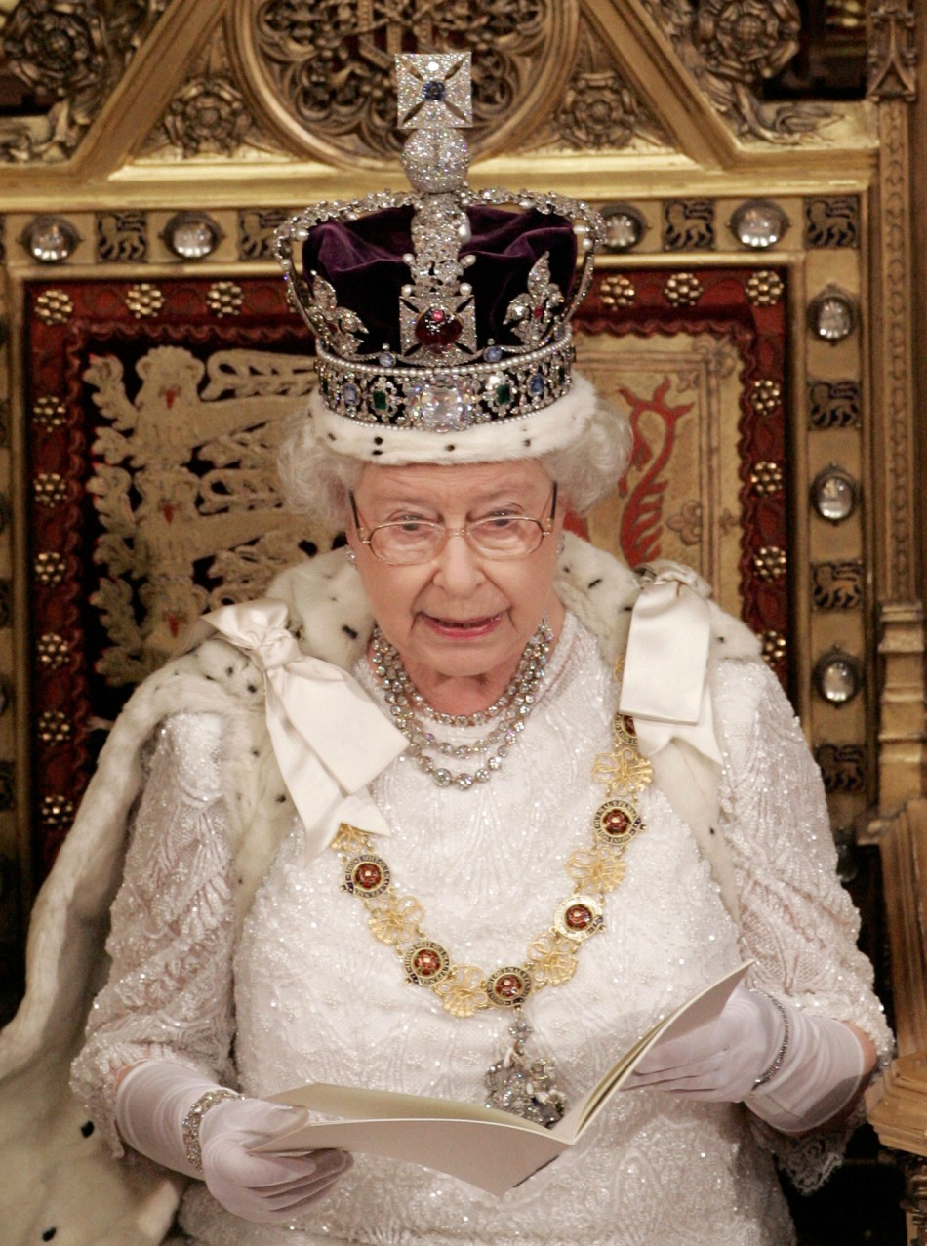
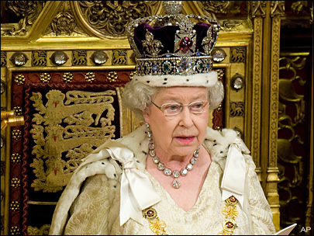

Slide 6
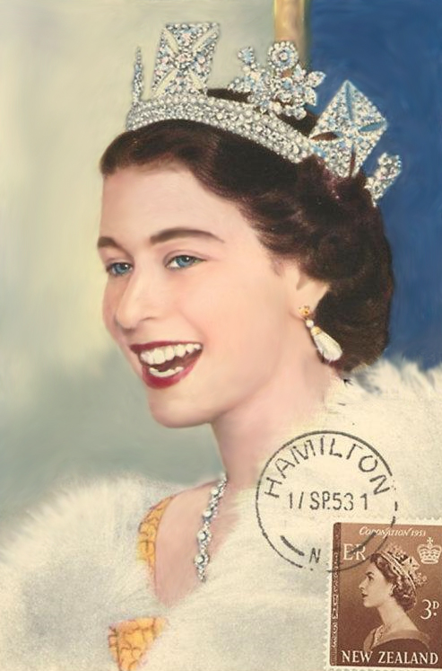
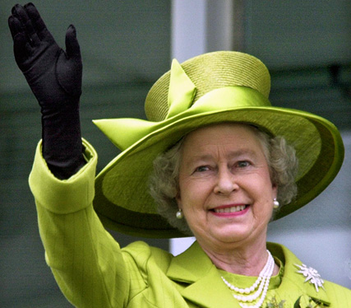
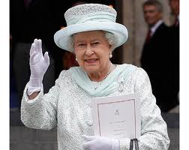
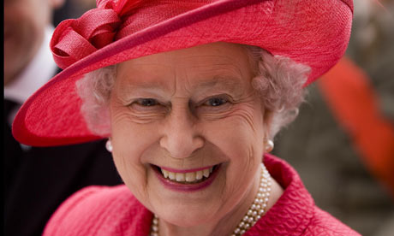

Slide 7
He is one of the members of the Royal Family. He was born in 1948. He is interested in many things: architecture, environment, history, alternative medicine, farming. His favorite sport is polo. He is well-known as a keen promoter of British interests. He has 2 children. He is…
Charles, the Prince of Wales

Slide 8
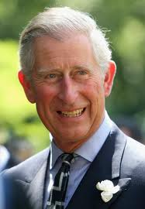

Slide 9
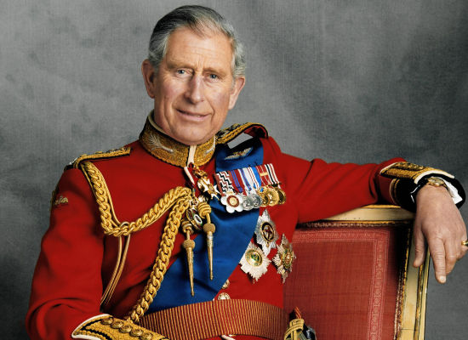

Slide 10
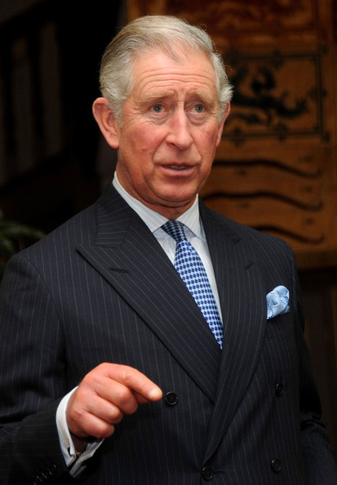
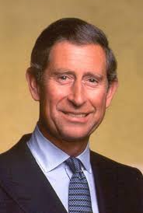
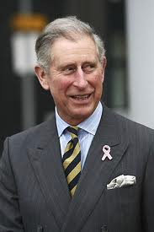
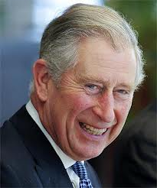
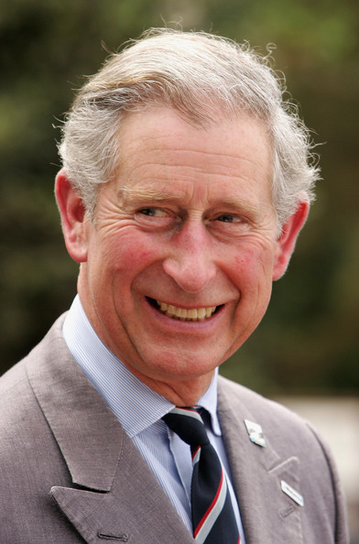
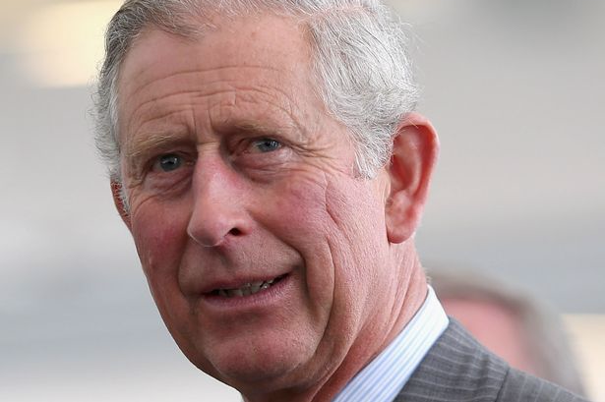

Slide 11
He is one of the members of the Royal Family. He is the youngest among the brothers. He studied at Cambridge University. He worked as a school teacher and as an actor at the theatre. Also he was an officer. His name is…
Prince Edward

Slide 12
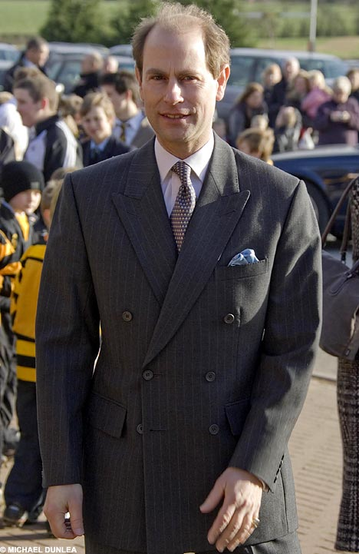

Slide 13
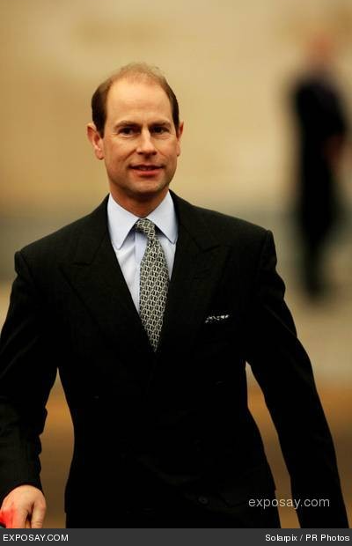
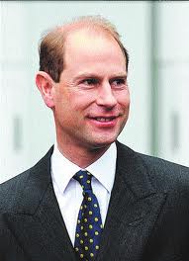
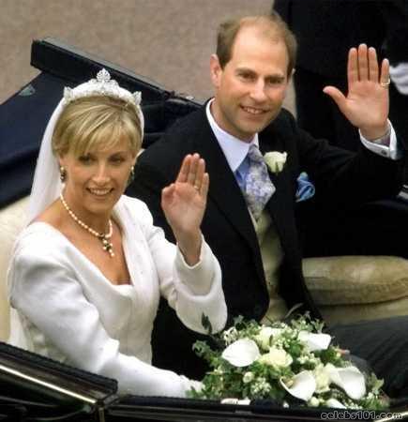
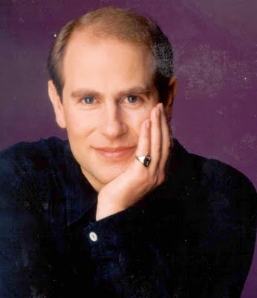
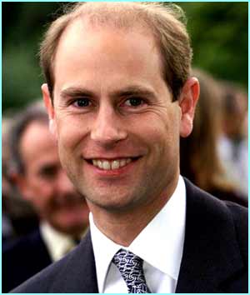
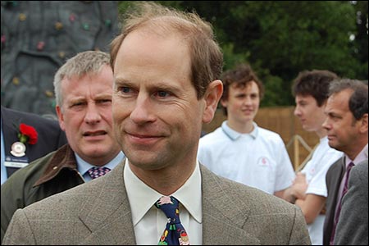
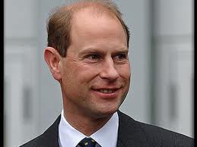

Slide 14
He is one of the members of the Royal Family. But he is not a monarch. He was born in Greece. He is a qualified pilot. Sometimes he gives interviews. The sphere of his interests is very wide: environment, wildlife, science and technology and sport. He is…
Prince Philip

Slide 15
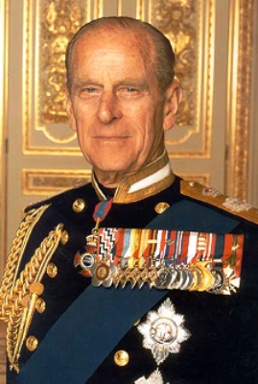

Slide 16
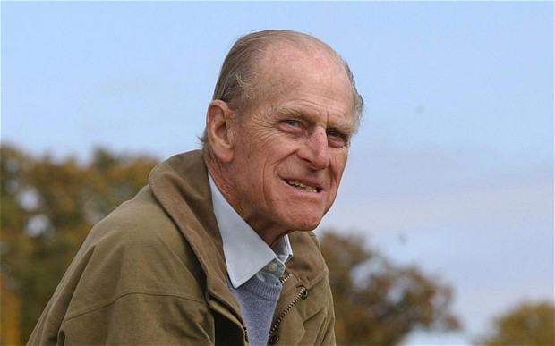
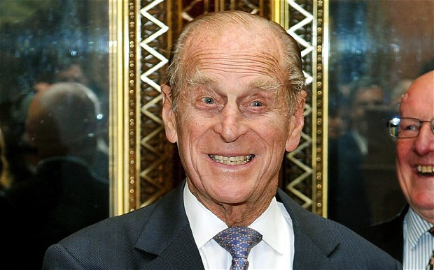
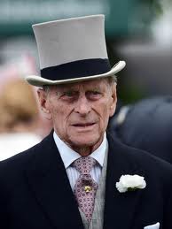
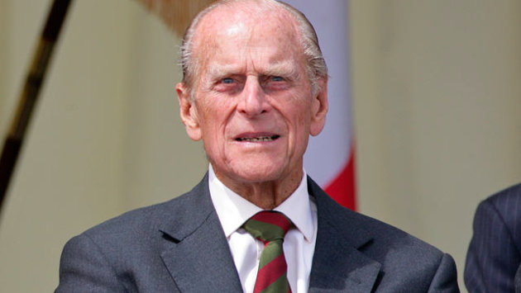

Slide 17
She is one of the members of the Royal Family. She finished Beneden school in Kent. She is the hardest working member of the family. She made an excellent sports career. In recent years she has become quite popular with public. She doesn’t wear expensive dresses but she always looks very elegant. She is…
Princess Anne

Slide 18
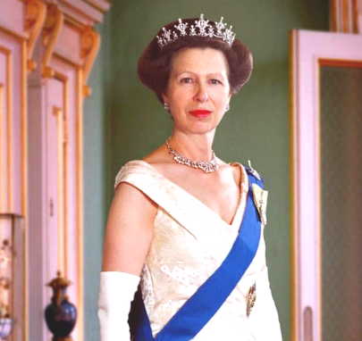

Slide 19
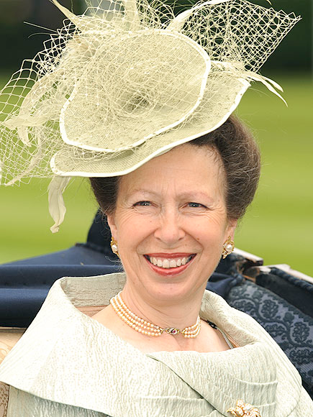
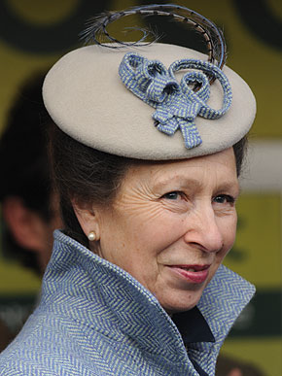
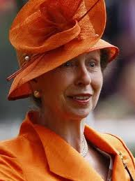
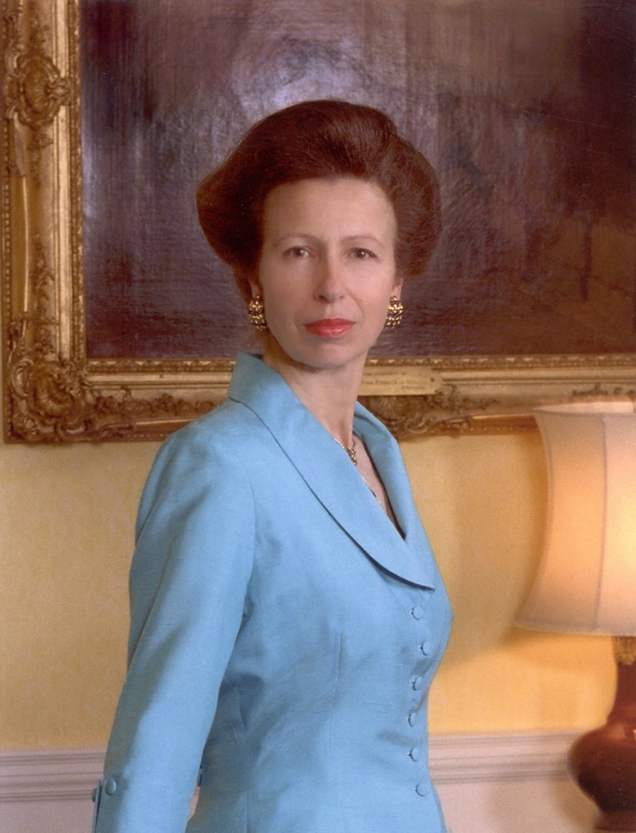
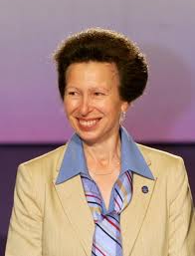

Slide 20
He is one of the members of the Royal Family. He is very good at sport. In 1980 he joined the Royal Navy and became a ‘sea King’ helicopter pilot. He is interested in photography. He speaks French and German. In 1986 he married Miss Sarah Ferguson and has 2 daughters. He is…
Prince Andrew, the Duke of York

Slide 21
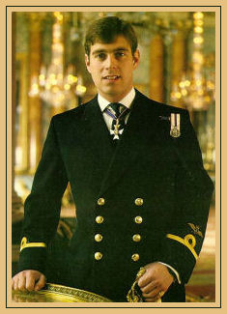

Slide 22
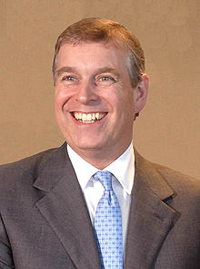
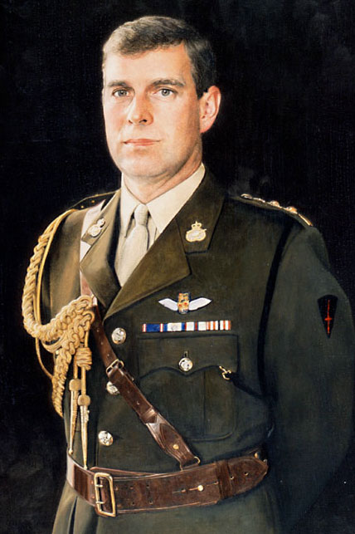
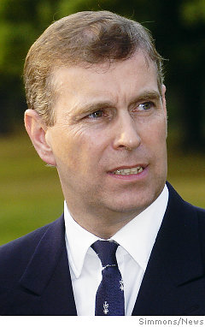
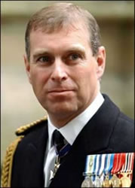
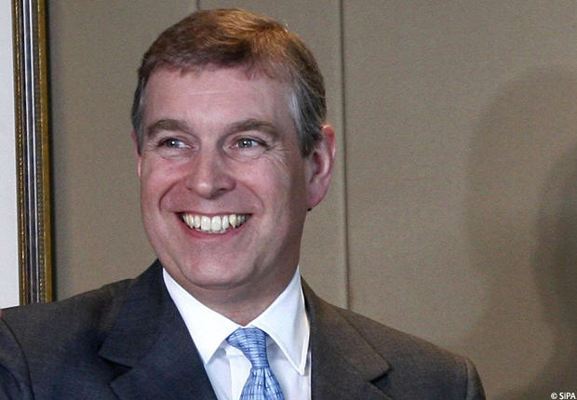

Slide 23
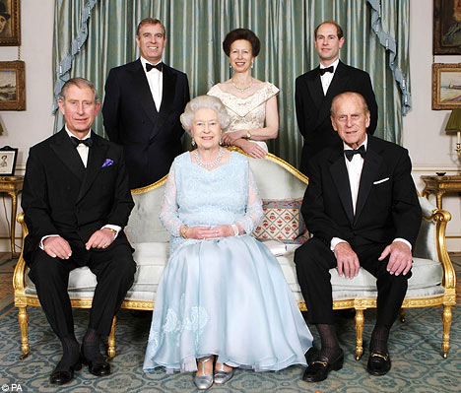

Slide 24
Thank you for your attention

