Slide 1
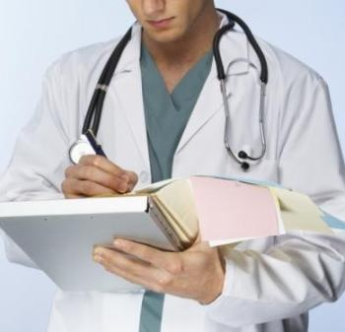
My future profession

Slide 2

There are many different professions in the world, but I want to become a doctor.
After finishing school I am going to enter medical institute. It seems to me that it’s my vocation. I like to help people. To become a doctor I must be good at studies because a doctor is needed and responsible profession.

Slide 3
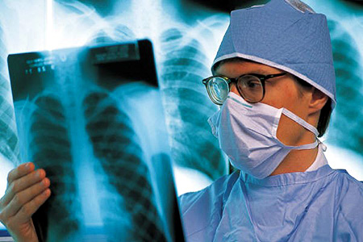
We trust doctors the main what we have – our life and that’s why a doctor must be qualified specialist. He must help people at any time of the day.

Slide 4
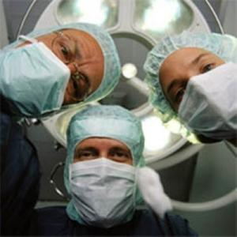
A doctor can’t make a mistake. Qualified specialist always diagnoses and institutes therapy correctly. Human life often depends on professionalism of a doctor. They must be very heedful and openhearted people.

Slide 5
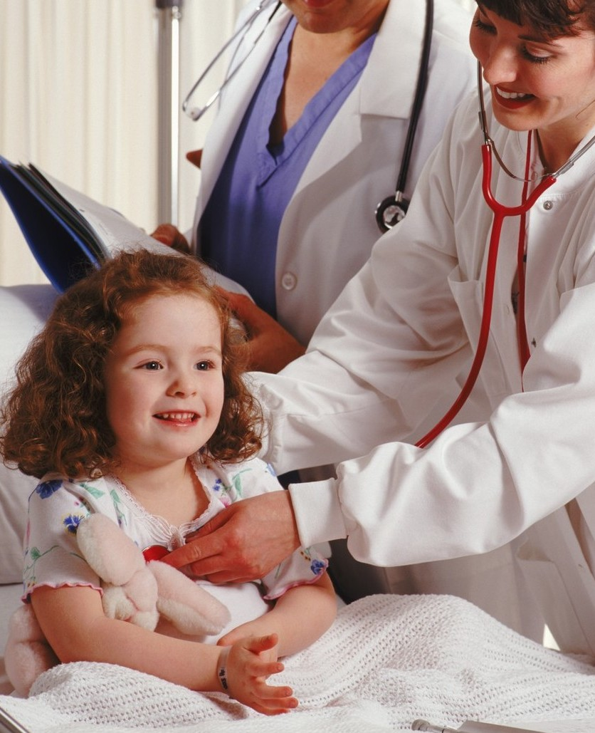
A doctor always must worry about a health of his patient. He must be able to inspire patients with faith. My mother and grandmother are doctors. They are proud of their profession and like it. I consider that a doctor is the best profession.

