Slide 1
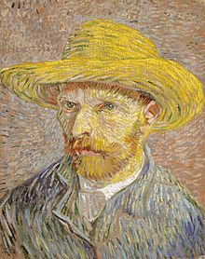
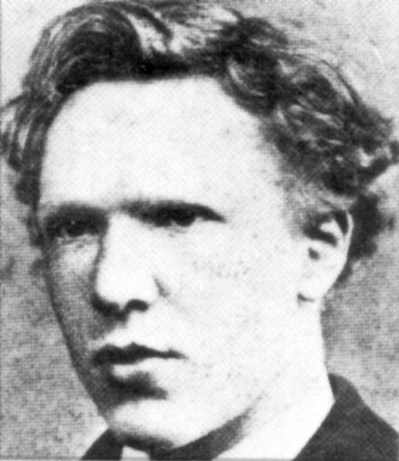
Vincent Willem van Gogh

Slide 2
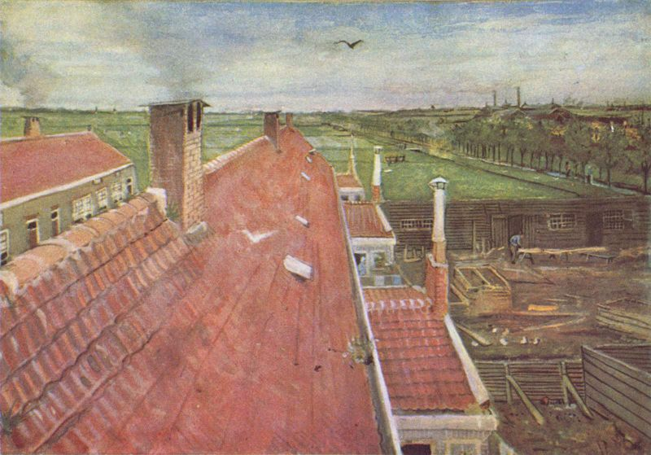
Vincent Willem van Gogh 30 March 1853 – 29 July 1890) was a post-Impressionist painter of Dutch origin whose work, notable for its rough beauty, emotional honesty and bold color, had a far-reaching influence on 20th-century art. After years of painful anxiety and frequent bouts of mental illness, he died aged 37 from a gunshot wound, generally accepted to be self-inflicted (although no gun was ever found). His work was then known to only a handful of people and appreciated by fewer still.

Slide 3
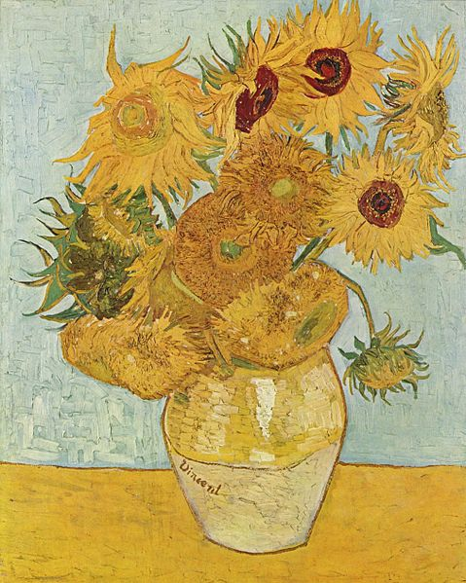
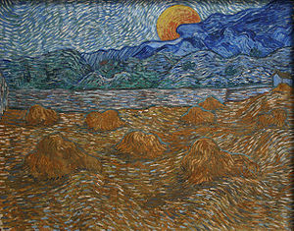
Van Gogh began to draw as a child, and he continued to draw throughout the years that led up to his decision to become an artist. He did not begin painting until his late twenties, completing many of his best-known works during the last two years of his life. In just over a decade, he produced more than 2,100 artworks, consisting of 860 oil paintings and more than 1,300 watercolors, drawings, sketches and prints. His work included self portraits, landscapes, still lifes, portraits and paintings of cypresses, wheat fields and sunflowers.

Slide 4
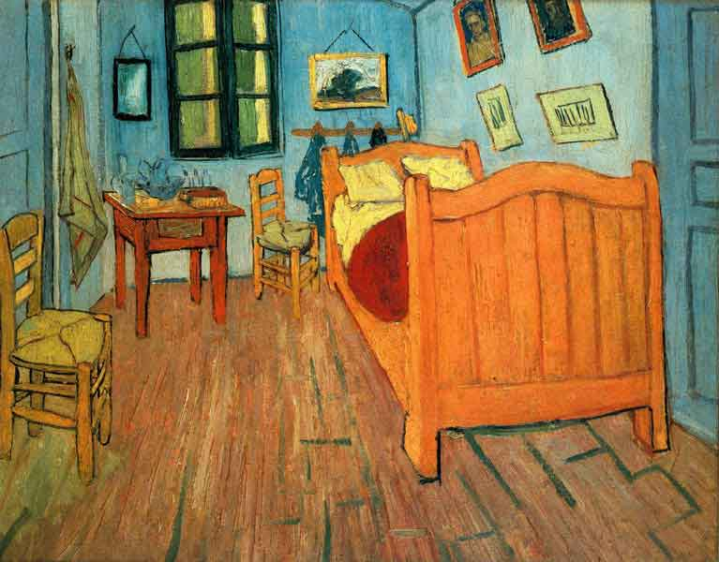
Bedroom in Arles
The painting depicts Van Gogh's bedroom at 2, Place Lamartine in Arles,Bouches-du-Rhône, France, known as his Yellow House.

Slide 5
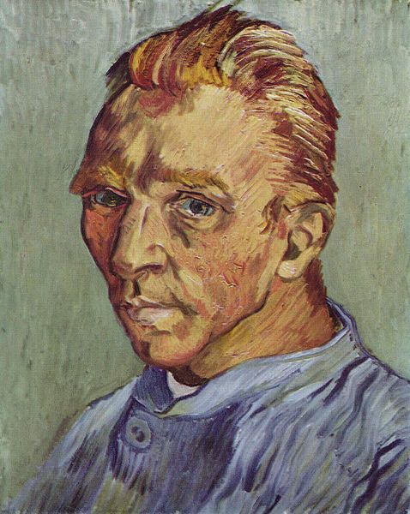
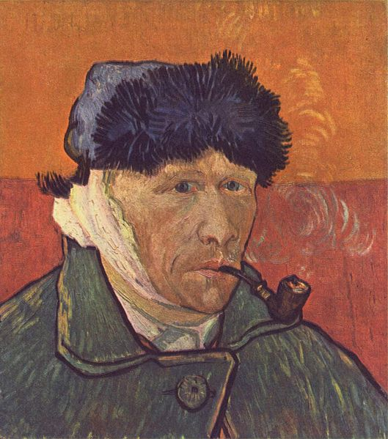
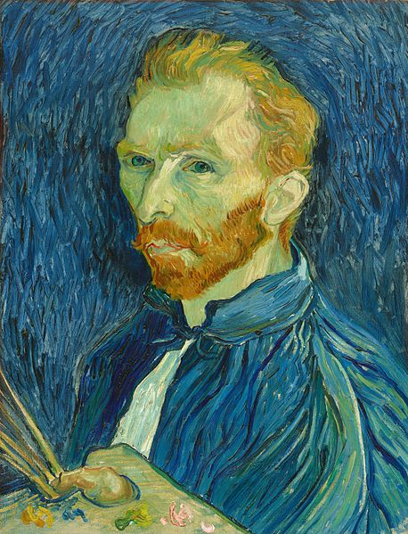
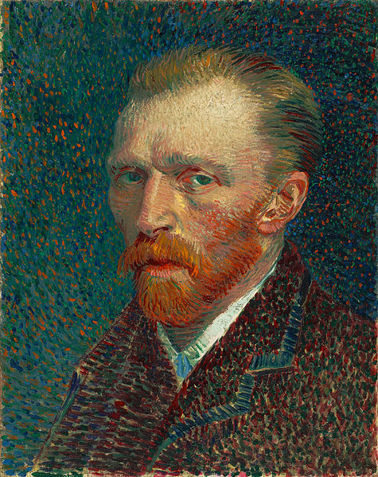
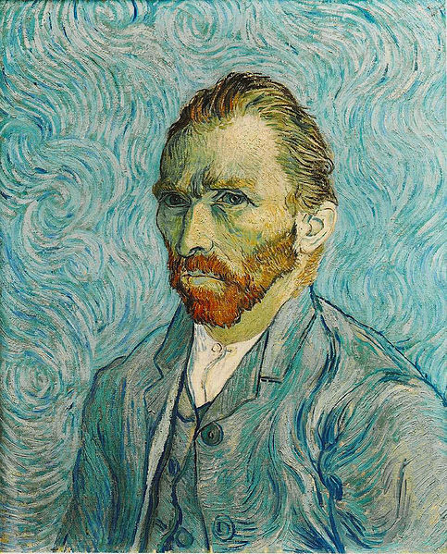
Self portraits

Slide 6
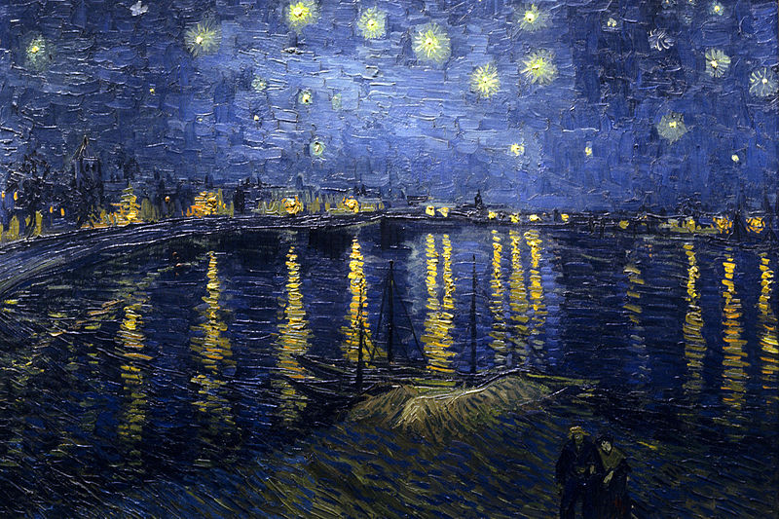
Starry Night Over the Rhone
It was painted at a spot on the bank of theRhone River that was only a one or two-minute walk from the Yellow House on the Place Lamartine which Van Gogh was renting at the time.

Slide 7
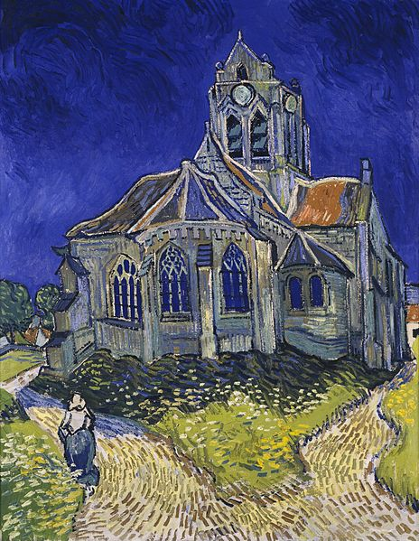
The Church in Auvers-sur-Oise
The Church at Auvers is an oil painting created in June 1890 which now hangs in the Musée_d'Orsayin Paris, France. The actual church is in France, 27km northwest of Paris.

Slide 8
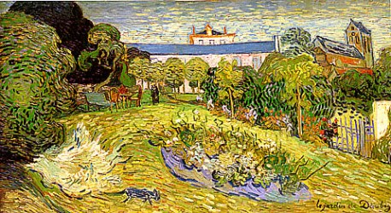
Daubigny's Garden 1890
Daubigny's Garden, painted three times by Vincent van Gogh, depicts the enclosed garden of Charles-François Daubigny, a painter whom Van Gogh admired throughout his life.

Slide 9
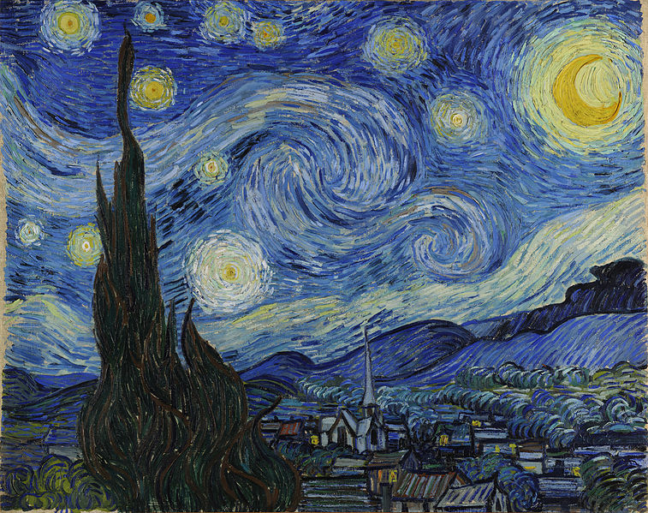
The Starry Night 1889
Painted in June 1889, it depicts the view outside of his sanitarium room window at Saint-Rémy-de-Provence (located in southern France) at night, although it was painted from memory during the day.

Slide 10
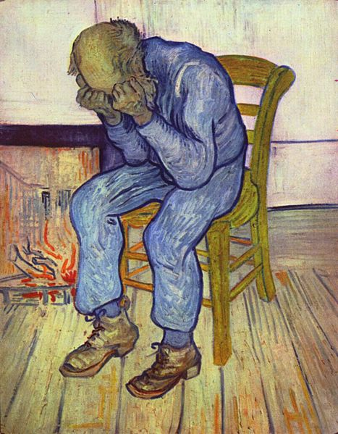
Sorrowing Old Man 1890
Sorrowing Old Man ('At Eternity's Gate') is an oil painting by Vincent van Gogh that he made in 1890 in Saint-Rémy de Provence based on an early lithograph. The painting was completed in early May at a time when he was convalescing from a severe relapse in his health and some two months before his death, generally accepted as a suicide

Slide 11
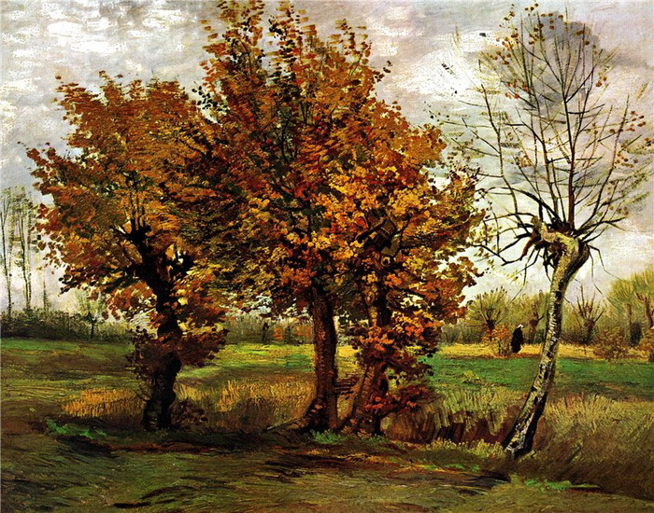
Autumn. Landscape with Four Trees 1885

