Slide 1
My favorite sportsman

Slide 2
Caroline Wozniacki
Caroline Wozniacki was born on July 11, 1990 in Odense, Denmark) - Danish-professional tennis player of Polish origin. The first Danish tennis player, who led the ranking WTA. Finalist of the U.S. Open 2009. The highest position in the women's rankings - № 1 (on October 11, 2010)

Slide 3
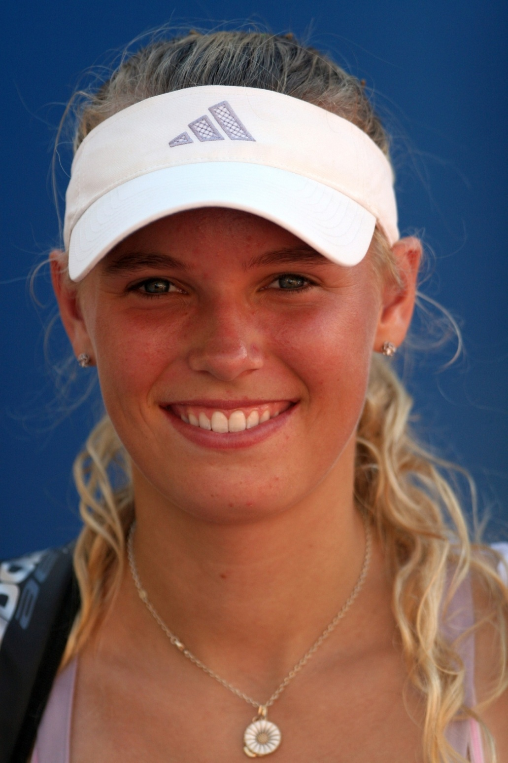

Slide 4
Сareer
Winner of several junior tournament, including Wimbledon and the Orange Bowl (2005). She made her debut at the WTA tournament in July 2006 at a tournament in Cincinnati. In 2008 he reached the 4th circle on US Open and won the first two titles WTA - Nordic Light Open, and New Haven. Took part in the Olympic Games in Beijing.

Slide 5


Slide 6
Сareer
In 2009 he reached the finals of the tournament Swedish Open, won the competition MPS Group Championships (Ponte Verde Beach, USA), AEGON International (Eastbourne) and the Pilot Pen Tennis (Connecticut, USA). Dishla the final of the U.S. Open, where she overcame Kim Clijsters.

Slide 7
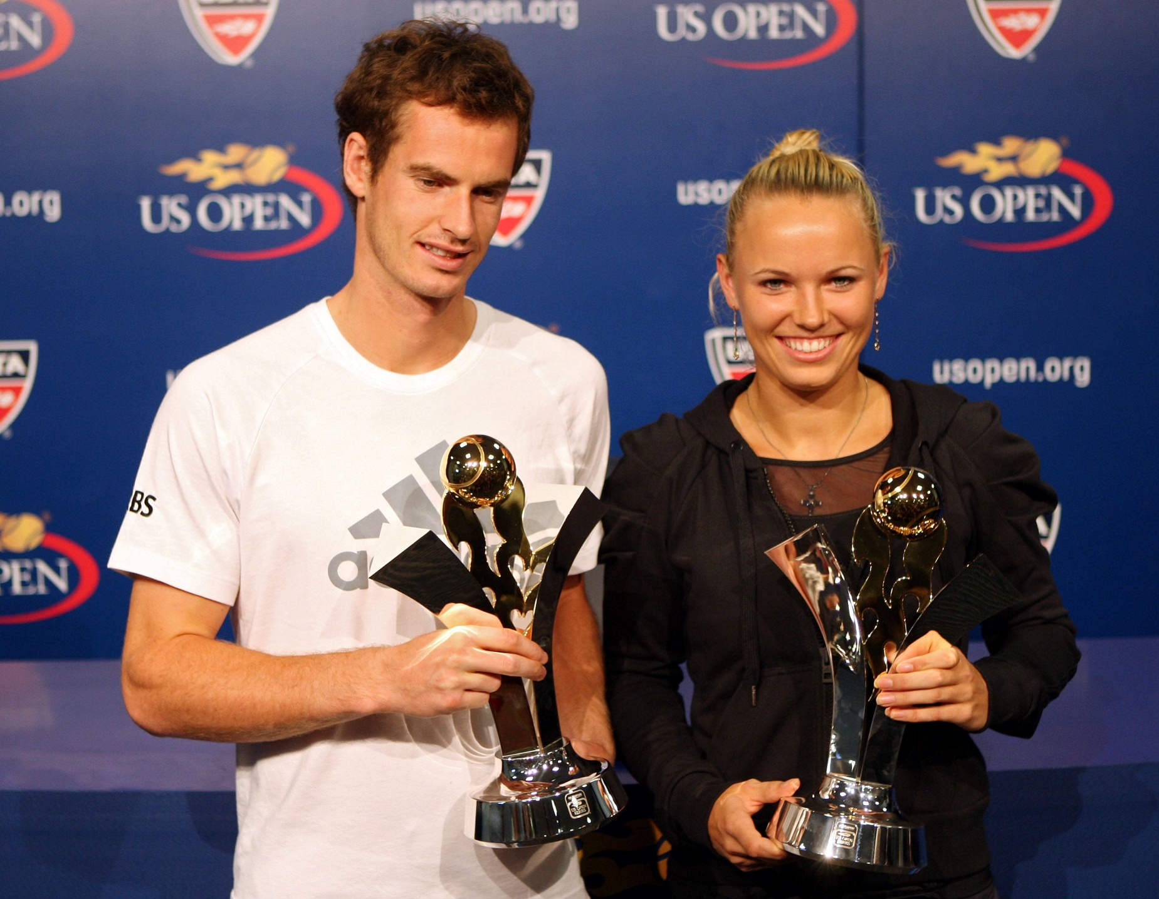

Slide 8
2010
Stable performance of the season allowed Caroline to be in October, the first racket of the world. First she also completed the first line of the world ranking. She also won the final tournament of the season - Cup WTA.

Slide 9


Slide 10
2011
At the Australian Open Caroline reached the semifinals, where Li Na lost in three sets. Dubai Tennis Championships Wozniacki was the first title in 2011. In the final, she defeated Svetlana Kuznetsova

Slide 11

By Julia Gumen

Slide 12
Julia Gumen

