Slide 1
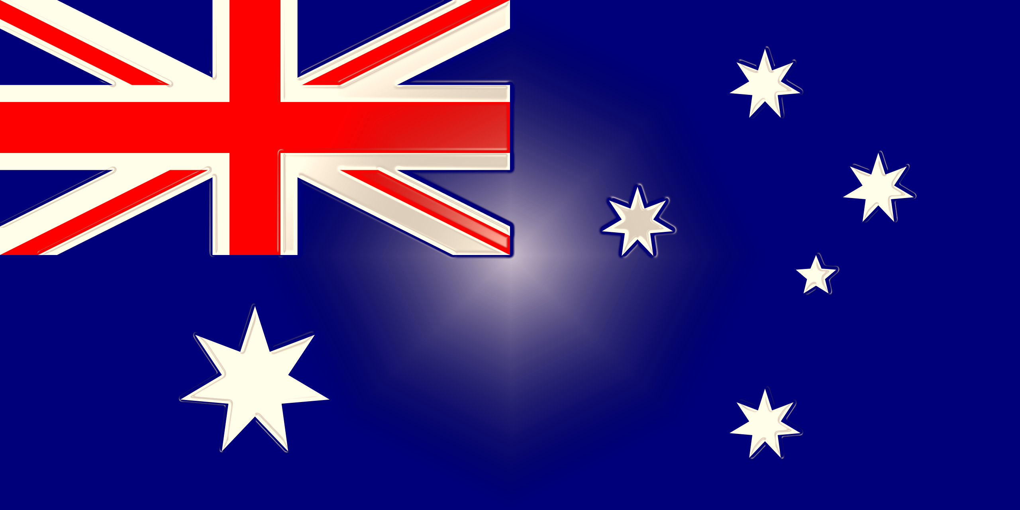
Australia

Slide 2
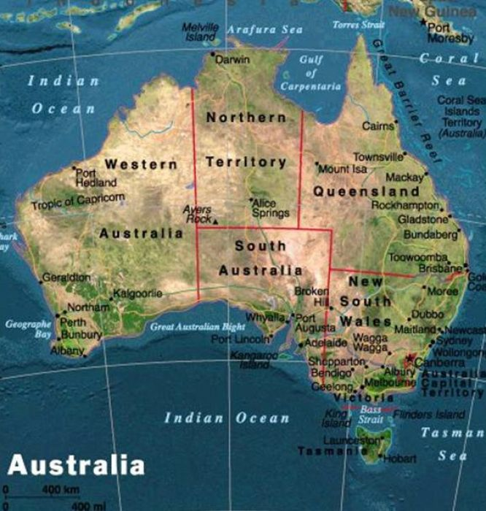
Australia - officially the Commonwealth of Australia -country in the southern hemisphere, occupying mainland Australia, Tasmania Island and several other islands in the Indian and Pacific Oceans, is the sixth state by area in the world.

Slide 3
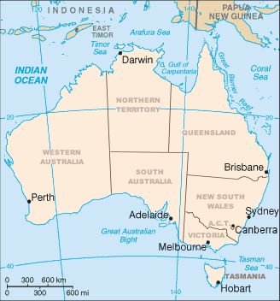
Political division
Australia has six states, three mainland territories and other smaller territories. States:
Victoria
Western Australia
Queensland
New South Wales
Tasmania
South Australia

Slide 4
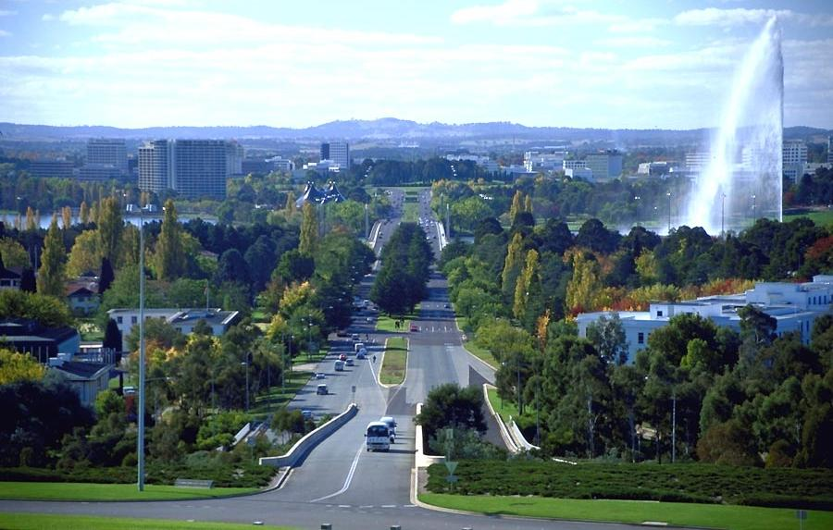
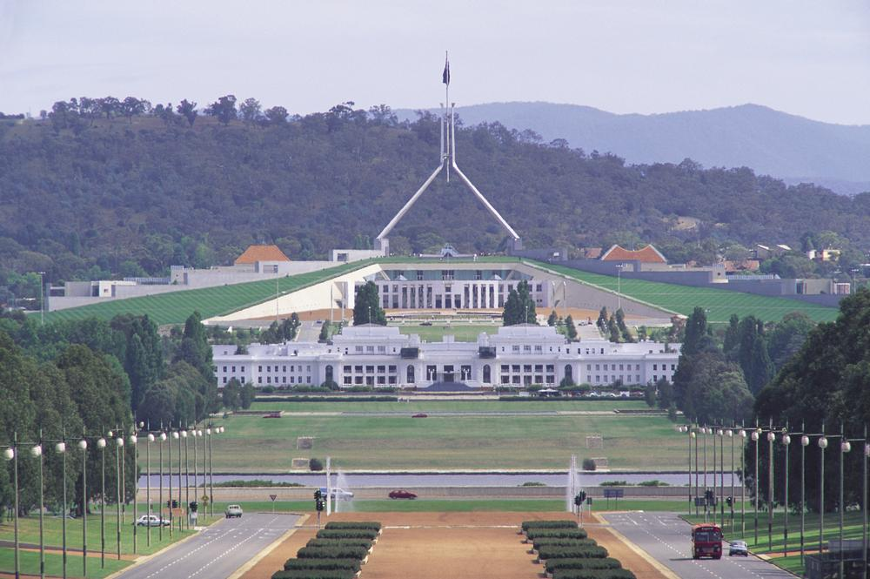
CANBERRA – capital of Australia
The Australian capital - Canberra. Population exceeds 345,000 people, Canberra is the largest city in Australia, located within the country rather than on the coast.

Slide 5
State symbols

Slide 6
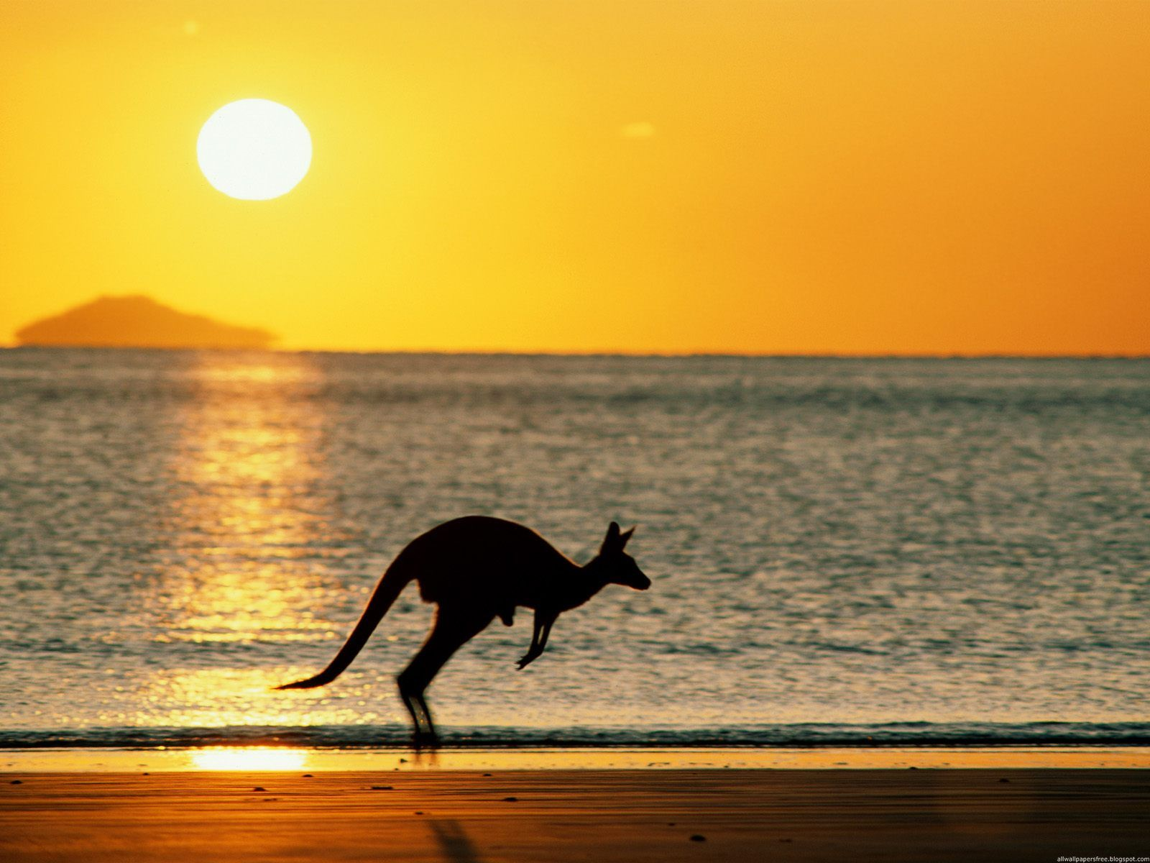
The term "Australia" in Australian English is derived from Latin. austrālis («South").

Slide 7
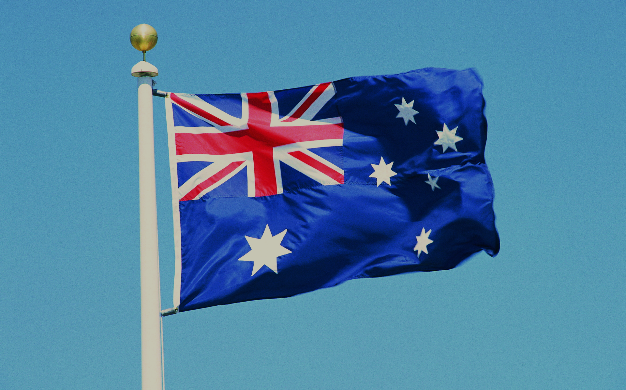
Australian flag is a rectangular cloth of blue, which depicts three elements: UK flag (also known as the "Union Jack"), the Commonwealth Star (or Star Federation, she Hadar) and the Southern Cross constellation

Slide 8
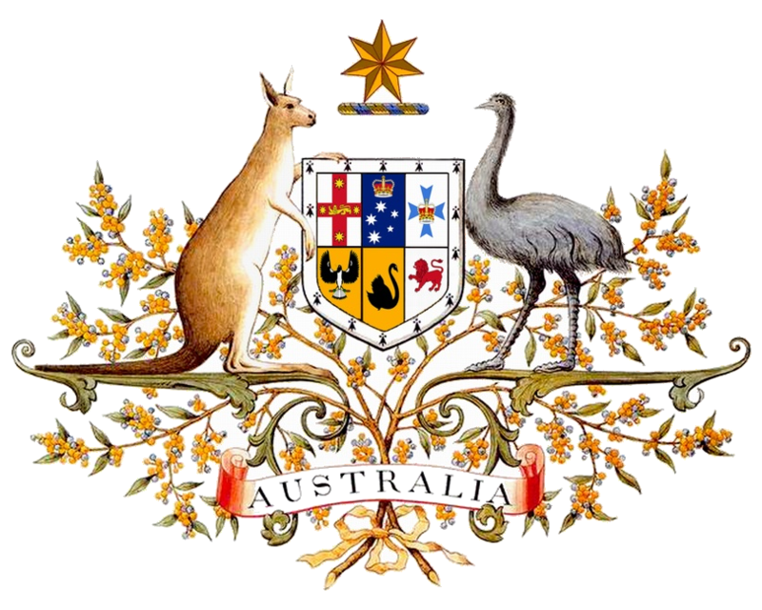
Australian coat of arms is a shield on the left, where the coats of arms of states: New South Wales, Victoria and Queensland. In the lower part of the shield, left to right: South Australia, Western Australia and Tasmania. Above the shield is the seven-edged "Commonwealth Star" or the Star of Federation over blue and gold wreaths. Six points of the star represent the six states and the seventh is a collection of territories and Australia itself. Shield hoard kangaroos and emus.

Slide 9
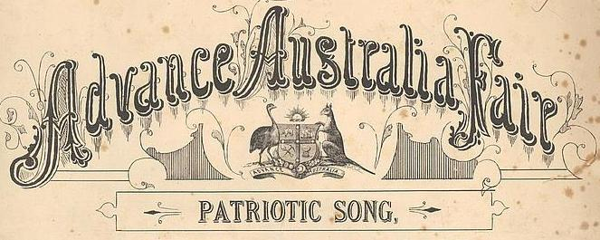
Australia's national anthem - «Advance Australia Fair" Composed by Peter McCormick in 1878. This hymn, on the recommendation of Robert Hawke government and with the permission of the governor-general Ninian Stephen, in 1984, was replaced by the British «God Save The Queen».

