Slide 1
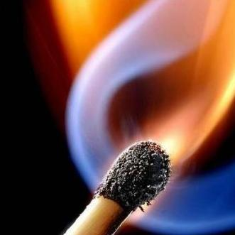
Forest fires

Slide 2
reasons of occurrence of forest fires
Among the reasons of occurrence of forest fires is considered to be the main anthropogenic factor (according to the statistics on population fault occurring each year 96-98% of forest fires). Therefore, special attention should be paid to forest areas, are located near major industrial centers, health facilities, roads, electricity. The natural and climatic conditions (high temperatures, small amount of precipitation, etc.) often only increase the probability of ignition and affect the speed of the spread of fire.

Slide 3
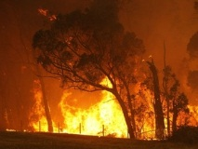
The Australian state of Victoria
According to the latest data, about 100 residential houses were burned to the East of Melbourne. The fire, which began in the state of Victoria, had spread to New South Wales and threatens to destroy the new house.

Slide 4
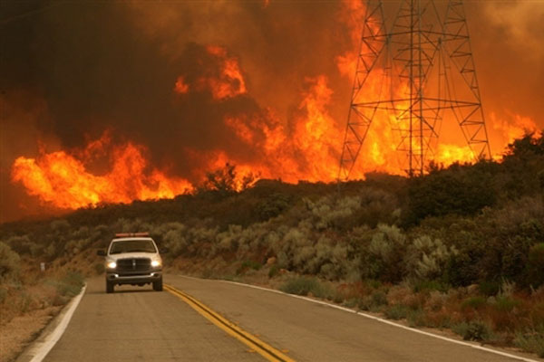
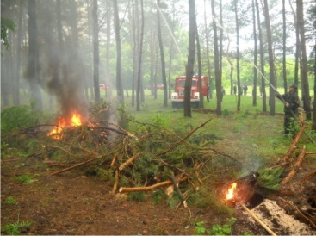

Slide 5
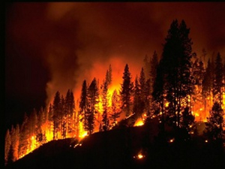
Dnepropetrovsk region, Novomoskovsk
In the Novomoskovsk district through the strong wind fire is approaching the village guards, where are located the military warehouses of fuel and lubricants

Slide 6
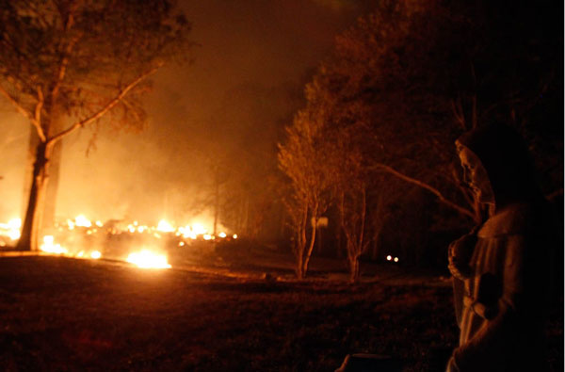
The American state of Colorado
In the American state of Colorado through natural fires evacuated already 32 thousand people. Earlier it was reported about the evacuation of 11 thousand people.

Slide 7
The rules of conduct in a forest fire
1)before you enter into a burning room, it must be covered with the head of the wet sheet, a cloak, a piece of cloth, etc.;
2)the door in the smoky room should be open caution to prevent flash of flame'I'm from the rapid influx of fresh air;
3)for protection from carbon monoxide need to breathe through the damp cloth;
4)if the man clothes on fire, you have to lie down on the ground and beat out the flames'I can't run, this will further fan the flames of'I;
5)if you see a man in a burning garment, put on her coat, a cloak, a sheet and tighten;
6)in extinguishing the fire, use fire extinguishers, water, sand, earth, sheets, and other means;
7)out of the fire zone must be against the wind, that is, in the direction from which the wind is blowing;
8)in extinguishing forest fires, use of a branch of the deciduous trees (birch, hazel), shovels, etc.; branches should be захльостувати the edge of the fire, with the help of spades fill the earth.

Slide 8
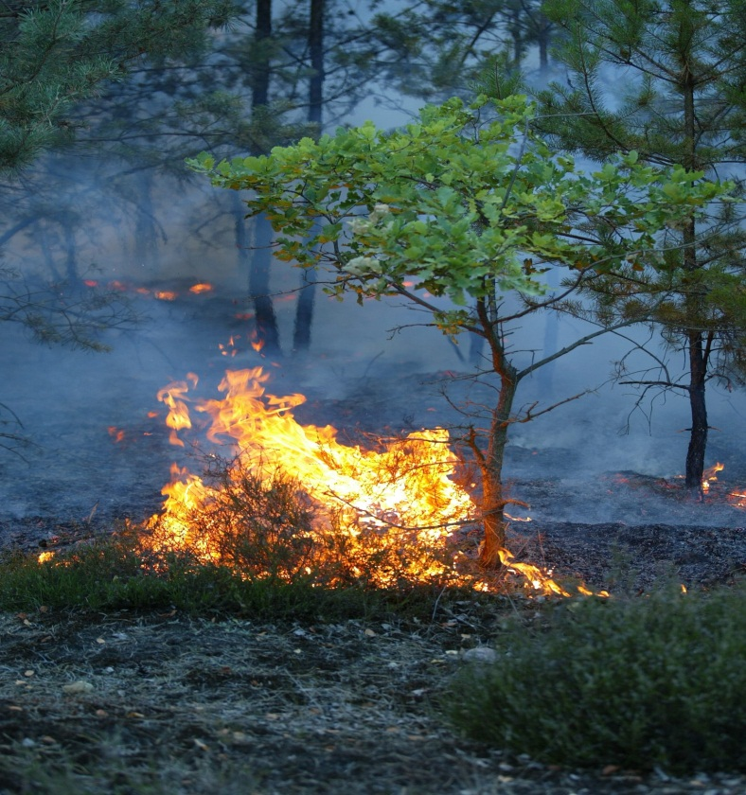
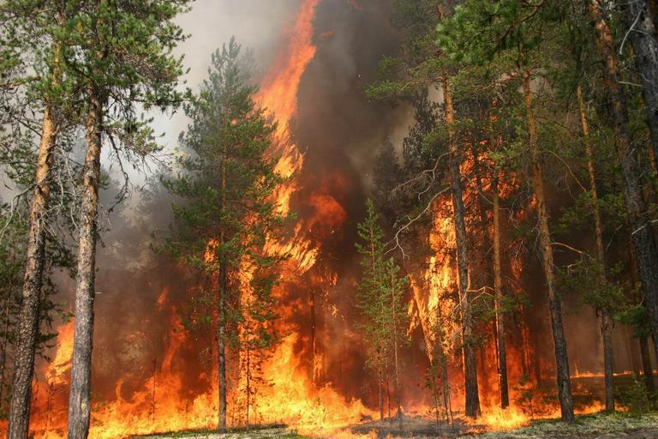
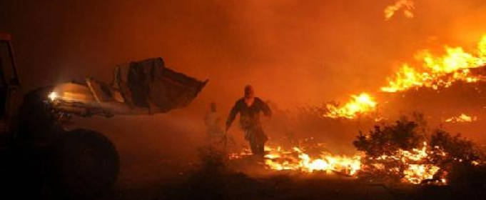
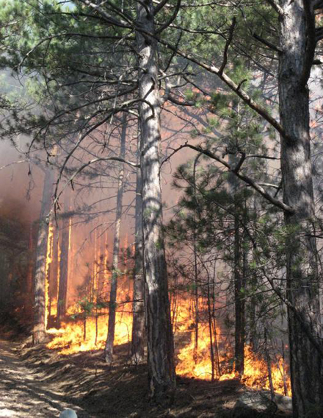

Slide 9
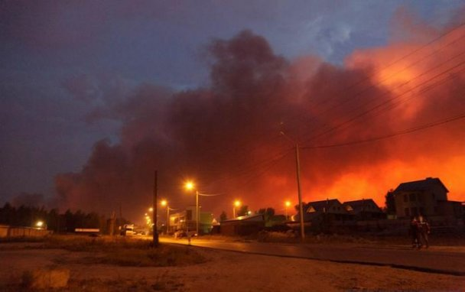
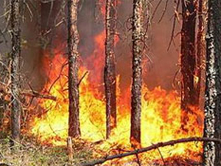
russia
The greatest number of fires was recorded in the republics of Komi, Sakha (Yakutia) and Karelia, Arkhangelsk region: there were registered 16 major forest fires. On the lands, which are under special state protection, fires were recorded. In Siberia during the day the area of forest fires has increased by 22.8 hectares to 143 hectares. The main cause of fires began to dry thunderstorms.

Slide 10
Fulfilled: a pupil of the 10-th class Olga BOBELA

