Slide 1
Example of success

Slide 2
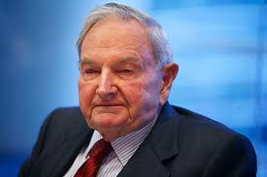
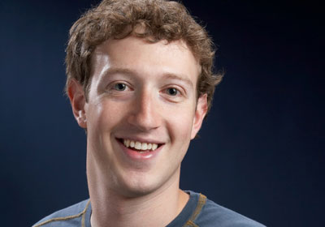
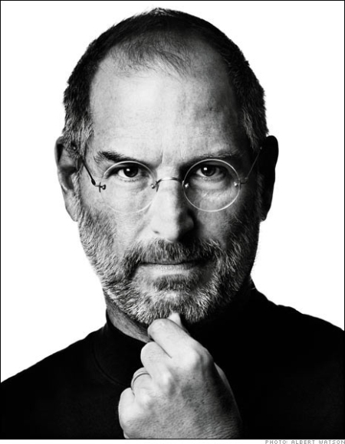
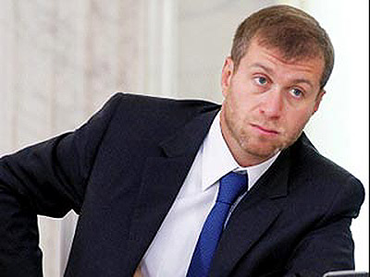

Slide 3
Marissa Mayer

Slide 4
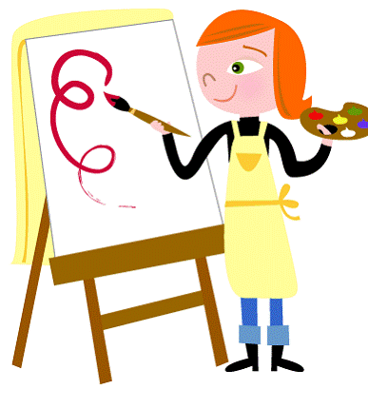
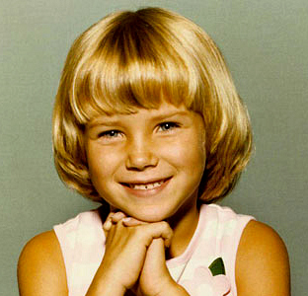
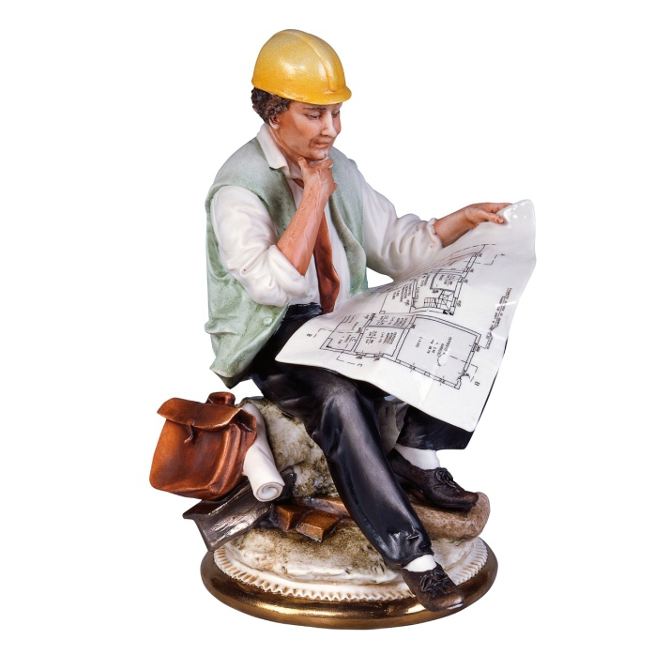
Biography
Margaret Mayer, an art teacher
Michael Mayer, an engineer
Marissa
(May 30, 1975)

Slide 5
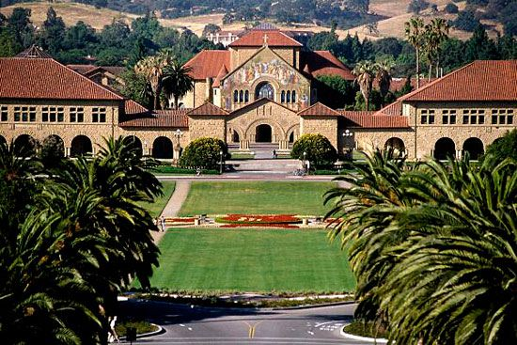
Education
Mayer graduated with honors from Stanford University with a B.S. in symbolic systems and an M.S. in computer science. For both degrees, she specialized in artificial intelligence. In 2009, the Illinois Institute of Technology granted Mayer an honoris causa doctorate degree in recognition of her work in the field of searc
h

Slide 6
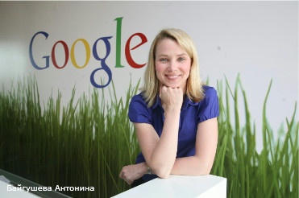
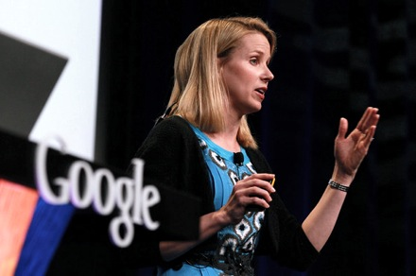
Career
Mayer joined Google in 1999 as employee and was the company's first female engineer. During her 13 years with the company, she was an engineer, designer, product manager and executive. Mayer held key roles in Google. She also oversaw the layout of Google's well-known, unadorned search homepage.In her final years with Google, she was Vice President of Local, Maps, and Location Services and, before that, Vice President of Search Products and User Experience

Slide 7
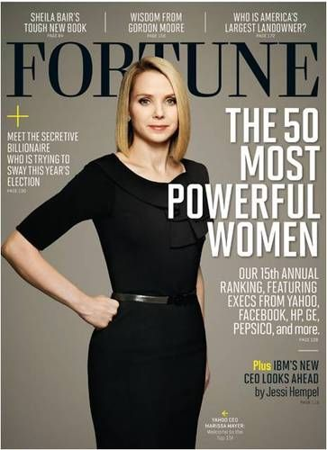
On July 16, 2012, Mayer was appointed President and CEO of Yahoo!, effective the following day. She is also a member of the company's board of directors. She became the youngest president of huge company.

Slide 8
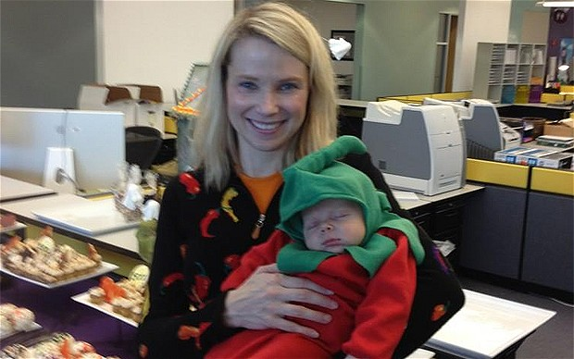
Mayer married lawyer and investor Zachary Bogue on December 12, 2009. Mayer gave birth to a baby boy on September 30, 2012

Slide 9
Marissa Mayer

