Slide 1
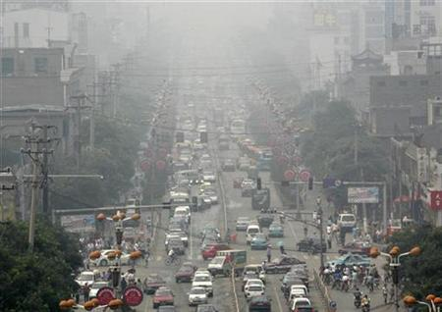
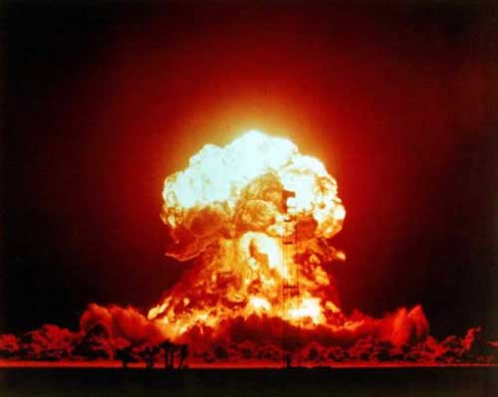
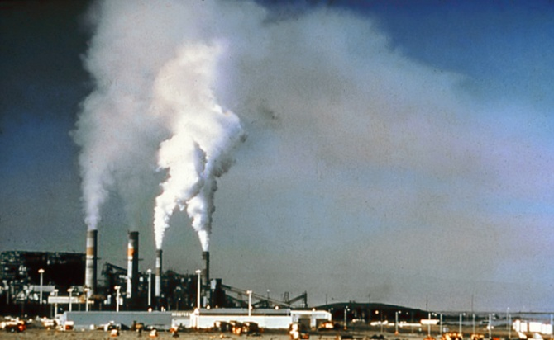
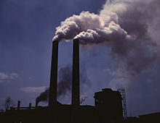
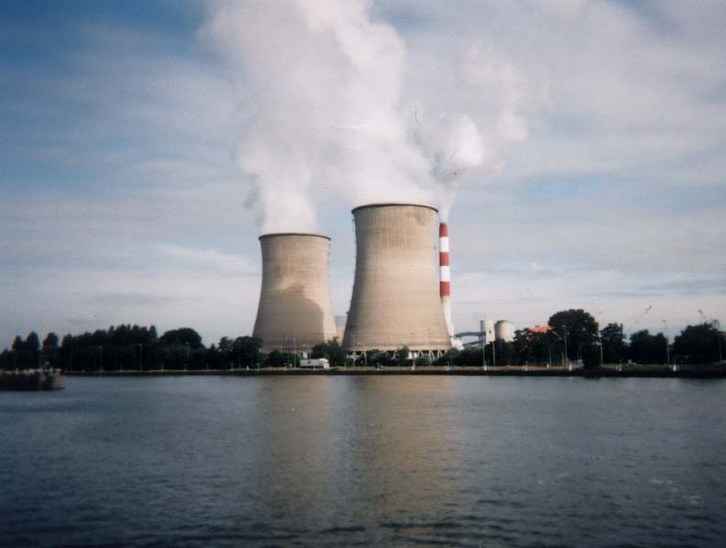
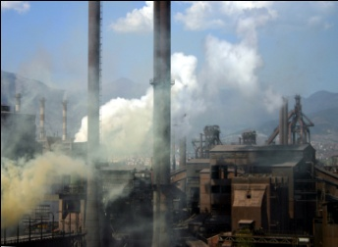
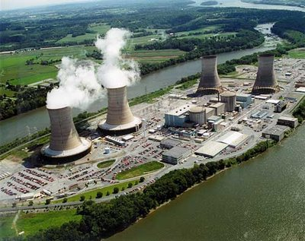
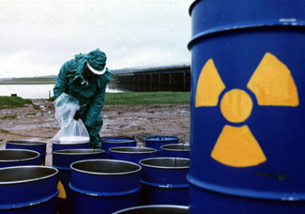
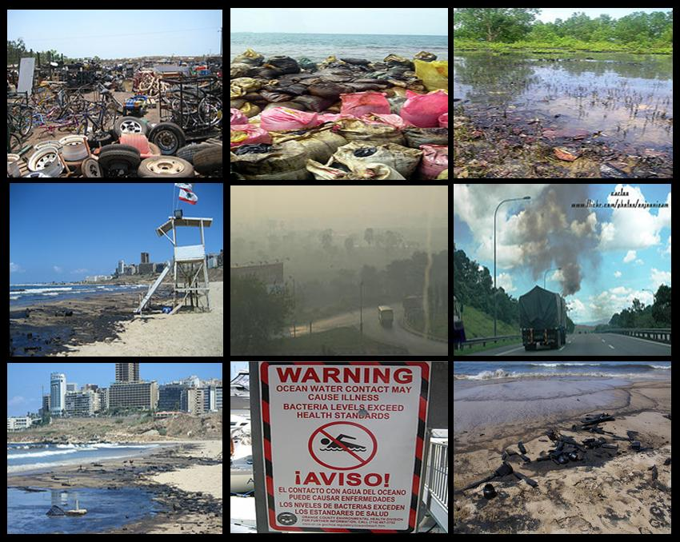
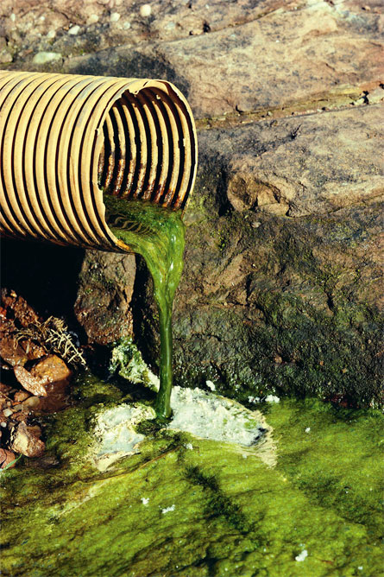
ENVIRONMENTAL
POLLUTION

Slide 2
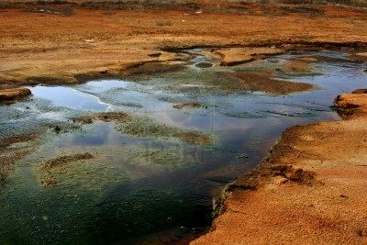
Types of pollution
Air Pollution
Water Pollution
Thermal Pollution
Soil Pollution
Radioactive Pollution

Slide 3

Air pollution
Imbalance in the quality of air so as to cause adverse affects on the living organisms existing on earth.

Slide 4
Causes of air pollution
1.Natural sources
Volcanic eruptions
Forest fires
Pollen grains of flowers
2.Man-made sources
Deforestation
Emission from vehicles
Rapid industrialization
Wars

Slide 5
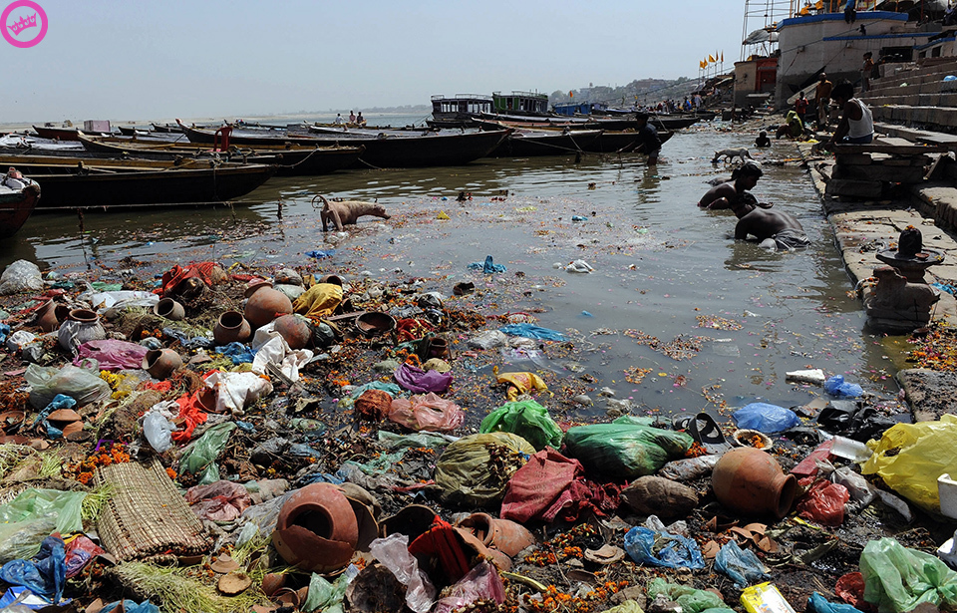
Water Pollution
  Contamination of water by addition of undesirable organic, inorganic or biological substances to water sources
  Natural sources: soil erosion, leaching of minerals from of rocks and decay matter.
  Industrial effluents
  Destroys ecosystem and effects human health

Slide 6
Sources of water pollution
Community waste waters
Industrial wastes
Agricultural sources
Under ground water pollution
Marine pollution
Thermal pollution

Slide 7
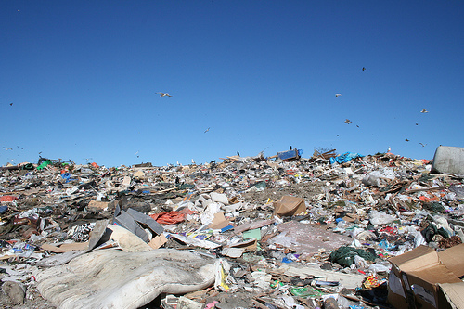
Soil pollution
Undesirable change in the physical, chemical or biological property which adversely affects its productivity
Caused by dumping of wastes, agrochemicals and as indirect result of air pollution

Slide 8
Sources of Soil Pollution
Domestic wastes
Agricultural wastes
Industrial wastes
Excretory products
Salination

Slide 9
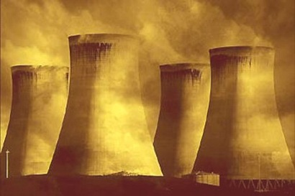
Radioactive pollution
Physical pollution that affects air, water and soil. Caused by ionizing radiations of harmful nature emitted from disintegrating atomic nuclei.
The natural sources include cosmic rays that reaches the earth surface and radiations from radium 224, uranium 235 thorium 232 etc

Slide 10
Man made sources
Nuclear weapons
Reactors and Nuclear fuel
Waste waters containing these wastes
X-rays used in medical practices
Ultra violet rays present in solar radiations

Slide 11
Effects
Mutation
Cancer
Radioactive substances in food chain cause retarded growth and bone cancer.
Increases infant mortality rate

Slide 12
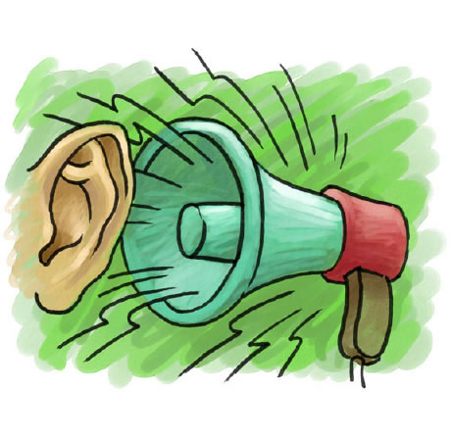
Noise pollution
Unwanted high pitch sound that pollutes the environment.
Maximum tolerable intensity of sound is 85 decibels
The main sources are automobiles, aero planes, loudspeakers, industries and other electro-mechanical devices.

Slide 13
Effects of noise pollution
Damage to ear drum and impairment to hearing.
Damages heart, liver and brain
Emotional disturbances and behavioral changes
Leads to anxiety and stress

Slide 14
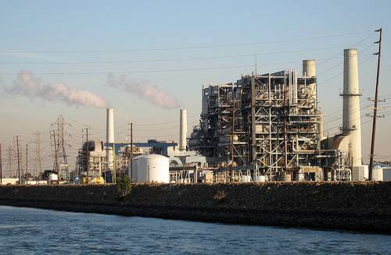
Thermal Pollution
The term thermal pollution has been used to indicate the detrimental effects of heated effluents discharged by various power plants.

Slide 15
Causes of thermal pollution
Nuclear power plants
Coal fired power plants
Industrial effluents

Slide 16
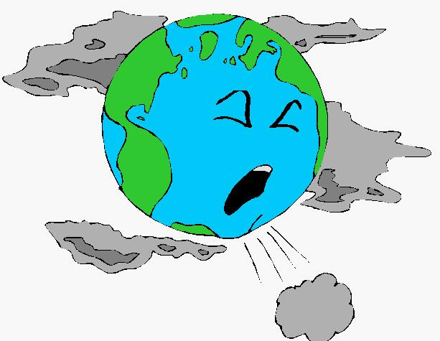
The End

